Slide 1

Crowd-sourcing of surface-temperature observations: exploiting their potential with improved first-guess forecasts.
Tom Hamill
ESRL Physical Sciences Division
Boulder, Colorado 80305
tom.hamill@noaa.gov
303-497-3060

Slide 2
With lots of surface temperature observations, are you guaranteed to generate a high-quality surface temperature analysis?
Some areas are likely to remain data sparse, away from roads, people.
Still need information there (e.g., for estimating temp over snow pack to model snow melt, runoff to reservoirs).
Data assimilation thus still important.

Slide 3
State estimation
(“data assimilation”) refresher
observations for time t
forecast for time t
“background”
data assimilation
state estimate for time t
“analysis”
weather
forecast
model
forecast for
time t+Δt
“background”

Slide 4
State estimation
(“data assimilation”) refresher
Should be unbiased
in order for
the assimilation
to work properly
observations for time t
forecast for time t
“background”
data assimilation
state estimate for time t
“analysis”
weather
forecast
model
forecast for
time t+Δt
“background”

Slide 5
Recall the assumption in data assimilation that background forecasts are unbiased.
Over one month, 2-meter temperatures did not appear to be for this time of day.

Slide 6
Suppositions:
(1) 2-m temperature forecast bias is ubiquitous and hard to fix; won’t go away with a few months of NWP development.
(2) New crowd-sourced observations will have little lasting impact if the forecast from the analysis snaps back to a biased state in a short-range forecast.
(3) If an alternative method existed that provided improved first-guess forecasts, this may result in sustained positive impact of crowd-sourced observations on the analysis quality.

Slide 7
Time series of observed temperatures and deviations at Albany, NY
Temperature deviation
from climatology doesn’t exhibit the diurnal wiggles
evident in the raw data
time series. Hour-to-hour
changes appear modest.

Slide 8
How does last hour’s temperature deviation from climatology predict this hour’s temperature deviation?
Pretty well, with less predictive skill around sunrise and sunset. No apparent bias.
Note: a small amount of noise is added to the measurements to aid in interpretation
given the discrete values of observed temperature (rounded to nearest °F).

Slide 9
How does last hour’s temperature deviation from climatology predict this hour’s temperature deviation?
Pretty well in summertime also.

Slide 10
RMSE’s across CONUS, July 00 UTC
gridded analysis generated with successive corrections technique, akin to Kriging.

Slide 11
Comparison vs. RTMA
RTMA results taken from de Pondeca et al., W&F, Oct 2011.
With no other extra predictors, and no cycling of data assimilation, persistence of deviation from climatology at stations is clearly lower error than RTMA.
Recently, RTMA switched from RAP model to HRRR background, but this is unlikely to account for all the error difference.

Slide 12
Where next: generating a gridded benchmark background forecast
Pieces of information:
(1) Last hour’s gridded climatology (background)
(2) Last hour’s observations
(3) Add back this hour’s climatology
Method: Use (1) and (2) to estimate a gridded deviation from climatology. Add that to this hour’s climatology to produce a 1-h forecast that replaces the NWP forecast. Covariance model is Gaussian and penalizes horizontal distance, vertical distance, and differences in a coastal proximity parameter
(I continue to tinker with this).

Slide 13
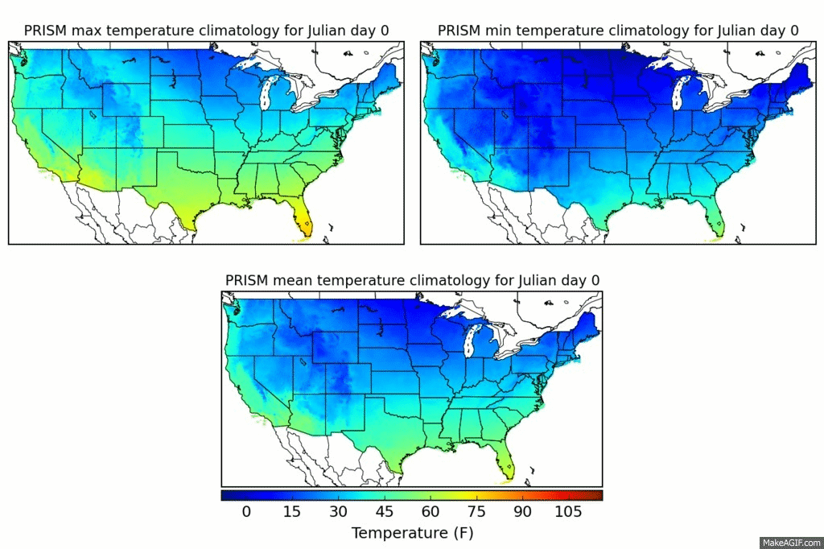
PRISM yearly cycle of Tmax, Tmin, Tmean
Tmax, Tmin included and used in next step to estimate diurnal cycle.

Slide 14
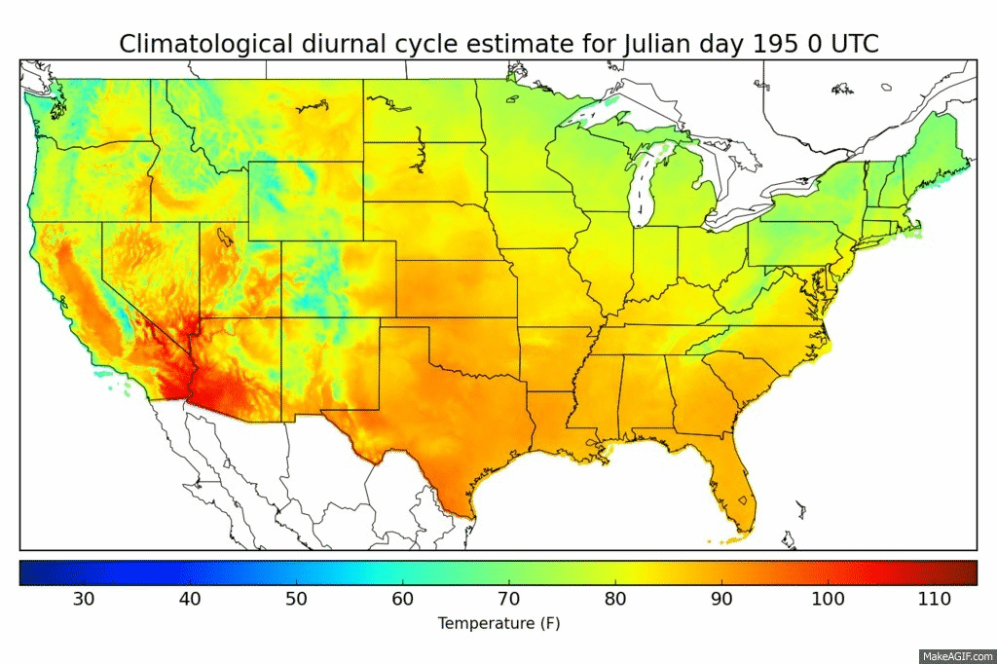
PRISM-based estimate of daily diurnal cycle for July 14
PRISM max and mean used to set the overall magnitude of diurnal cycle, and Kriged station estimates
of the diurnal cycle at stations used to set hourly variations within the PRISM-defined max/min range.

Slide 15
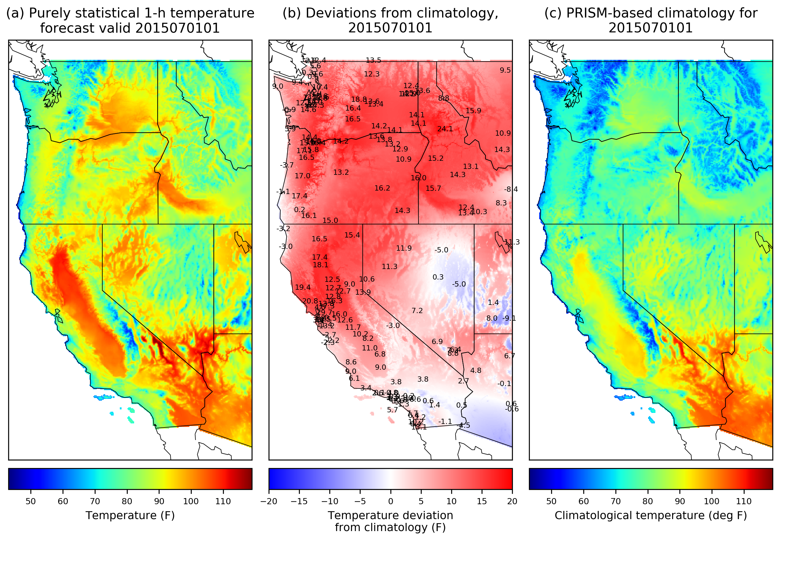
1-h predictions of temperature: moving from stations to grid.
A purely statistical
1-hour temperature
forecast based on the
concept of persisting
the deviation from
climatology.
PRISM provides the climatology (panel c, which has been munged to vary with day of year, hour of day).
Gridded forecast deviations from climatology (b) are based
on the previous hour’s deviations from climatology at obs locations, then statistically interpolated to the grid.
Final first guess is produced by adding (b) and (c) to produce (a).

Slide 16
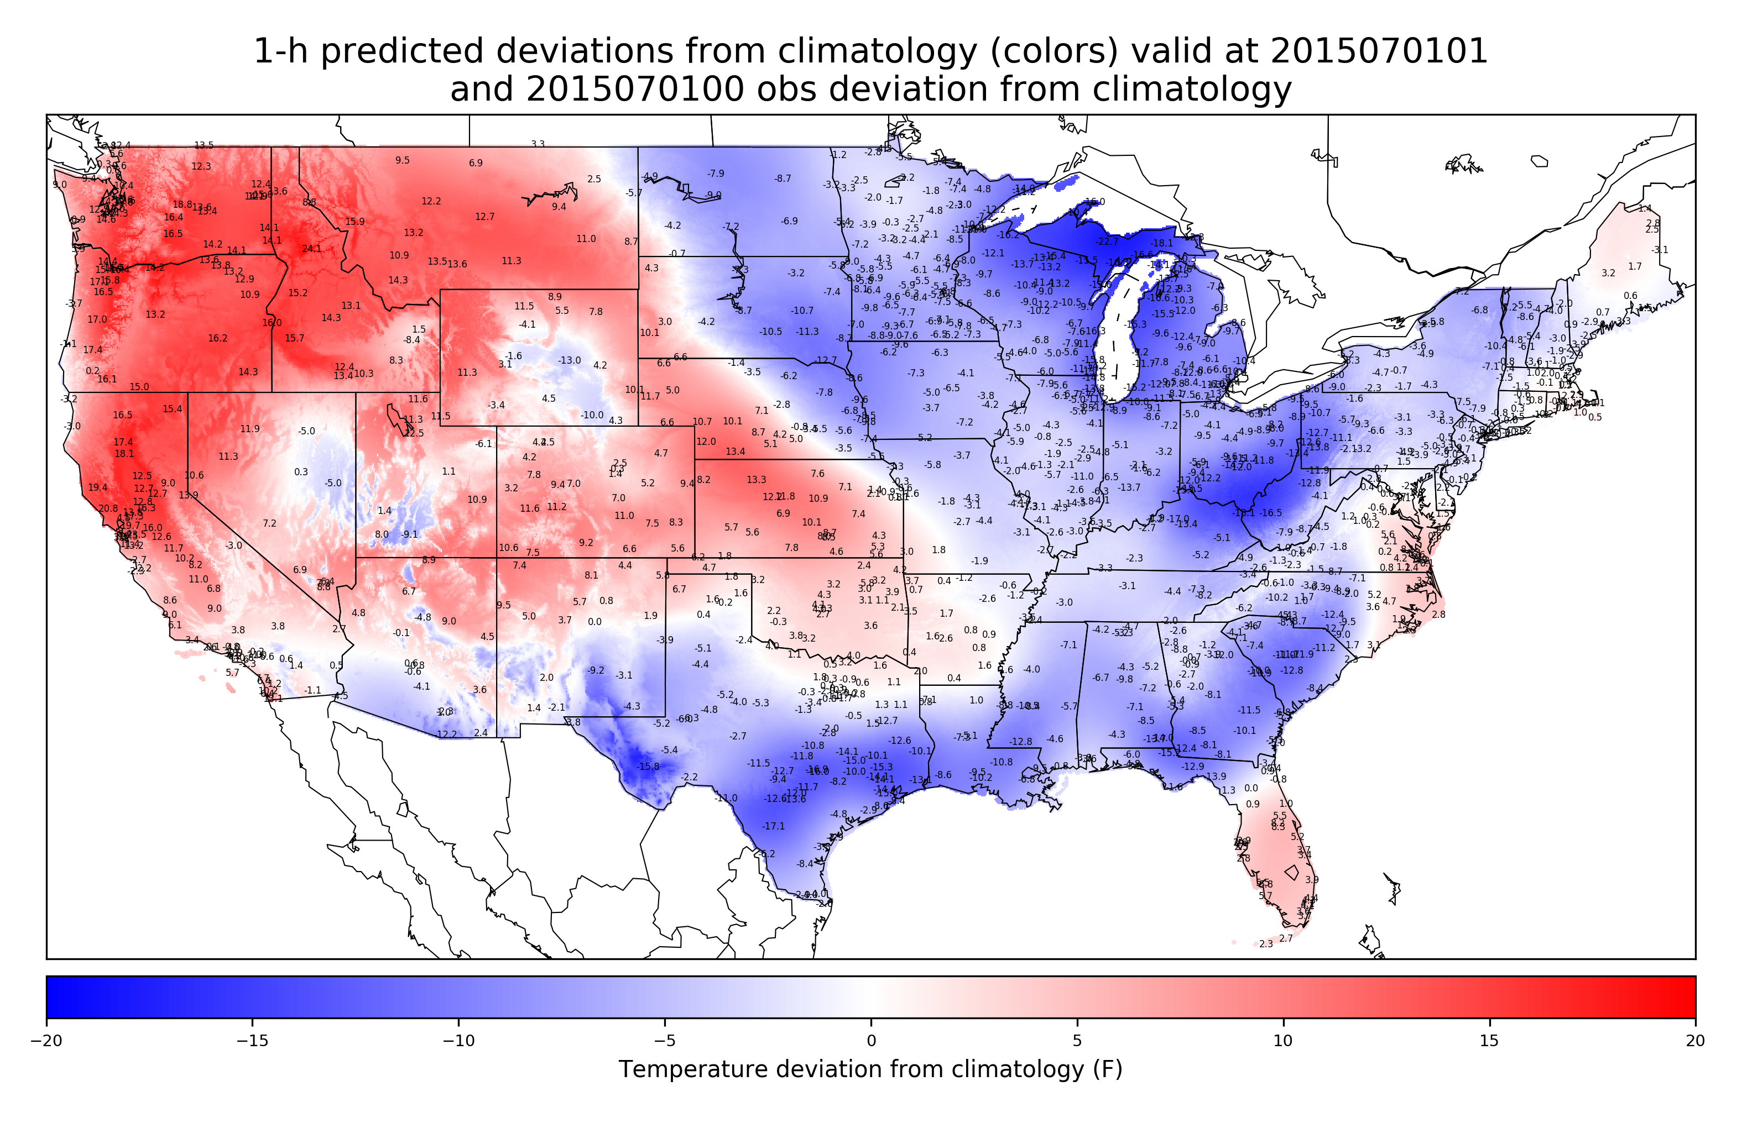
Obs deviations and OI analysis of deviations across CONUS
These deviations are what are persisted and added to the next hour’s climatology to
create the 1-h background forecast of 2-meter temperature.

Slide 17
Comparison of HRRR July 2015 1-h forecasts vs. this statistical model verified against CONUS stations
Hour of day (UTC) | HRRR bias (°F) | Statistical bias (°F) | HRRR MAE (°F) | Statistical MAE (°F) | HRRR RMSE (°F) | Statistical RMSE (°F)
01 | -0.77 | -0.65 | 2.26 | 1.80 | 3.09 | 2.37
04 | -1.46 | -0.43 | 2.47 | 1.72 | 3.20 | 2.22
07 | -1.15 | -0.26 | 2.22 | 1.55 | 2.88 | 2.03
10 | -0.98 | -0.16 | 2.12 | 1.50 | 2.82 | 1.98
13 | 3.11 | 0.62 | 3.81 | 1.78 | 4.61 | 2.31
16 | 3.50 | 0.61 | 4.02 | 1.57 | 4.78 | 2.12
19 | 2.31 | 0.27 | 3.55 | 1.59 | 4.39 | 2.27
22 | 0.77 | -0.05 | 2.81 | 1.73 | 3.79 | 2.50
in degrees F (sorry C fans!)
Not yet cross validated; all stations used in DA. Will repeat later where 10% of obs withheld in 10 parallel experiments.

Slide 18
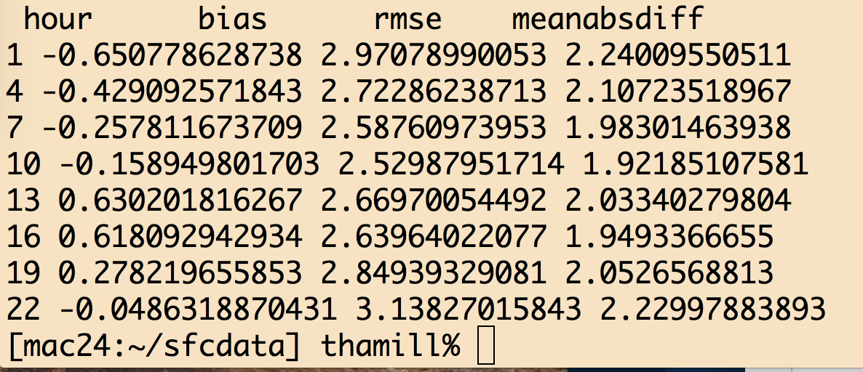
Without vertical weighting

Slide 19
Conclusions
Statistical benchmark outperformed 1-h first guess forecast at stations, indicating the substantial challenge of producing useful 1-h numerical background forecast for hourly surface temperature data assimilation.
Representativeness at stations may make this comparison somewhat unfair, so…
Now working on cross-validated comparisons of 1-h gridded statistical forecasts vs. gridded dynamical forecasts.
If the gridded and cross-validated statistical forecasts are competitive with the HRRR forecast, then what?

Slide 20
Next steps
  Probably tinker with covariance model some more (Gaussian → Matern).
  Verify more extensively that modified forecasts and analyses are unbiased, accurate.
Pending discussions with NCEP/EMC and ESRL/GSD, we might:
  Blend background HRRR and statistical forecasts over CONUS
  Use 1-h statistical forecasts for HRRR bias correction.
  Use statistical surface analysis to help in coupled DA to adjust soil temperatures.
And presumably, then presumably new crowdsourced observations will have bigger impact on analysis quality.

Slide 21
Supplementary slides

Slide 22
Details on data assimilation methodology
Insert here

Slide 23
Benchmarking test procedures
Observation data: surface observations over US (data from NCAR DS 472.0, 2004-2013, from NOAA MDL).
  For this study, use only stations with > 97% data availability (1352 stations, 1118 in CONUS).
Forecasts for extra predictors: from GEFS reforecast data set (Hamill et al., BAMS, 2013)
Determine hourly, daily climatology at each station.
  Cubic spline; 8 knots across year, cross-validated by year.
T → T’ : express temperature time series as deviations from climatology.
Explore potential predictors for T’(next hour) at surface stations first
Later: consider how to make a gridded background from these.

Slide 24
Climatology for Albany NY, 00 UTC
Red line denotes climatology from cubic-spline fit, 8 knots.

Slide 25
Fitted Albany, NY climatological diurnal cycle
No surprises, climatological temperatures generally warmest at 18, 21 UTC.

