Slide 1

Changing US National Blend of Models PQPF forecasts to include closest-histogram weighting and Gamma-distribution dressing
Tom Hamill
NOAA Earth System Research Lab, Physical Sciences Division, Boulder Colorado USA
August 2017

Slide 2
A starting point for discussion
The following presentation presumes a familiarity with the previous version of the National Blend software for probability of precipitation. This is documented in:
  Hamill, T.M., E. Engle, D. Myrick, M. Peroutka, C. Finan, and M. Scheuerer, 2017: The U.S. National Blend of Models for Statistical Postprocessing of Probability of Precipitation and Deterministic Precipitation Amount. Mon. Wea. Rev., 145, 3441–3463, https://doi.org/10.1175/MWR-D-16-0331.1
There are roughly six important steps in that POP algorithm:
  Enlarging training sample size via “supplemental locations.”
  Enlarging ensemble size using a stencil of surrounding model grid points.
  Quantile mapping to address distributional biases.
  Dressing each member with (amount-dependent) Gaussian noise to enlarge spread.
  Calculating probabilities from ensemble relative frequency.
  Spatial smoothing of the resulting POP probability field with a Savitzky-Golay smoother

Slide 3
Where PSD’s development of the National Blend of Models PQPF algorithm is headed.
Perform the precipitation postprocessing individually, model by model, followed by a step where probabilities are linearly combined.
Use a more objective, statistically informed algorithm for dressing of ensemble (adding kernels of probability density around each bias-corrected member).
Enlarge the synthetic ensemble sample size in the quantile mapping process, now using a 5 x 5 stencil of surrounding grid points instead of current 3 x 3 (see Hamill et al. 2017 for more). This reduces sampling variability and accounts for overconfidence in the position of precipitation features.
  Also, new version removes the previous version’s Savitzky-Golay smoothing of probability fields, as the larger stencil means a larger ensemble with less sampling error.
Automatic ability to generate full probabilistic PQPF, not just probability of precipitation (POP; > 0.254 mm/12h).
Simplify the calculations of climatological forecast and analyzed precipitation cumulative distributions, now estimating them with Gamma distributions and a “fraction zero.” This means less disk space storage of CDFs.

Slide 4
Current POP Blend algorithm
CMC ensemble data
CMC deterministic data
NCEP ensemble data
NCEP deterministic data
FNMOC ensemble data
FNMOC deterministic data
National Blend algorithm:
Quantile mapping with supplemental locations
Dressing with (state-dependent) normally distributed noise.
Generating probabilities from ensemble relative frequency.
Smoothing
Final maps of POP12 probabilities

Slide 5
Current POP Blend algorithm
CMC ensemble data
CMC deterministic data
NCEP ensemble data
NCEP deterministic data
FNMOC ensemble data
FNMOC deterministic data
National Blend algorithm:
Quantile mapping with supplemental locations
Dressing with (state-dependent) normally distributed noise.
Generating probabilities from ensemble relative frequency.
Smoothing
Will a future algorithm
be able to gracefully
handle the possible
non-availability of
some data? The
more sophisticated
dressing algorithms
will have trouble in
this regard. Closest-
member histograms (see subsequent slides) are tied to ensemble size.
Final maps of POP12 probabilities

Slide 6
Current POP Blend algorithm
CMC ensemble data
CMC deterministic data
NCEP ensemble data
NCEP deterministic data
FNMOC ensemble data
FNMOC deterministic data
What if we have
reforecasts for
this system only
and want to
perform more
sophisticated
postprocessing?
National Blend algorithm:
Quantile mapping with supplemental locations
Dressing with (state-dependent) normally distributed noise.
Generating probabilities from ensemble relative frequency.
Smoothing
Final maps of POP12 probabilities

Slide 7
Future Blend PQPF algorithm
CMC ensemble data
CMC deterministic data
NCEP ensemble data
NCEP deterministic data
FNMOC ensemble data
FNMOC deterministic data
Enhanced National Blend algorithm
Enhanced National Blend algorithm
Enhanced National Blend algorithm
Enhanced National Blend algorithm
Enhanced National Blend algorithm
Enhanced National Blend algorithm
CMC ensemble
PQPF
CMC deterministic
PQPF
NCEP ensemble
PQPF
NCEP deterministic
PQPF
FNMOC ensemble
PQPF
FNMOC deterministic
PQPF
Weighted linear combination
Final maps of PQPF

Slide 8
Future Blend algorithm
more straightforward to deal with data outage;
just change weights of existing systems.
CMC ensemble data
CMC deterministic data
NCEP ensemble data
NCEP deterministic data
FNMOC ensemble data
FNMOC deterministic data
Enhanced National Blend algorithm
Enhanced National Blend algorithm
Enhanced National Blend algorithm
Enhanced National Blend algorithm
Enhanced National Blend algorithm
Enhanced National Blend algorithm
CMC ensemble
PQPF
CMC deterministic
PQPF
NCEP ensemble
PQPF
NCEP deterministic
PQPF
FNMOC ensemble
PQPF
FNMOC deterministic
PQPF
Weighted linear combination
Final maps of PQPF

Slide 9
Future Blend algorithm
Can swap out algorithm for systems with
more training data, or different quality (HRRRE).
CMC ensemble data
CMC deterministic data
NCEP ensemble data
NCEP deterministic data
FNMOC ensemble data
FNMOC deterministic data
Enhanced National Blend algorithm
Enhanced National Blend algorithm
Reforecast Blend algorithm
Enhanced National Blend algorithm
Enhanced National Blend algorithm
Enhanced National Blend algorithm
CMC ensemble
PQPF
CMC deterministic
PQPF
NCEP ensemble
PQPF
NCEP deterministic
PQPF
FNMOC ensemble
PQPF
FNMOC deterministic
PQPF
Weighted linear combination
Final maps of PQPF

Slide 10
Organization of the rest of the presentation
Results (reliability diagrams, Brier Skill scores) to motivate your interest.
An example of the forecasts generated from the algorithm.
A description of the underlying algorithm.

Slide 11
Postprocessing results.
(data on 1/8 degree grid over CONUS, April-June 2016, trained and evaluated against CCPA precipitation analyses. Previous 60 days of forecasts/analyses used to train).

Slide 12
Left panels: reliability/skill of raw ensemble guidance
Middle panels: after quantile mapping, now using
5x5 stencil instead of 3x3.
Right panels: After additional step of Gamma
distribution dressing.
For +24-h POP, it is possible to make each individual model’s post-processed guidance highly reliable.
Three remaining questions to be answered in the following slides:
Is a multi-model combination of the probabilities (50% ECMWF, 25% NCEP, 25% CMC) better than ECMWF alone?
What about reliability and skill for other precipitation thresholds?
What about longer forecast lead times?

Slide 13
The weighted linear combination of the three models performs better than any individual model, here for the POP at +24 h lead.
Note that the CMC and ECMWF skill scores for each individual model are slightly different from those on the previous page. This is because NCEP data was missing for several days in June 2016, and CMC and ECMWF data were similarly pruned for this slide.

Slide 14
MME post-processed guidance is still more skillful (slightly) at the > 10 mm / 12 h threshold, +24 h lead time.
Forecasts are still quite reliable.

Slide 15
+72-h post-processed POP (left) and > 10 mm forecasts (right).
Note MME still improves over ECMWF.

Slide 16
+120-h post-processed POP (left) and > 10 mm forecasts (right).
Note MME improves over ECMWF at 10 mm, but not POP.

Slide 17
+168-h post-processed POP (left) and > 10 mm forecasts (right).
Note MME improves over ECMWF at 10 mm, but not POP.

Slide 18
A quick case study (NCEP GEFS).
Notice a few things from this system’s postprocessing:
Quantile mapping in panel (b) adds spatial detail, i.e., is performing statistical downscaling against higher-resolution analysis data. Some decrease in sharpness too.
Dressing in panel (c) generally further moderates extreme probabilities.
For the NCEP system, in regions with no precipitation, the postprocessing determines the dressing distribution leveraging a climatology of errors (see subsequent slides). In the case of the NCEP system, it is determined to be overconfident in its zero forecast, and these are moderated slightly.

Slide 19
A quick case study (CMC ensemble).
The CMC dressed ensemble in panel (c) doesn’t boost the probabilities in dry regions as much as with the NCEP ensemble. This is because the statistics in dry regions are different for the Canadian system. In its design, it tends to produce ensembles with wider spread and greater reliability (see page 11) and so the zero probabilities don’t need to be modified as much. (The subsequent slides will explain the procedure).

Slide 20
A quick case study (ECMWF).
There is less of a change from the
quantile mapping step in (b) to the
dressed ensemble in (c) because the
quantile-mapped probabilities are
already fairly reliable. The dressing
does less work.

Slide 21
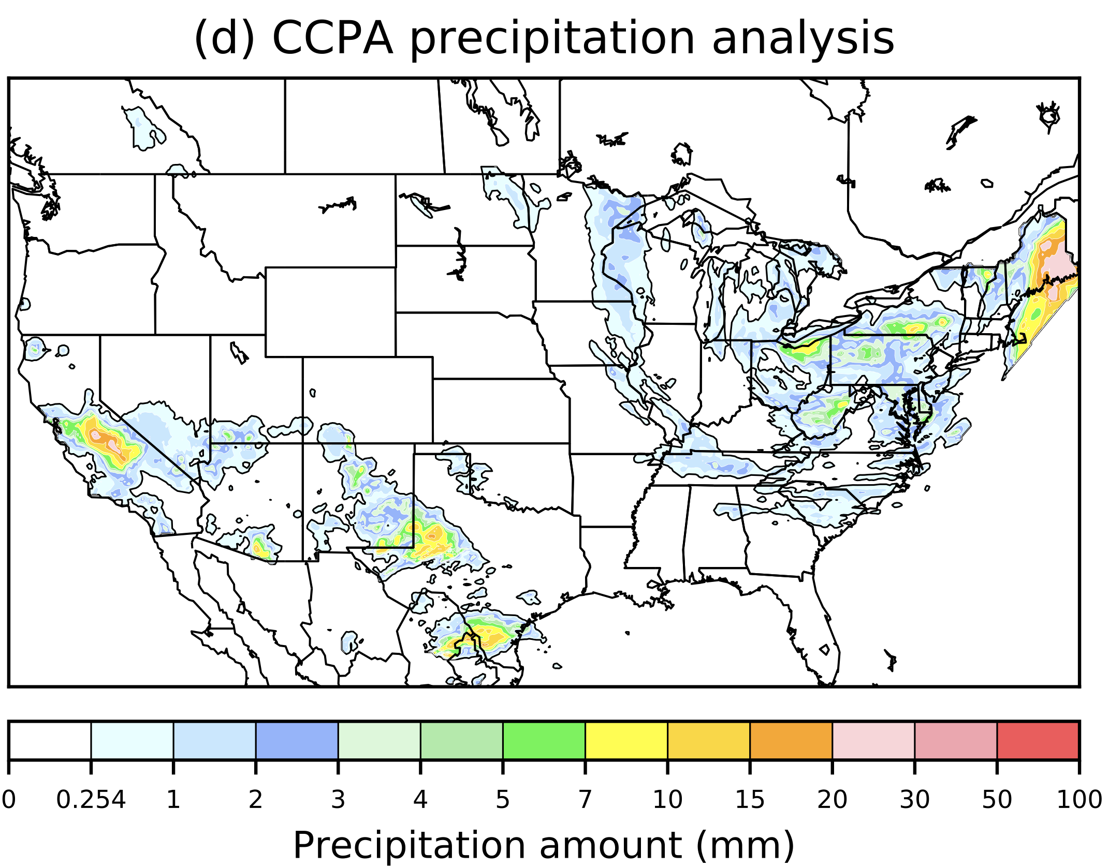
A quick case study (multi-model ensemble).
The final product is a linear combination
of the three systems’ probabilities, here arbitrarily set to 25% to NCEP and CMC, 50 % to ECMWF.
This weighting is admittedly ad-hoc, but
makes some sense because of the larger ECMWF ensemble size and the larger ensemble skill. A more objective procedure is possible and relatively simple.
e

Slide 22
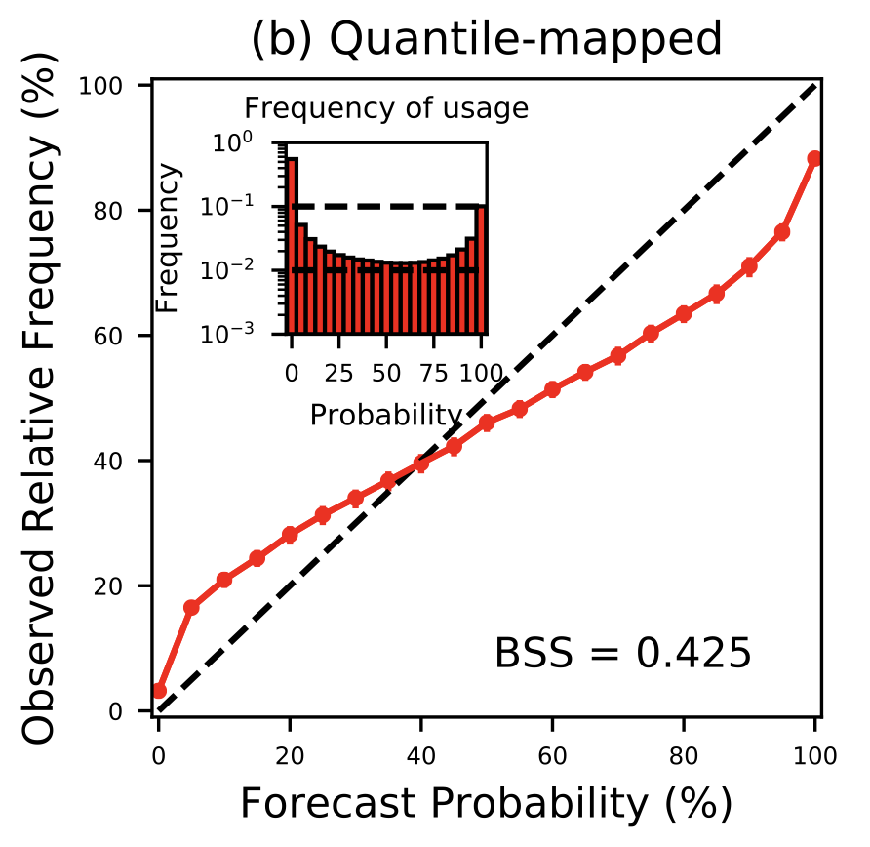
Understanding the new algorithm
Quantile-mapped forecasts are still unreliable, i.e., over-confident in their probabilities.
Having addressed errors in the mean with quantile mapping, we turn to addressing spread deficiency with “dressing.” See Vincent Fortin et al. article for a rationale for postprocessing an ensemble using a dressing algorithm with different weights and different probability distributions for each member.
NCEP
24-h
quantile
mapped
forecasts
of POP

Slide 23
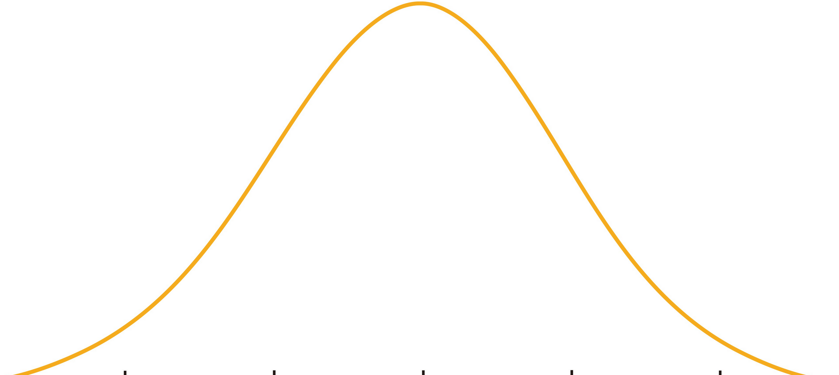
Fortin’s two ways to address overconfidence
1. Increase ensemble spread by “dressing” with pdfs.
BEFORE
(more sharp)
probability from relative frequency = 9/10
0 mm
1 mm
2 mm
3 mm
4 mm
POP
threshold
probability from integrating kernel densities ~ 85 %
AFTER
(less sharp)
0 mm
1 mm
2 mm
3 mm
4 mm
POP
threshold
Fortin extends this even farther, permitting the kernels to vary in their characteristic, member by member

Slide 24
Fortin’s two ways to address overconfidence
2. Re-weight the ensemble
probability from weighted relative frequency = 0.75
0.08
0.08
0.25
0.08
0.08
0.08
0.08
0.08
0.08
0.13
0 mm
1 mm
2 mm
3 mm
4 mm
To objectively re-weight the ensemble, we need evidence from the data of past quantile-mapped
forecasts as to which sorted member is closest to the analyzed state. These provide weights
to apply to each member.

Slide 25
Technical description of the algorithm.

Slide 26
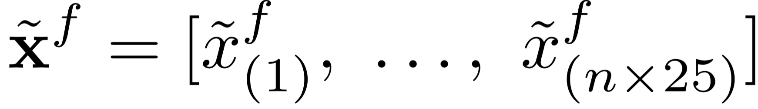
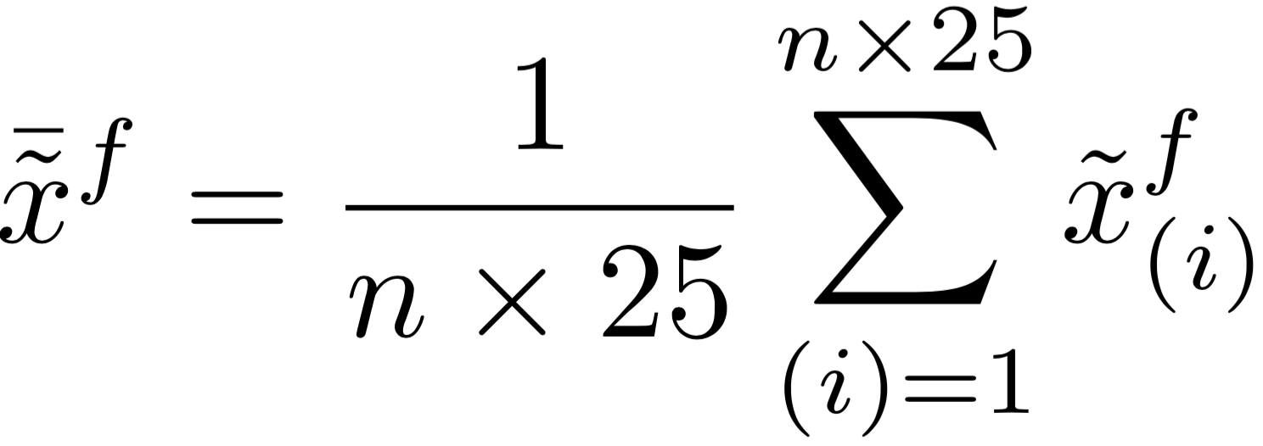
Revised PQPF procedure
Let’s assume we’re postprocessing a system’s ensemble of precipitation amount at a particular (i,j) grid point, for a particular model, at a particular lead time.
We assume we have already performed the step of quantile mapping each of n forecast members to ameliorate bias, and enlarging the ensemble twenty-five-fold using the 5x5 stencil of surrounding grid points, following procedure described in Hamill et al. (2017). Sort this n x 25 member ensemble.
We’ll also use an ensemble mean of the quantile-mapped, enlarged ensemble.
~ denotes quantile mapped, ^{f} denotes forecast,
_{(i)} denotes the (i)th sorted member.

Slide 27
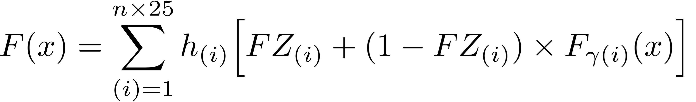
PQPF procedure, continued.
The big picture is this: we are going to generate a post-processed CDF F(x) as a function of precipitation amount x. There will be a point mass probability at zero and then a distribution of positive amounts. The overall CDF will be obtained from the weighted summation of point masses and CDFs for the positive amounts associated with each sorted member.
see next slide for explanation of terms

Slide 28
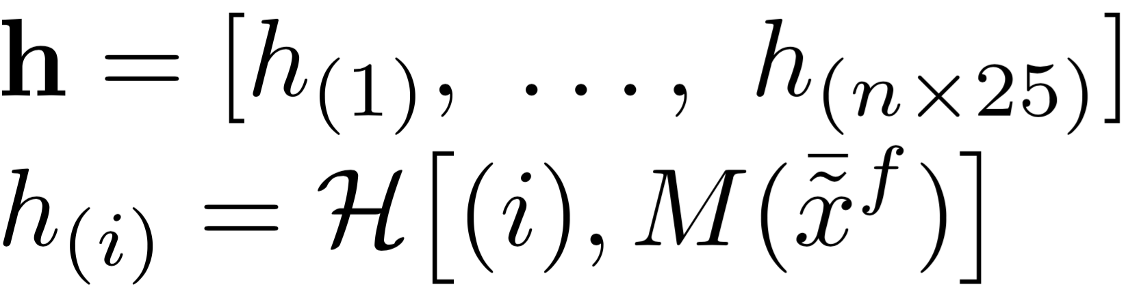
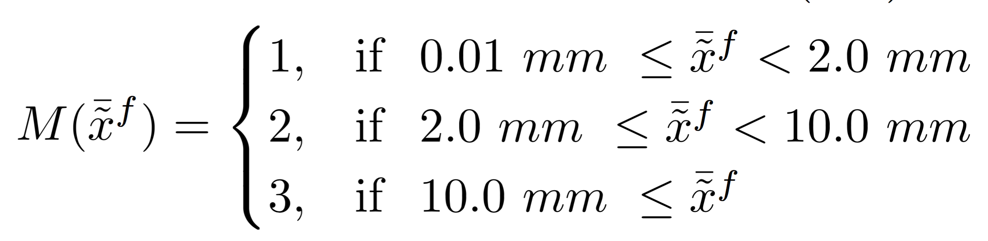
zero point mass
cdf for nonzero
h_{(i)} is a weighting applied to the (i)th sorted member, based on the “closest-member histogram” discussed in next slide. These are Fortin’s weights.
The histogram weights depend on the rank (i), and an index based on the mean quantile-mapped precipitation amount
FZ_{(i)} is the fraction of samples that have zero precipitation associated with the (i)th sorted member. How this is modeled is described later.
F_{ɣ(i)}(x) is the cumulative non-exceedance probability from a Gamma for the (i)th sorted member at the value x. How this is modeled is described later.

Slide 29
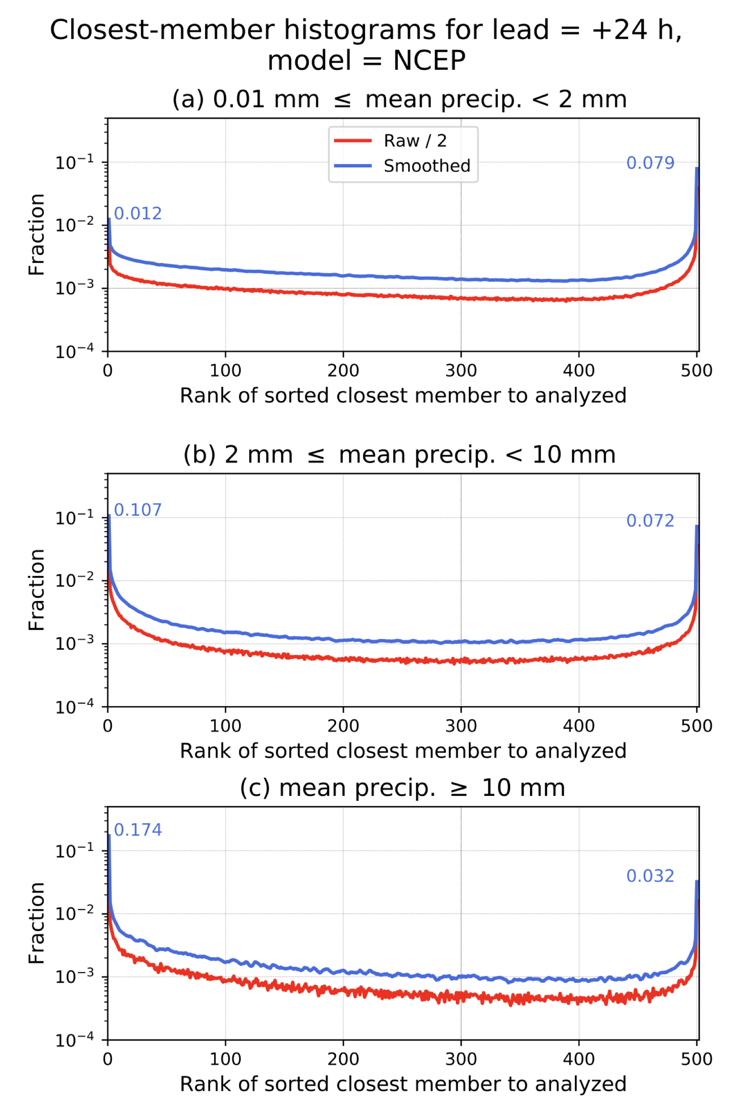
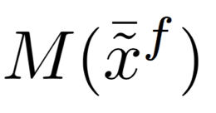
Sample closest-member histograms (NCEP, +24 h) used in weighting the ensemble members.
(index 1 for M)
To generate these histograms, we sort the quantile-mapped and twenty-five-fold enlarged ensemble from lowest to highest. Compare this to the analyzed precipitation. Only one member (except in the case of ties) can be the best, the closest to the analyzed.
For various mean precipitation amounts, we tally statistics of which sorted member was closest to the analyzed over the CONUS and over the training sample. Savitzky-Golay smoothed curves in blue are the actual ones used. This provides the h_{(i)} discussed in previous slides. The histograms are very similar to rank histograms.
The histogram we choose to use will vary with quantile-mapped forecast mean precipitation amount (the three panels to the left). This is from previous page.
Note that the outlying members have much greater probability of being the “closest” member, consistent with an overconfident ensemble. Those outlying members are thus weighted more, increasing ensemble spread.
(index 2 for M)
(index 3 for M)

Slide 30
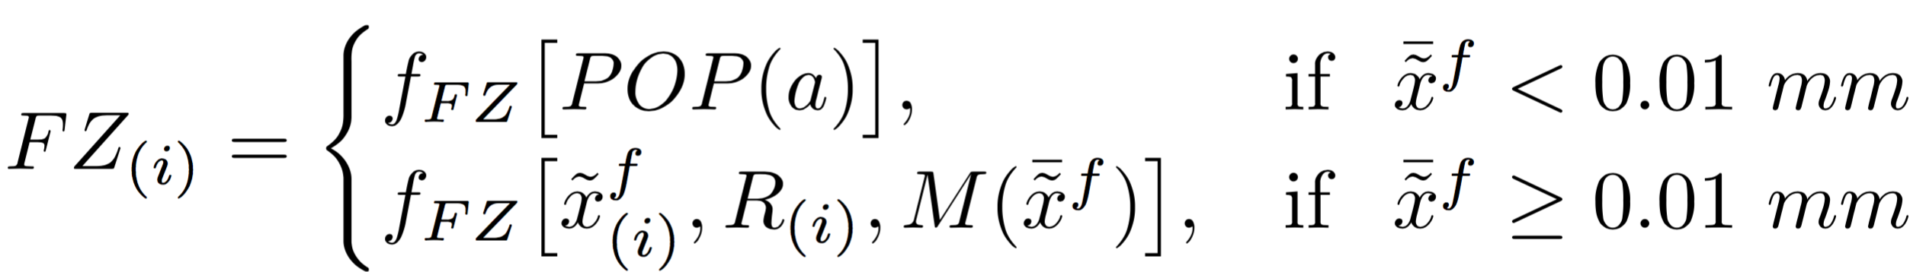
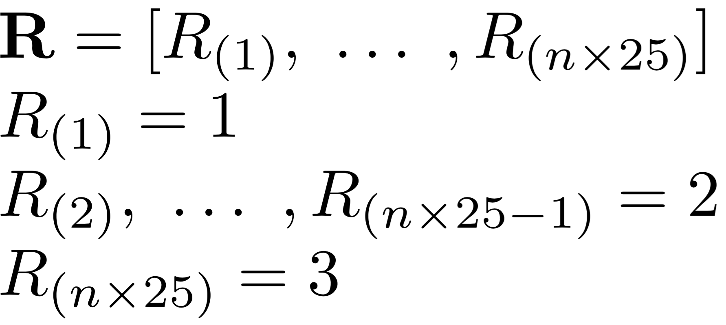
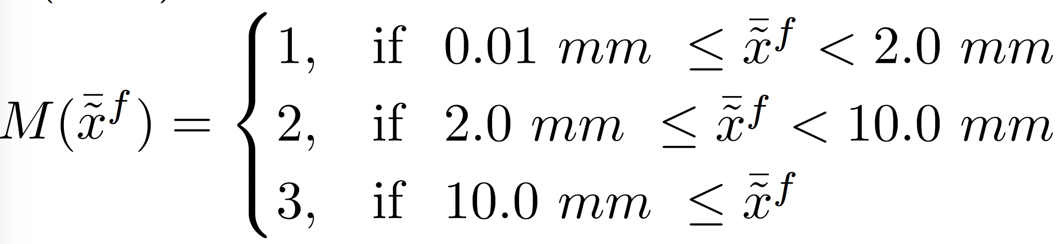
Fraction zero definition.
In situations where the ensemble-mean forecast is effectively zero, we will set the fraction zero for all members to
be stratified by the climatological probability of analyzed precipitation, POP(a), which will vary with location and month of the year. In situations with nonzero precipitation, the fraction zero will be a function of precipitation amount associated with the sorted member number (i), an index of the sorted member number R_{(i)} , and M as defined below.
R_{(i)} is an index which is 1 for the lowest sorted member, 2 for intermediate members, 3 for the highest sorted member. M is an index that is 1, 2, or 3 depending on the quantile-mapped mean precipitation amount.
we will differentiate the dressing statistics between
lowest, intermediate, and highest members.
the fraction zero is permitted to depend not just on a single
member’s amount, but whether the mean is large or small.

Slide 31
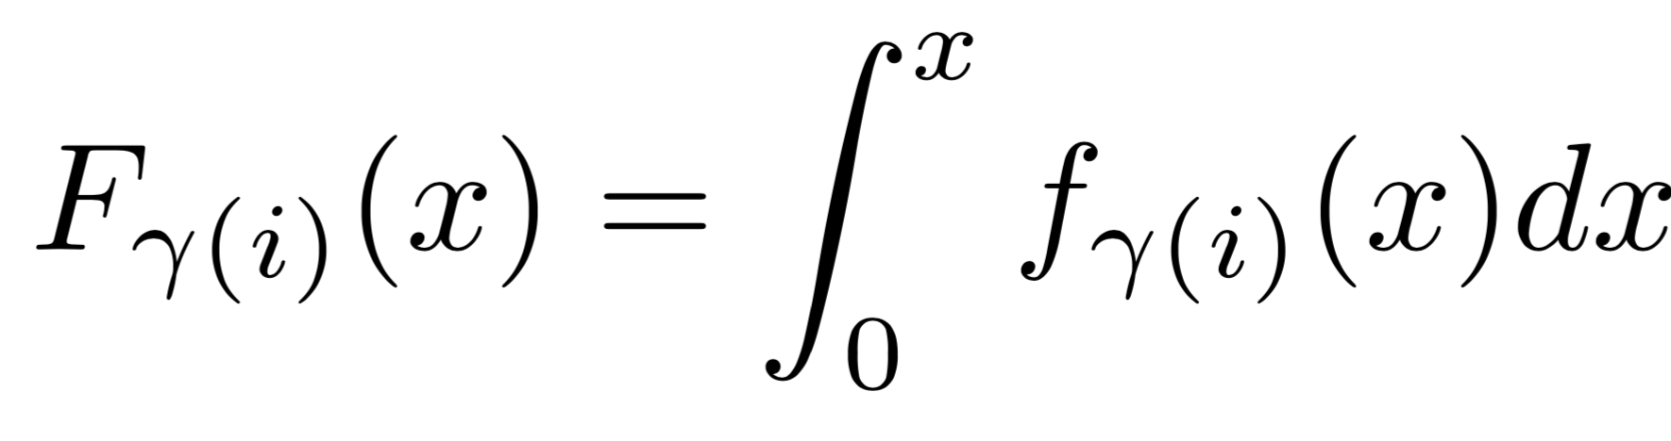
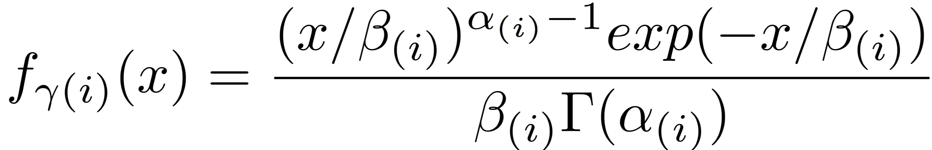
Gamma CDF and PDF definitions.
The Gamma CDF for the _{(i)th} sorted member for the precipitation amount x is defined as
and the associated Gamma pdf is defined as
The shape and scale parameters α_{(i)} and β_{(i)} are described in the subsequent slide.

Slide 32
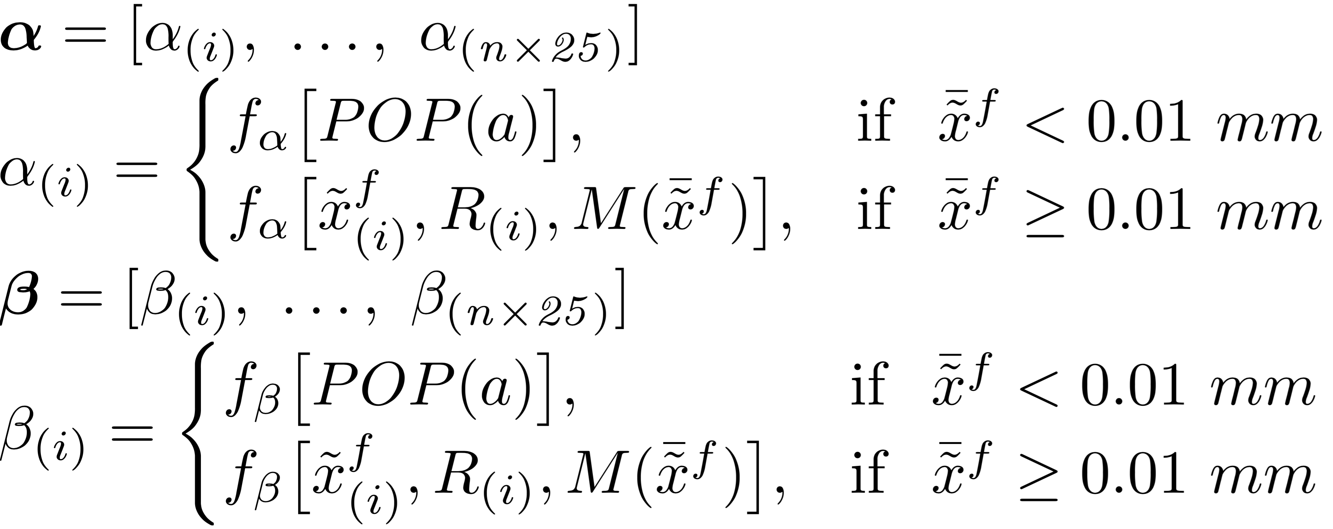
Shape and scale parameters for the Gamma distribution.
We will have Gamma shape α_{(i)} and scale β_{(i)} parameters that can be estimated separately for each sorted member. If there is zero or extremely light precipitation, the parameters depend only on the analyzed POP for that grid point. With heavier precipitation, there will be a dependence on the quantile- mapped amount of the sorted member, the rank via R(i) [see previous slide], and a category for the mean amount (previous slide) mean precipitation.

Slide 33
Why should Gamma distribution parameters vary with the rank of the sorted ensemble?
Imagine we have a sorted ensemble like the one below:
a wider dressing distribution of the analyzed given the lowest member
is probably appropriate since there is
a wide range of possible values lower
than the lowest member.
a wider dressing distribution of the analyzed given the highest member is probably appropriate since there is a wide range of possible values higher than the highest member.
0 mm
5 mm
10 mm
15 mm
20 mm
interior ranks are bounded in the distribution of possible analyzed
values by the other ensemble members; hence, the
distributions are going to be relatively narrow, and centered
on the quantile-mapped value.

Slide 34
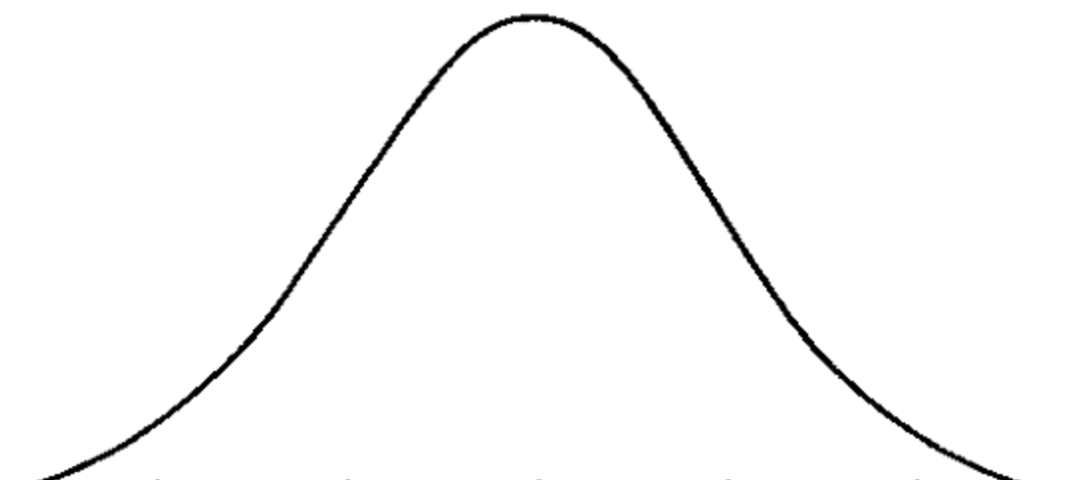
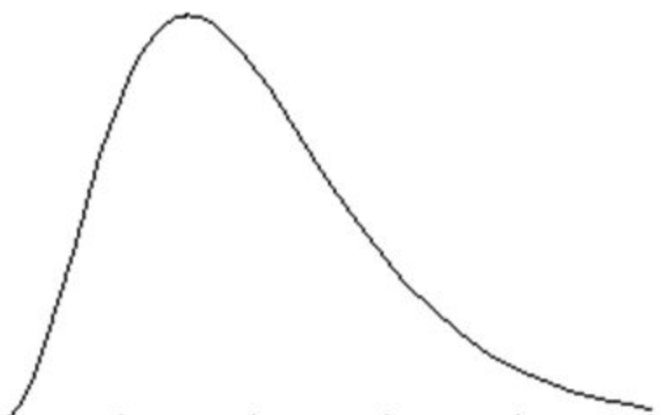
Why should Gamma distribution parameters vary with the rank of the sorted ensemble?
distribution could be centered on
a value higher than the largest
member, and skewed.
0 mm
5 mm
10 mm
15 mm
20 mm
dressing
distribution is
more narrow
and symmetric

Slide 35
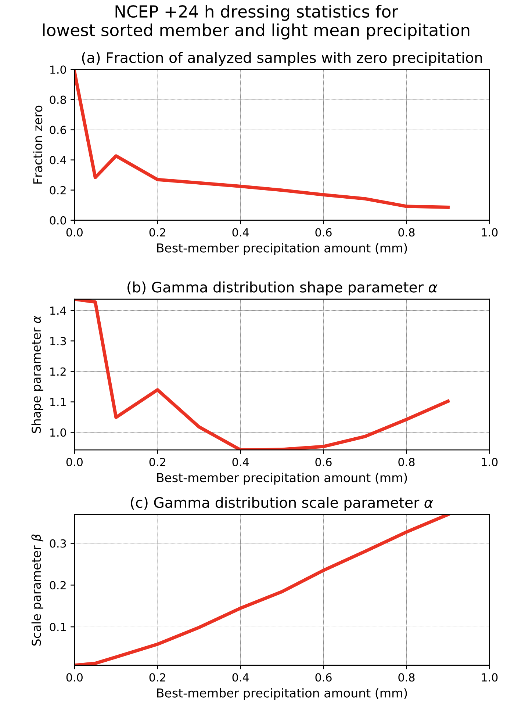
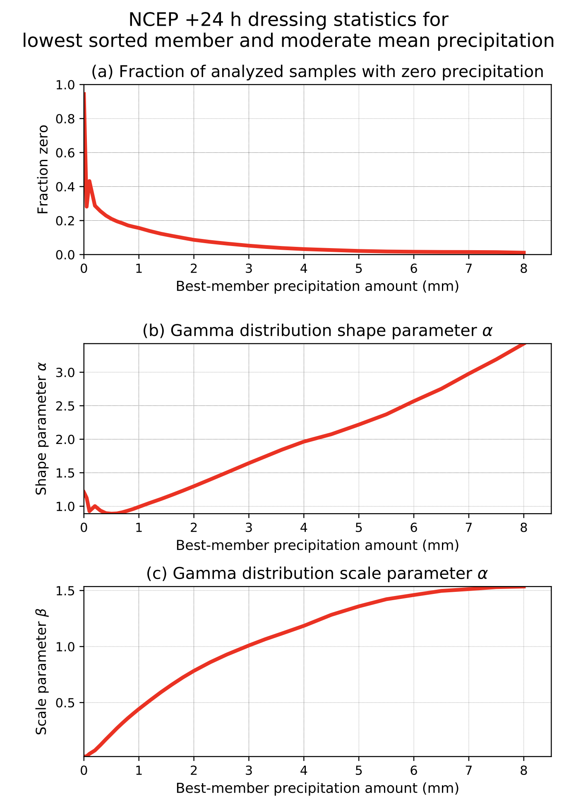
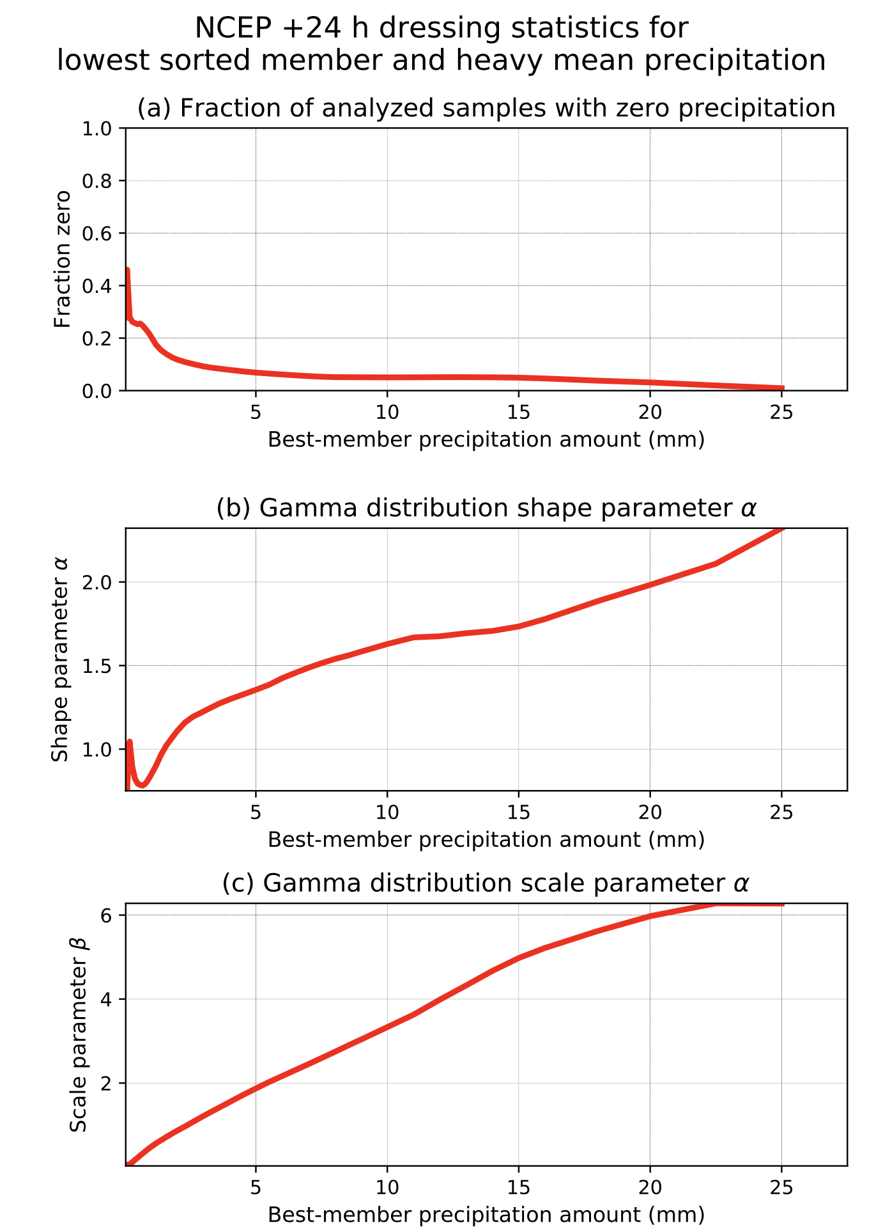
Sample of objectively determined FZ (fraction zero) and Gamma distribution parameters for lowest sorted member.
The fraction zero and Gamma distribution parameters are shown here for the lowest sorted member and various
mean precipitation amounts. The implied pdfs are shown on the next slide.

Slide 36
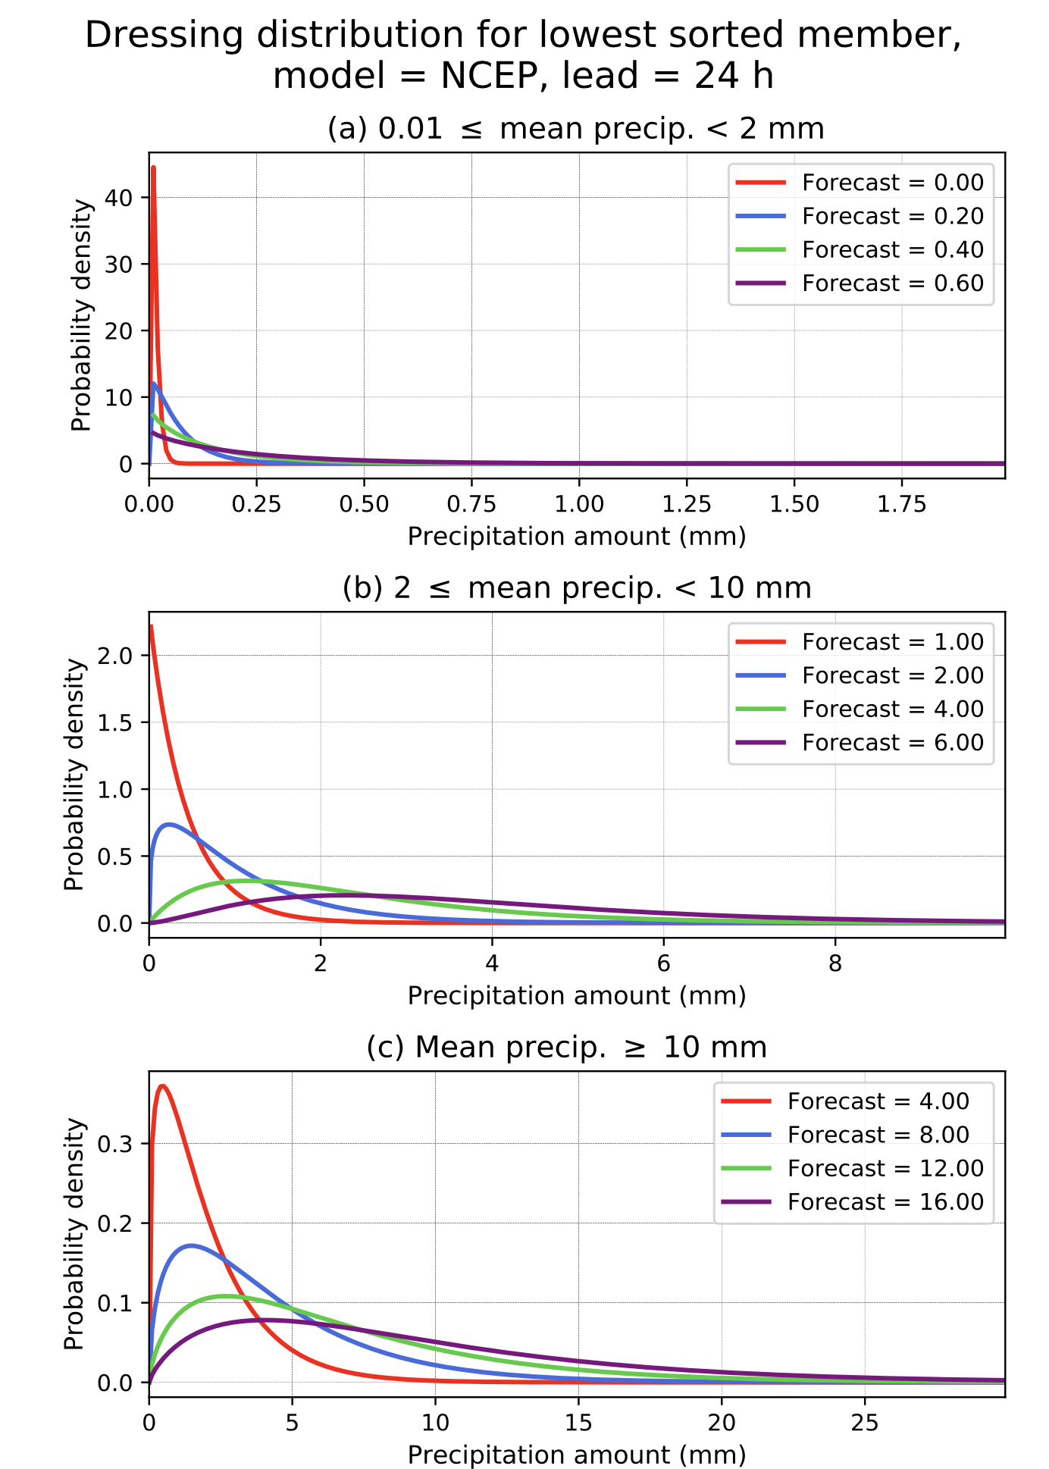
Gamma PDFs based on α and β parameters, and why they are different for extreme ranks
Again, the dressing distributions for the lowest or highest member are not centered on the precipitation value of interest (this makes sense).
For the lowest sorted member shown here, the fitted distribution of the analyzed given the forecast is shifted to yet lower amounts. For example (bottom panel) when the mean precipitation is > 10 mm and a the highest quantile-mapped member forecast is 16 mm, the maximum probability density is around 4 mm.
The effect of this is, in combination with the large weights associated with the lowest rank (see closest histogram statistics on earlier page) is to broaden the pdf, making the post-processed guidance less sharp but more reliable.

Slide 37
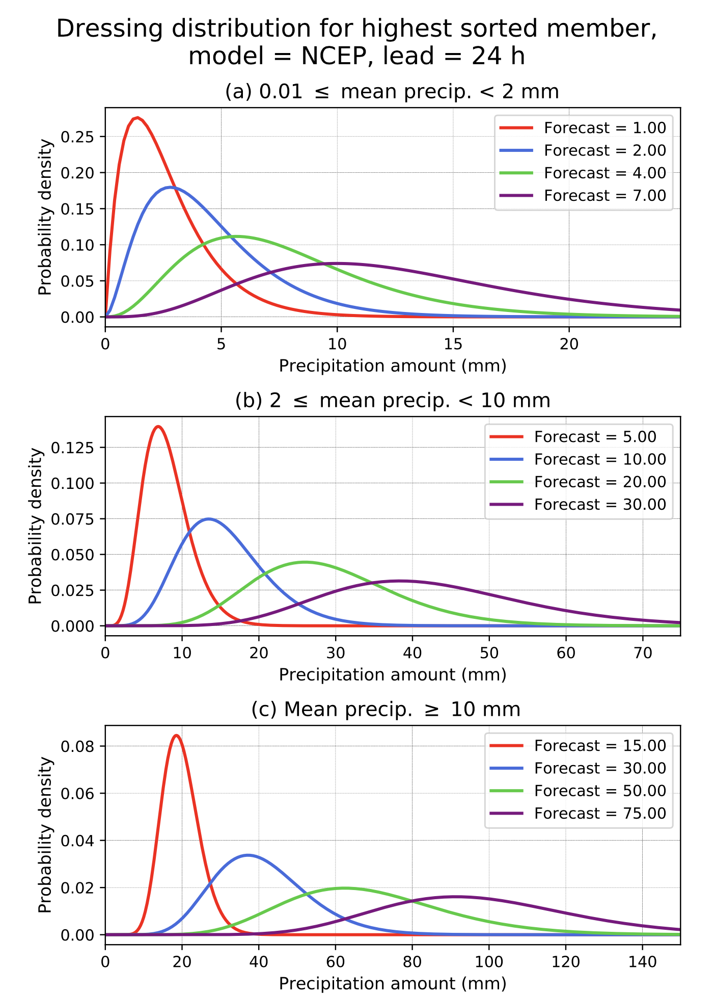
Gamma PDFs based on α and β parameters, and why they are different for extreme ranks
Again, the dressing distributions for the lowest or highest member are not centered on the precipitation value of interest (this makes sense).
For the highest sorted member shown here, the fitted distribution of the analyzed given the forecast is shifted to yet higher amounts. For example (bottom panel) when the mean precipitation is > 10 mm and the highest quantile-mapped member forecast is 15 mm, the maximum probability density is around 19 mm.
The effect of this is, in combination with the larger weights associated with the highest rank (see closest histogram statistics on earlier page) is to broaden the pdf, making the post-processed guidance less sharp but more reliable.

Slide 38
Dressing the intermediate ranked members of the sorted ensemble.
Arguably, exact dressing distributions for these are going to be narrow (bounded by other ensemble members).
Arguably, the mean of the dressing distribution for these intermediate-ranked members should be centered on the quantile-mapped value.
Accordingly, we dress (arbitrarily) with a Gamma distribution whose mean is the quantile mapped value and whose spread is 1/20th the value of that member.
  Results show that the final probabilities are insensitive to the choice of distribution and moderate changes in the amount of spread.

Slide 39
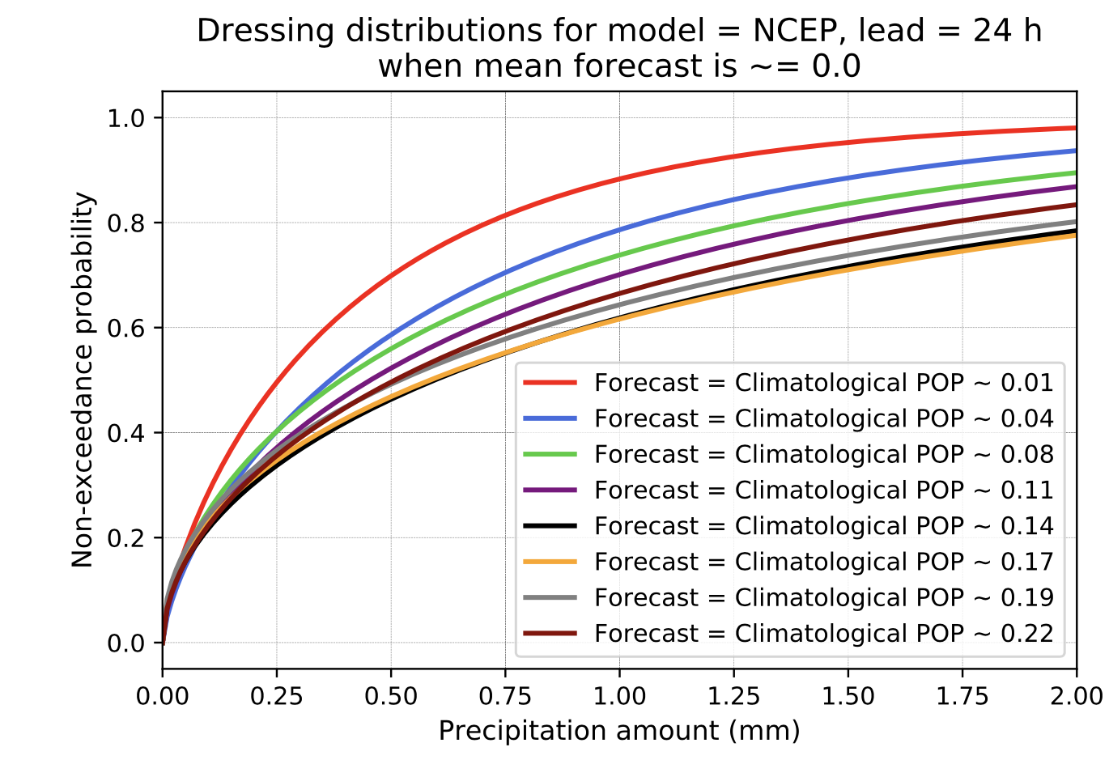
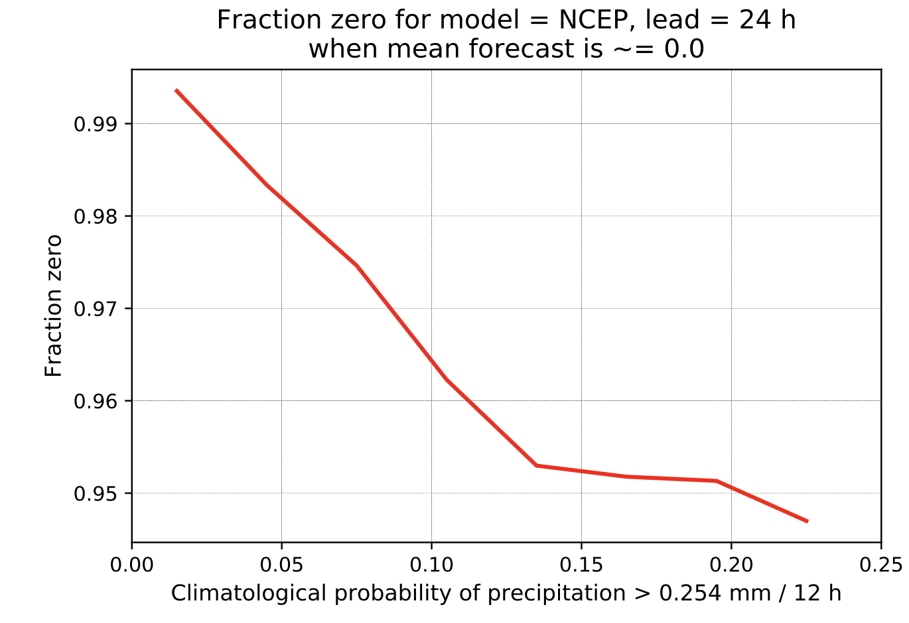
Special procedure for estimating dressing pdf when all quantile-mapped members are zero.
Here are data-derived estimates for 24-h NCEP forecasts of the Fraction Zero and Gamma distributions for the non-zero probabilities based on climatological POP.

Slide 40
Thom estimators of Gamma distribution parameters
We now turn our attention to a practical way to estimate the Gamma-distribution parameters. We desire to: (1) estimate the parameters correctly, and (2) store a minimal amount of data on the way to estimating those parameters. We use the Thom (1958) approach (see Wilks text).
In addition, we’ll estimate a fraction of samples with zero precipitation (FZ), tallying the number of zeros (n_zeros) and the number of ones (n_ones).

Slide 41
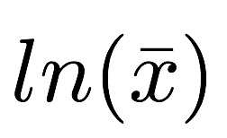
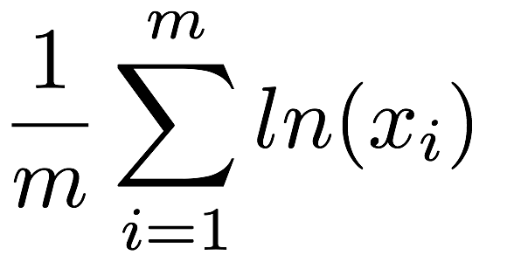
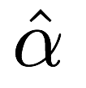

How the software works in practice.
Daily statistics (forecast, analyzed)
We want 60 days of dressing statistics (green boxes). Each such day is
generated using the past 60 days of forecasts and analyses. With
60 days of dressing statistics, we collate these and use this to postprocess
the forecast for the next day (orange box).
Jan 01
Jan 02
.
.
.
Feb 28
Mar 01
Mar 02
.
.
.
Apr 29
Apr 30
May 1
sum(x), sum(ln(x)), n_zeros, n_ones
sum(x), sum(ln(x)), n_zeros, n_ones
2 Mar
ensemble forecast
sum(x), sum(ln(x)), n_zeros, n_ones
sum(x), sum(ln(x)), n_zeros, n_ones
(60-d training data for 2 Mar quantile mapping)
Determine 2 Mar dressing stats: (1) Quantile map forecasts, and (2) Determine dressing stats.
2 Mar
dressing stats
FZ,
(60-d training data for 3 Mar quantile mapping)
Determine 3 Mar dressing stats: (1) Quantile map forecasts, and (2) Determine dressing stats.
FZ,
3 Mar
dressing stats
sum(x), sum(ln(x)), n_zeros, n_ones
.
.
.
.
.
.
Determine dressing
statistics over 60 days
sum(x), sum(ln(x)), n_zeros, n_ones
3 Mar
ensemble forecast
(60-d training data for 30 Apr quantile mapping)
2 Mar – 30 Apr
dressing stats
FZ,
Determine 30 Apr dressing stats: (1) Quantile map forecasts, and (2) Determine dressing stats.
30 Apr
dressing stats
30 Apr
ensemble forecast
(60-d training data for 1 May quantile mapping)
FZ,
Post-process 1 May forecast, quantile mapping and dressing

Slide 42
Conclusions
A new, data-informed procedure for postprocessing of ensemble precipitation forecasts with short training data sets has been developed.
Ensemble systems are postprocessed individually and then post-processed probabilities are linearly combined.
It is possible to make each individual system’s probabilities fairly reliable.
After the linear combination, there is further improvement in reliability and skill in most circumstances.
ESRL/PSD now will work with NWS/MDL colleagues to transfer the methodology to operational use in the National Blend.

Slide 43
Ongoing concerns and work.
Making the code as usable and well documented as possible for a range of users (MDL, but including ECMWF, Met Office) [Hamill]
Determining what modifications should be made to current deterministic QPF procedure as we split up forecasts to model-by-model processing [Hamill].
Testing and validating supplemental locations code at 2.5 km grid over CONUS [Hamill].
Adaptation of Hamill software to MDL [Engle].
Document algorithm and describe performance with a journal article [Hamill]

