Slide 1

NOAA’s current and planned ensemble prediction systems and products
Tom Hamill
ESRL Physical Sciences Division, Boulder, CO tom.hamill@noaa.gov
http://www.linkedin.com/in/thomasmorehamill
http://www.thomasmhamill.info
(303) 497-3060
a presentation to UVIG, Feb 2015, Denver

Slide 2
Current (Feb 2014) NWS ensemble-related systems
High-resolution Rapid Refresh (HRRR) 3-km grid over CONUS to + 15 h lead. Can get small lagged ensemble.
Short-range ensemble forecast (SREF) system; ~ 16-km grid, to + 84 h lead. Web products here.
Global Ensemble Forecast System (GEFS); T254 (~40 km @ 40° N) to day +8, T190 (~54 km @ 40° N) to day + 16. Also reforecasts, discussed later.
Climate Forecast System v. 2 (CFSv2); T126 (~ 80-km grid @ 40° N) to +9 months. Reforecasts too.

Slide 3
Challenges with using raw ensemble predictions for wind energy
Sub-optimal configuration of the ensemble.
  Initial-condition uncertainty not addressed in fully proper ways.
  Model uncertainty not addressed in fully proper ways.
  Sampling error from finite-sized ensemble.
  Coarse spatial and temporal resolution: the model only forecasts larger scales and longer periods of time than those of interest to wind energy (e.g., 3-hourly output on ½-degree grid from GEFS).
  More
Such errors may be manifested as unconditional (e.g., consistently too windy) or conditional (e.g., consistently too windy post cold front) systematic errors.

Slide 4
How to fix these problems
Increase the model “resolution.”
Develop improved sets of initial conditions.
Estimate the uncertainty due to the model more carefully.
… and more.
“Post-process” the guidance – use old forecasts and observations to adjust and downscale the current forecast
But ensemble prediction system development is a
slow process. What can we provide now?

Slide 5
How to fix these problems
Increase the model “resolution.”
Develop improved sets of initial conditions.
Estimate the uncertainty due to the model more carefully.
… and more.
“Post-process” the guidance – use old forecasts and observations to adjust and downscale the current forecast
But ensemble prediction system development is a
slow process. What can we provide now?

Slide 6
How to fix these problems
Increase the model “resolution.”
Develop improved sets of initial conditions.
Estimate the uncertainty due to the model more carefully.
… and more.
“Post-process” the guidance – use old forecasts and observations to adjust and downscale the current forecast
But ensemble prediction system development is a
slow process. What can we provide now?

Slide 7
Statistical post-processing of GEFS using reforecasts
Reforecasts: retrospective forecasts using (hopefully) the same model, same data assimilation system that is used operationally. GEFS reforecasts described here.
Useful for adjustment of the current forecast by statistically correcting based on past forecasts and observations/analyses.
Post-processing of
CONUS precipitation
with “analog”
method and large
reforecast training
data set can
dramatically improve
skill and reliability
of probabilistic
forecasts. Method
described here. Also:
supplements 1 and 2.

Slide 8
“Reliability diagrams”
Our precipitation forecasts were dramatically improved in reliability and skill with
post-processing. Though we haven’t tried this for longer-lead wind power forecasts,
it’s likely that similar techniques would perform well (see Luca delle Monache’s talk).
Ref: ibid

Slide 9
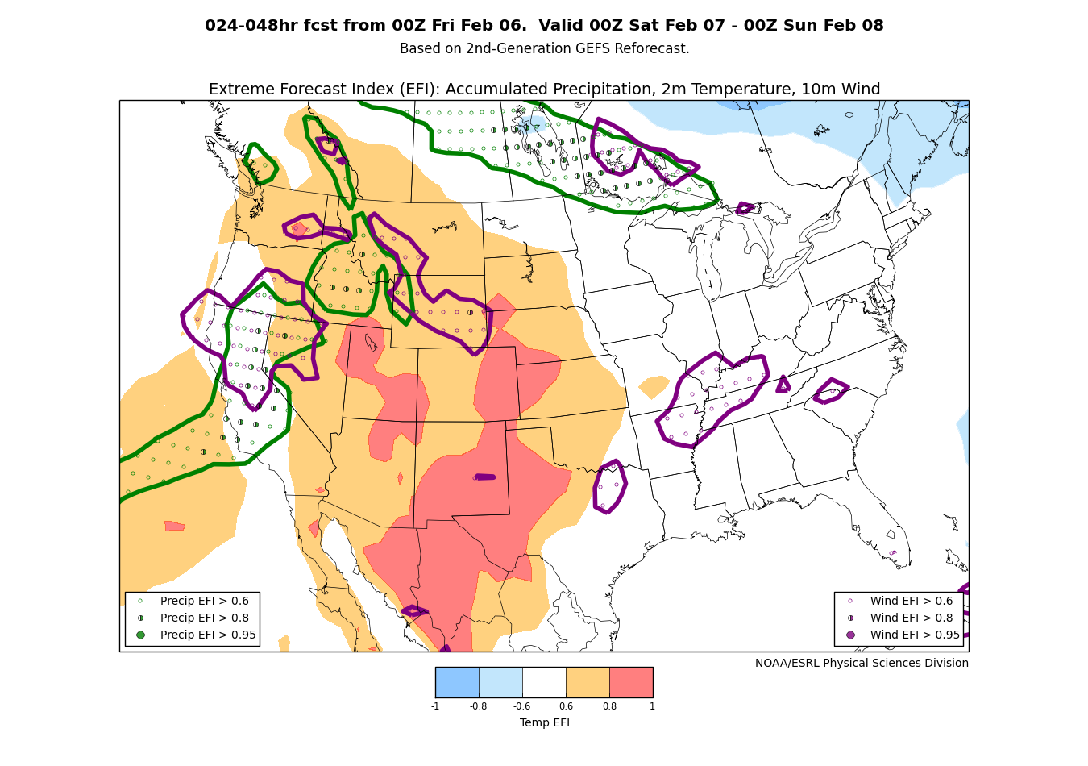
“Extreme forecast index”
Not post-processing per se, but indicates how different today’s ensemble forecast is relative to the climatology of past forecasts.
Methodology, originating
at ECMWF, described
here and here.
GEFS reforecast-based,
real-time experimental
products available here.

Slide 10
GEFS reforecast version 2 details
Seeks to mimic GEFS (NCEP Global Ensemble Forecast System) operational configuration as of February 2012.
Once daily from 00 UTC initial conditions, we produce an 11-member forecast, 1 control + 10 perturbed.
These reforecasts were produced every day, for 1984120100 to current ( > 17M CPU hours, > 150 TB data stored on disk).
CFSR (NCEP’s Climate Forecast System Reanalysis) initial conditions (3D-Var) + ETR perturbations (cycled with 10 perturbed members). After ~ 22 May 2012, initial conditions from hybrid EnKF/3D-Var.
Resolution: T254L42 to day 8, T190L42 (~ 70 km) from days 7.5 to day 16.
Data storage:
  Fast data archive at ESRL of 99 variables, 28 of which stored at original ~1/2-degree resolution during week 1. All stored at 1 degree. Also: mean and spread to be stored.
  Full archive at DOE/Lawrence Berkeley Lab, where data set was created under DOE grant.

Slide 11
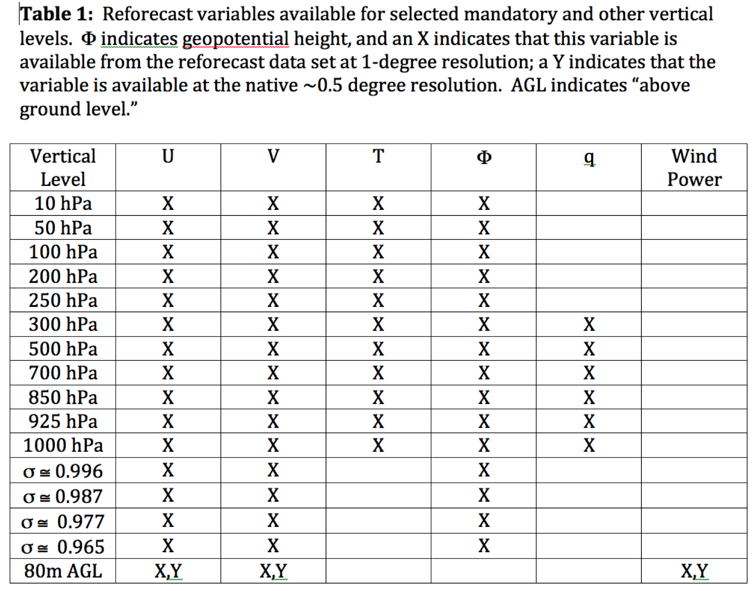
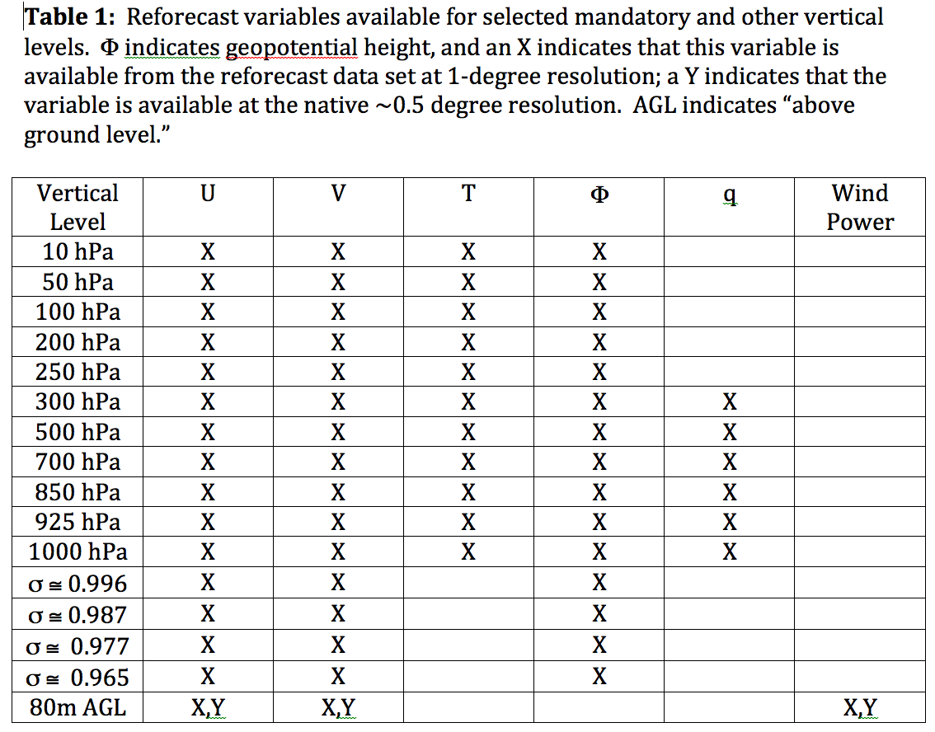
GEFS reforecast data readily available
These may be especially helpful for wind-energy post-processing.

Slide 12
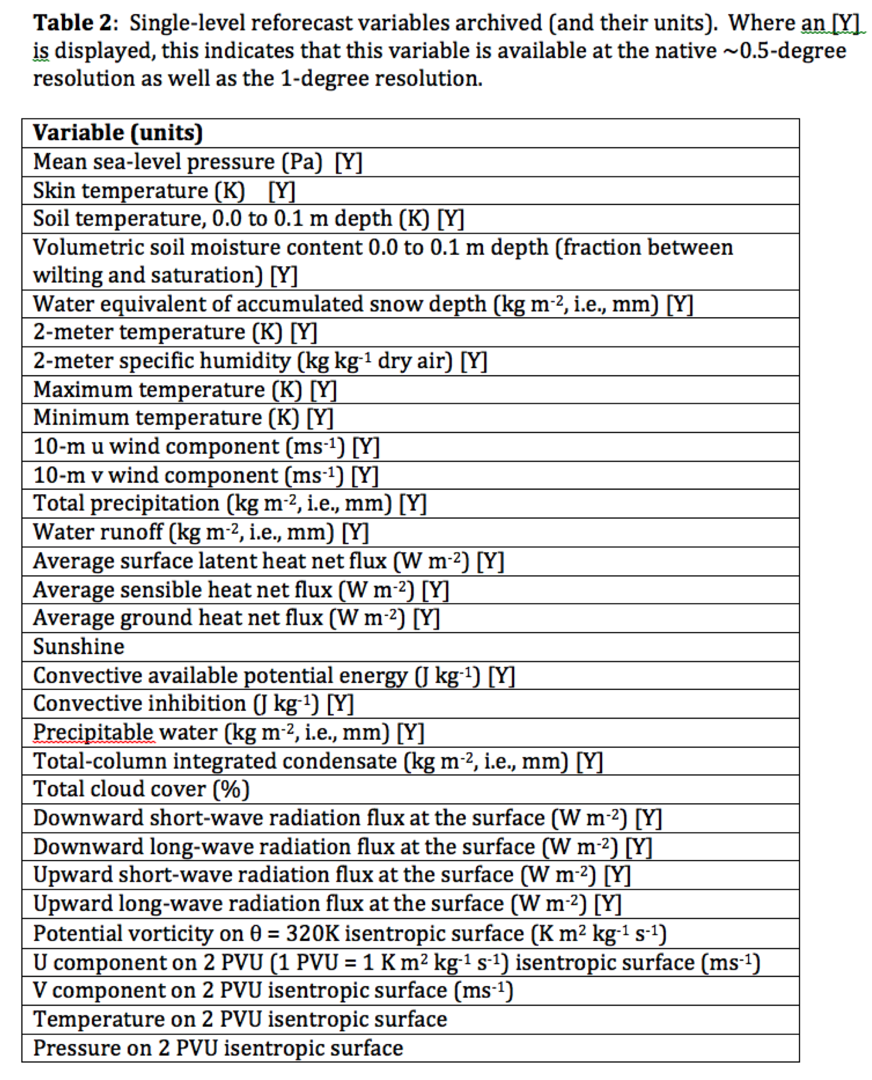
GEFS reforecast data readily available
Perhaps your company is interested in making solar-forecast products, too.

Slide 13
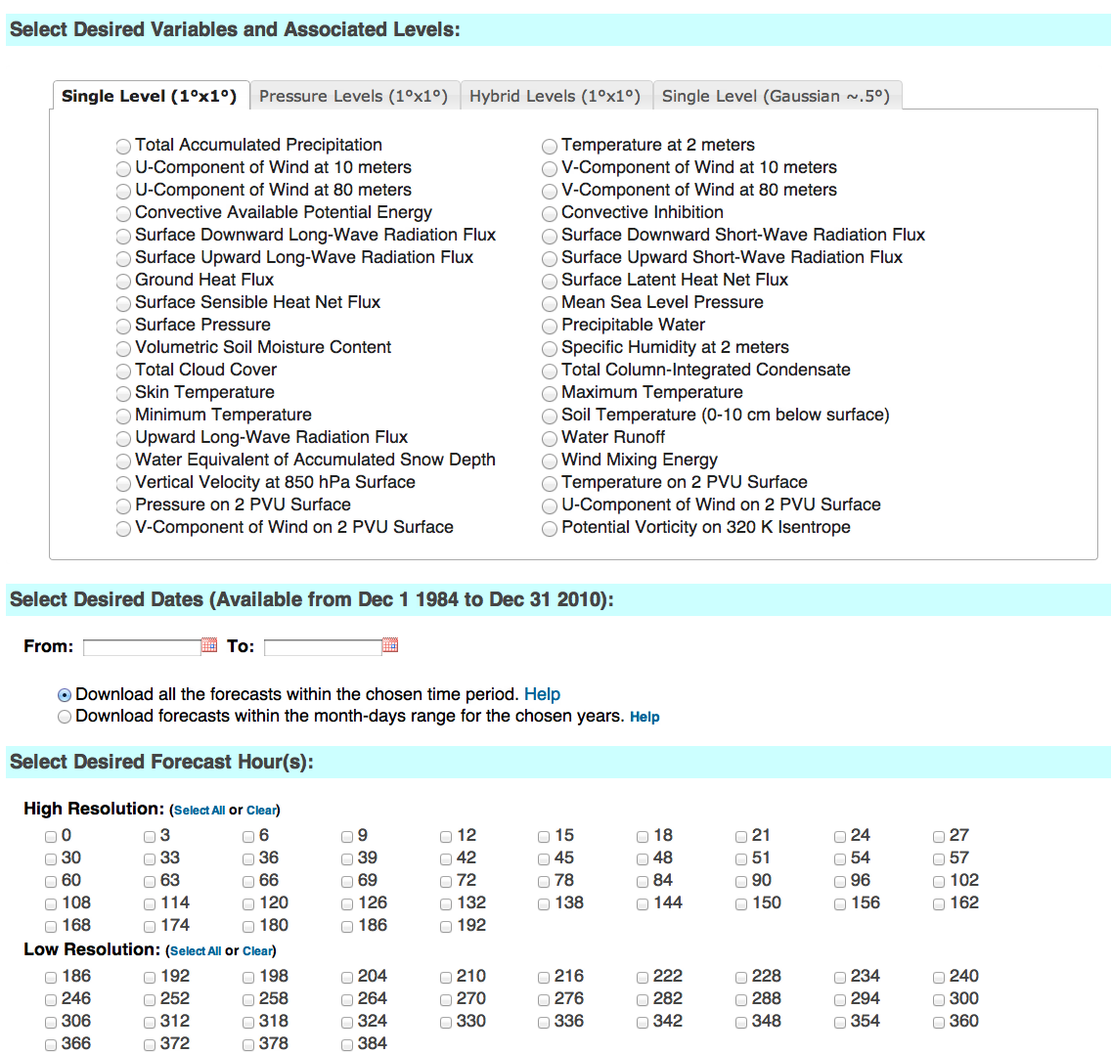
esrl.noaa.gov/psd/forecasts/reforecast2/download.html
Produces
netCDF files.
Also: direct
ftp access to
allow you to
read the raw
grib files.

Slide 14
Cartoon of reforecast-based “analog” approach to probabilistic post-processing of subcritical winds
Today
Wind speed
Forecast
Lead Time

Slide 15
Cartoon of reforecast-based “analog” approach to probabilistic post-processing of subcritical winds
Today
Wind speed
Forecast
Lead Time
(replicated)

Slide 16
Cartoon of reforecast-based “analog” approach to probabilistic post-processing of subcritical winds
Jan 23, 2009
Jan 13, 2010
Jan 31, 2013
Today
Feb 23, 2010
Mar 10, 2014
Mar 21, 2013
Wind speed
Forecast
Lead Time
Feb 09, 2012
Jan 19, 2014
Mar 04, 2014
Step 1: Identify
dates of the
past forecasts
with a similar
time series of
winds. - - -
Jan 28, 2011
Mar 16, 2012
Feb 21, 2014

Slide 17
Cartoon of reforecast-based “analog” approach to probabilistic post-processing of subcritical winds
Jan 23, 2009
Jan 13, 2010
Jan 31, 2013
Power
Power
Power
Today
Feb 23, 2010
Mar 10, 2014
Mar 21, 2013
Wind speed
Power
Power
Power
Forecast
Lead Time
Feb 09, 2012
Jan 19, 2014
Mar 04, 2014
Step 2: Retrieve
wind power
time series on
these dates.
___
Power
Power
Power
Jan 28, 2011
Mar 16, 2012
Feb 21, 2014
Power
Power
Power

Slide 18
Cartoon of reforecast-based “analog” approach to probabilistic post-processing of subcritical winds
Jan 23, 2009
Jan 13, 2010
Jan 31, 2013
Power
Power
Power
Today
Feb 23, 2010
Mar 10, 2014
Mar 21, 2013
Wind speed
Power
Power
Power
Forecast
Lead Time
Feb 09, 2012
Jan 19, 2014
Mar 04, 2014
Step 3: Apply
criteria for
power threshold,
duration.
___
Power
Power
Power
Jan 28, 2011
Mar 16, 2012
Feb 21, 2014
Power
Power
Power

Slide 19
Cartoon of reforecast based “analog” approach to probabilistic post-processing of subcritical winds
Jan 23, 2009
Jan 13, 2010
Jan 31, 2013
Power
Power
Power
Today
Feb 23, 2010
Mar 10, 2014
Mar 21, 2013
Wind speed
Power
Power
Power
Forecast
Lead Time
Feb 09, 2012
Jan 19, 2014
Mar 04, 2014
Step 3: Count
the number of
analogs meeting
these criteria.
Power
Power
Power
Jan 28, 2011
Mar 16, 2012
Feb 21, 2014
Power
Power
Power

Slide 20
Cartoon of reforecast-based “analog” approach to probabilistic post-processing of subcritical winds
Jan 23, 2009
Jan 13, 2010
Jan 31, 2013
Power
Power
Power
Today
Feb 23, 2010
Mar 10, 2014
Mar 21, 2013
Wind speed
Power
Power
Power
Forecast
Lead Time
Feb 09, 2012
Jan 19, 2014
Mar 04, 2014
Step 4: Make
probability
forecast from
relative frequency.
( here = 5 / 12 )
Power
Power
Power
Jan 28, 2011
Mar 16, 2012
Feb 21, 2014
Power
Power
Power

Slide 21
Evolution of NCEP’s ensemble forecast systems
Big picture, ~ 5-year time frame: NCEP “UCACN” review committee has recommended consolidation of suite of prediction systems. Should NCEP follow this, the consolidation will presumably permit:
  One regional prediction system, with ensemble aspects (possibly lagged forecasts) at very high resolution covering US and surrounding areas. Reforecasts? Unclear.
  One global ensemble prediction system, at greatly increased resolution. Eventually “non-hydrostatic.” Accompanied by some reforecasts.

Slide 22
More detail on future GEFS plans
April 2015: GEFS upgraded to use semi-Lagrangian advection as in deterministic GFS; T574 resolution (~ 27 km on linear Gaussian grid) till day +8, T382 resolution days +8 to +16. Initial perturbations ETR → EnKF. Minimal accompanying reforecast data set; exact details TBD.
  2012 version of GEFS (compatible with our reforecast) will be run as legacy system (00 UTC cycle only) for a year or possibly more.
~ 2016: Deciding soon on general configuration. Possibly greatly increased resolution (to > T1000?), upgraded model uncertainty parameterizations for improved reliability, and more extensive reforecasts. Recommended reforecast configuration discussed here.
  Possibility that SREF will be retired and products switched to GEFS.
Longer term:
  GEFS upgraded every ~2 years, accompanied by ~20-year reanalysis/reforecast.
  Extension of GEFS to +30 days to support intra-seasonal forecast applications.
  With Next-Generation Global Prediction System (NGGPS) support, an eventual replacement of the hydrostatic GEFS with a new community-supported non-hydrostatic dynamical core.

Slide 23
Shorter-range regional ensemble plans
A bit more up in the air, as the extent to which NCEP consolidates its dynamical cores will affect this. See some various visions for this from the 2014 NCEP Production Suite Review.

Slide 24
Conclusions
Wind energy can likely benefit statistical post-processing.
NOAA has aggressive plans for improving its ensemble prediction products in the next several years.
NCEP/EMC has committed to producing reforecast data regularly in the future, facilitating statistical post-processing applications.
NOAA will do its best to continue to make its reforecast data easily accessible and freely available.

Slide 25
Suggested reading list
Hamill, T. M., and R. Swinbank, 2015: Stochastic forcing, ensemble prediction systems, and TIGGE. Upcoming Book Chapter. Available here.
Hamill, T. M., G. T. Bates, J. S. Whitaker, D. R. Murray, M. Fiorino, T. J. Galarneau, Jr., Y. Zhu, and W. Lapenta, 2012: NOAA's second-generation global medium-range ensemble reforecast data set. Bull Amer. Meteor. Soc., 94, 1553-1565.
a review of issues and research
directions in ensemble prediction
a description of and motivation
for the reforecast data set.

