Slide 1
Guided discussion of
“The Plumbing of Land Surface Models: Benchmarking
Model Performance” by Martin Best et al.
J. Hydrometeorology, June 2015
(with some of my own benchmarking results)
Tom Hamill

Slide 2
Why should us ensemble types care about the land surface?
LSMs are an integral part of atmospheric prediction systems, predicting energy exchanges between surface and atmosphere.
  which are related to surface temperature changes and the location and timing of surface-related thunderstorms.
Forecasts are sensitively dependent to changes of land-state parameters and fields within the range of analysis uncertainty (next slides).
Possibly there is significant structural error in the formulation of LSMs, causing bias in the forecasts (the Best et al. article, review to follow).
  hence, we ensemblers need to (a) work with LSM experts to ameliorate, and/or (b) appropriately stochasticize (See Gary and Maria’s previous presentations)

Slide 3
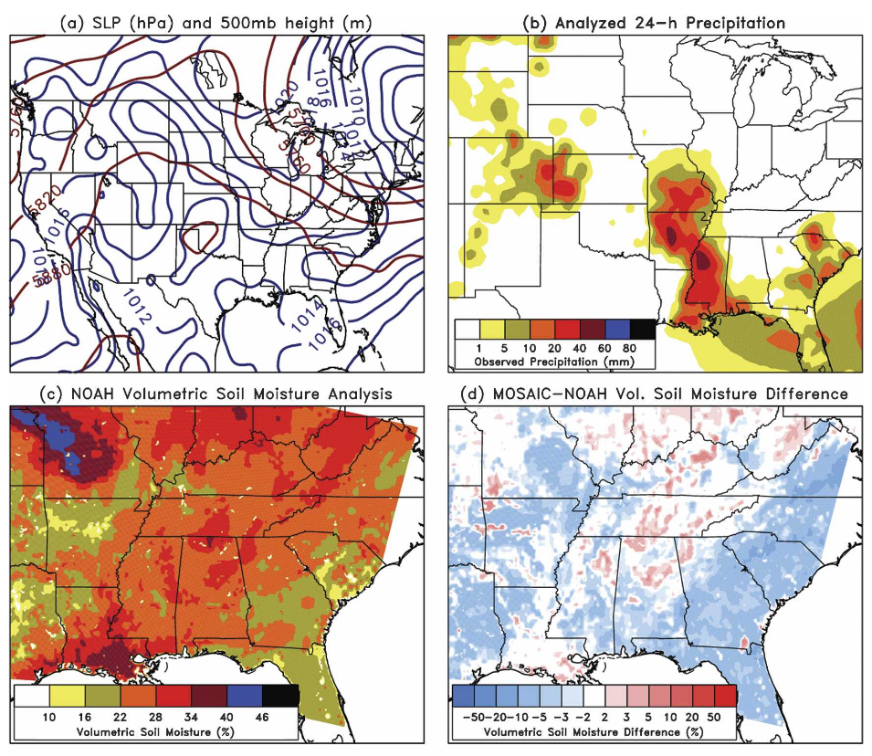
Results from Sutton et al. (2006)
WRF experiments at
20 km (parameterized
convection) and 5 km
(cloud permitting).
Initialized with either
NOAH (from NOAA) or
MOSAIC (from NASA)
soil moisture analyses.
ref: Sutton et al. 2006
MWR, here.

Slide 4
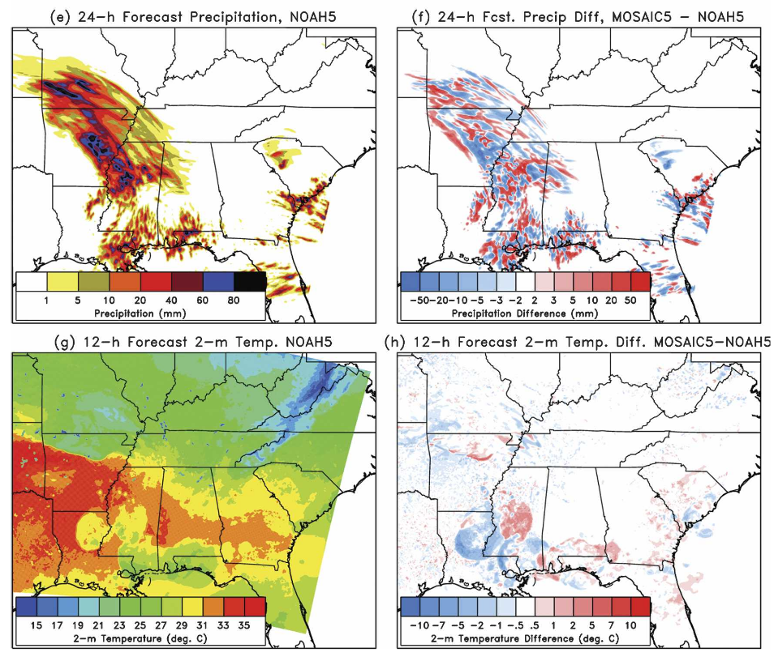
5-km WRF simulation differences
Perturbing the soil
moisture results
in differences in the
small-scale positions
of where convection
occurs, but not so
much the general
envelope of where it
occurs (i.e., it’s still
driven by larger-scale
atmospheric forcings).
Some surface
temperature
differences noted,
largely differences
due to different
cold-pool dynamics.

Slide 5
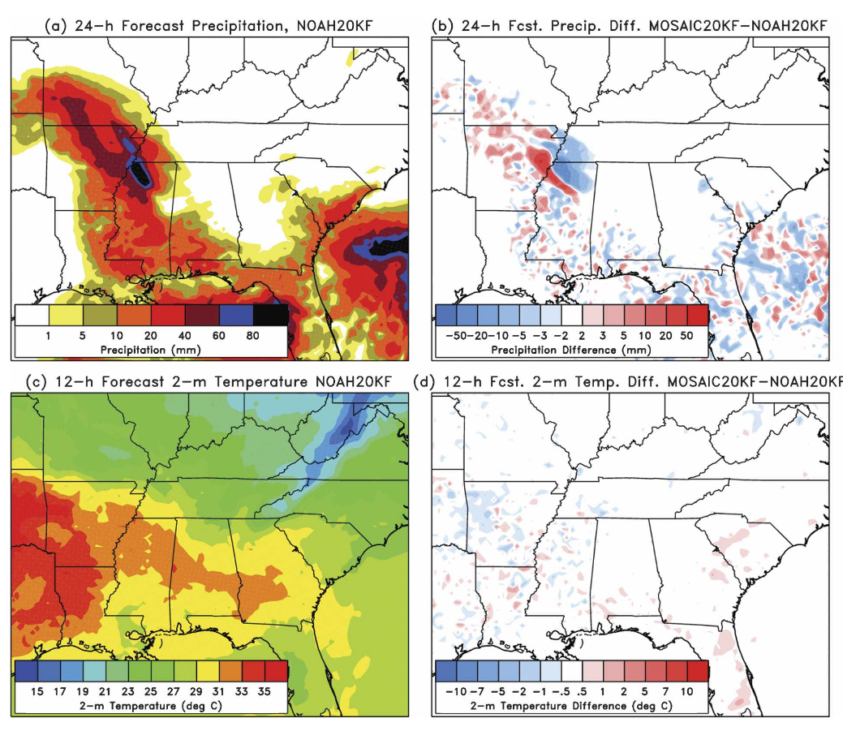
20-km WRF simulation differences
Still significant differences
in some aspects of the
precipitation forecasts with
parameterized deep
convection.
Less differences in aspects
of the surface temperature.

Slide 6
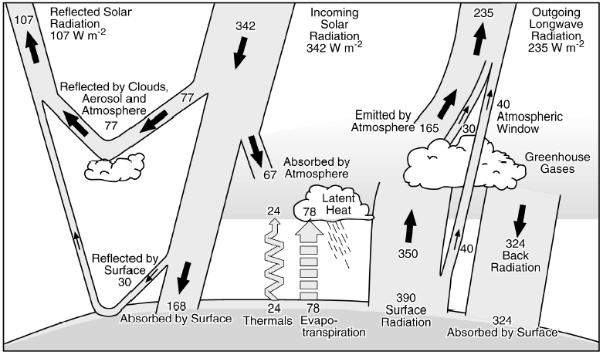
Why are NWP background forecasts of 2-m temperature sometimes biased?

Slide 7
Why are NWP background forecasts of 2-m temperature sometimes biased?
Clouds are very difficult to predict well in NWP models, often producing biased estimated of downward solar radiation.

Slide 8
Why are NWP background forecasts of 2-m temperature often biased?
Energy-balance problems: Partitioning into latent heat flux (evaporation), sensible heat flux (change in air temperature) and ground heat flux (soil temperature change) may depend critically on hard-to estimate variables and parameters such as soil moisture, roughness lengths, soil hydraulic conductivity, stomatal resistance.
Also possible structural errors in LSMs.

Slide 9

J Hydrometeorology

Slide 10
Abstract
The Protocol for the Analysis of Land Surface Models (PALS) Land Surface Model Benchmarking Evaluation Project (PLUMBER) was designed to be a land surface model (LSM) benchmarking intercomparison. Unlike the traditional methods of LSM evaluation or comparison, benchmarking uses a fundamentally different approach in that it sets expectations of performance in a range of metrics a priori—before model simulations are performed. This can lead to very different conclusions about LSM performance. For this study, both simple physically based models and empirical relationships were used as the benchmarks. Simulations were performed with 13 LSMs using atmospheric forcing for 20 sites, and then model performance relative to these benchmarks was examined. Results show that even for commonly used statistical metrics, the LSMs’ performance varies considerably when compared to the different benchmarks. All models outperform the simple physically based benchmarks, but for sensible heat flux the LSMs are themselves outperformed by an out-of-sample linear regression against downward shortwave radiation. While moisture information is clearly central to latent heat flux prediction, the LSMs are still outperformed by a three-variable nonlinear regression that uses instantaneous atmospheric humidity and temperature in addition to downward shortwave radiation. These results highlight the limitations of the prevailing paradigm of LSM evaluation that simply compares an LSM to observations and to other LSMs without a mechanism to objectively quantify the expectations of performance. The authors conclude that their results challenge the conceptual view of energy partitioning at the land surface.

Slide 11
“Evaluation” vs. “comparison” vs. “benchmarking”
Evaluation: model outputs compared to observations under a specified error metric. Metrics with errors deemed to be large are ID’ed for development.
Comparison: model outputs compared not just to observations but to guidance from other models. ID relative performance or ID common systematic errors.
Benchmarking: defining performance expectations a priori:
  better than another model (weak; what if both models poor?)
  fit for a particular application (achieves errors low enough to satisfy customer requirements)
  effectively utilizes available information (defines expectations based on the complexity of a model and the amount of information provided to it).

Slide 12
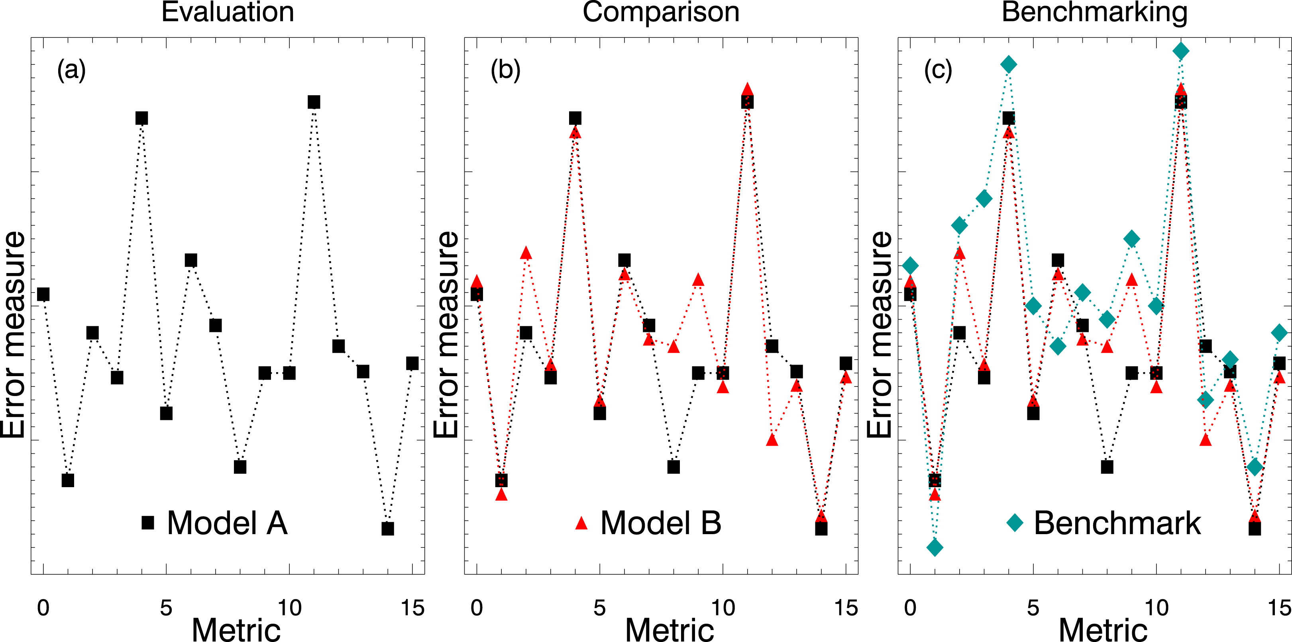
Fig. 1. Conceptual figure showing the performance of models through (a) evaluation, (b) comparison, and
(c) benchmarking. The x axis represents a series of metrics a modeler might use to evaluate the model, and the y axis
represents the normalized error from each metric used to assess model performance. The dotted lines are a visual guide
and have no scientific relevance.

Slide 13
For these metrics, the error is large. A model developer would try to understand why they might be large
and then target development resources to improve these aspects of the model.
Fig. 1. Conceptual figure showing the performance of models through (a) evaluation, (b) comparison, and
(c) benchmarking. The x axis represents a series of metrics a modeler might use to evaluate the model, and the y axis
represents the normalized error from each metric used to assess model performance. The dotted lines are a visual guide
and have no scientific relevance.

Slide 14
Comparison shows these high errors are common between the two models (which may suggest these are difficult to correct).
Fig. 1. Conceptual figure showing the performance of models through (a) evaluation, (b) comparison, and
(c) benchmarking. The x axis represents a series of metrics a modeler might use to evaluate the model, and the y axis
represents the normalized error from each metric used to assess model performance. The dotted lines are a visual guide
and have no scientific relevance.

Slide 15
Improvement to some aspects of model B appear possible, given relative performance of model A. Hints that one should examine differences in the models that may be related to the performance for these metrics.
Fig. 1. Conceptual figure showing the performance of models through (a) evaluation, (b) comparison, and
(c) benchmarking. The x axis represents a series of metrics a modeler might use to evaluate the model, and the y axis
represents the normalized error from each metric used to assess model performance. The dotted lines are a visual guide
and have no scientific relevance.

Slide 16
Model A fails to meet the benchmark, while model B succeeds. If you really cared about this metric to the exclusion of all others, it would suggest either using model B or improving model A, which is obviously deficient in this respect.
Fig. 1. Conceptual figure showing the performance of models through (a) evaluation, (b) comparison, and
(c) benchmarking. The x axis represents a series of metrics a modeler might use to evaluate the model, and the y axis
represents the normalized error from each metric used to assess model performance. The dotted lines are a visual guide
and have no scientific relevance.

Slide 17
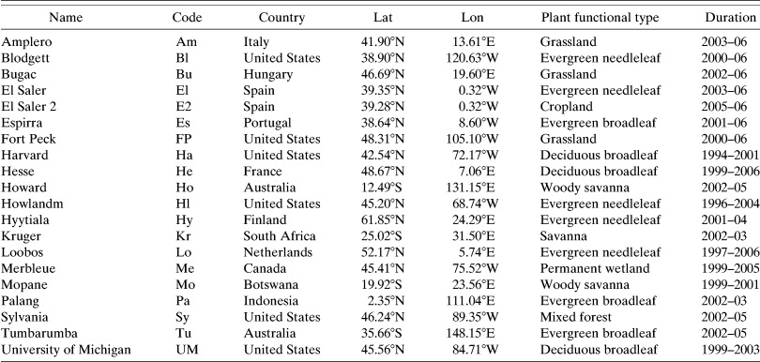
FLUXNET site information

Slide 18
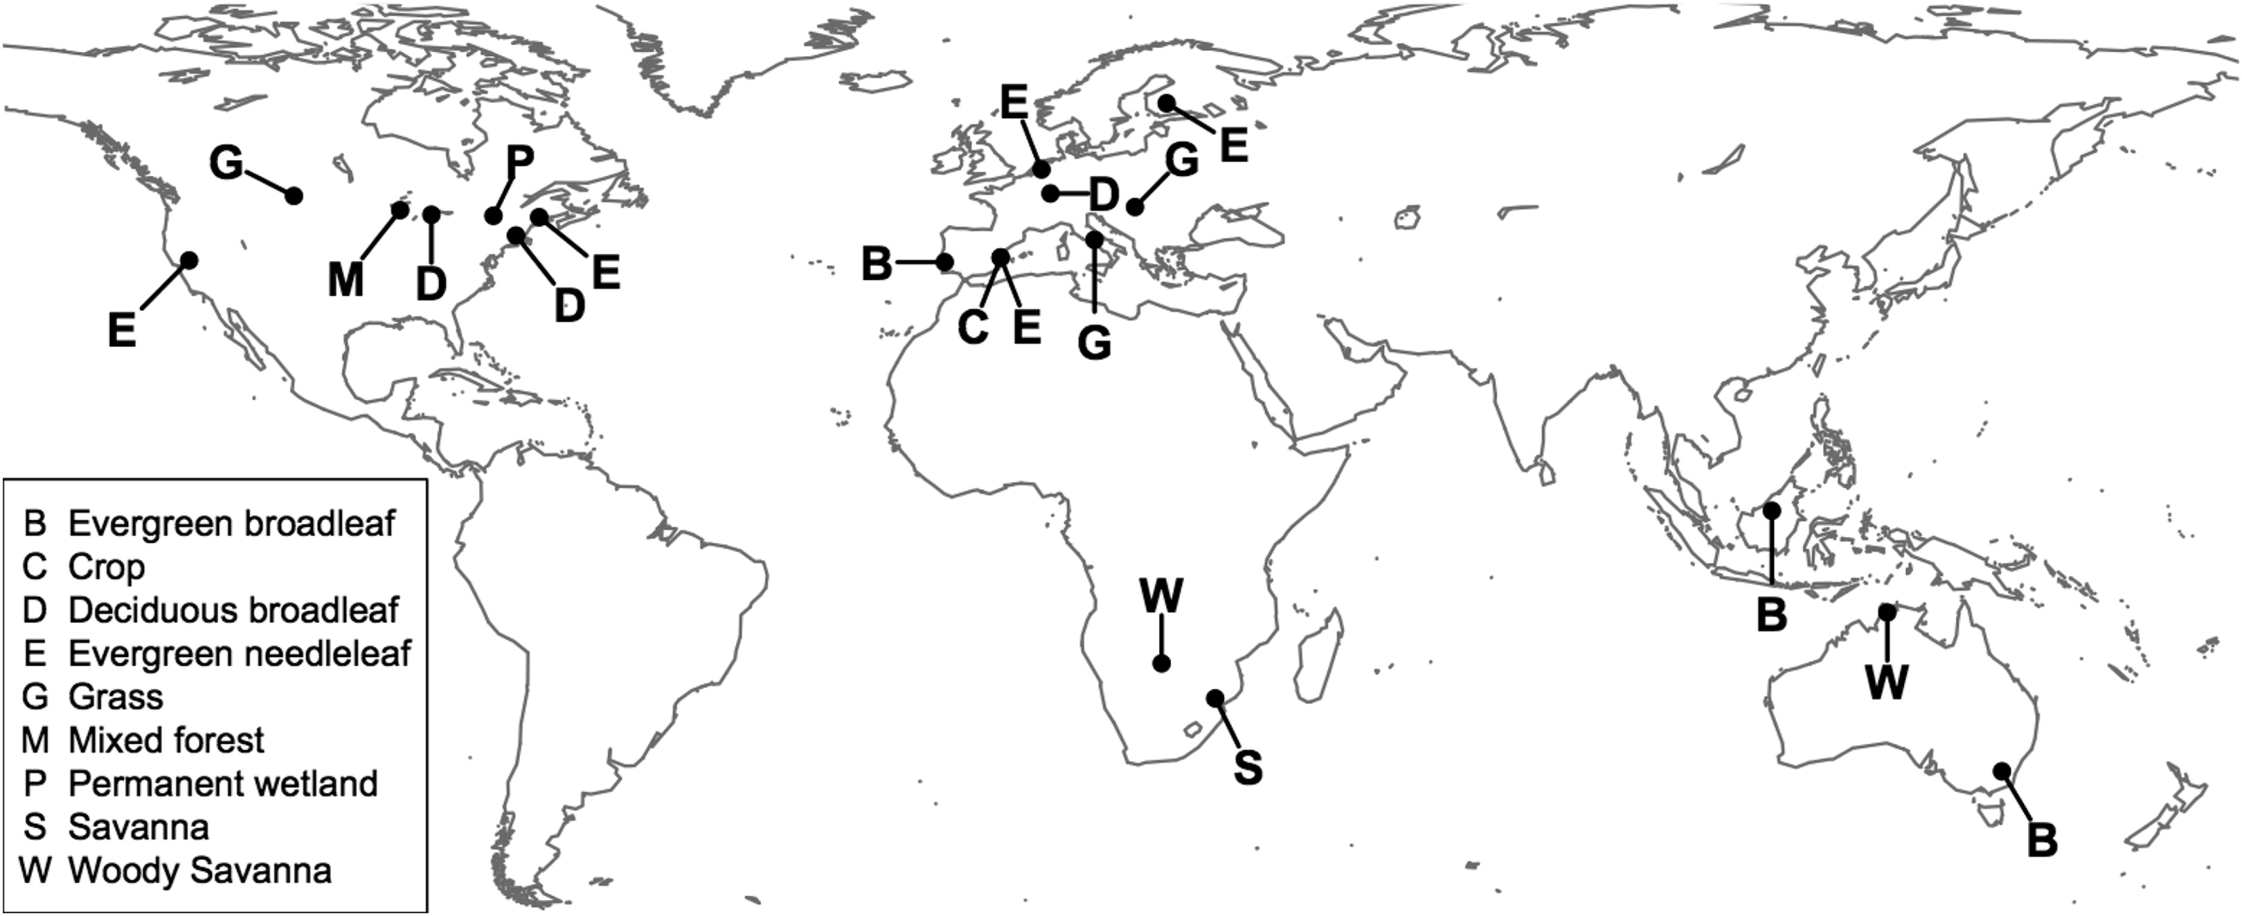
Map of FLUXNET sites
many of the sites do not have long-term energy balance closure, which could affect results
somewhat (though newer research suggests this is not at the heart of the problem).

Slide 19
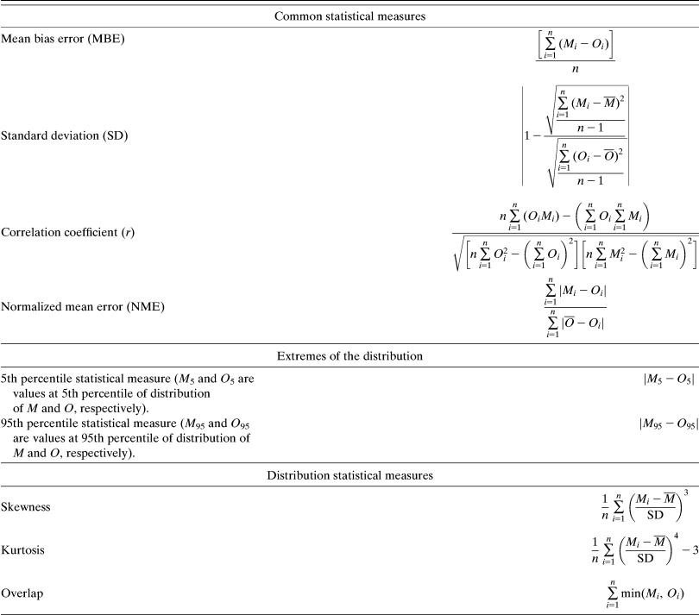
Statistical metrics
M = model values
O = observed values

Slide 20
Physical benchmarks
Manabe (1969) “M69” bucket model: moisture represented by simple bucked filled by infiltration into soil, emptied by evapotranspiration. Model tends to evaporate too quickly b/c of lack of appropriate surface resistances. Used b/c physically based LSMs ought to beat this model.
“PM” (Penman-Monteith): approximates Q_{E} (latent heat flux), requiring as input temperature, wind speed, RH, and solar radiation. Assumes standard reference crop, irrigated so never water stressed; hence no requirement to model soil moisture (a limitation). Ground heat flux specified, sensible determined from energy balance.
Both PM and M69 here assume surface exchange turbulence modeled with reference grass surface, and albedo set to 0.2 for all sites.

Slide 21
Empirical benchmarks (i.e., statistical models)
EMP1lin: linear regression of Q_{E} (latent) and Q_{H} (sensible) against incoming solar radiation SWdown.
EMP2lin: multiple linear regression of Q_{E} and Q_{H} against SWdown and near-surface air temperature T_{a}.
EMP3KM27: nonlinear regression against SWdown, T_{a}, and near-surface relative humidity R_{H}. Uses k-means clustering (next page) approach to create 27 different sub-domains of the SWdown-Ta-RH domain and then performs a multiple linear regression between Q_{E}, Q_{H}, and the three meteorological variables. This delivers a non-linear (piecewise linear) response to the three forcing variables.
All are out-of-sample, i.e., site X is trained with data from other sites but not X.
All benchmarks represent instantaneous predictions to a subset of an LSM’s meteorological
forcing. No internal state variables, no memory of past soil moisture, soil temperature,
vegetation, or soil properties. Empirical benchmarks not constrained by surface energy
balance.

Slide 22
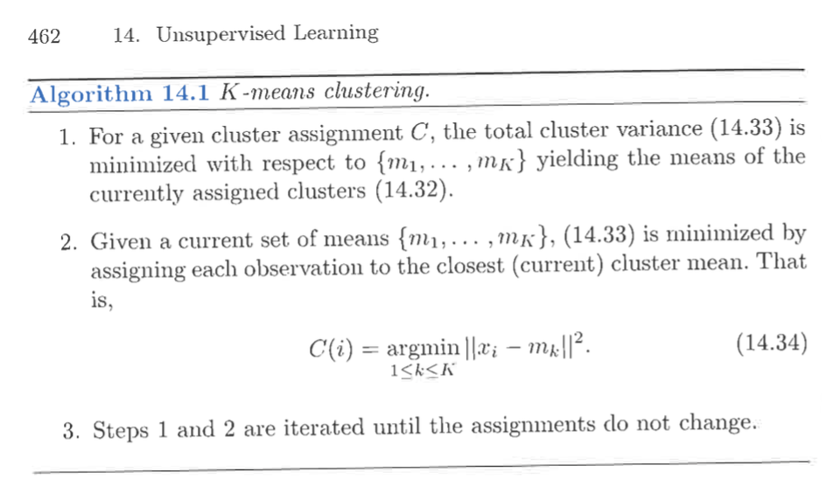
k-means clustering
adjust means of
clusters.
adjust assignment
of points to each
cluster based
on physical distance.
iterate till no change.
From Hastie, Tibshirani, and Friedman, 2001: The Elements of Statistical Learning.

Slide 23
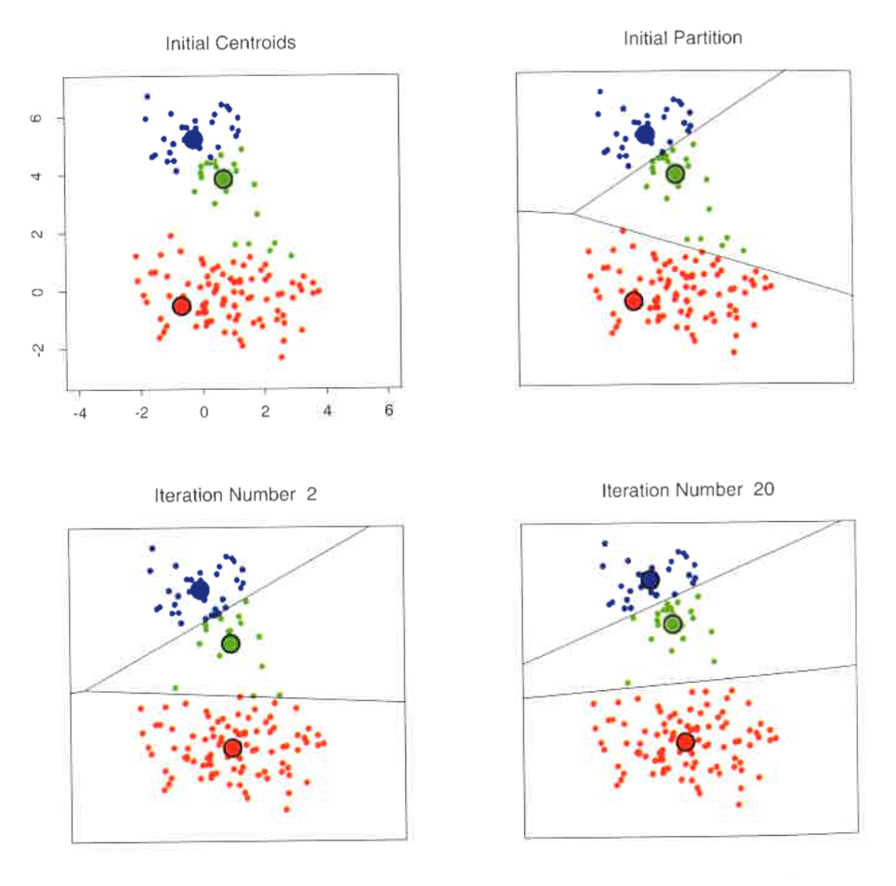
k-means clustering example
Ref:
ibid

Slide 24
Results
Statistics for all of the LSMs and all of the physical and empirical benchmarks are determined.
Each LSM is ranked relative to all of the benchmarks, with best performing sample element given a score of 1 and worst given a score of 6.
Rankings are averaged over all statistics and all sites.

Slide 25
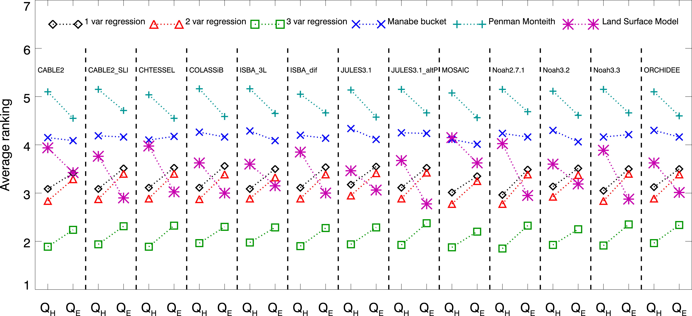
PLUMBER results
Q_{E} latent
Q_{H} sensible heat
Ranking of benchmarks and each model for the standard statistics (MBE, NME, SD, r) across all 20 sites.
(1) LSMs usually better than physical benchmarks Manabe bucket and Penman-Monteith.
(2) LSMs competitive with 1-variable and 2-variable regressions.
(3) LSMs usually inferior to the 3-variable regression benchmark.
(4) LSMs actually more competitive with 3-variable regression for latent than for sensible.

Slide 26
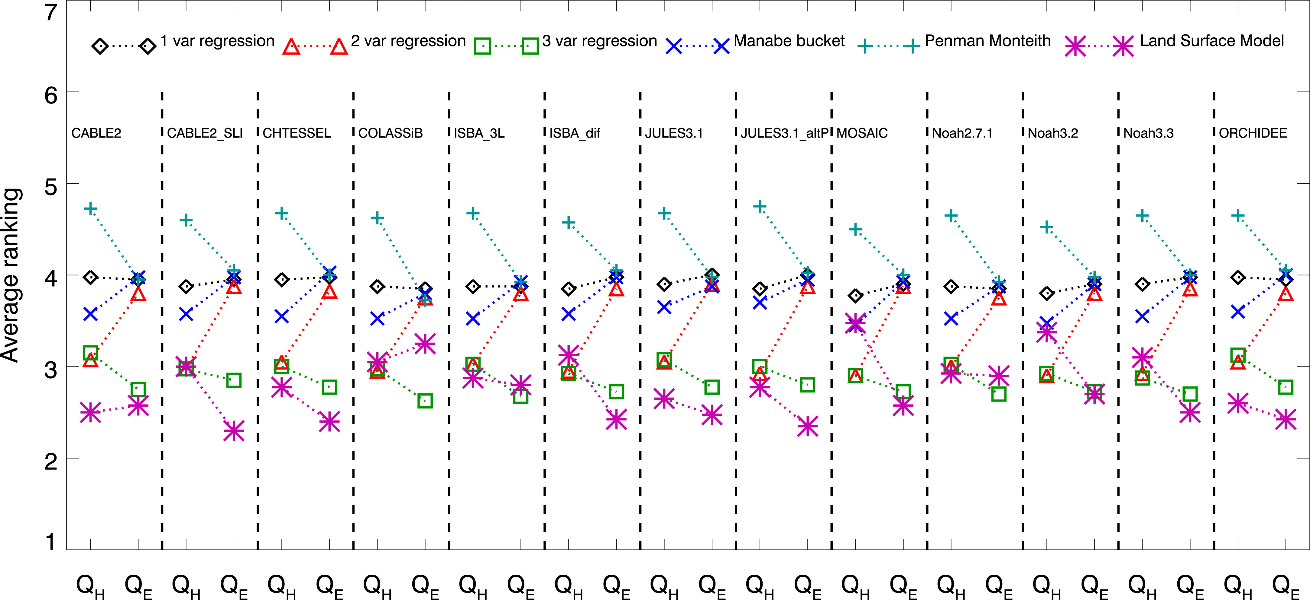
5th and 95th percentiles
LSMs now on par with 3-variable regression. Why? Empirical benchmark acts as a smoother,
so one wouldn’t expect them to be good at predicting the extremes (next slide).
Still an indication that the LSMs are generally better at predicting latent relative to sensible
heat fluxes, despite comparative conceptual simplicity of predicting sensible.

Slide 27
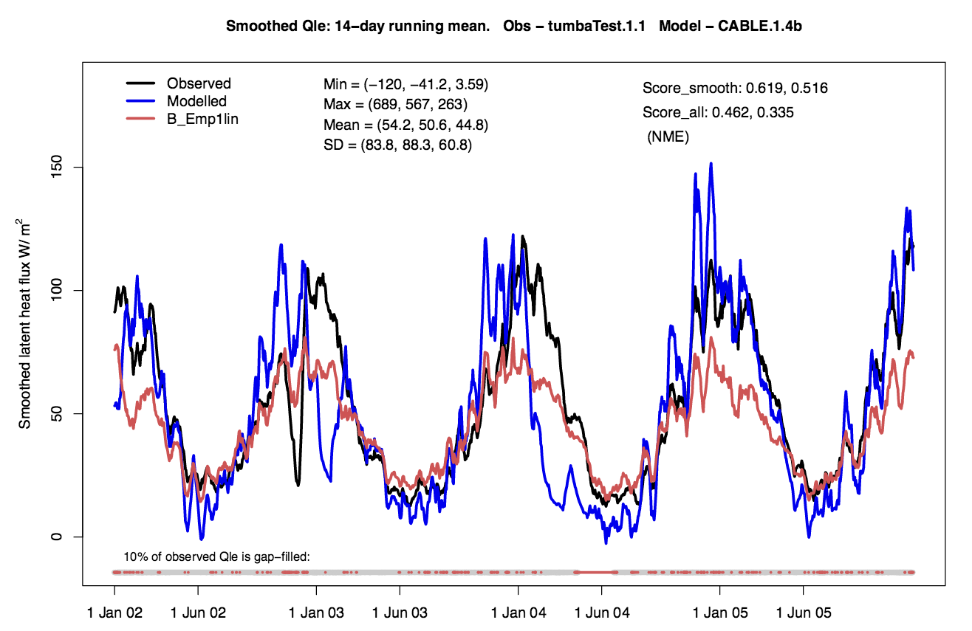
Illustration of smoothing nature of empirical benchmark
Ref: Abramowitz 2012, doi:10.5194/gmd-5-819-2012

Slide 28
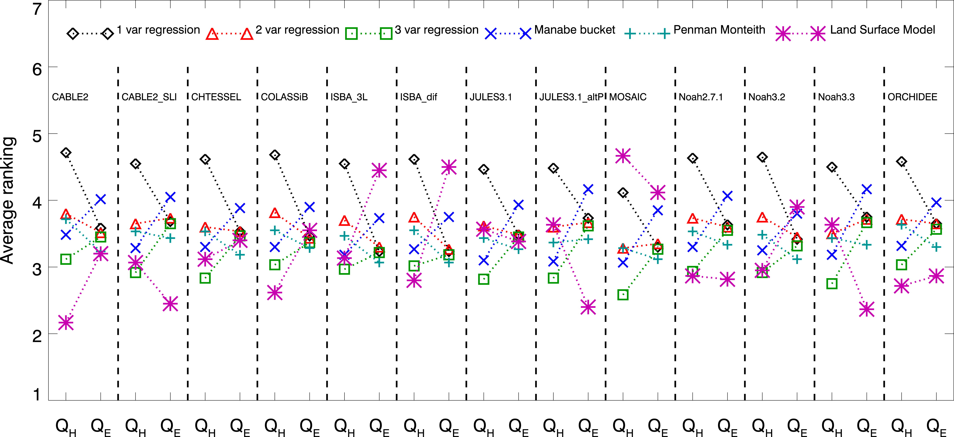
Skewness, kurtosis, overlap.
Again, these statistics reflect the ability of the models to predict the extremes, and the
LSMs are better than or competitive with 3-variable regression benchmark.

Slide 29
Best et al.’s discussion
Benchmarking is :
  a useful way to tell you if any of the models is any good, in a way that evaluation and comparison cannot.
  could and should be extended to other LSM aspects, such as soil moisture, and tested in specific phenomena such as droughts.
There is significant scope for improvement of LSMs without the need for more parameter or time-varying input data.
There is more information content in the atmospheric forcing data to determine the Q_{H} and Q_{E} than is currently used by LSMs.
Given the performance of benchmarks (using RH), there may be more information in the instantaneous RH than the memory from soil moisture (or that inappropriate soil moistures are hindering prediction).
  suggests our understanding of how soil moisture influences evaporation may not be correct.
  in situations where we may expect soil moisture to have a dominant control on stomata and hence Q_{E}, the LSMs tend to be worse.

Slide 30
Best et al: challenging conceptual view of energy partition at surface
Traditional: given amount of available energy set by radiative processes, the role of surface energy balance is largely to partition between Q_{H} and Q_{E}.
Hypothesized: Benchmarking suggests sufficient information in SWdown to determine Q_{H}, and thus perhaps role of surface energy balance is to redistribute the remaining energy between Q_{E} and soil heat flux.
  the assumption that radiative, turbulent, and soil fluxes share the same physical surface temperature may need to be reconsidered.

Slide 31
Some thoughts re: ensembles.
Complexity of modern LSMs leads to sensitive dependence on poorly constrained model parameters?
  perhaps LSM physics are more appropriate if every database is perfect, but they can be highly imperfect if database inaccurate.
Not only are fluxes sub-optimal, but surface temperatures / humidities are biased, and they are very important for NWP.
  affect timing and intensity of deep convection.
  surface temperatures are one of the most important forecast variables for customers.
  if surface temperature forecasts are poor, in the absence of new observations, the surface analyses will be poor (see subsequent slides).
So …. what are the potential pitfalls of adopting a regression model approach as a surrogate for a full LSM?
  a potential benefit: for reanalyses, wouldn’t need to cycle the LDAS, which in turn requires that reanalyses be produced sequentially rather than parallel. Speed up generation of reanalyses.
  regression models come with error estimates, and these could be used to provide stochasticity.

Slide 32
My own benchmarking
(of 1-h surface temperature forecasts)
[motivated by a desire to improve upon RTMA]

Slide 33
Time series of observed temperatures and deviations at Albany, NY
Last hour’s temperature
deviation from climatology
is frequently a decent first guess approximation for
this hour’s temperature
deviation (and thus temperature, by adding
back climatology).

Slide 34
Climatology for Albany NY, 00 UTC
Red line denotes climatology from cubic-spline fit, 8 knots.

Slide 35
Albany, NY climatological diurnal cycle
No surprises, climatological temperatures generally warmest at 18, 21 UTC.

Slide 36
Proposed statistical model to generate first guess (at stations)
T’(forecast next hour) =
  T’(analyzed this hour) +
  b₁*(analyzed cloud cover) +
  b₂*(soil moisture) + … +
  b_{n-1}*(850 hPa vertical velocity)
  b_{n}*(forecast 925 hPa temperature change)
T’ is the deviation from the climatological mean
for this time of day, day of year.

Slide 37
Procedures
Observation data: surface observations over US (data from NCAR DS 472.0, 2004-2013).
  For this study, use only stations with > 97% data availability (1352 stations, 1118 in CONUS).
Forecasts for extra predictors: from GEFS reforecast data set (Hamill et al., BAMS, 2013)
Determine hourly, daily climatology at each station.
  Cubic spline; 8 knots across year, cross-validated by year.
T → T’ : express temperature time series as deviations from climatology.
Explore potential predictors for T’(next hour) at surface stations first
Later: consider how to make a gridded background from these.

Slide 38
Proposed statistical model to generate first guess
T’(forecast next hour) =
  T’(analyzed this hour) +
  b₁*(analyzed cloud cover) +
  b₂*(soil moisture) + … +
  b_{n-1}*(850 hPa vertical velocity)
  b_{n}*(forecast 925 hPa temperature change)
Let’s start by examining how well
this simpler model performs.

Slide 39
How does last hour’s temperature deviation from climatology predict this hour’s temperature deviation?
Pretty well, with less predictive skill around sunrise and sunset. No apparent bias.
Note: a small amount of noise is added to the measurements to aid in interpretation
given the discrete values of observed temperature (rounded to nearest °F).

Slide 40
How does last hour’s temperature deviation from climatology predict this hour’s temperature deviation?
Pretty well in summertime also.

Slide 41
How does last hour’s temperature deviation from climatology predict this hour’s temperature deviation?
More errors with ABQ in summertime, but still not huge errors.

Slide 42
RMSE’s across CONUS, July 00 UTC
gridded analysis generated with successive corrections technique, akin to Kriging.

Slide 43
Comparison vs. RTMA
RTMA results taken from de Pondeca et al., W&F, Oct 2011.
With no other extra predictors, and no cycling of data assimilation, persistence of deviation from climatology is clearly lower error than RTMA at stations.
Recently RTMA switched from RAP model to HRRR background, but this is unlikely to account for all the error difference.

Slide 44
Better yet? Proposed statistical model
T’(forecast next hour) =
  T’(analyzed this hour) +
  b₁*(analyzed cloud cover) +
  b₂*(soil moisture) + … +
  b_{n-1}*(850 hPa forecast vertical velocity)
  b_{n}*(forecast 925 hPa temperature change)
Will there be any additional reduction in
error from including such predictors?

Slide 45
First-guess errors at stations after ridge regression
Ridge regression penalizes
large predictor coefficients,
as may happen with strongly
co-linear forecasts.
A small but noticeable further reduction of errors using predictors suggested in previous slides. Half the error of RTMA at stations!
Results are not cross validated, but for a few selected stations,
this appeared to have a negligible effect given the large
training sample size (> 900).

Slide 46
Tentative conclusions regarding Best et al.
Worth thinking through whether simple regression models might be worth testing in GEFS as a replacement for LSMs.
Potential advantages:
  simple.
  generally unbiased.
  no dependence (as of yet) on precipitation analyses (difficult to obtain).
  can incorporate stochasticity.
  parallelizable, for reanalyses.
Potential disadvantages:
  FLUXNET sites probably don’t span full range of land-surface conditions, and we need to model every location, land/ice/partial snow/partial lakes, etc.. Hence regression equations may not be universally valid, only representative if grid point has land-surface characteristics in the span of the training data.
  Not getting right answer for right reason; what’s the improvement path with a regression model?

Slide 47
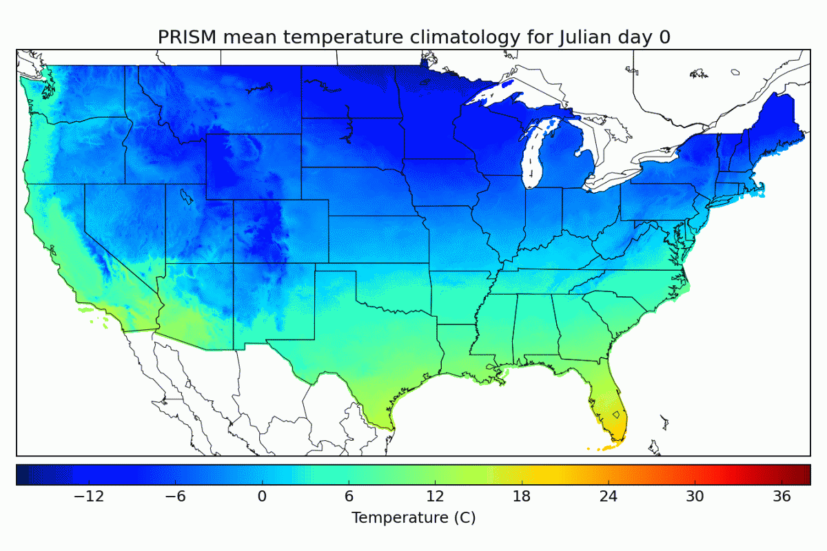
PRISM yearly cycle of daily mean temperature
Here, a loop of spline-fitted daily temperature data based on PRISM monthly data.
Much of spatial variations in temperature can be explained by the spatially varying climatology.

Slide 48
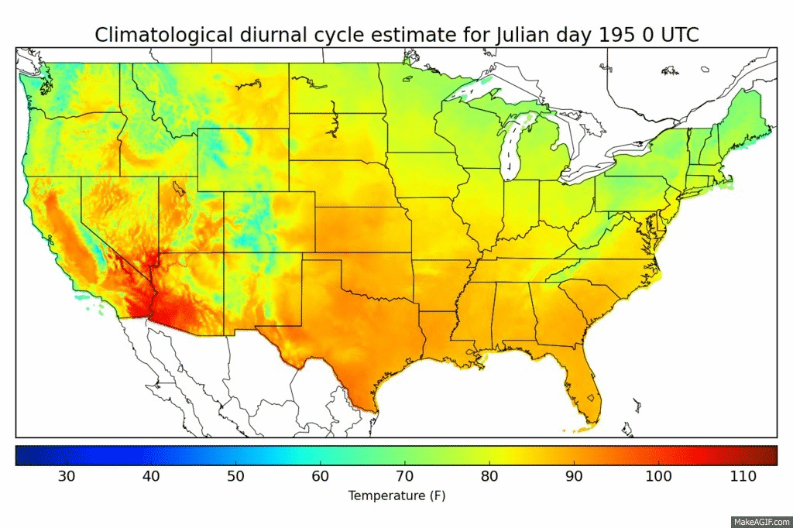
PRISM-based estimate of daily diurnal cycle for July 14
Based on PRISM max and min climatology together with diurnal cycle information
at stations spatially analyzed to a grid. The climatological diurnal cycle also
explains a lot of the temperature variation.

