Slide 1

The US National Blend of Models
POP12 algorithm: new best-member dressing with Gamma-distributed noise.
Tom Hamill, ESRL Physical Sciences Division
tom.hamill@noaa.gov +1 (303) 497-3060
(with tremendous help by Eric Engle, MDL, in generating data, and Michael Scheuerer (CIRES) for science discussion)
Presentation at AMS Annual 2017, Seattle

Slide 2
Reliability and skill of raw MME over CONUS for
24, 72, 120, 168-h lead times, April-June 2016.
Raw multi-model ensemble
Probabilities derived directly from global MME forecasts are quite unreliable, here verified against the 1/8-degree precipitation analysis (“CCPA”). Some unreliability is due to model bias (and coarse resolution), some is due to under-spread ensembles.
So we want to statistically post-process, i.e., adjust current forecast using information on differences between past forecasts and observations. Likely biases in more than just first moment of distribution.

Slide 3
The challenge: reliable, skillful POPs with high spatial detail from coarse-resolution global MMEs
How does the unreliability and low skill in the previous slide manifest itself? In this case, broad areas of desert regions in the MME with unrealistically high probabilities of precipitation, not much geographically related detail such as accentuation of precipitation along Sierra Nevada mountain range in CA.
NWS forecasters want an MME POP with skill, reliability, realistic geographic detail for initializing their national, gridded POP forecasts (“National Blend of Models” project).

Slide 4
Teaser: here’s a sample of the post-processed POP
Many of the problems
have been dealt with;
terrain-related detail added, high POPs in southwest US diminished.
How? That’s the subject today.

Slide 5
How do we get around the problem of a lack of training data?
Say you want to statistically post-process your model precipitation forecast to improve it. Training only with data at this particular point, we don’t have enough information to make a statistically meaningful correction to the most recent forecast.

Slide 6
Pool training data in the surrounding region?
Biases can be related to geographic location.
Illustration of how two nearby locations can have very different conditional systematic
bias.
CDFs here were built from more than a decade of daily reforecasts from the NCEP GEFS system (Hamill et al., BAMS, 2013).
Naïve pooling of training data
together across wide regions
will be harmful in some areas
like western US.

Slide 7
The technological solutions we put in place to correct MME POPs with little training data.
Post-process using last 60 days of NCEP and CMC MME forecasts and higher-resolution (1/8-degree) “CCPA” precipitation analyses.
Utilize “supplemental locations” to enlarge the training sample size while retaining geographic detail of bias. Unique supplemental locations were defined for each grid point, each month.
Quantile mapping to adjust for errors in the mean precipitation amount.
  CDFs of forecast, analyzed built from last 60 days, with supplemental locations.
  Expand quantile-mapped ensemble size nine-fold by using mapping forecasts at neighboring points.
Estimate POPs using “best-member dressing” of each member (following Fortin et al. 2006) to deal with remaining over-confidence:
  Integrate probabilities of weighted, dressed members.
  Weights reflect the likelihood this sorted member is closest to the analyzed.
Spatial smoothing of the POP forecast, with more smoothing in geographically flat regions and just outside CONUS borders.

Slide 8
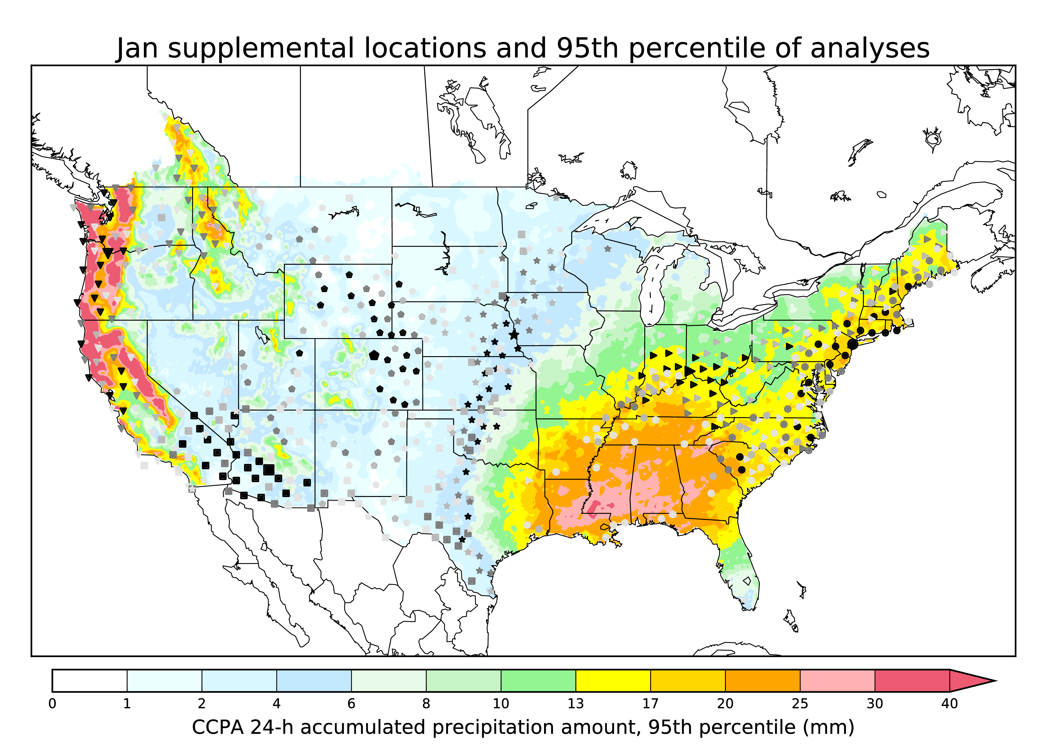
Enlarging training sample size with supplemental locations.
Large symbol = where we are defining the supplemental locations.
Small symbol = supplemental locations, chosen for similarity of precipitation climatology, terrain aspect and height.
Darkness of the symbol indicates the penalty function (lighter symbols are a poorer fit).
While only a few locations are shown, this procedure was used to define supplemental locations for every 1/8-degree grid point across the CONUS.
These were then used to populate the CDFs used in the later quantile mapping step.
See Appendix A of this for more: Hamill, T. M., E. Engle, D. Myrick, M. Peroutka, C. Finan, and M. Scheuerer, 2016: The US National Blend of Models statistical post-processing of probability of precipitation and deterministic precipitation amount. Mon. Wea. Rev., conditionally accepted. Appendix A and Appendix B.

Slide 9
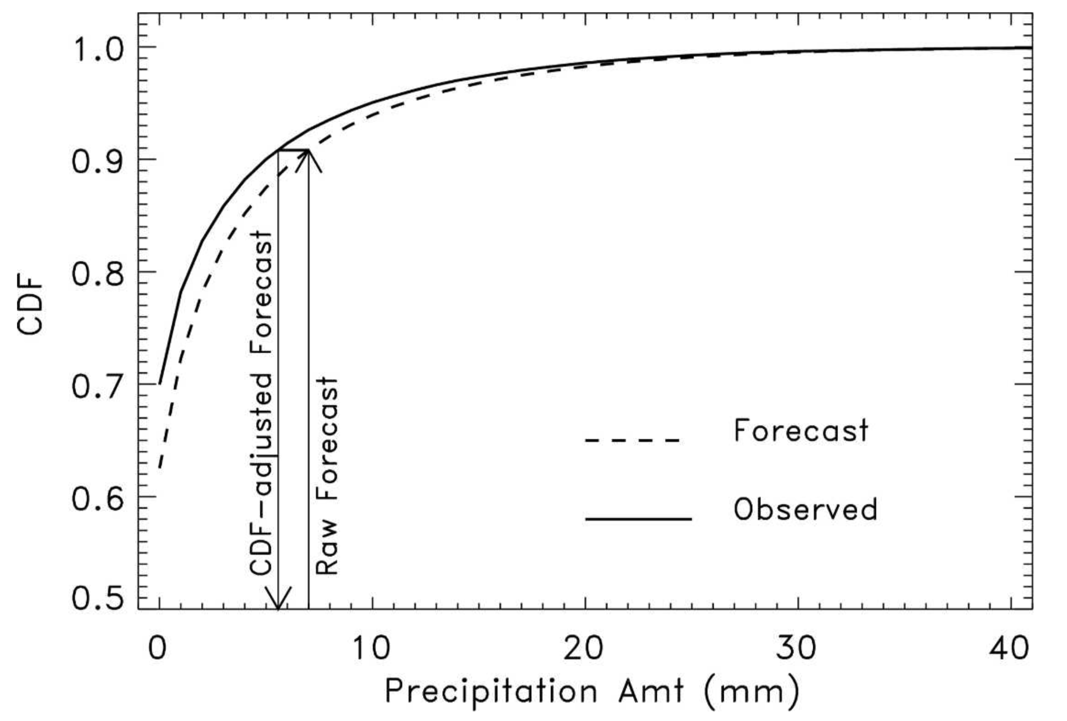
Quantile mapping.
Replace the forecast value with the observed value associated with the same cumulative percentile of the distribution.
This procedure is repeated independently for each ensemble member. Different forecast CDFs are permitted for different members in CMC ensemble.

Slide 10
Why quantile mapping to adjust for conditional bias?
Regression will not preserve diversity of adjusted ensemble at long leads; all members regress toward mean, resulting in loss of more spread.
Non-linear mapping relationships preferable to linear regression.

Slide 11
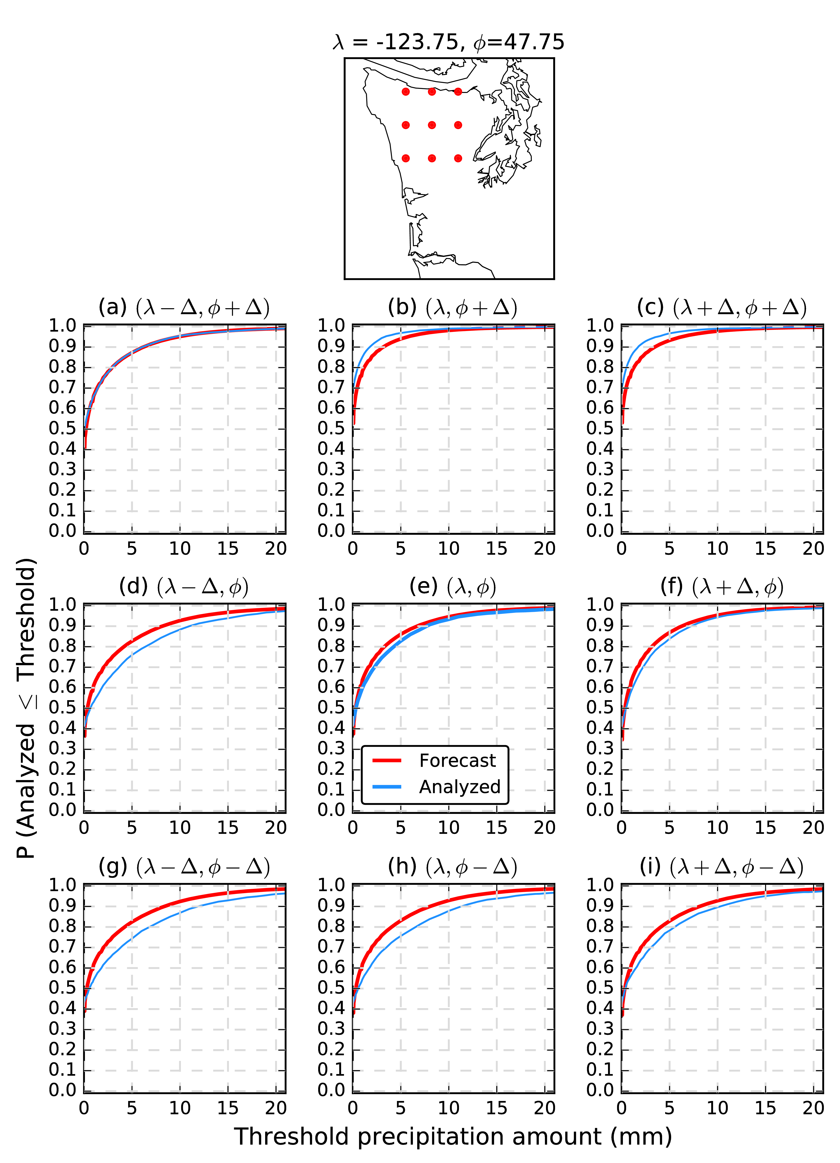
Enlarging ensemble size and dealing with overconfidence in precipitation location: quantile mapping using surrounding points.
We seek an enlarged, quantile-mapped ensemble at the center point,
and a way of implicitly accounting for over-confidence of ensemble
prediction systems in the spatial location of precipitation features.
Forecasts at the 3 x 3 array of points are all quantile mapped to central grid point. The trick here is to use the forecast CDFs unique to each of the 3x3 array of points (red curves) but the CDF for the central point.
In this way, ensemble forecasts are all adjusted such that they are consistent with the analyzed climatology at the center point.
This process is repeated independently for each model grid point in the CONUS.
Inspired by Michael Scheuerer; see Scheuerer and Hamill (2015) MWR.

Slide 12
“Best-member” dressing
Dressing: replacing ensemble member by associated pdf of expected errors given this forecast is the best member. Generally enlarges the spread. Dressing statistics are based on errors of prior forecasts.
  Different dressing distributions estimated here, depending on the member’s quantile-mapped precipitation amount (and forecast lead time). Differently shaped distributions of noise to low precipitation values vs. high precipitation values (see following slides).
  Provide a different weight to each dressed member based on probability it is the best member.
  Different than BMA in many respects.
See supplementary slides for my theoretical justification; see also Fortin et al. QJRMS, 2006, 132, 1349-1369.

Slide 13
Synthetic example estimating POP using dressing distributions.
Assume dressing distribution modeled with point probability mass at zero and a pdf of nonzero precipitation
Probability of exceeding POP threshold (= 0.254 mm) = 1.0 – probability of non-exceedance.
Say we have a 3-member ensemble, already quantile mapped, and with the dressing distributions for each member, M1, M2, M3, and the probability a sorted member is closest.
Closest-
member
probability
Then the probability of non-exceedance
P_{ne} can be estimated numerically:
P_{ne} = 0.5 × 0.5 + 0.1 × 0.3 + 0.02 × 0.2 +
0.5 × (1.0 - 0.5) × P(M1 < T) +
0.3 × (1.0 - 0.1) × P(M2 < T) +
0.2 × (1.0 - 0.02) × P(M3 < T)
M3
Probability of zero
M1
0.50
0.50
0.30
0.20
0.1
M2
0.02
probability density
POP
threshold
precipitation amount
and finally, POP = 1. – P_{ne}

Slide 14
Under-spread,
over-confident characteristic of ensemble forecasts is more pronounced at shorter leads.
Such statistics are suggestive that the best member of the sorted ensemble is more likely to be the lowest member than an intermediate member.
Histogram shape depend on precipitation amount? See supplementary slides.
Simplification here: dressing uses only center point in 3x3 array.

Slide 15
Fitted parameter values of dressing distribution.
We assume the dressing distribution has three parameters: fraction with zero precipitation, and Gamma shape (α) and spread (β).
Values for these fitted parameters shown at right. They vary with precipitation amount and forecast lead time.
The values do not vary geographically, a simplification that assumes regional biases were eliminated in the previous quantile mapping step.
Also, dressing stats determined with center point in 3x3 array of quantile-mapped values. Likely over-estimates the spread in the dressing distribution.

Slide 16
Some sample fitted distributions.
The idea here is as follows, then:
for a deterministically quantile-
mapped member with a precipitation
value x, identify the (fz, α, β)
associated with this x for this lead
time.
From that we randomly sample
from the associated distribution.
That random draw becomes our
new member.

Slide 17
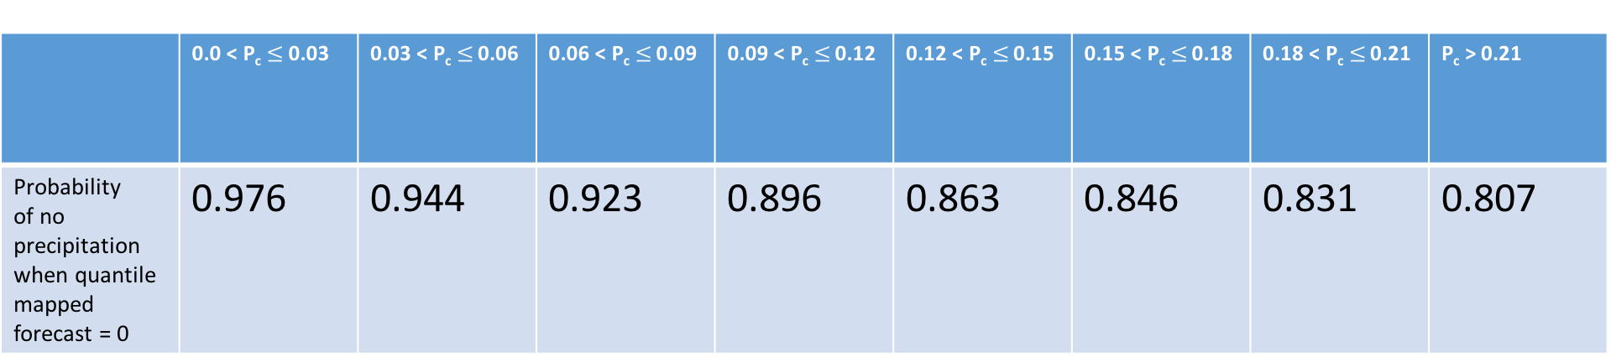
When quantile-mapped member forecast = 0, note the relationship between probability of no observed precipitation and climatological POP.
Climatological probability (P_{c}) of nonzero precipitation
 | 0.0 < P_{c}$≤$ 0.03 | 0.03 < P_{c}$≤$ 0.06 | 0.06 < P_{c}$≤$ 0.09 | 0.09 < P_{c}$≤$ 0.12 | 0.12 < P_{c}$≤$ 0.15 | 0.15 < P_{c}$≤$ 0.18 | 0.18 < P_{c}$≤$ 0.21 | P_{c} > 0.21
Probability of no precipitation when quantile mapped forecast = 0 | 0.976 | 0.944 | 0.923 | 0.896 | 0.863 | 0.846 | 0.831 | 0.807
So, indeed the climatological probability does provide extra information. Let’s build this into the dressing algorithm. When the quantile-mapped forecast is zero, we’ll use the climatological POP to further refine the probability of zero precipitation forecast.
(statistics here for Apr-May-Jun 2016 over CONUS)

Slide 18
Results

Slide 19
Reliability diagrams for
other leads in
supplementary slides;
similar character of
post-processed reliability.
So is this good? Compare against another benchmark.

Slide 20
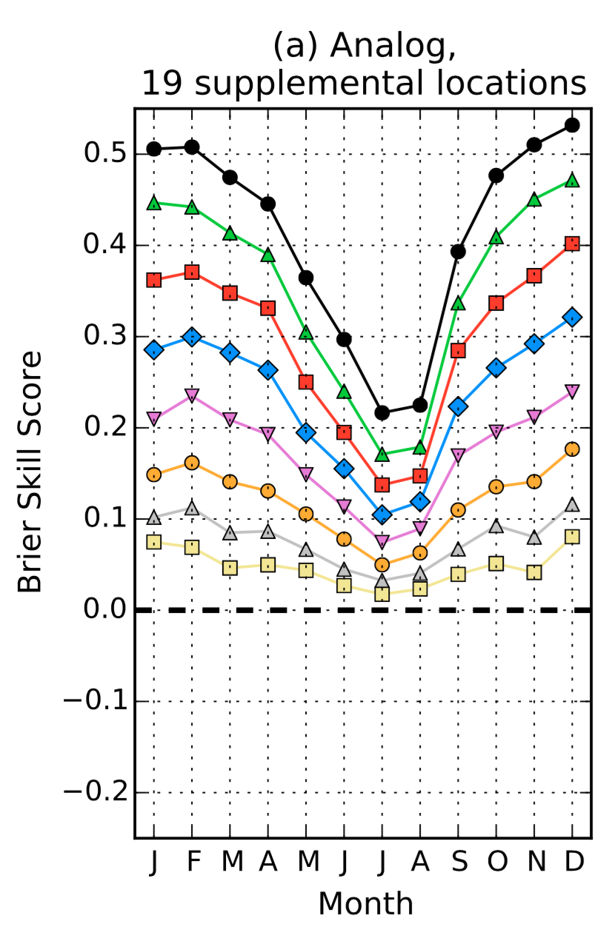
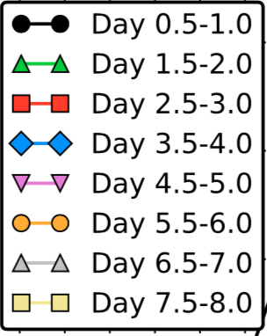
Skill scores of MMEs relative to GEFS reforecasts with analog post-processing.
Lead time (h) | GEFS v2 reforecasts with post-processing 2002-2013 average > 1 mm BSS | MME based POP12 post-processing, AMJ 2015 with short training data set
12-24 h | ~ 0.38 | 0.48
60-72 h | ~ 0.27 | 0.38
108-120 h | ~ 0.16 | 0.24
Remains to be seen if this method is competitive for higher precipitation thresholds.
from Hamill, T. M., M. Scheuerer, and G. T. Bates, 2015: Analog probabilistic precipitation forecasts using GEFS Reforecasts and Climatology-Calibrated Precipitation Analyses. Mon. Wea. Rev., 143, 3300-3309. Also: online appendix A and appendix B.

Slide 21
Case study, 72-84 h forecasts from 00 UTC 6 April 2016
Of concern:
Widespread high POPs in SW US, with relatively light-to-moderate ensemble-mean precipitation (not shown).
Lack of terrain-related detail.

Slide 22
Case study, 72-84 h forecasts from 00 UTC 6 April 2016
Quantile mapping has
ameliorated a lot of these
biases and has added terrain-related detail in western US.
Perhaps still overconfident
in aspects like zero precip
in wide areas of the country.

Slide 23
Case study, 72-84 h forecasts from 00 UTC 6 April 2016
After dressing on top of the quantile mapping.
Dressing adds some slight probabilities to the low end, diminishes the high-end probabilities further.
Note: points outside CONUS mostly lack training data for calibration, with exception of Columbia River basin and
a few points on Canadian border.

Slide 24
Case study, 72-84 h forecasts from 00 UTC 6 April 2016
With smoothing, we adjust POPs on US borders, also make
the fields slightly smoother, especially in the eastern US.

Slide 25
Conclusions
It is possible to provide spatially detailed, reliable POP forecasts using coarser-resolution multi-model ensembles, post-processed with short training data sets.
Key technologies:
  (1) Supplemental locations to increase training sample size;
  (2) Quantile mapping to reduce errors in mean precipitation amount; and
  (3) Best-member dressing of quantile-mapped ensemble members.
This, or some minor variant of it, should be in a future version of the National Blend of Models. That is, this procedure will underlie the NWS National Digital Forecast Database in the future.
Future research: will same technique provide reliable full PQPF?

Slide 26
Supplementary slides

Slide 27
Theoretical basis Fortin’s for best-member dressing
Assume we have an n-member collection of ensemble of forecasts at some specific time and location.
x = [x₁, …, x_{n}]. (1)
Let’s assume these ensemble members may be collected from different ensemble prediction systems, and hence each member may have different error characteristics. For example, some members of the Canadian global ensemble prediction system have different biases from other members.
Let us assume that through quantile mapping, we can make each forecast member conditionally unbiased with respect to an analyzed or observed climatology. Let’s also now add to each member an infinitesimally small random error so that no two ensemble members have the same value. Call this adjusted ensemble
x^{q} = [x^{q}₁, …, x^{q}_{n}]. (2)

Slide 28
After quantile mapping, for any given precipitation amount T, and averaged over many samples, we expect
P(x^{q}_{i} > T) = P(A > T), (3)
where A is the analyzed value used in the quantile mapping. If eq. (3) holds for every ensemble member i = 1, … , n, then the resulting ensemble x^{q} is exchangeable, i.e., all members have the same statistical properties. We do not assume that after quantile mapping that the analyzed and the ensemble randomly sample the same distribution; the ensemble may still have higher-moment errors such as a lack of spread.
We now sort the resulting ensemble from lowest to highest. Our quantile-mapped ensemble is now
x^{q} =­ [x^{q}₍₁₎, …, x^{q}_{(n)}] (4)
where (i) indicates that this member is the ith largest of the n members.
We seek a probability distribution of the analyzed (or observed) state A given the ensemble forecast x^{q}, i.e., P(A|x^{q}).
Let us define the event B_{(i)} as the event when |x^{q}_{(i)} -A|< |x^{q}_{(j)} -A|, j=1,…,n, j ≠ i. That is, B_{(i)} is the event that the ith-sorted member has the lowest absolute difference with respect to the verifying analysis. B₍₁₎ , …. , B_{(n)} are mutually exclusive and collectively exhaustive events.

Slide 30
Closest member histogram and dependence on precipitation amount.
Generally, for moderate to
heavy forecast precipitation, the
best member is more likely
to be the lowest member.
Results shown in previous slides
used the same histogram for all
forecasts (the green one).

Slide 31
slight under-forecasting
of moderate probabilities
with regards to
1/8-degree analysis
might mean forecasts
are more reliable
relative to higher-res.
or point precipitation.

Slide 35
Why quantile mapping to adjust for conditional bias?
Regression will not preserve diversity of adjusted ensemble at long leads; all members regress toward mean, resulting in loss of more spread.
Non-linear relationships, especially near zero precipitation forecast.

Slide 36
Why quantile mapping to adjust for conditional bias?
Regression will not preserve diversity of adjusted ensemble at long leads; all members regress toward mean , resulting in loss of more spread.
Non-linear relationships, especially near zero precipitation forecast.

