Slide 1


GEFS-based high-resolution probabilistic QPF over Northern California before and after post-processing
NOAA Earth System
Research Laboratory
Tom Hamill
ESRL Physical Sciences Division tom.hamill@noaa.gov (303) 497-3060

Slide 2
Reforecast refresher
Need many past forecast/analyses in order to statistically post-process precipitation forecasts; more past samples are needed for rare events, like especially heavy precipitation.
We have “reforecasts” for the current version of the NWS Global Ensemble Forecast System (GEFS), 11 members daily from 1985-current.
  Ref: http://dx.doi.org/10.1175/BAMS-D-12-00014.1
Reasonable quality precipitation analysis data over CONUS extends back to 2002 (on 4-km grid, 1/8-degree, 1 degree).
  Ref: http://dx.doi.org/10.1175/JHM-D-11-0140.1
Have frequently used “analog” method for post-processing in the past; form ensemble of observed data on dates when past forecast resembles current forecast. Can this procedure be demo’ed to work with 4-km precipitation analysis data?

Slide 3
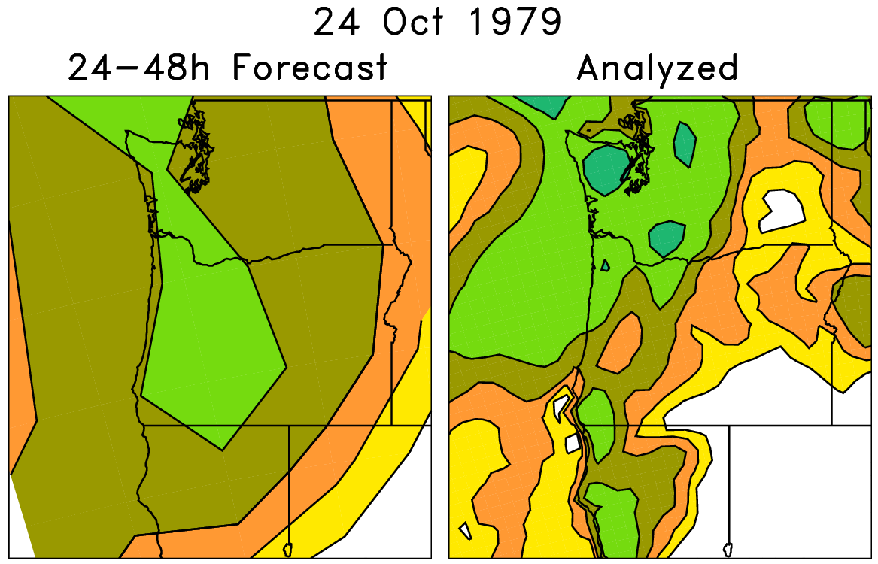
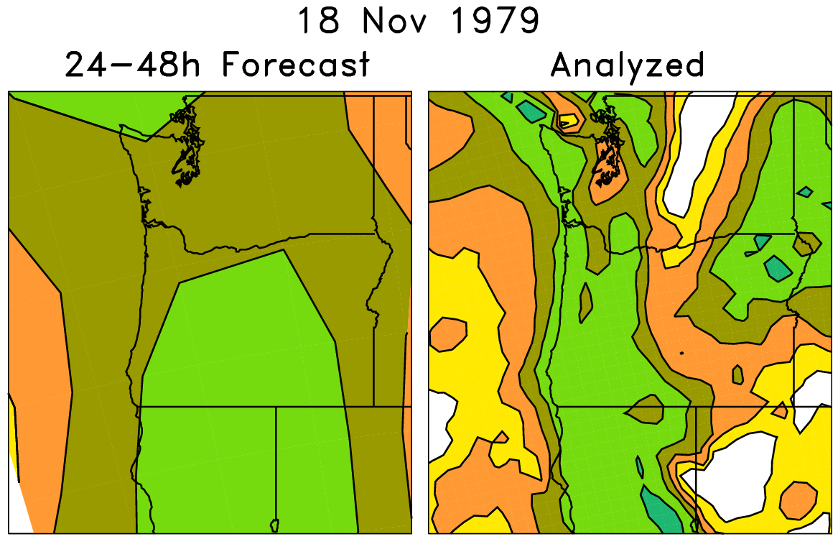
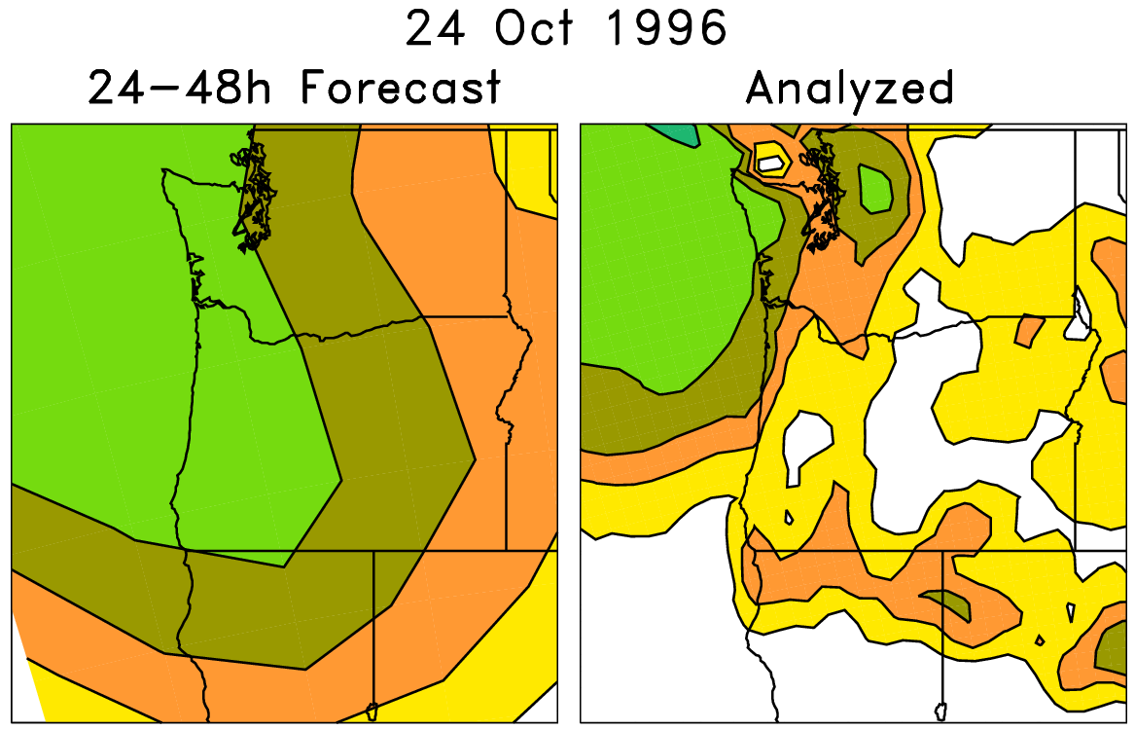
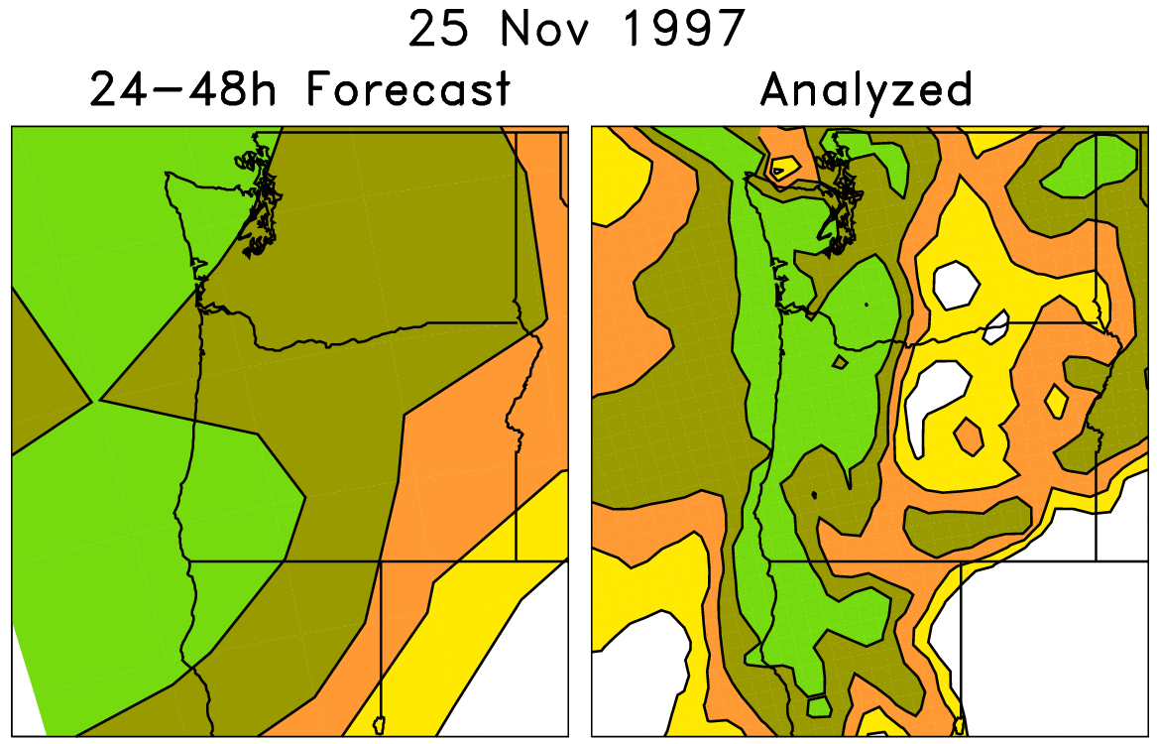
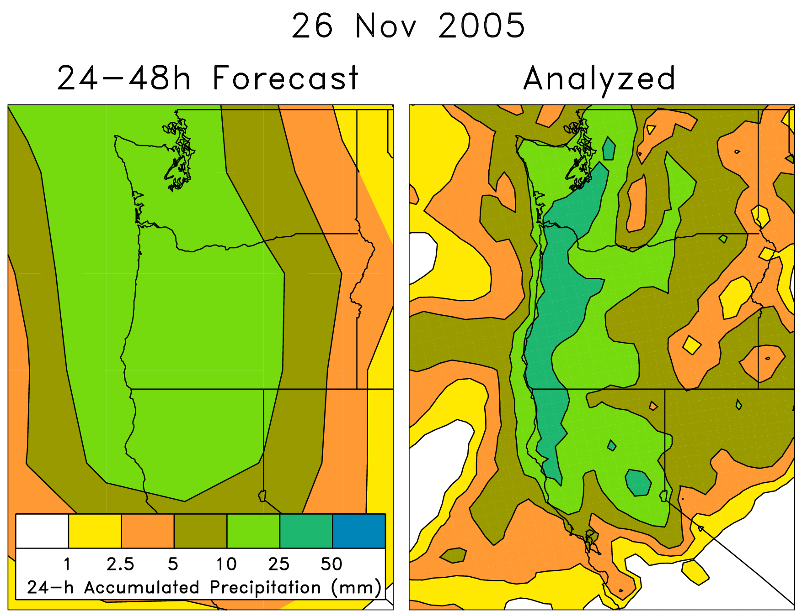
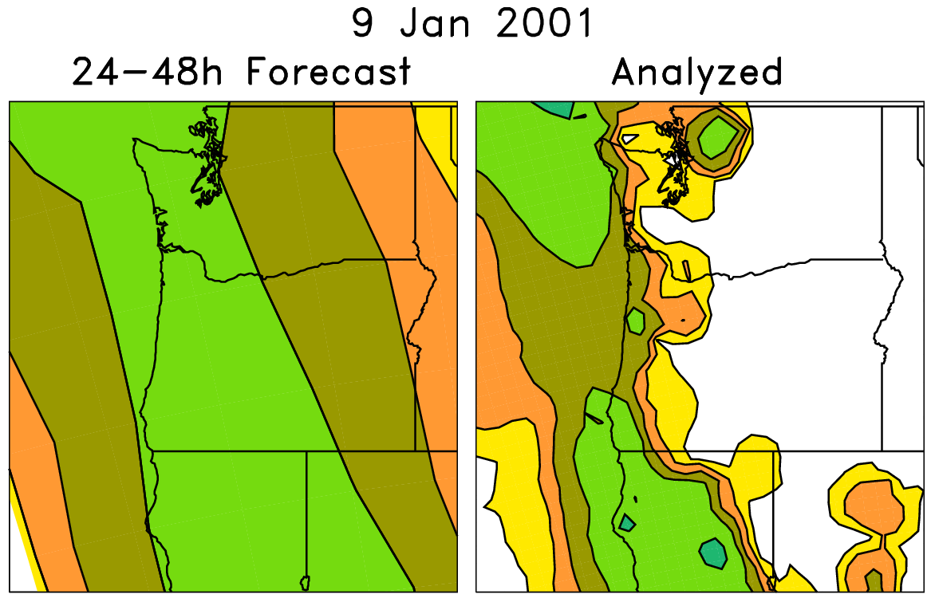
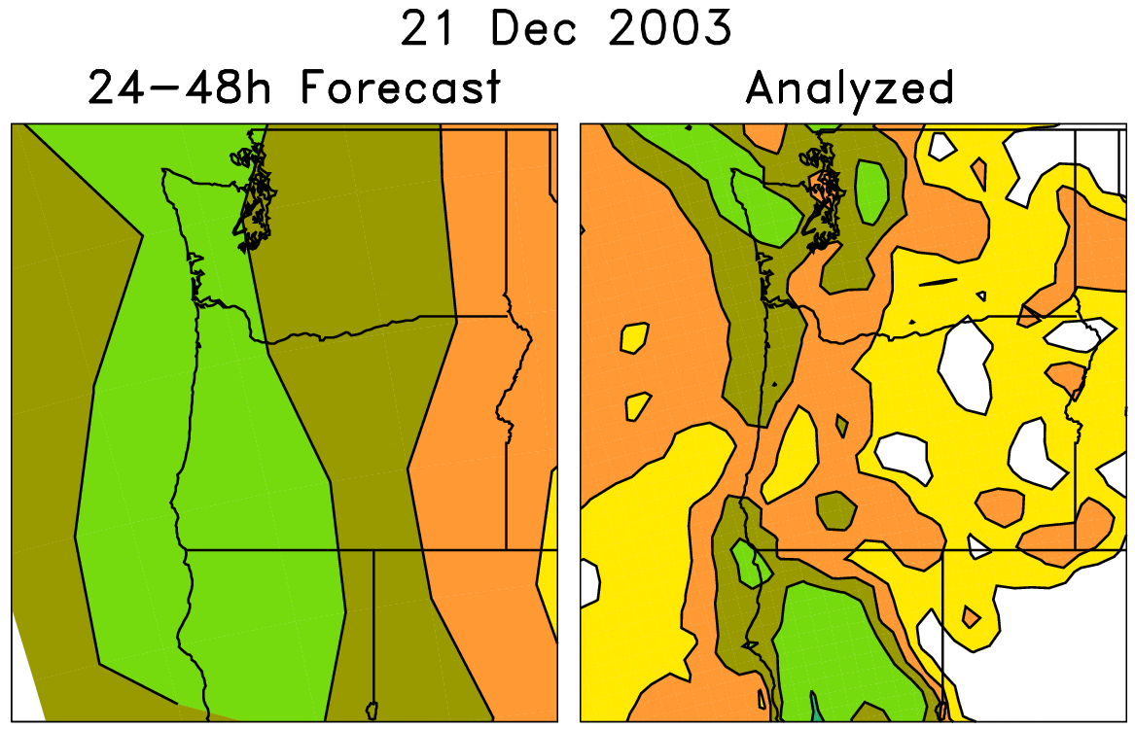
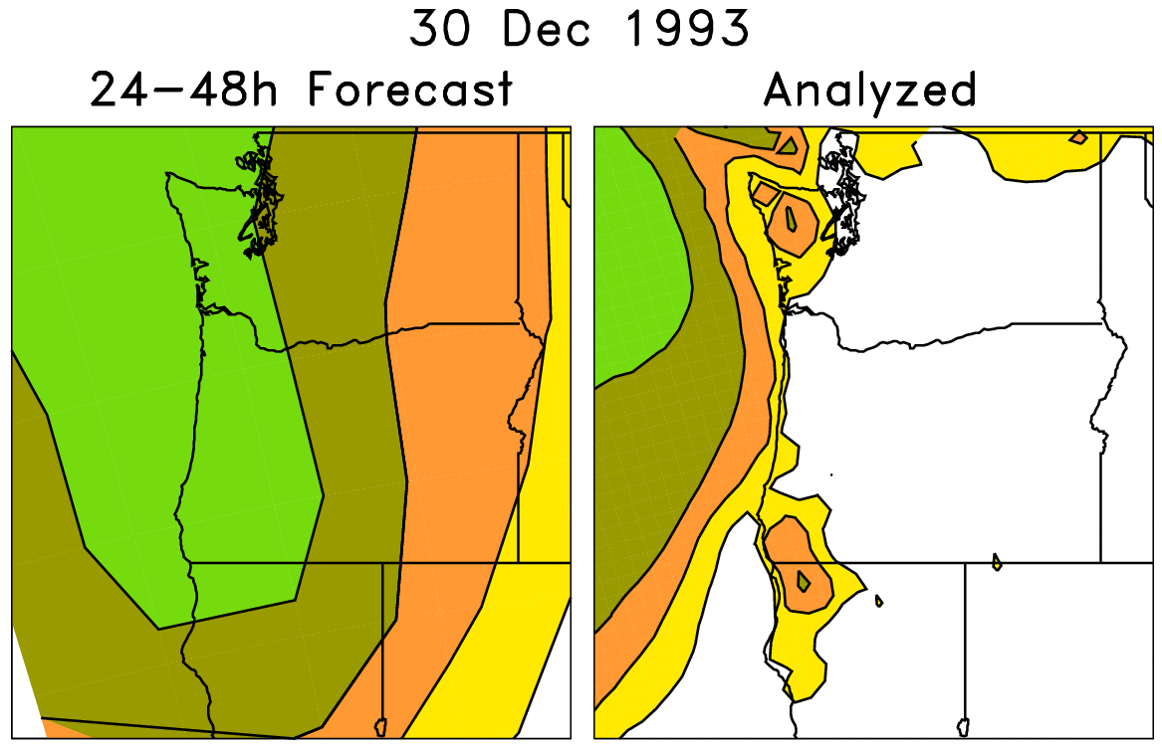
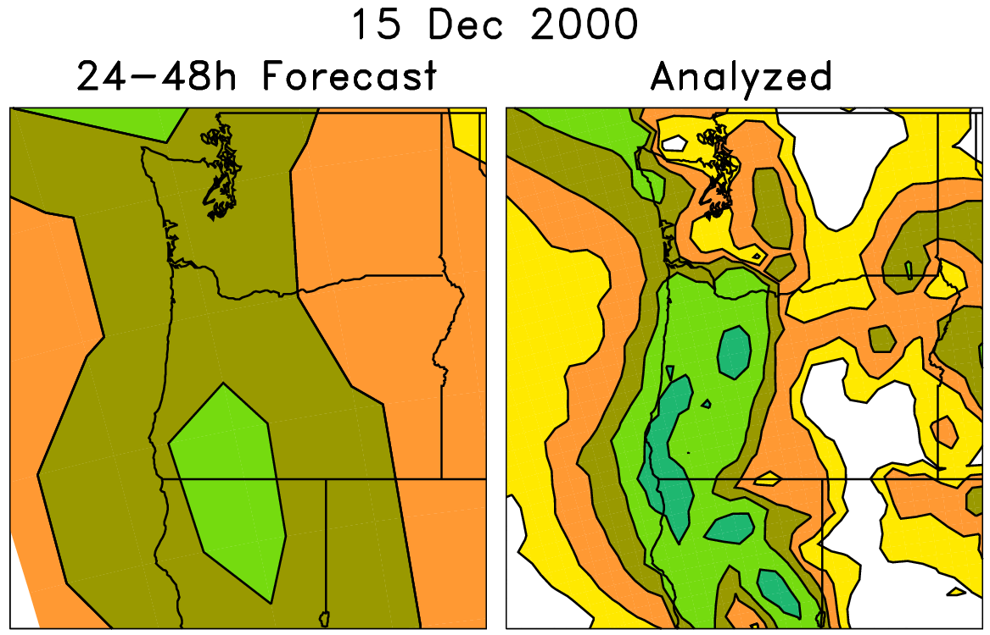
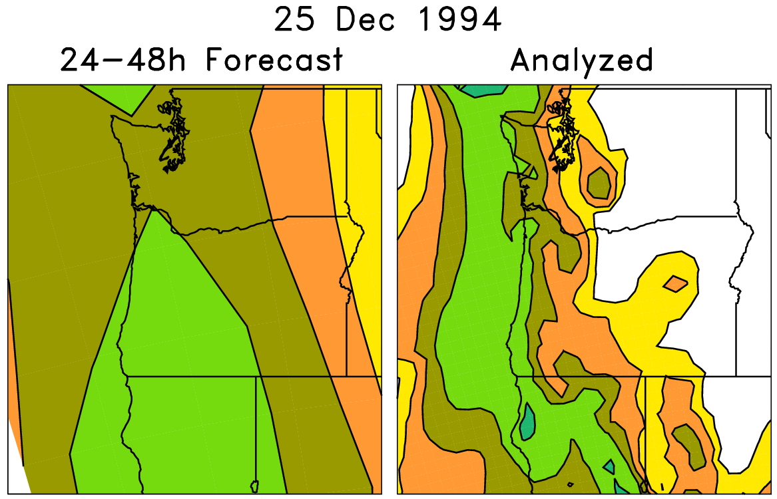
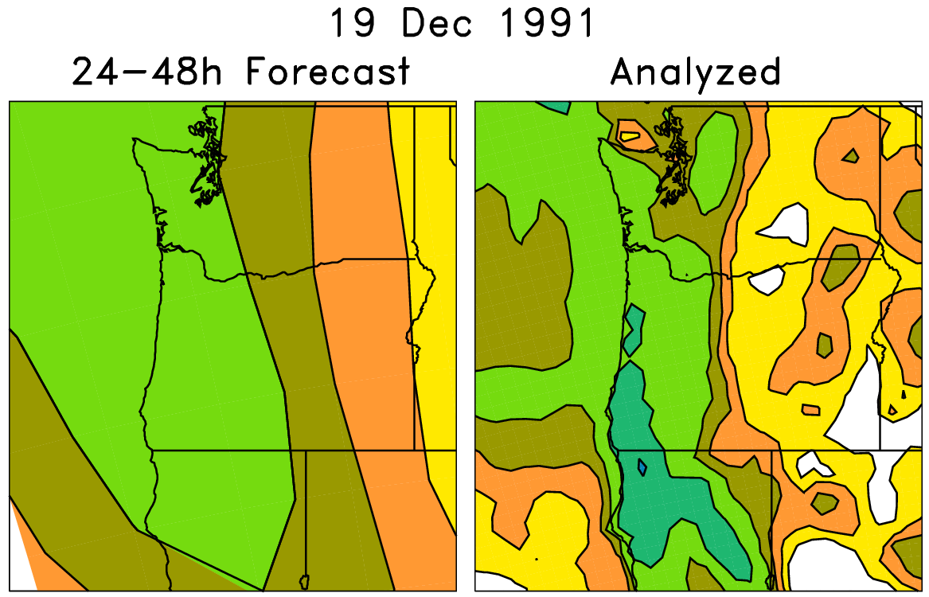
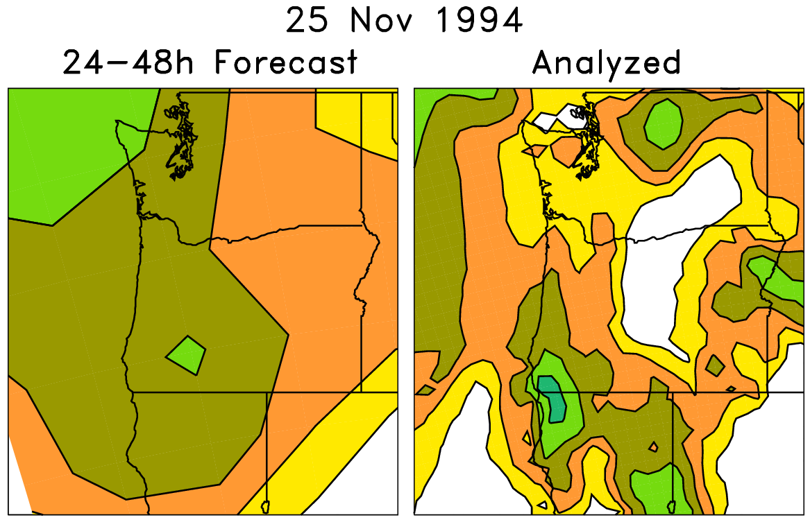
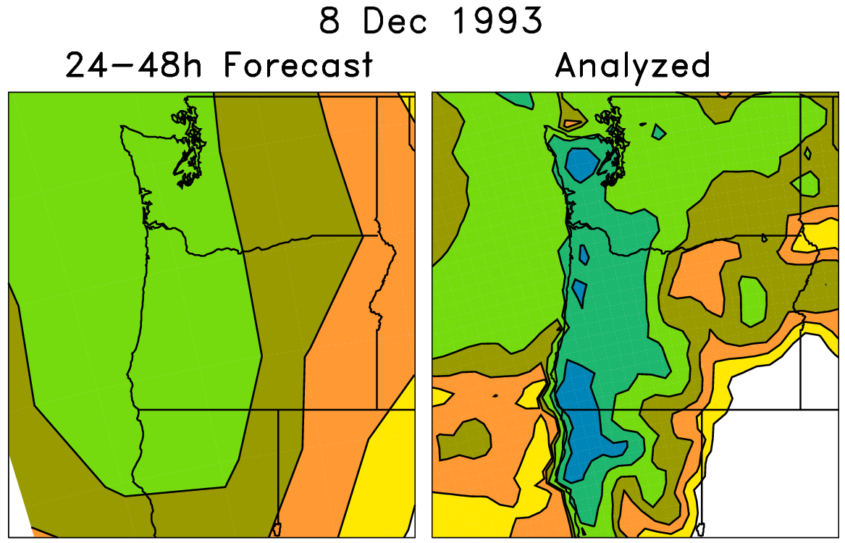
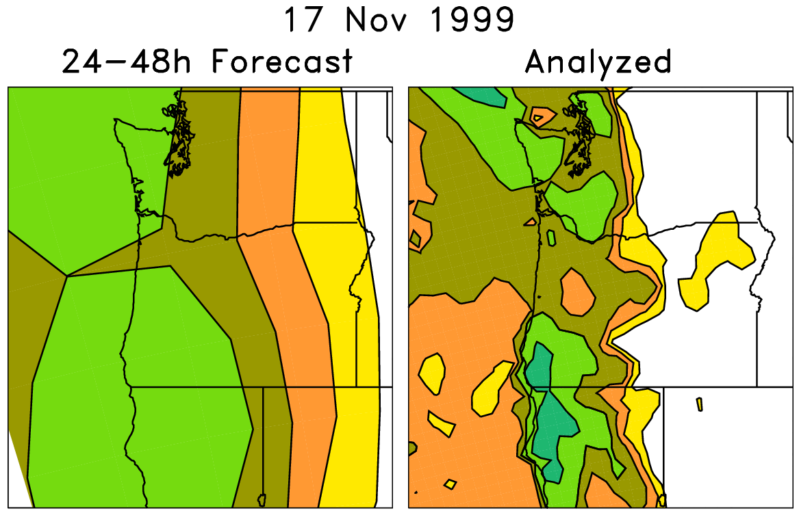
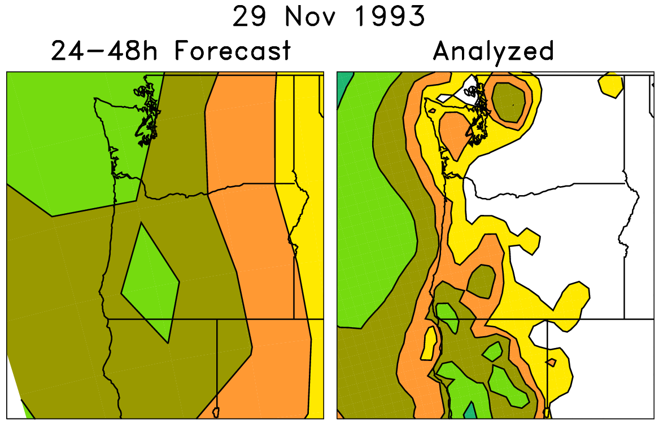
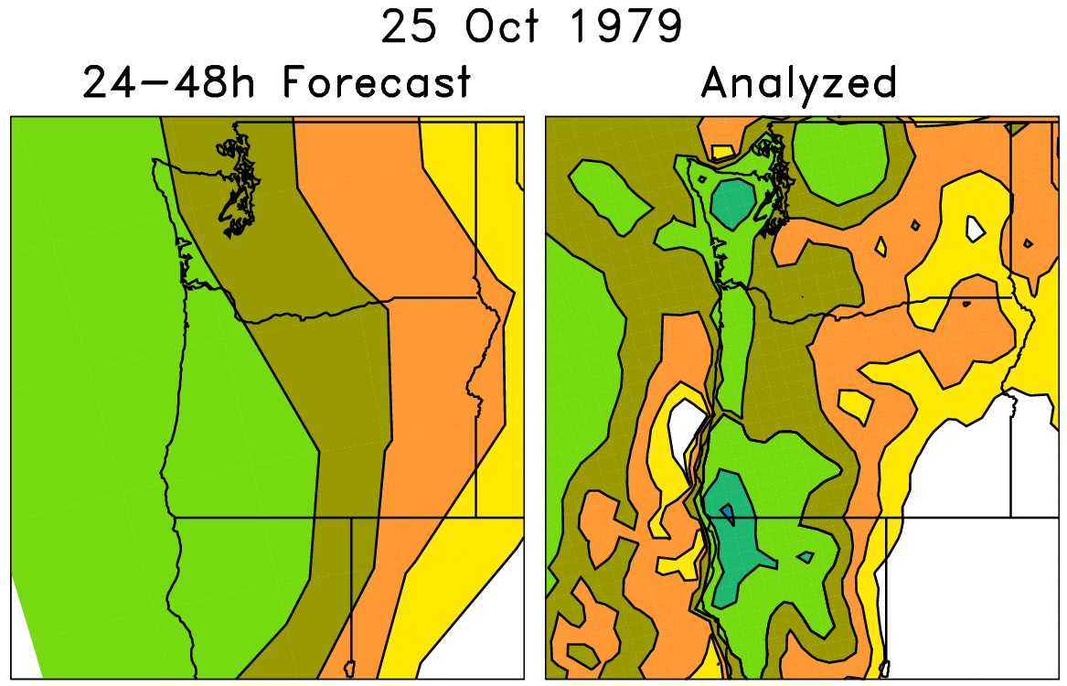
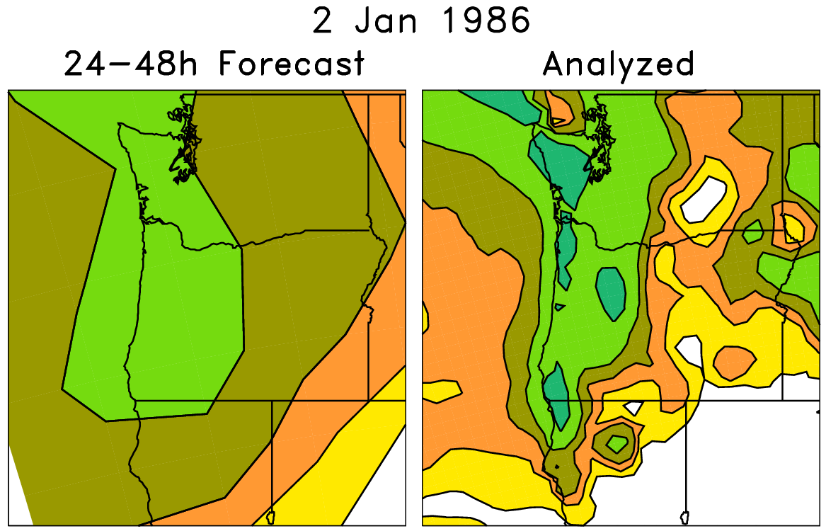
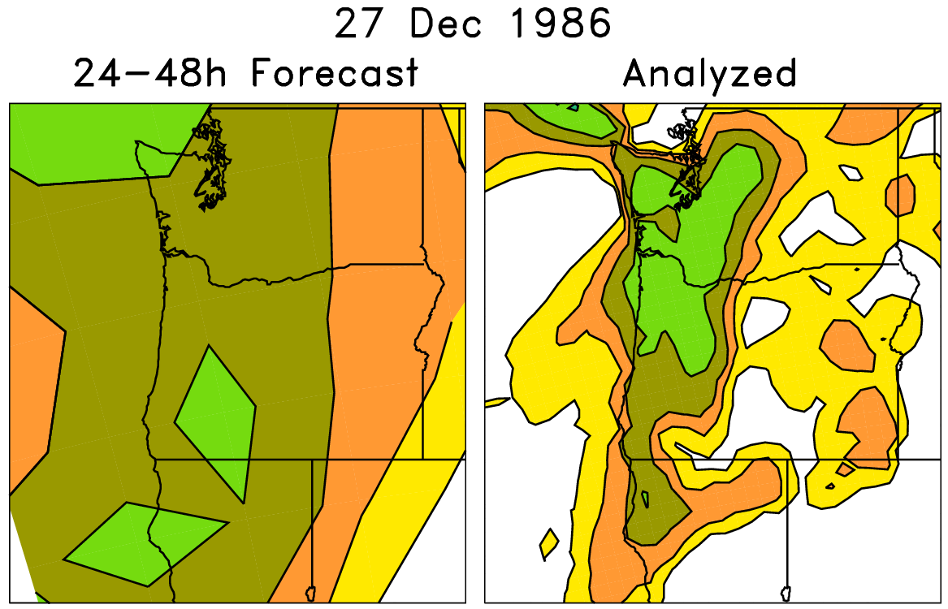
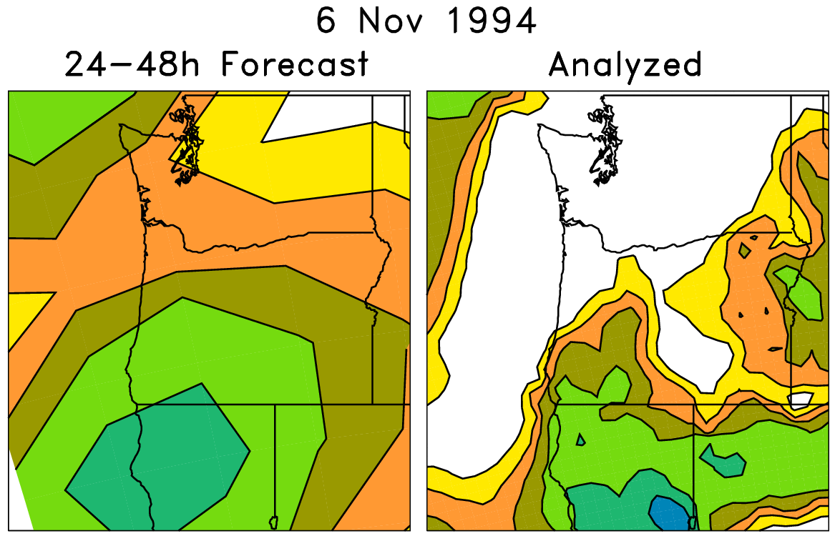
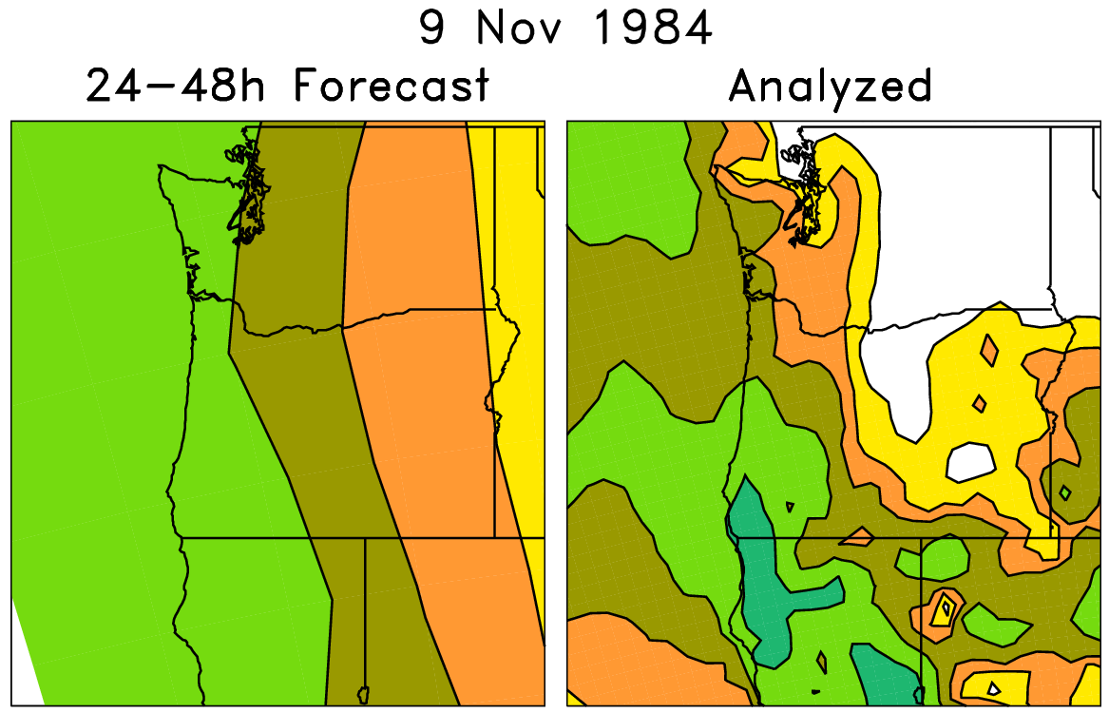
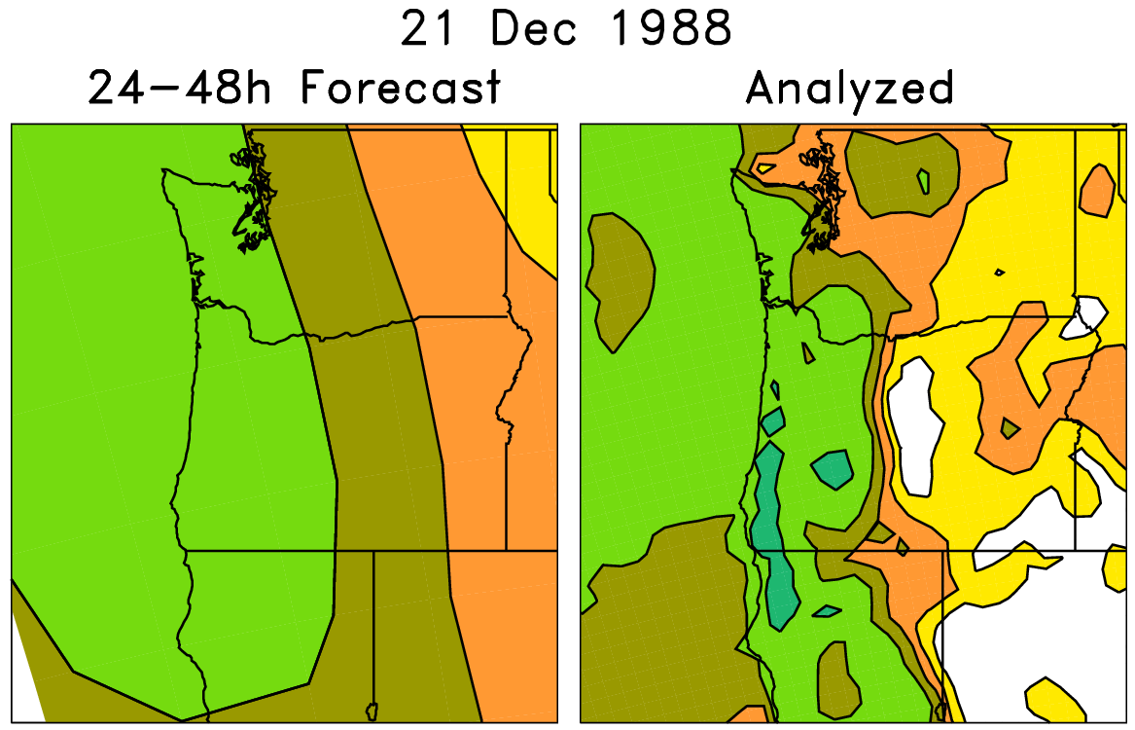
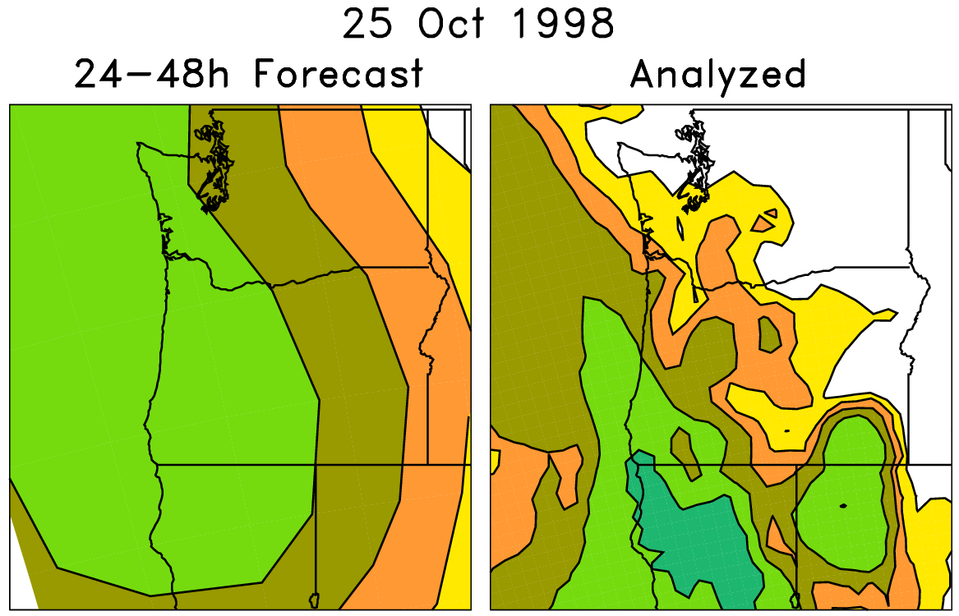
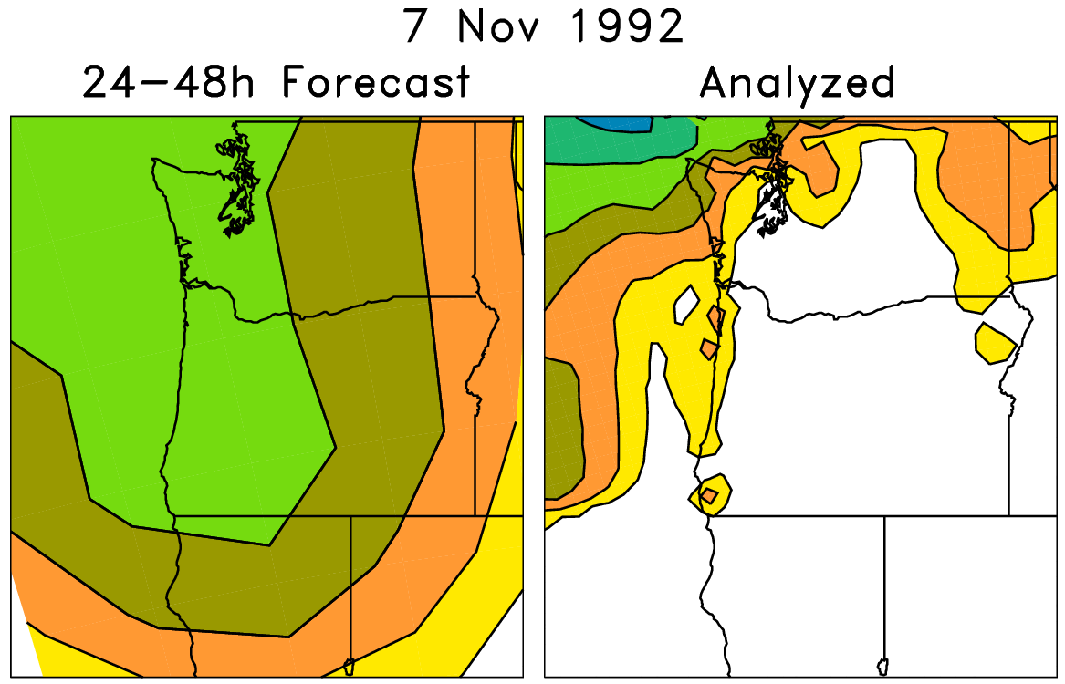
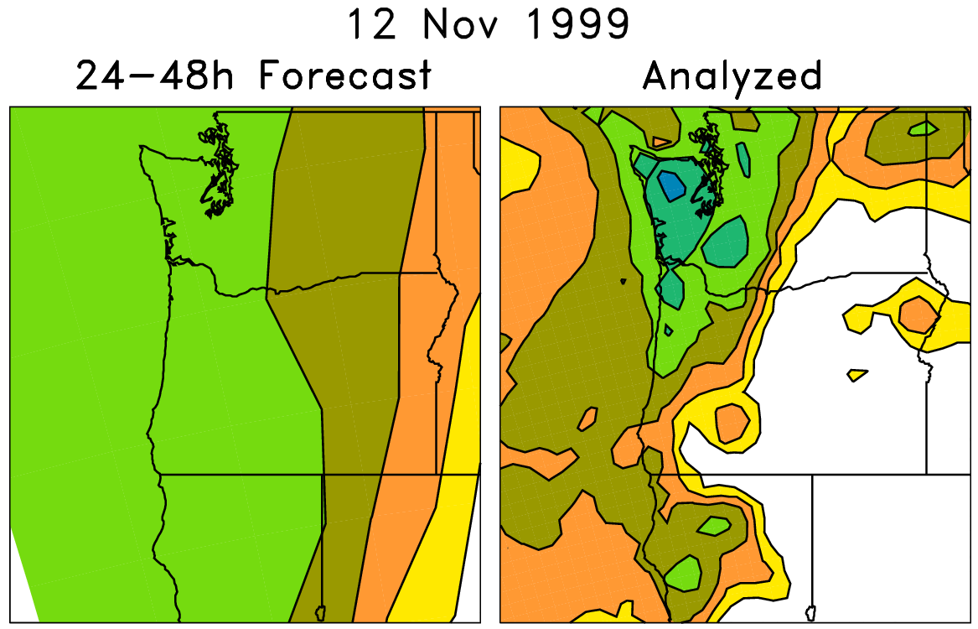
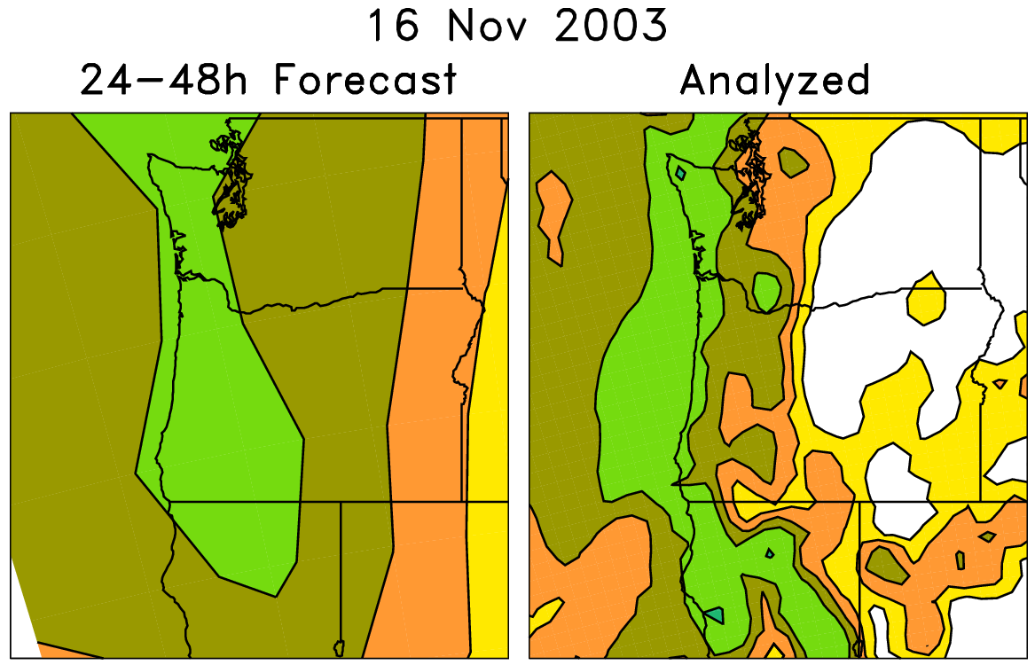
“Analog” post-processing leveraging reforecasts
Today’s forecast (& observed)
For each pair (e.g. red box), on the left are old forecasts that are somewhat similar to this day’s ensemble-mean forecast. The boxed data on the right, the analyzed precipitation for the same dates as the chosen analog forecasts, can be used to
statistically adjust and downscale the forecast.
Analog approaches like this
may be particularly useful for
hydrologic ensemble applications, where an ensemble of weather realizations is needed as inputs to a hydrologic ensemble streamflow system.

Slide 4
Modifications to previously documented analog algorithm
Analog algorithm matches point data now, not patterns around a grid point.
  This allows use of supplemental data locations for training purposes (next slide).
  Finding analogs: 70% match of mean precipitation forecast, 30% match of total-column precipitable water forecast.
Analog method’s forecasts have some sampling noise, so where terrain is ~ even, we smooth probabilities with a Savitzky-Golay smoother before dissemination.

Slide 5
Supplemental data locations
Idea is to supplement
training data at
each grid point using
n extra grid points
that have similar
observed climatology
and similar
forecast-observed
relationships. In this
plot, big symbol is
where we’re training,
smaller symbol where
we’re supplementing
training data.
In subsequent analog
method plots shown,
n=20.
We’ll process only in a
domain surrounding
N. CA, and supplemental
locations must be
within this domain.

Slide 6
Smoothing the post-processed precipitation forecasts
Savitzky-Golay (S-G) filter used. For more details, see:
  http://research.microsoft.com/en-us/um/people/jckrumm/SavGol/SavGol.htm
  http://www.wire.tu-bs.de/OLDWEB/mameyer/cmr/savgol.pdf (good tutorial)
  Numerical Recipes text.
I coded up the S-G filter with a window size of 9 and using 3rd-order polynomial fitting.

Slide 7
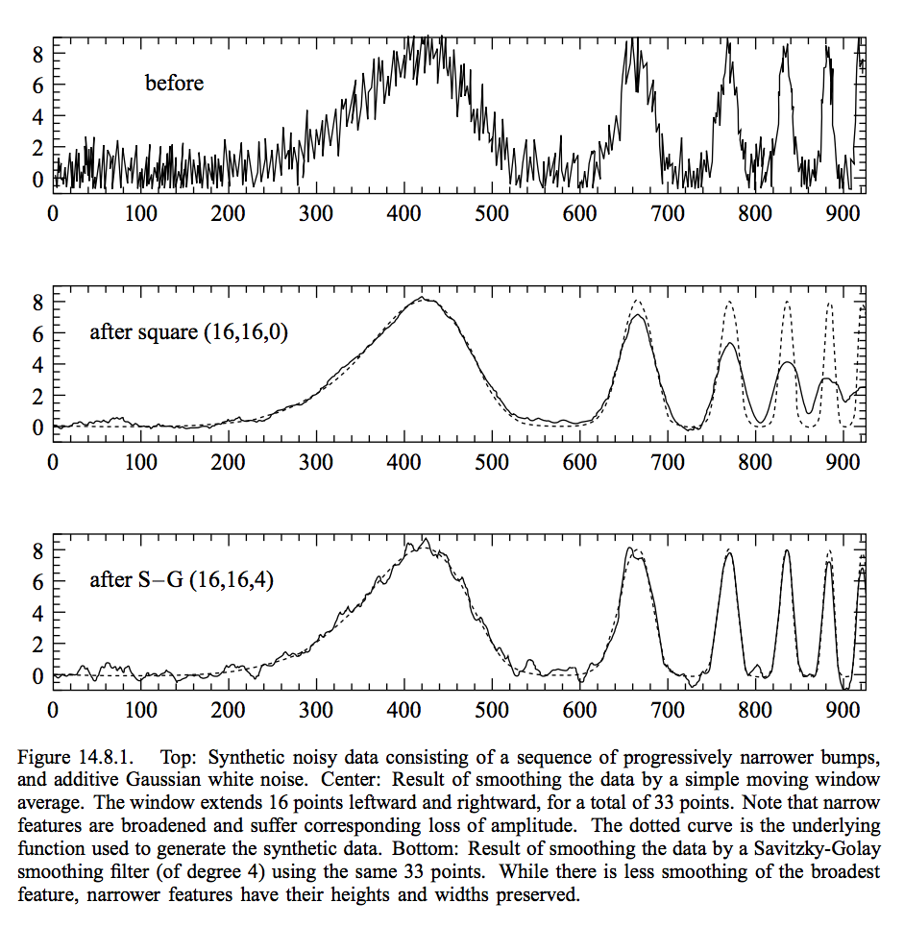
Savitzky-Golay filter
designed to preserve amplitudes, unlike more common nxn block smoothers
[More detail in supplementary slides]
from Press et al. Numerical Recipes text

Slide 8
Results over Northern California
Brier skill scores throughout the year
  Brier skill score measures skill of a particular event (1=perfect skill, 0=skill of climatology forecast)
Reliability diagrams
  Show you whether the probabilistic forecasts produced probabilities consistent with event frequency
Maps of yearly-average Brier skill score

Slide 9
the strongly
negative values
in the warm
season for raw
ensembles is
probably
reflective of the
tendency for
the GEFS to
produce
drizzle where
it’s normally
quite dry.

Slide 10
Improvement
that’s equivalent
to several days
lead time, e.g,
a day+3 to 3.5
analog forecast
is roughly as
skillful as a
day +0 – 0.5
raw ensemble
forecast.

Slide 11
This is the skill
in predicting
forecasts
greater than
the 95th
percentile of the
climatological
distribution,
which varies for
each 4-km
grid point and
each month of
the year.
Again, notable
improvement of
analog over raw.

Slide 12
These are reliability diagrams. They help assess whether the forecast event happens at
the same frequency they are forecast (does it rain 70% of the time when a 70% POP forecast
is made?) Inset histogram shows how often forecasts of a given probability were issued.

Slide 13
A characteristic you’ll see throughout is much improved reliability from the analog
procedure, though the forecasts are not as “sharp,” i.e. they don’t forecast high
probabilities as often as the raw. But when they do, they’re usually reliable.

Slide 21
Now we switch to a much rarer event > 25 mm (~ 1 inch) in 12 hours. Again, analog
is more reliable and skillful, but less sharp.

Slide 26
The seeming lack of reliability for high-end probabilities with the analog is really more of a
reflection of small sample size; at these longer leads, the analog method virtually
never forecasts high probabilities.

Slide 30
Now we’re looking at the skill of the ensemble in predicting whether precipitation exceeded
the 95th percentile of the distribution, and again, that 95th percentile is computed separately
for each 4-km grid point and each month of the year.

Slide 39
Finally, we present some maps of the skill of analog forecasts vs. raw.

Slide 69
Conclusions
Analog procedure has been demonstrated previously, in many situations, to work well when one has a long time series of past forecasts from the same modeling system used operationally.
The novel aspect here was applying the analog methodology to 4-km gridded data, effectively doing a much finer statistical downscaling.
Results are consistent with previous results; analog method significantly improves reliability and skill, though forecasts are less sharp.
Scripts have been developed to permit this sort of analysis to be done on any other region in the CONUS.

Slide 70
Supplementary slides

Slide 71
Savitzky-Golay smoothing example
Applying S-G smoother uniformly over the US?Detail in areas of complex terrain also smoothed out, too, perhaps inappropriately.
In the following plots, we illustrate how the S-G smoother was applied to smooth these probabilistic forecasts from the analog procedure.

Slide 72
Example: raw ensemble mean forecast

Slide 73
Example: raw probabilities from ensemble
too
sharp

Slide 74
Example: analog probabilities, unsmoothed
noisiness due to
finite ensemble
size

Slide 75
Analog probabilities after domain-wide Savitzky-Golay filtering
smoother, but
too smooth in
mountainous
regions?

Slide 76
Tentative solution: weight smoothed S-G more in even terrain, weight the raw analog more in complex terrain
Specifically, compute standard deviation σ of terrain elevation in 3x3 box around each forecast grid point (using terrain data on a 1/2-degree grid).
Weight of raw forecast:
  = 0.8 if √σ > 18
  = (√σ-8) / 16.667 if 8 > √σ ≥ 18
  = 0.2 if √σ ≥ 8

Slide 77
√σ as determined from
~ ½ degree terrain elevation data

Slide 78
Partially S-G smoothed analog probabilities based on terrain roughness

