Slide 1


Comparison of GFS/EnKF ensemble precipitation forecasts for Jul-Oct 2010 over CONUS relative to NCEP, ECMWF, UKMO, and CMC operational ensembles
NOAA Earth System
Research Laboratory
Tom Hamill
NOAA ESRL, Physical Sciences Division
tom.hamill@noaa.gov
(303) 497-3060
(thanks to Jeff Whitaker for support)

Slide 2
Main points
We examined precipitation forecasts from T254 GFS/EnKF and other 20-member operational ensembles (NCEP, ECMWF, CMC, UKMO) run during Jul-Oct 2010.
Validated against EMC-derived “CCPA” 1-degree analysis of daily precipitation, which uses regression correction of Stage-IV to CPC analysis (Luo et al. 2010).
Key results
  Better (consistently better) Brier skill scores in EnKF with new GFS relative to NCEP operational.
  Less sharp (less binary) probabilistic forecasts.
  Better equitable threat scores in EnKF with new GFS, too.

Slide 3
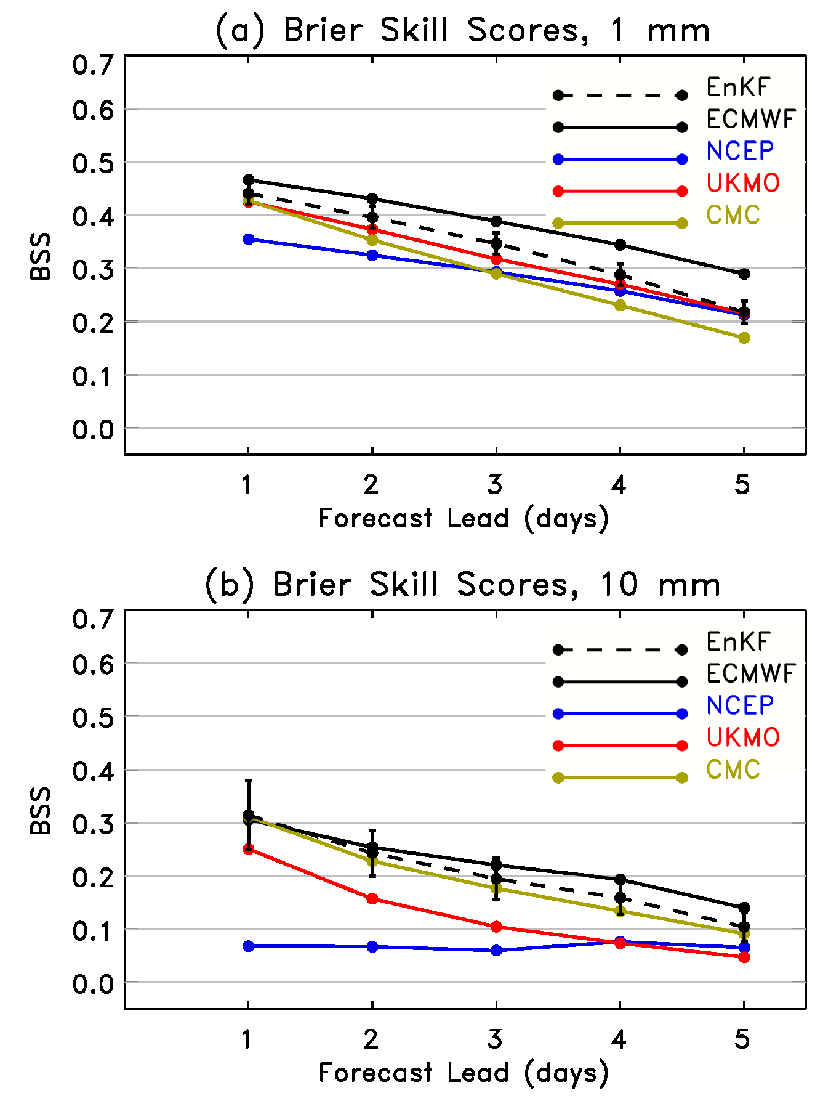
One teaser: improved probabilistic skill scores
EnKF + T254 new GFS narrows the difference between NCEP and ECMWF, especially at higher amounts.
Confidence interval 2.5% to 97.5% based on paired t-test between EnKF and NCEP, including correction for sample size due to autocorrelation.

Slide 4
Precipitation verification
Use EMC “CCPA” dataset of Stage-IV precipitation, regression-corrected to CPC analysis over CONUS, and upscaled to 1-degree. Described in Luo et al. (2010).
Verify only where 1-degree box is within CONUS.
Verify 24-h accumulations.
Verify forecasts initialized from both 00Z and 12Z.

Slide 5
GFS/EnKF configuration
2010 version 9.01 of GFS; T254L64, 80 members cycled for EnKF assimilation
  Assimilate all observations used in GSI + TCVitals sea-level pressure observation.
  Run in quasi-realtime during hurricane season; leveraging these forecasts.
Hurricane verification discussed at http://tinyurl.com/4kzamb3 , AMS Annual ’11
Thereafter, 20 perturbed member forecasts + control computed to 5 days lead.
The EnKF here approximates that which will be used in GSI-EnKF hybrid; we are working with data assimilation group members, e.g., Kleist, Derber, Parrish, aiming for April 2012 implementation.

Slide 6
Are improvements due to the EnKF?
In following comparisons of NCEP and EnKF, there are several differences:
  Version of GFS used. T254 EnKF uses the latest (9.01), operational T190 ensemble older version (version 8.0).
  Model resolution (T254L64 for EnKF, T190L28 for NCEP ensemble).
  Different control analysis around which perturbed initial conditions are centered. GSI for NCEP, EnKF mean for EnKF.
  Different structures of the perturbed initial conditions.
We don’t know yet for sure which provides the greatest benefit; some results suggest EnKF mean may provide substantial benefit, others suggest GFS changes more important than data assimilation (next 2 slides).

Slide 7
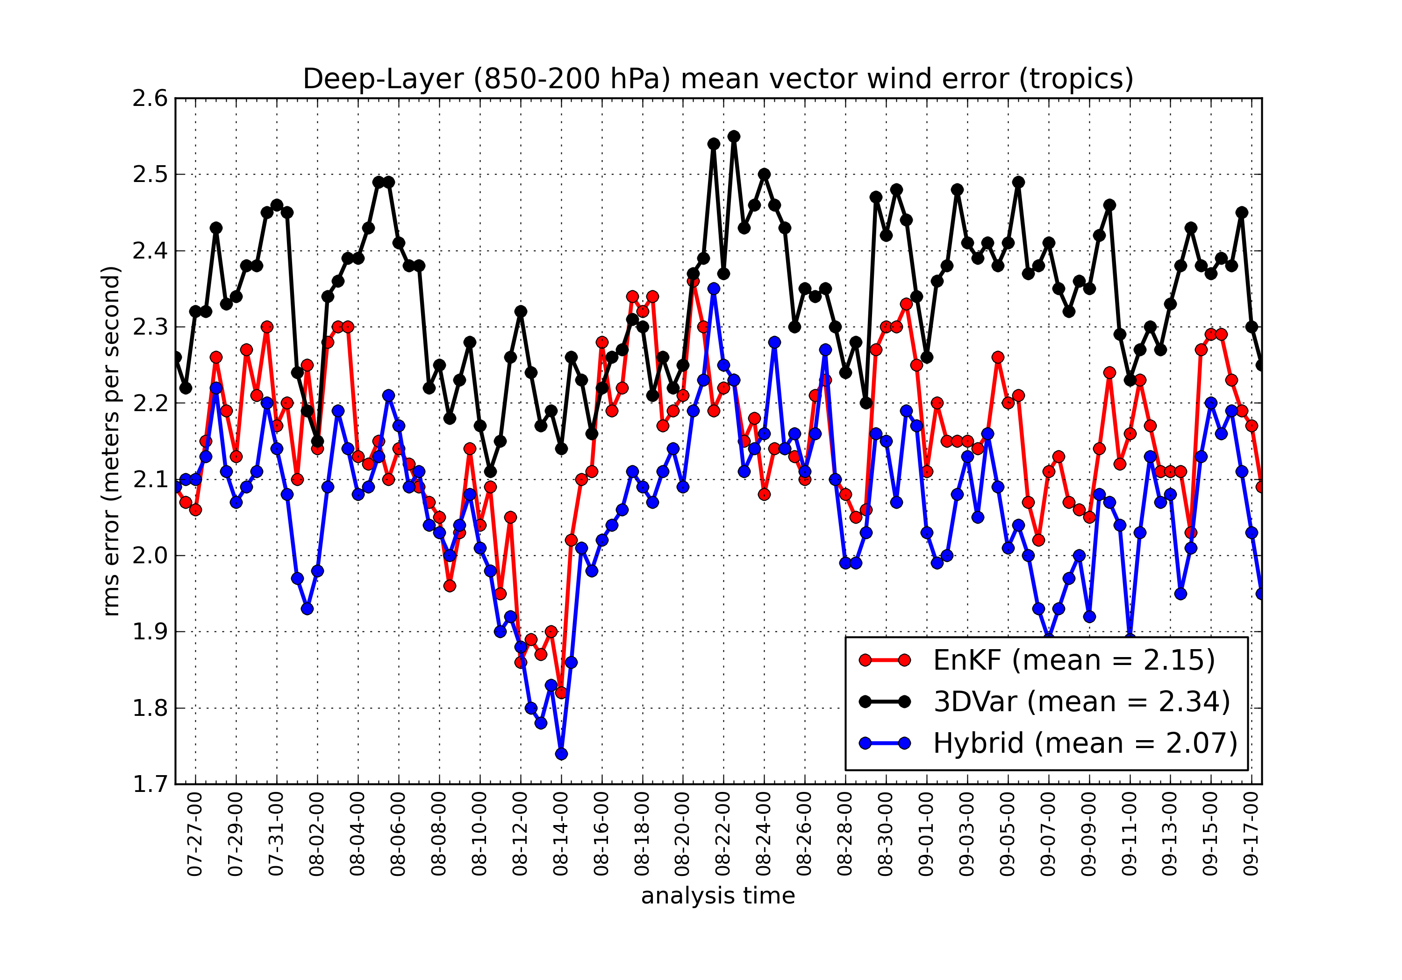
72-h (deterministic) wind errors vs. ECMWF analysis
c/o Jeff Whitaker & Daryl Kleist
Same version of GFS used in each deterministic forecast (T574L64). If ECMWF analysis can be regarded as truth, hybrid and EnKF are consistently much lower RMS than GSI.

Slide 8
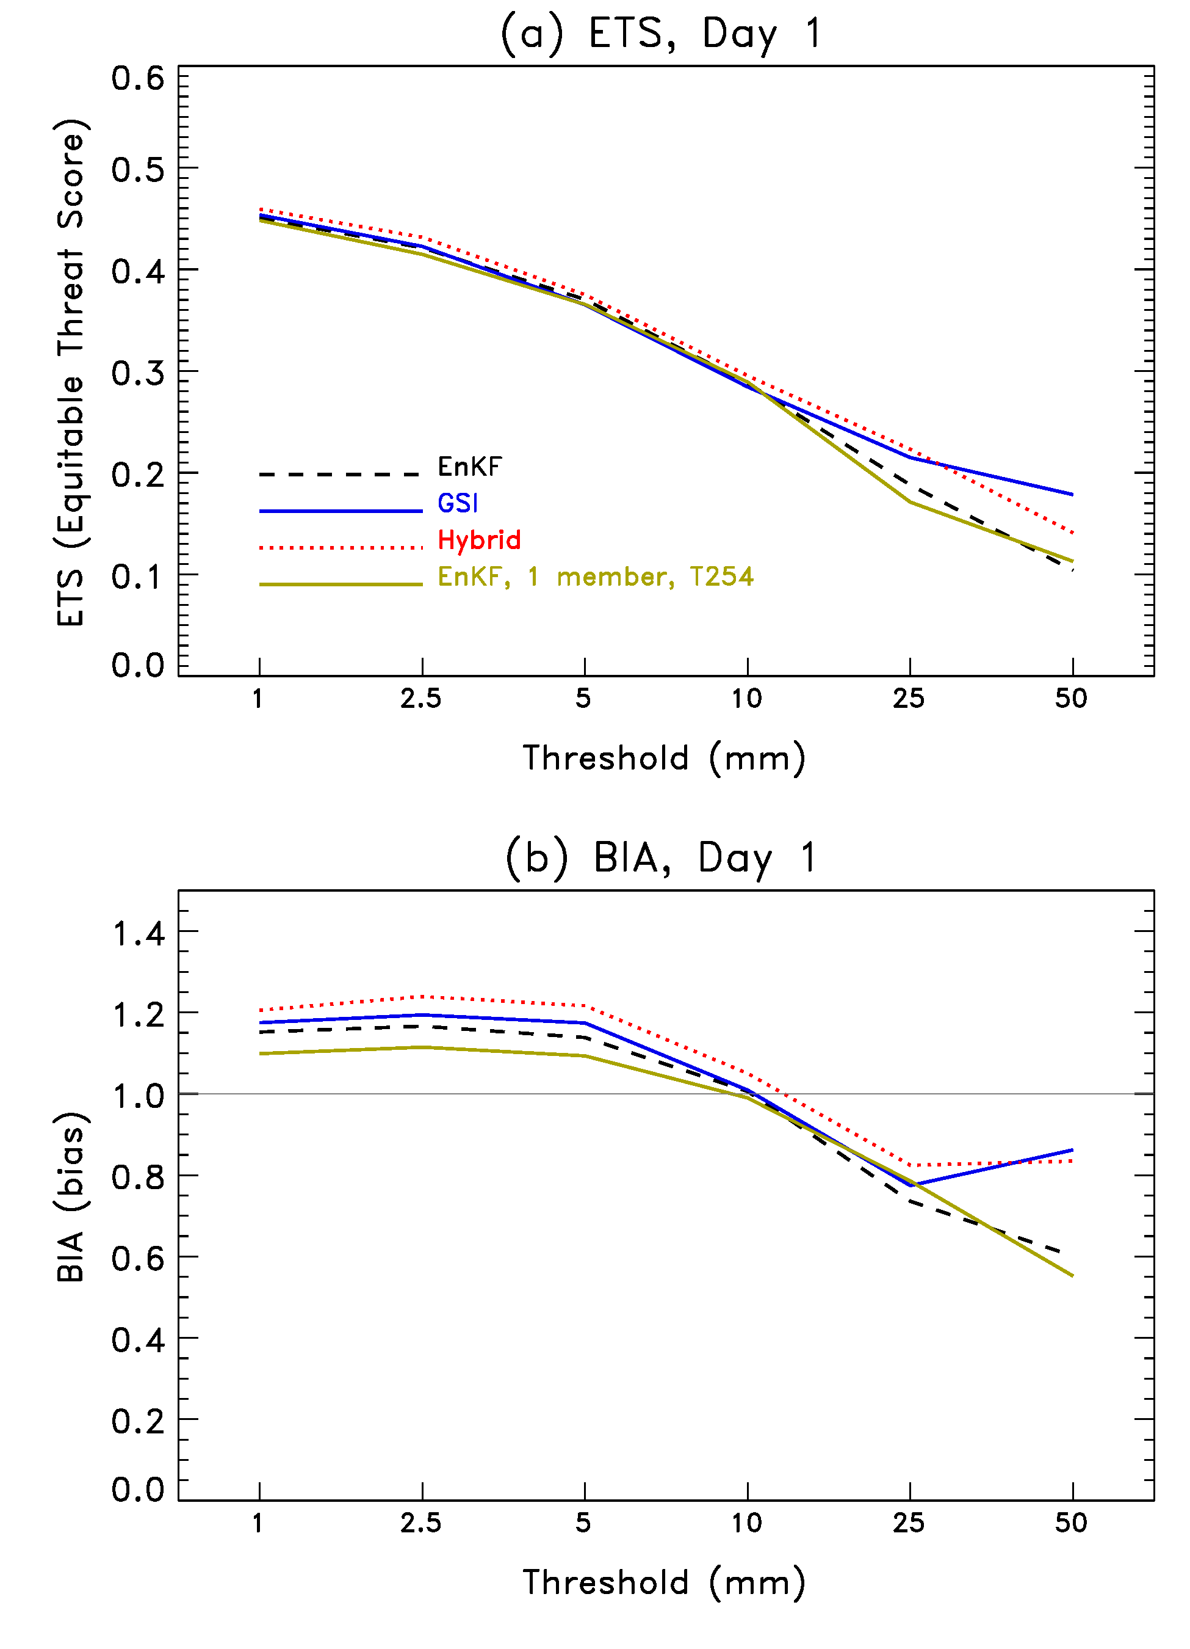
Threat scores of T574 deterministic forecasts
For these day+1 forecasts (similar results
for days +3 and +5), we examine ETS and
BIA for control runs with various data
assimilation systems using the lastest
GFS model. The GSI used a T574 forecast
model and the operational GSI assimilation
system. The EnKF took the mean analysis
from the T254 EnKF system and initialized
T574 control forecasts. The hybrid used
the T254 EnKF forecasts in the T574 GSI
hybrid system. Forecasts here are from
July through mid-September 2010.
There appears to be little difference in
threat scores. We do not yet have a
parallel run of the full ensemble system
(a T254 GSI+ETR with the same version
of the GFS) to compare ensemble products.

Slide 9
Other ensemble systems
(via TIGGE)
NCEP operational, 20 members, T190L28. Uses older version of GFS
ECMWF operational, first 20 members, T639L80
UK Met Office, 20 members
CMC, 20 members

Slide 10
Verification techniques
CRPS, continuous ranked probability score
Brier skill scores
Reliability diagrams
ETS (Equitable Threat Score) & Bias
Sharpness plots
Details in supplementary slides, here.

Slide 11
Results

Slide 12
Brier skill scores
EnKF + T254 + new GFS narrows the difference between NCEP and ECMWF, especially at higher amounts.
Confidence interval 2.5% to 97.5% based on paired t-test between EnKF and NCEP, including correction for sample size due to autocorrelation.

Slide 13
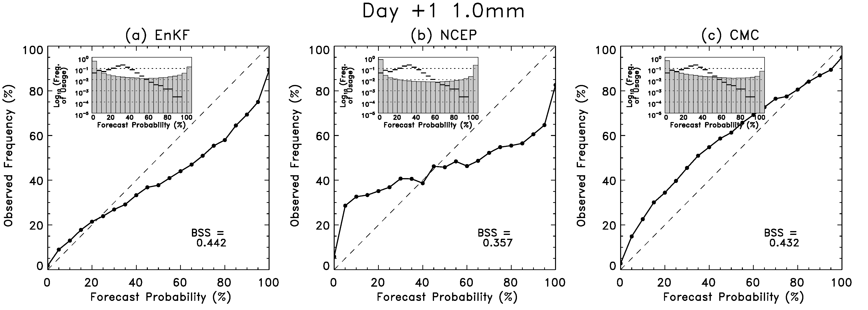
1-mm reliability, day +1
Solid lines on inset frequency of usage histogram are the frequency of usage of the
climatological probabilities across the CONUS and over the 4-month period.

Slide 14
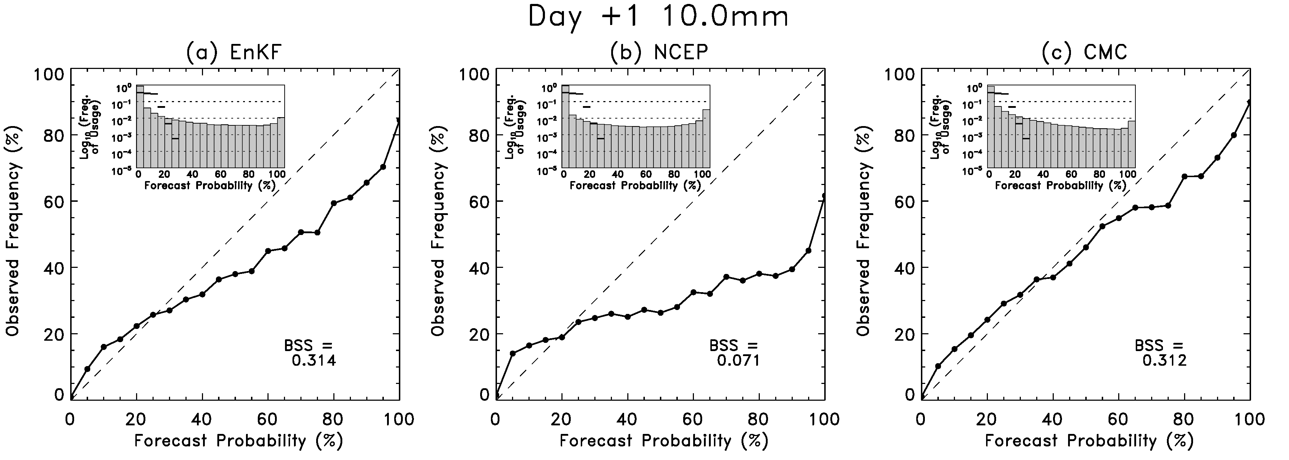
10-mm reliability, day +1
(in between)
(sharpest)
(most reliable)

Slide 15
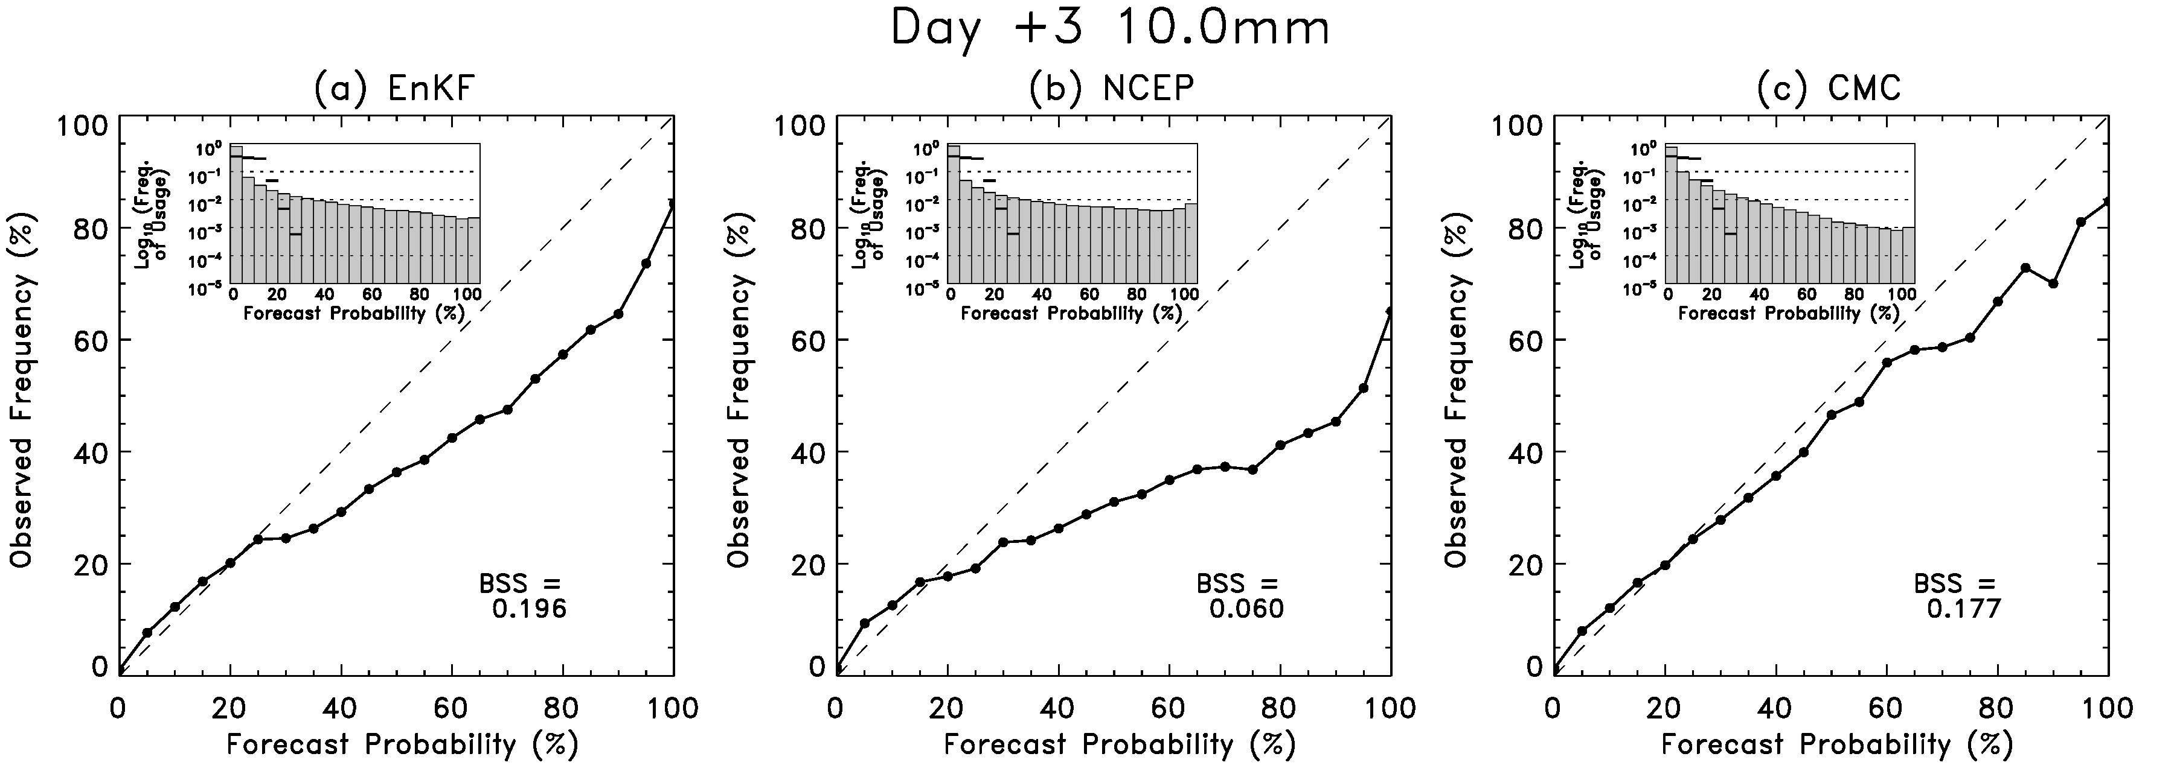
10-mm reliability, day +3

Slide 16
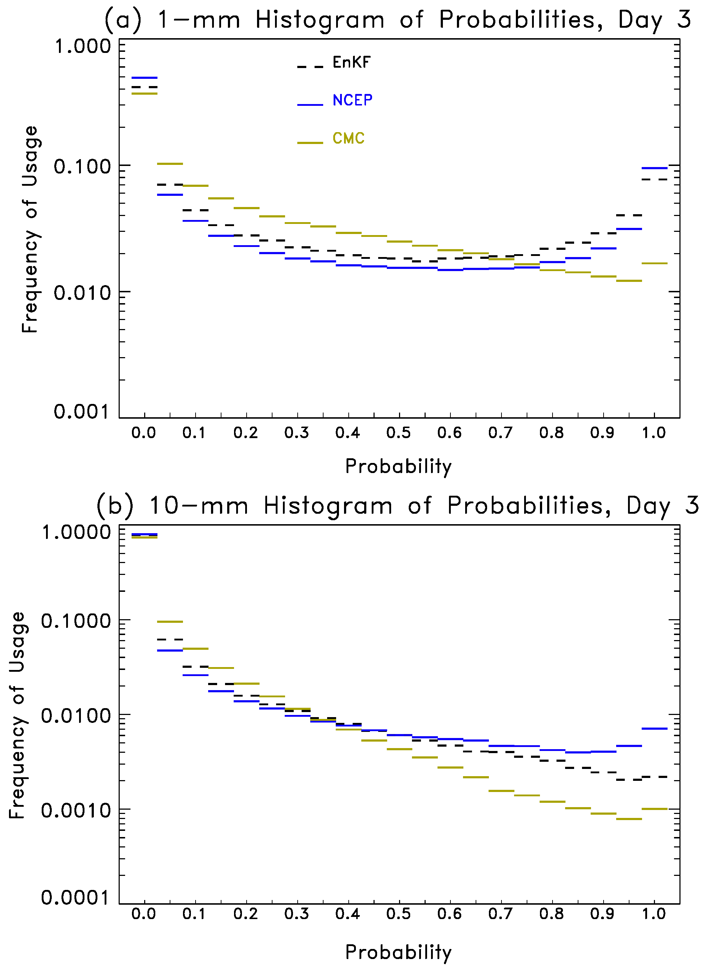
Sharpness of the probabilistic precip. forecasts, day +1

Slide 17
Sharpness of the probabilistic precip. forecasts, day +3

Slide 18
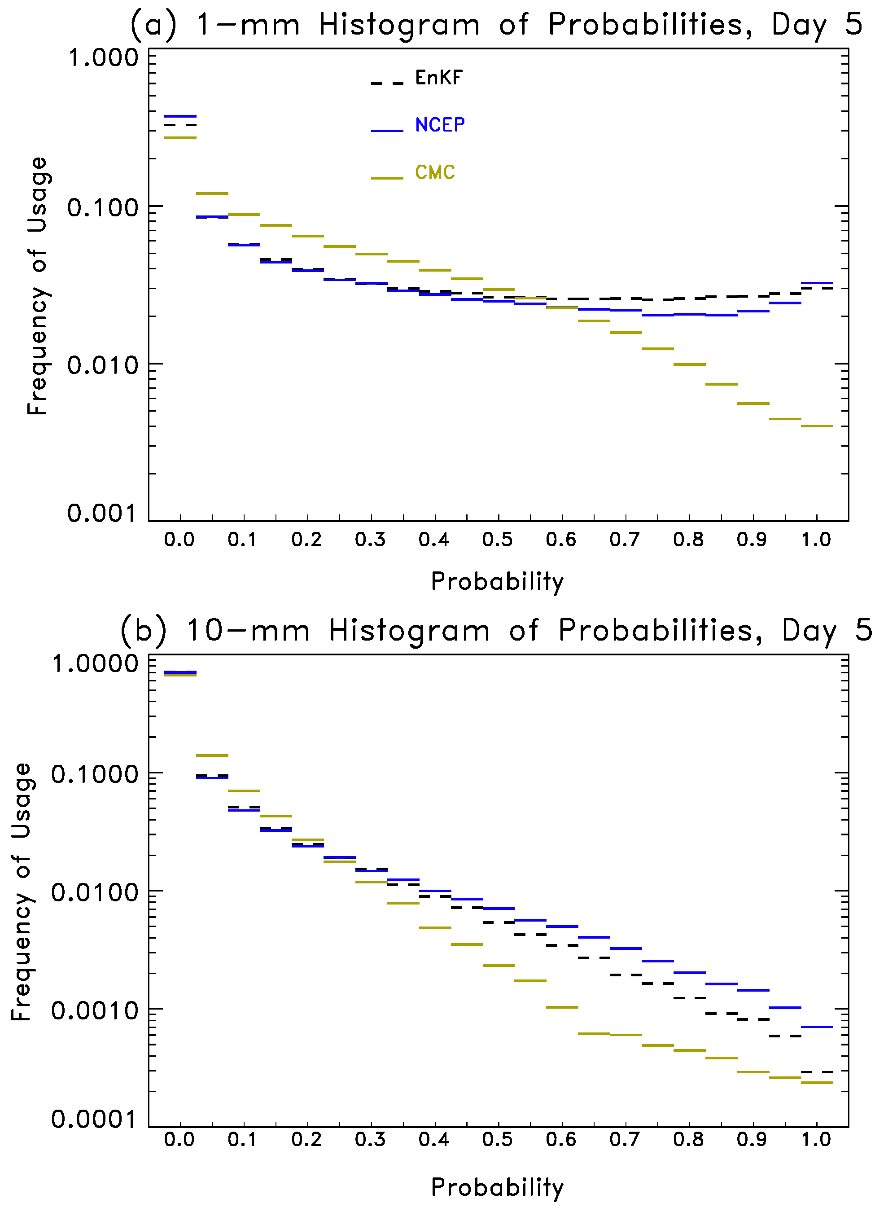
Sharpness of the probabilistic precip. forecasts, day +5

Slide 19
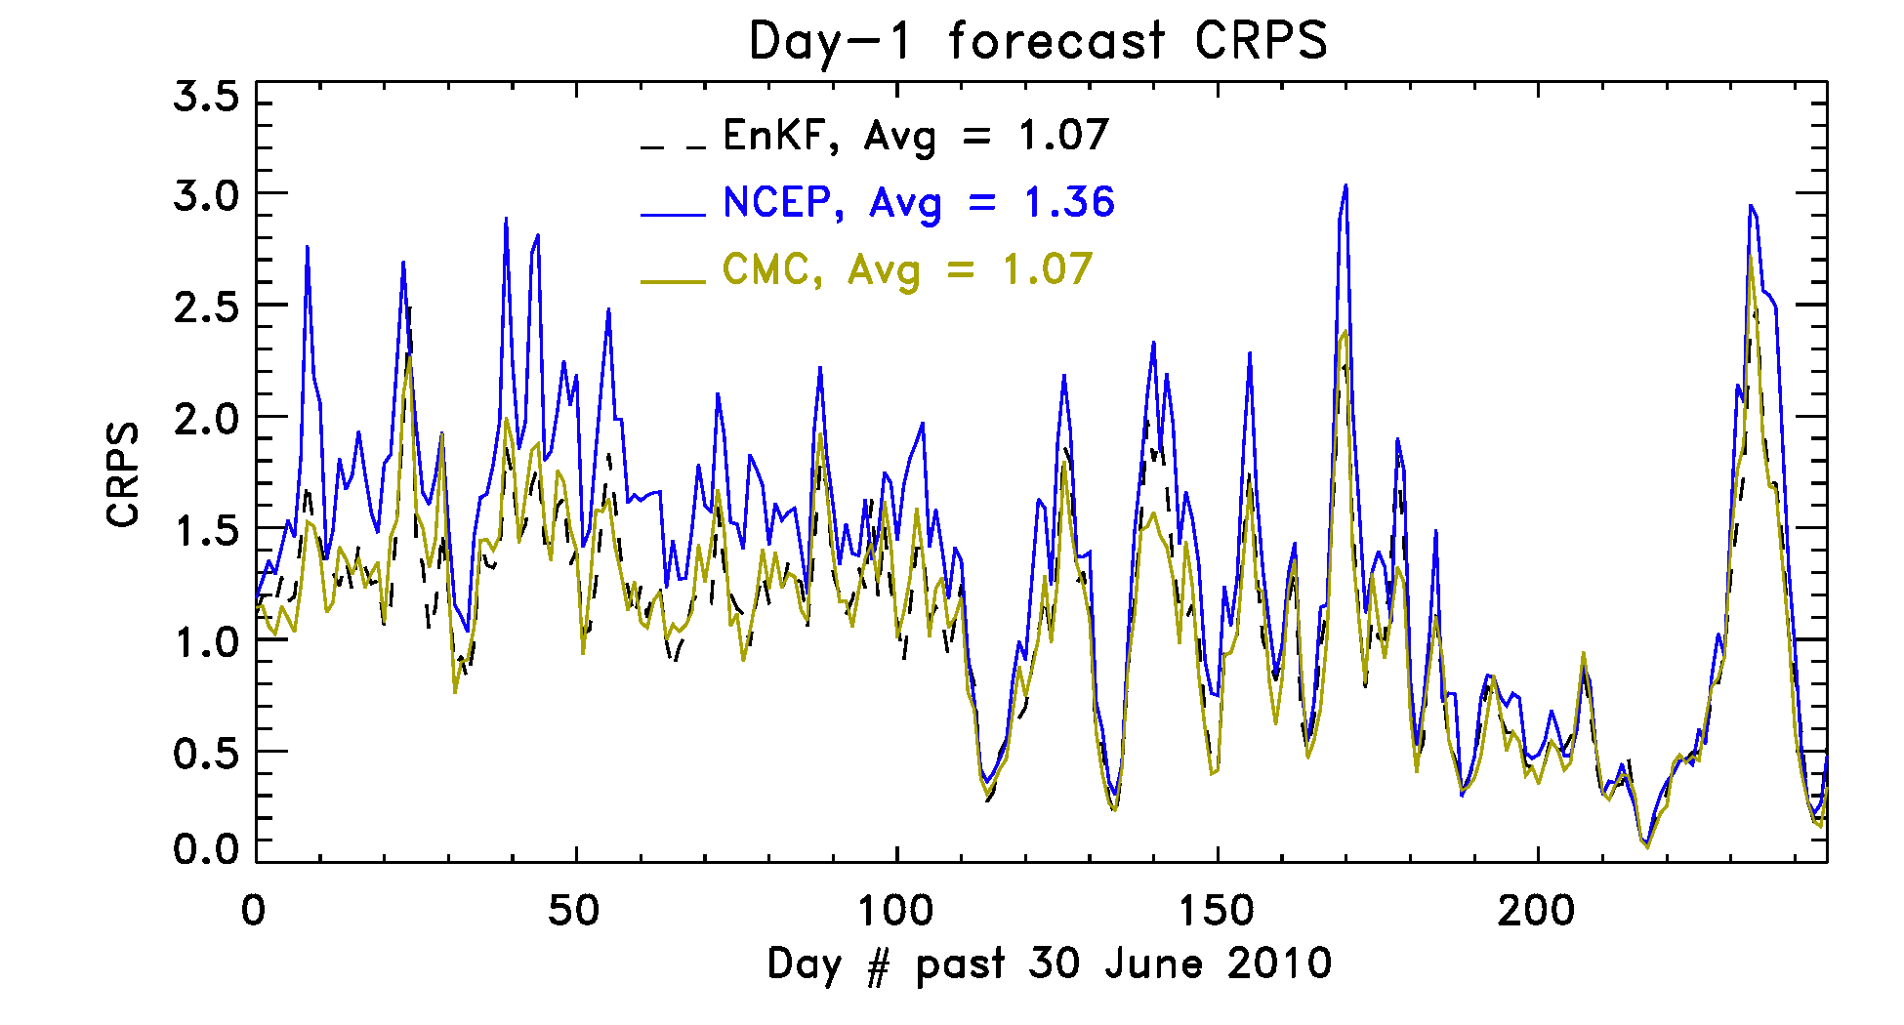
Continuous ranked probability scores
This measures the integrated squared difference between the forecast and observed cumulative
distribution functions. Lower is better. Main point here is that the time series shows that
the T254 EnKF +new GFS is rather consistently lower in error than the NCEP system. Would see
the same in a time series of BSS.

Slide 20
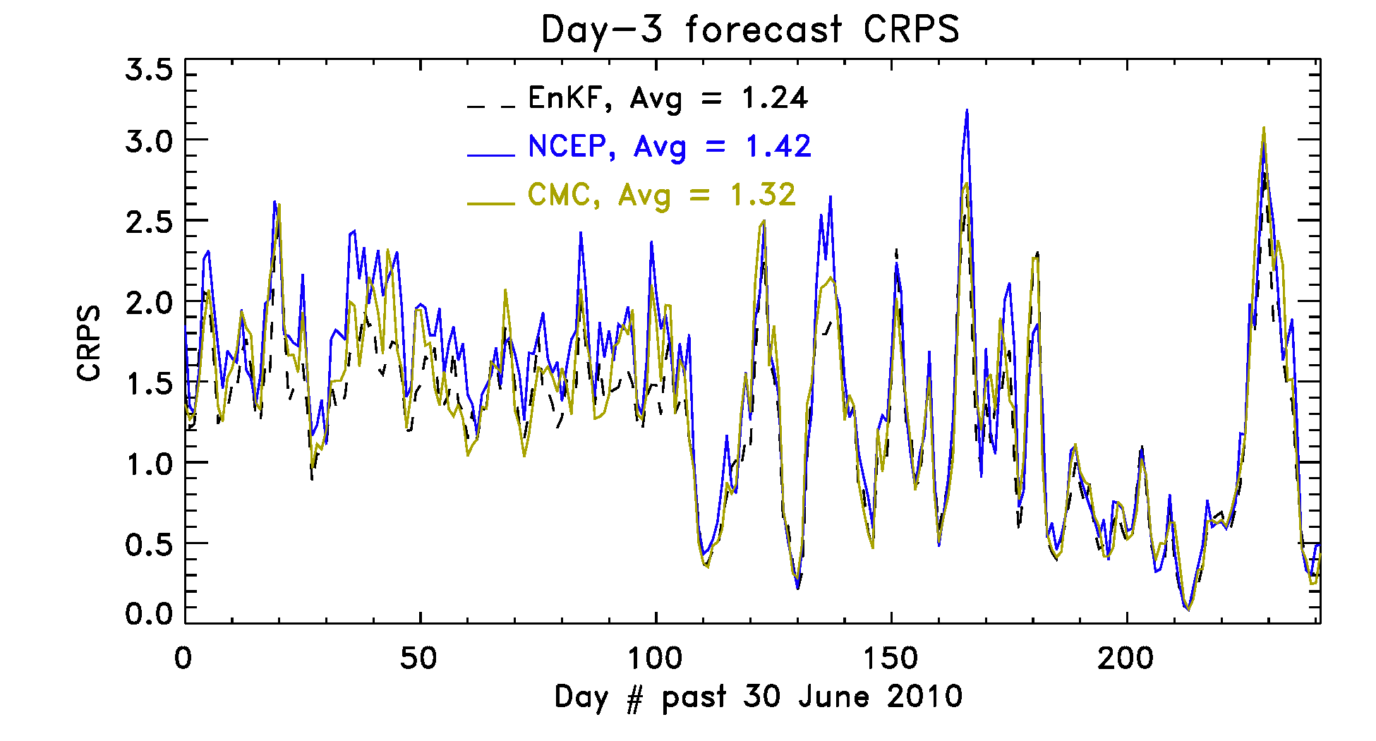
Continuous ranked probability scores
T254 EnKF + new GFS preserves relative advantage over NCEP at day +3 lead.

Slide 21
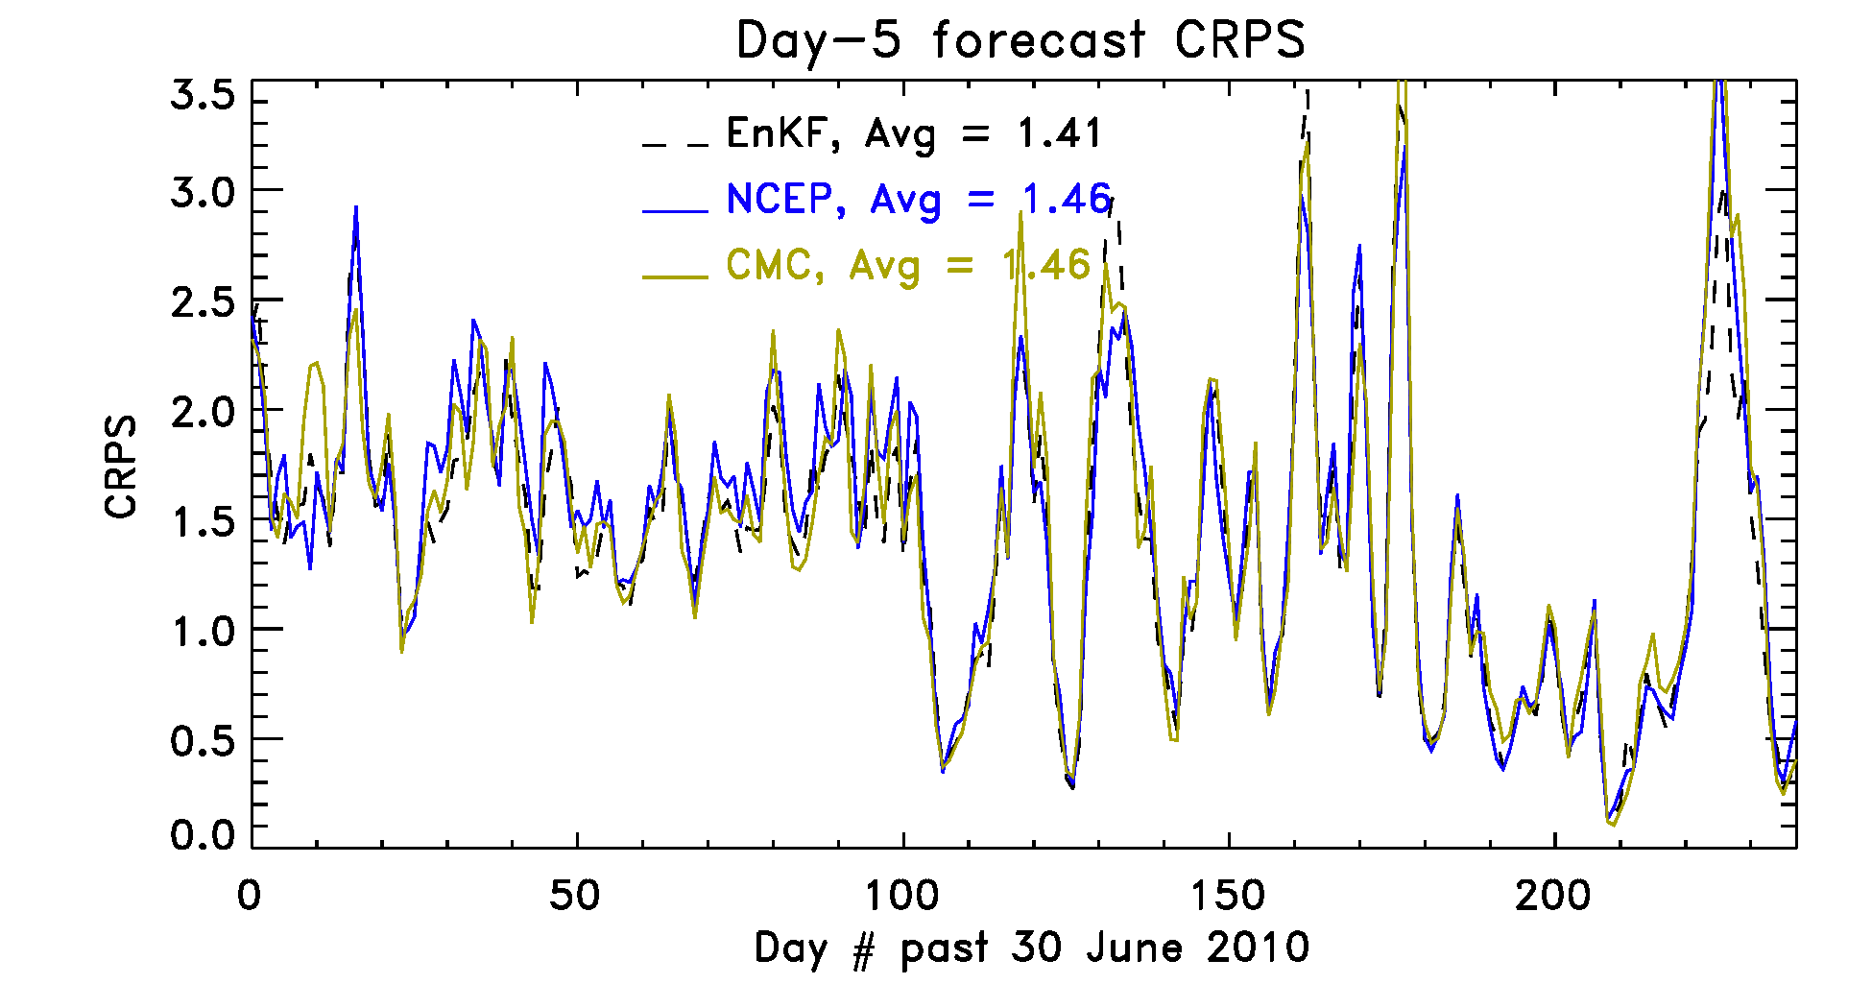
Continuous ranked probability scores
Model forecasts are all more similar as predictability of daily precipitation is
marginal.

Slide 22
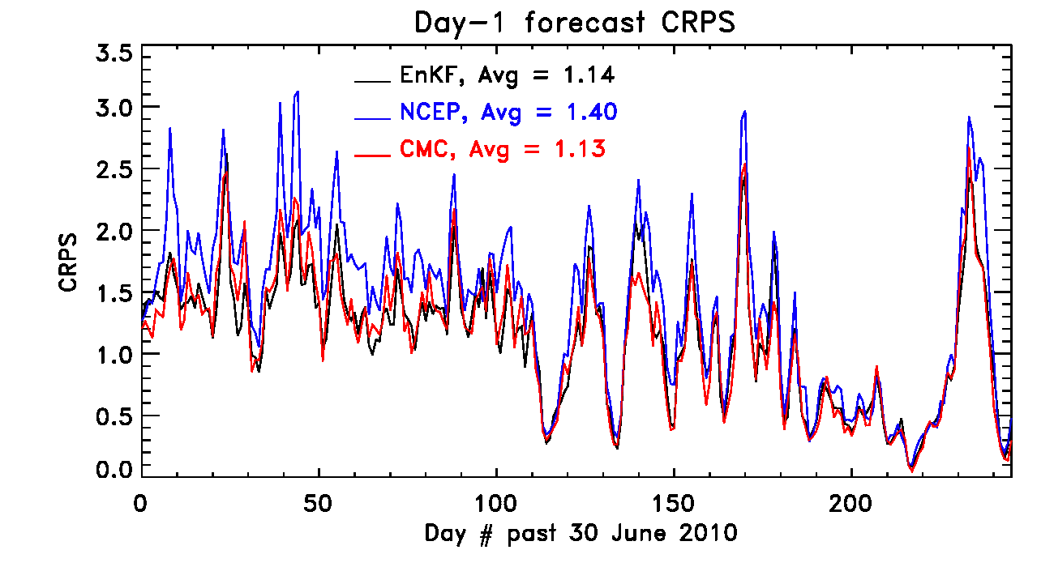
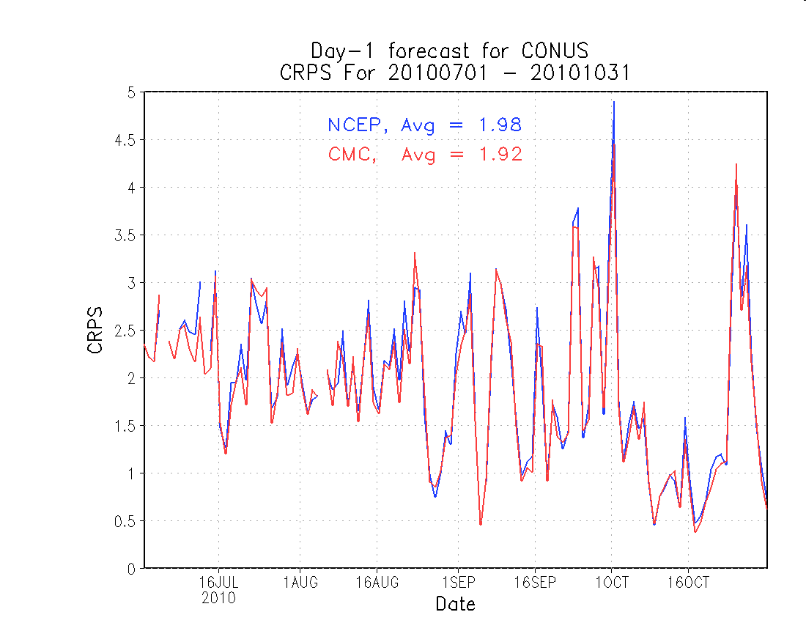
Comparison w. Yuejian Zhu’s time series
Differences:
NCEP only
12Z forecasts
(2) NCEP verified
against rain gage
observations,
mine here with
Stage–IV analysis
(3) Code used --
mine at end of
presentation
NCEP’s verification - Zhu

Slide 23
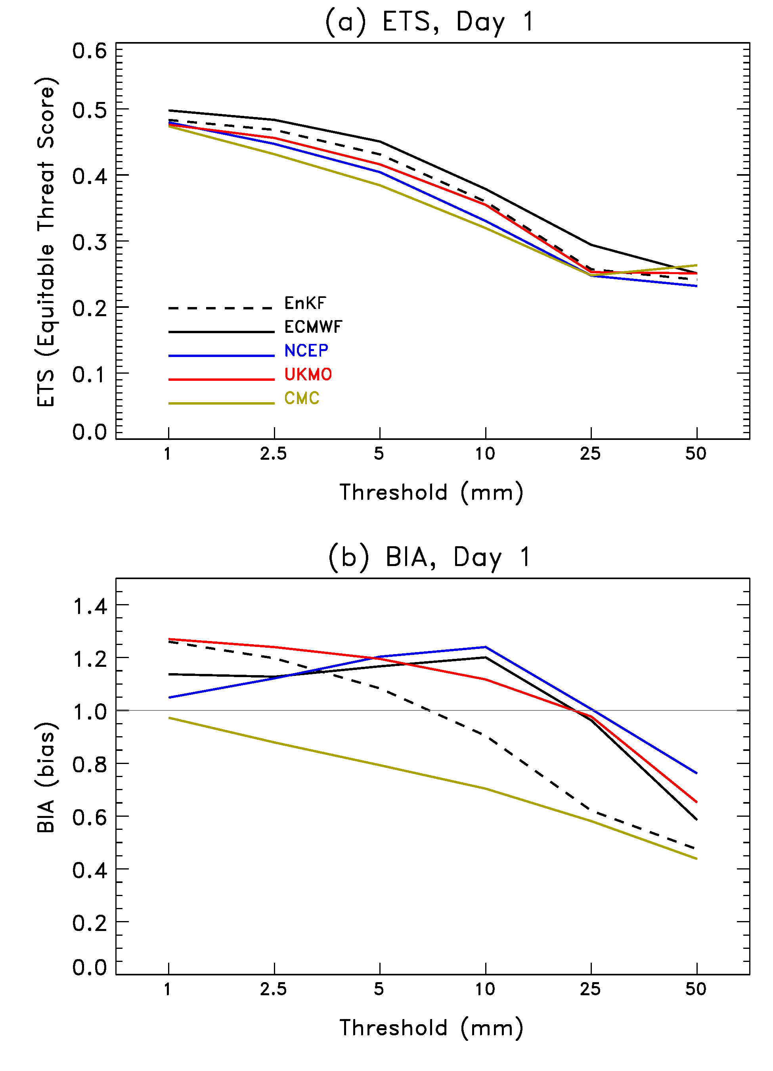
Equitable
Threat Score and Bias
ETS of the 20-member ensemble-mean forecast. Again, improvement with EnKF + new GFS.
CMC forecasts less skillful because their forecasts are less sharp (see later slides).

Slide 24
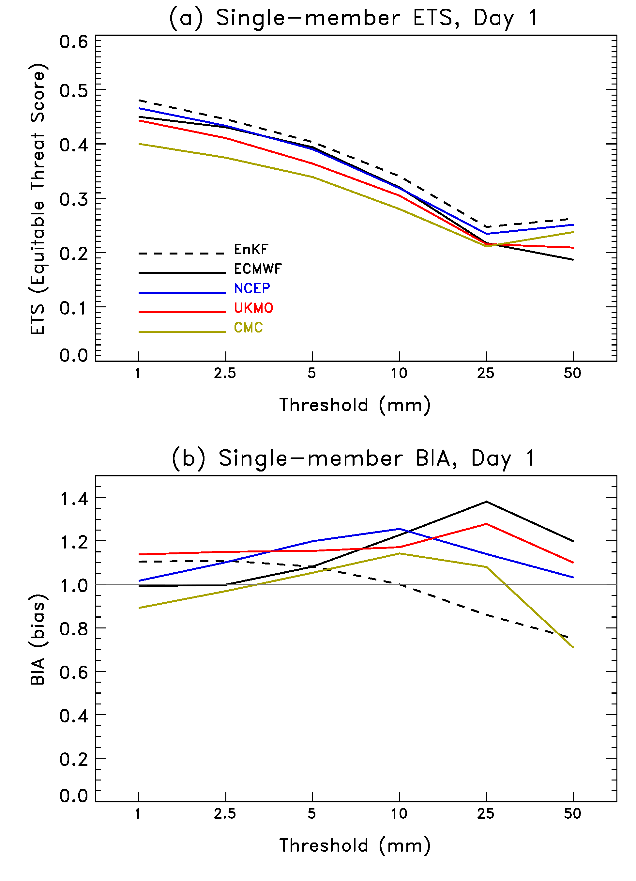
ETS of single member forecast
ETS and BIA will be affected by
the ensemble averaging
process, e.g., smearing out and
reducing the amplitude of the
precipitation maxima. Here’s
stats for one member only.
EnKF with new GFS
at the top of the pack (but
worse than ECMWF in probabilistic
metrics)?! Our ensemble system
doesn’t simulate model error in
any fashion, e.g., no stochastic
backscatter.

Slide 25
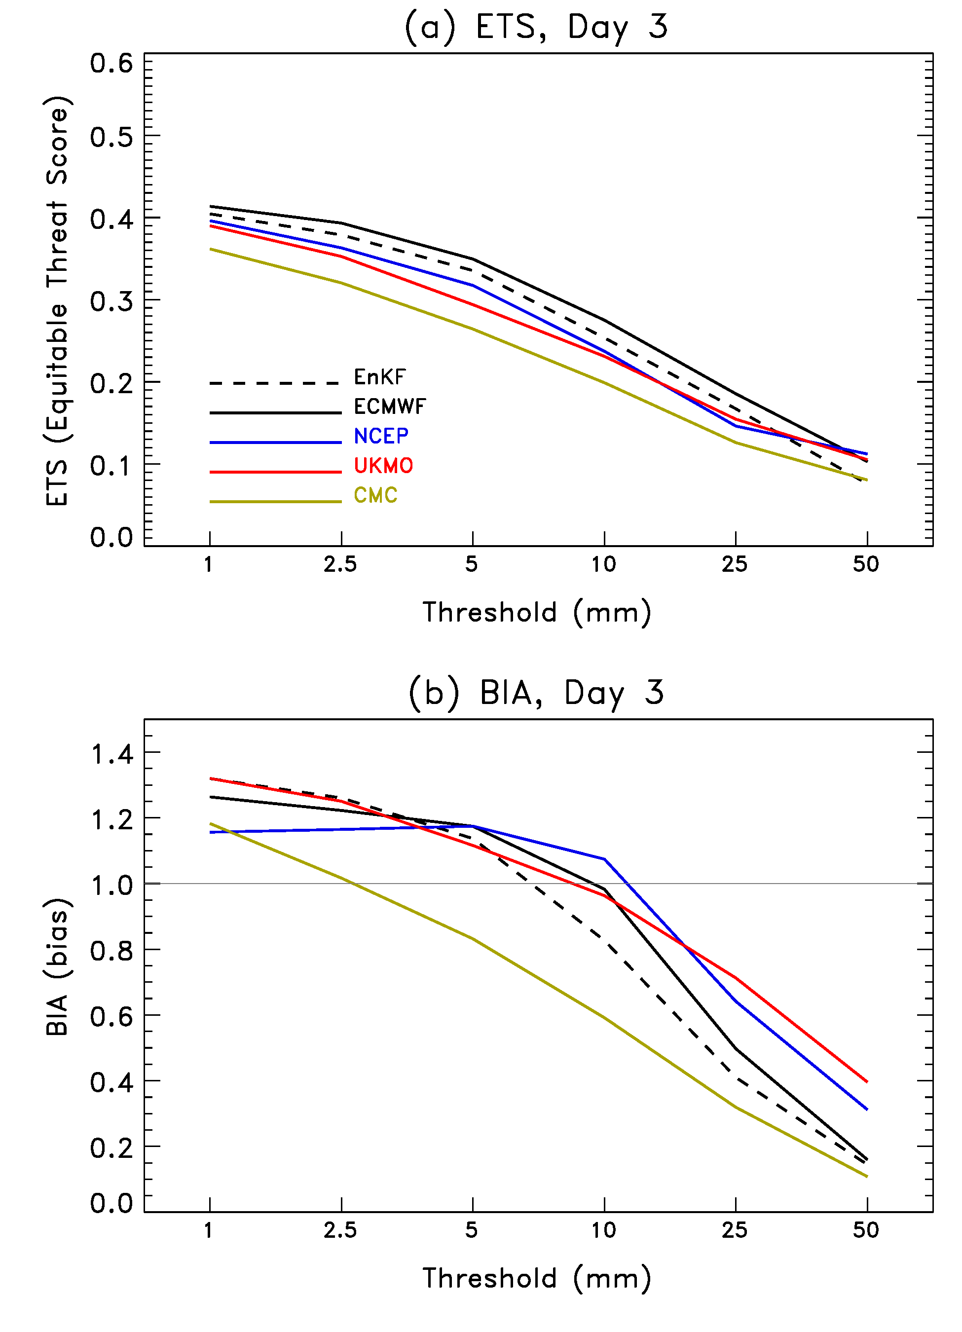
Equitable
Threat Score
and Bias
A similar story for the
day +3 forecasts.

Slide 26
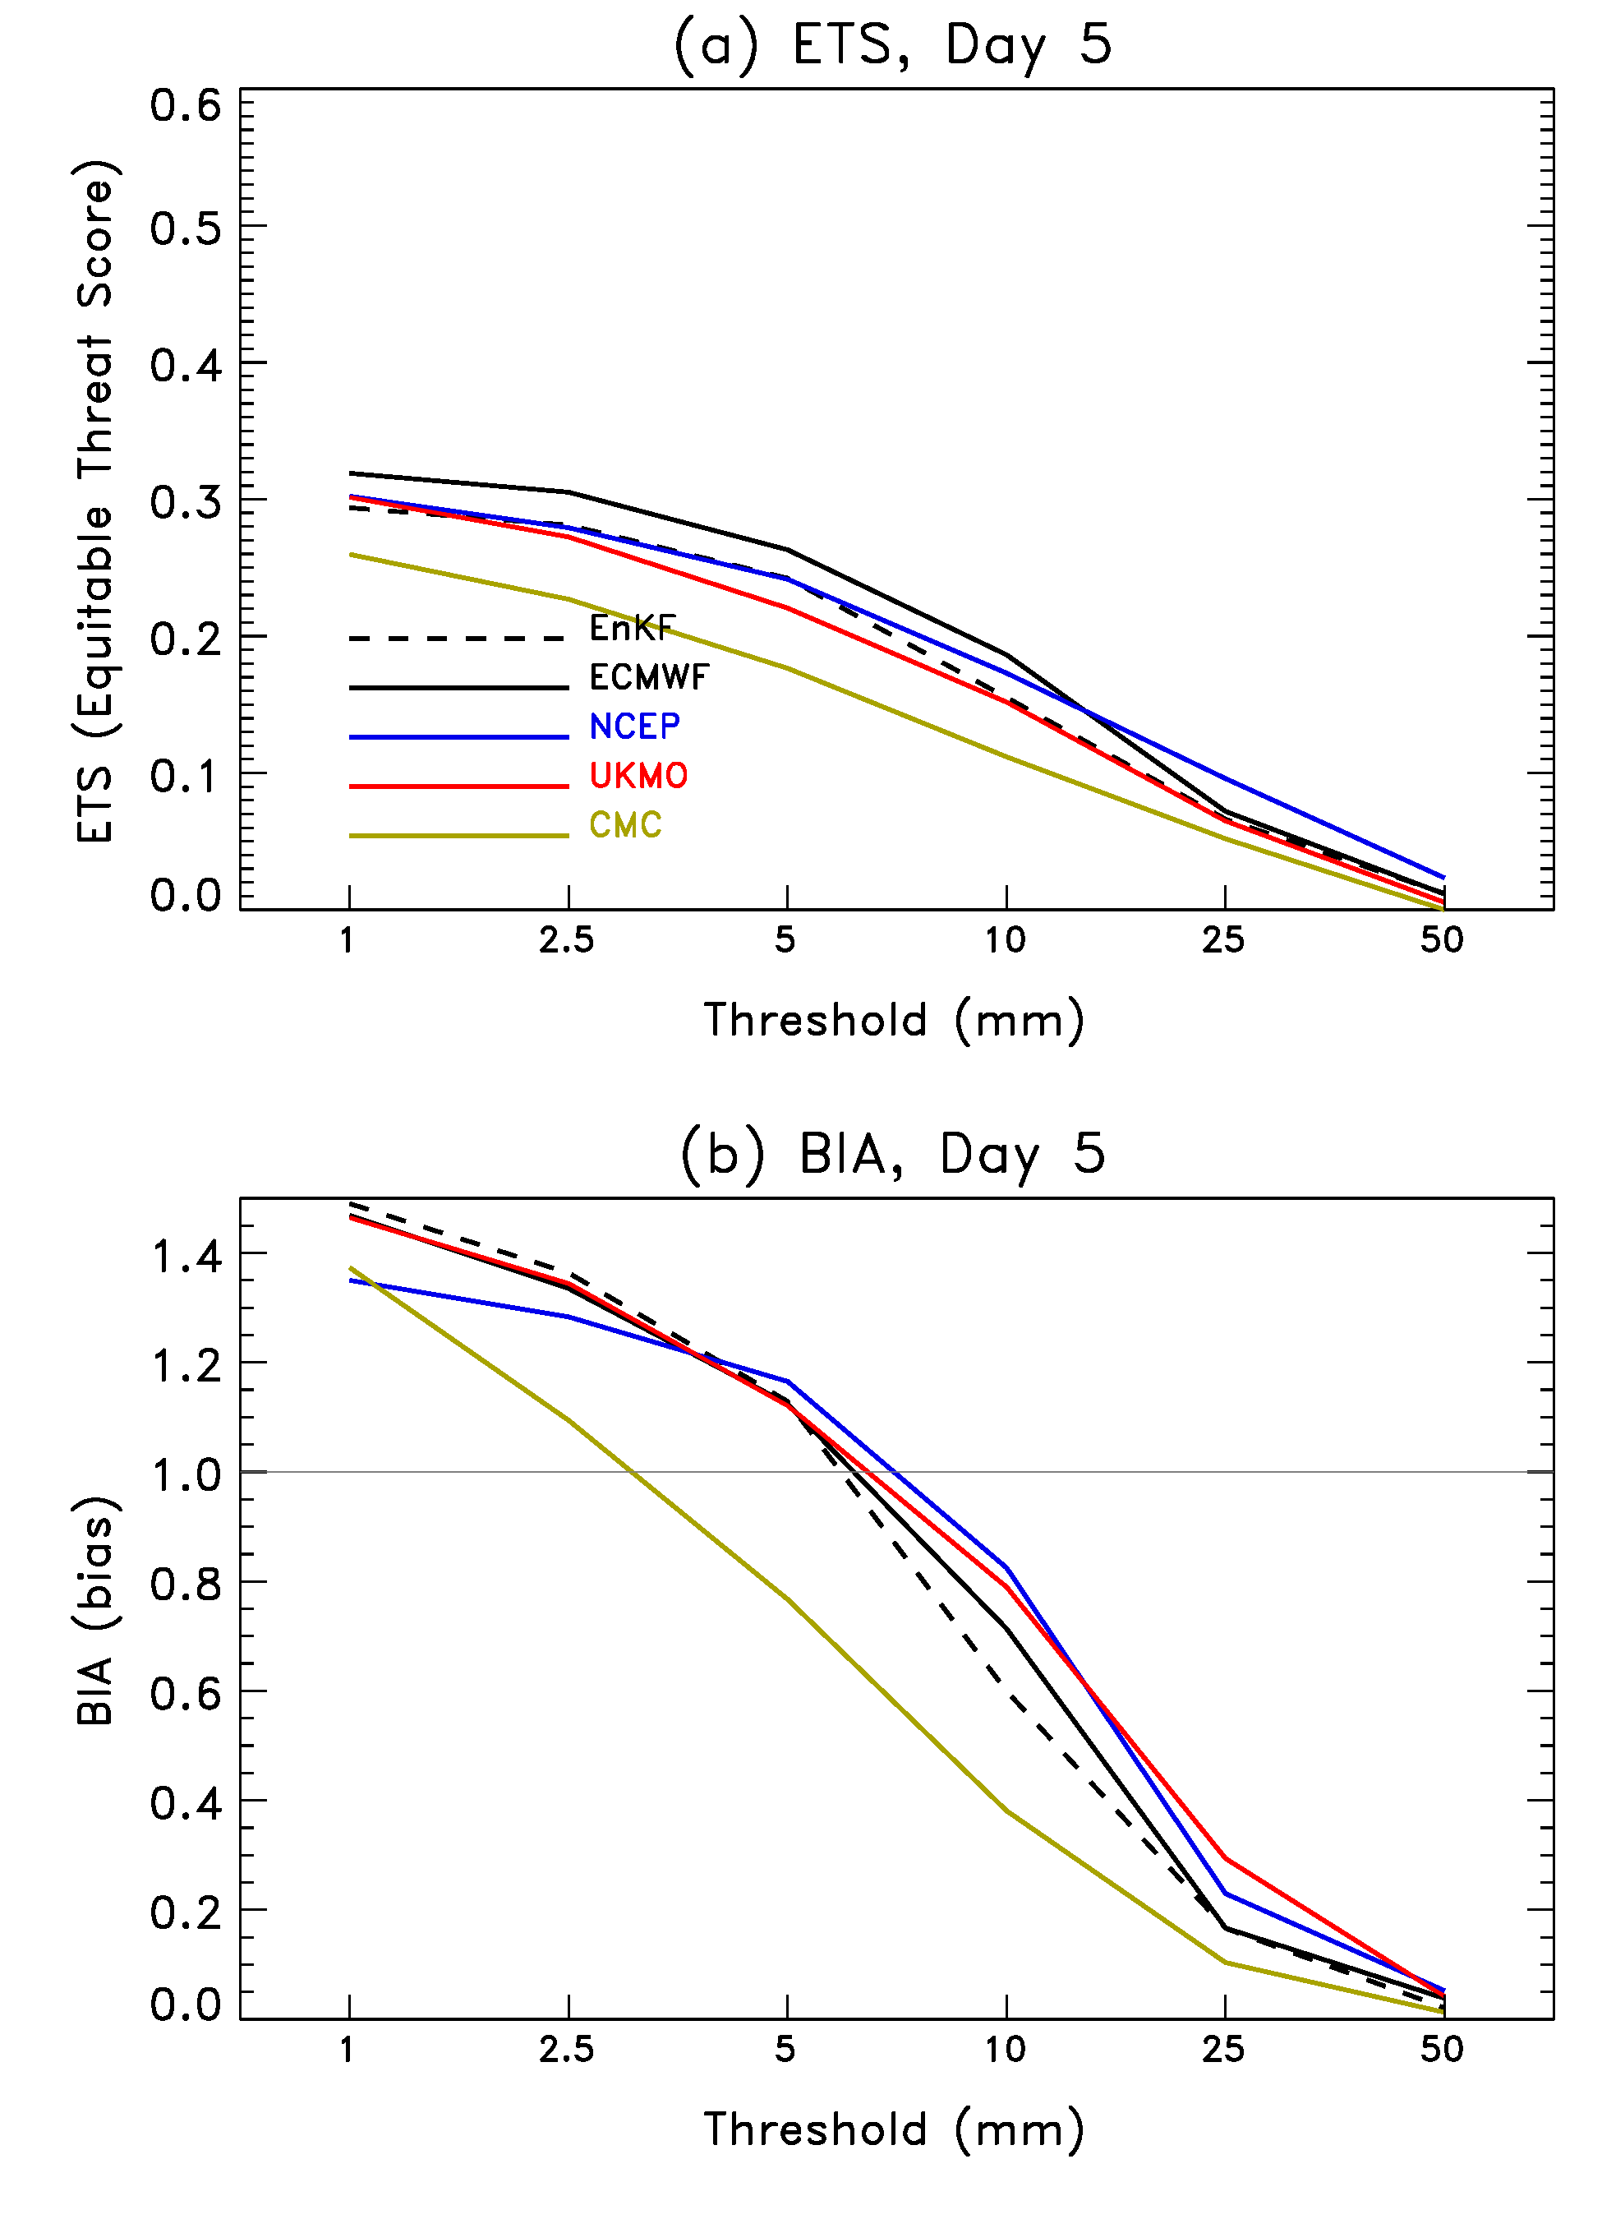
Equitable
Threat Score and Bias
Now the advantage of the EnKF
+ new GFS has largely disappeared
relative to NCEP in this norm.

Slide 27
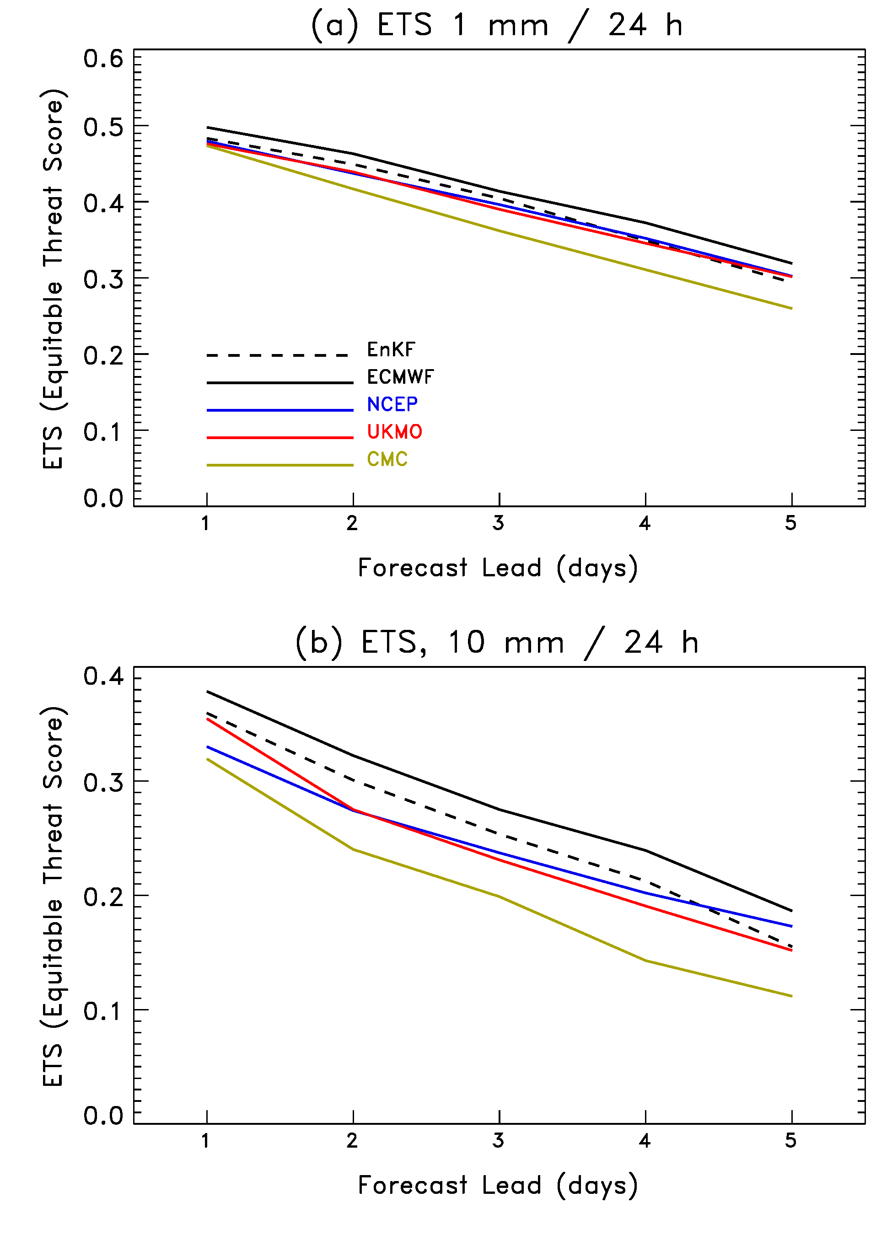
ETS as a function of lead time

Slide 28
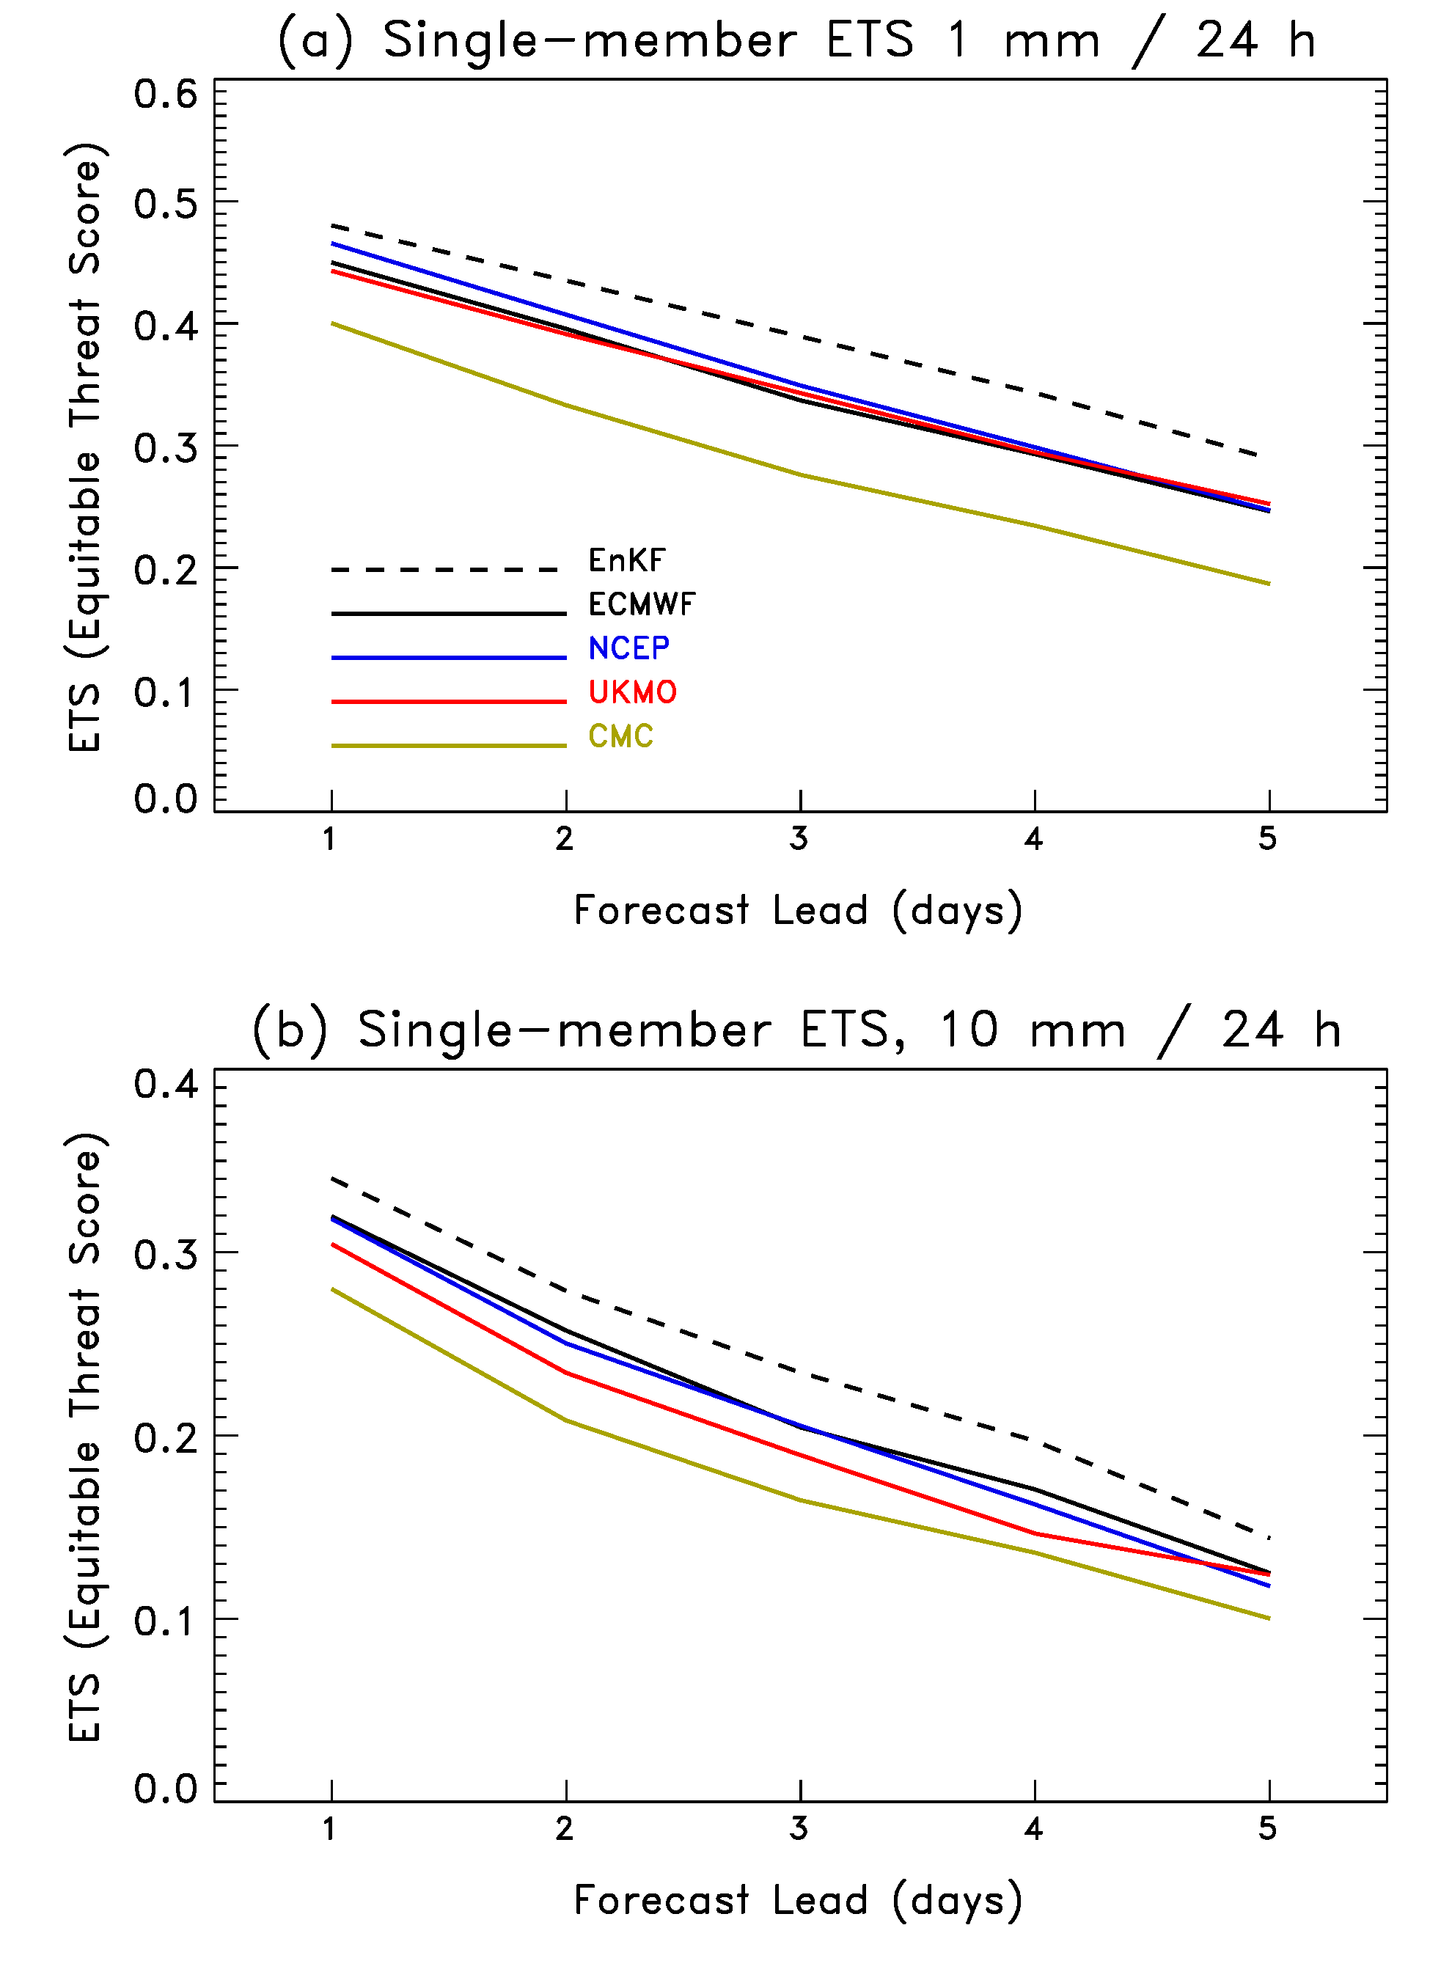
ETS as a function of lead time, single member of ensemble.

Slide 29
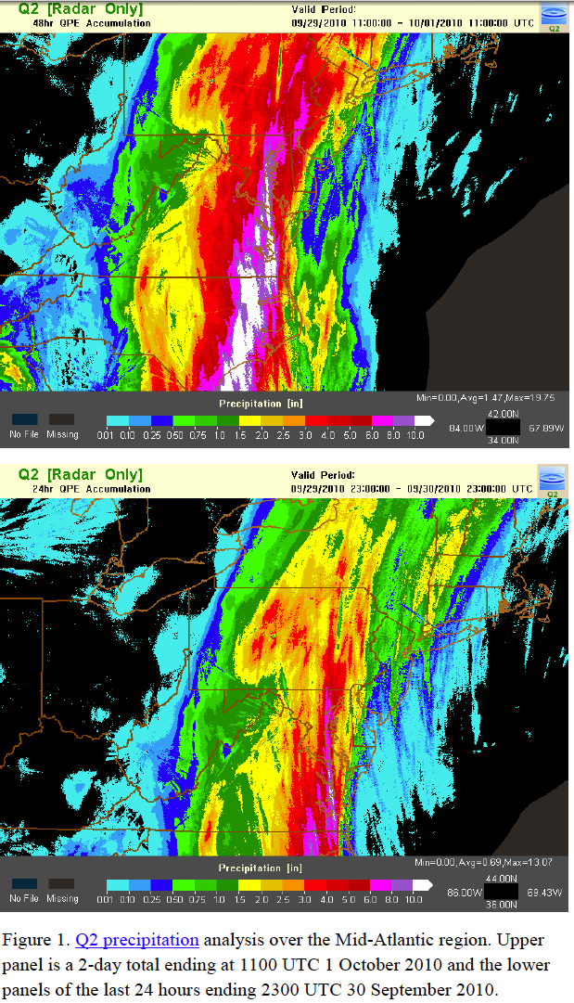
Case study:
Extreme rainfall from remnants of TS Nicole, 29-30 September 2010
24-h accumulated precipitation valid
1100 UTC 1 October 2011
Massive and widespread East-coast
rain event, linked in part to moisture
advected ahead of remnants of
tropical storm Nicole.
precipitation analysis, c/o Rich Grumm, NWS/WFO,
State College PA

Slide 30
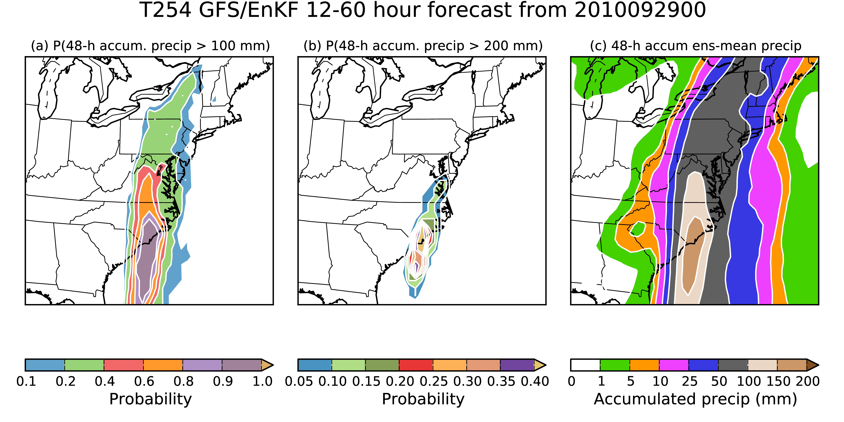
Probability and ensemble mean, GFS/EnKF
Axis of high probability for 100 mm too far west, but axis for 200 mm better. Ensemble-
mean amounts in excess of 150 mm.

Slide 31
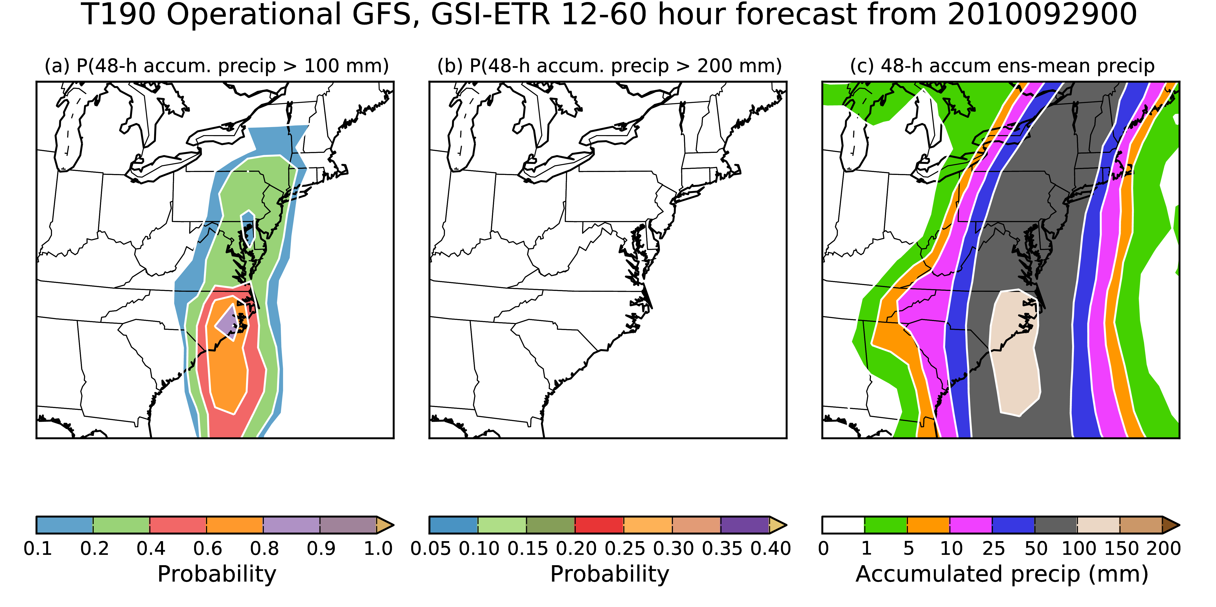
Probability and ensemble mean, NCEP opnl
Better job with axis of high probability for 100 mm relative to GFS/EnKF on previous slide,
but no probabilities in excess of 200 mm. Are the lesser amounts relative to GFS/EnKF
a function of the coarser grid size (here, 1-degree grid vs. 0.5-degree for GFS-EnKF)?

Slide 32
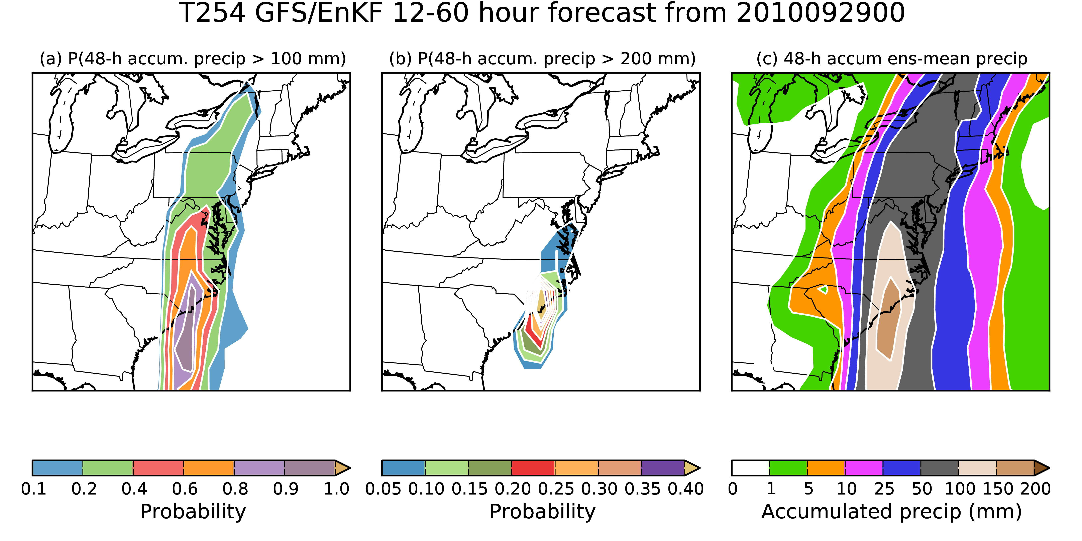
Probability and ensemble mean, GFS/EnKF, degraded to 1-degree grid of operational
Axis of high probability for 100 mm too far west, but axis for 200 mm better. Ensemble-
mean amounts in excess of 150 mm.

Slide 33
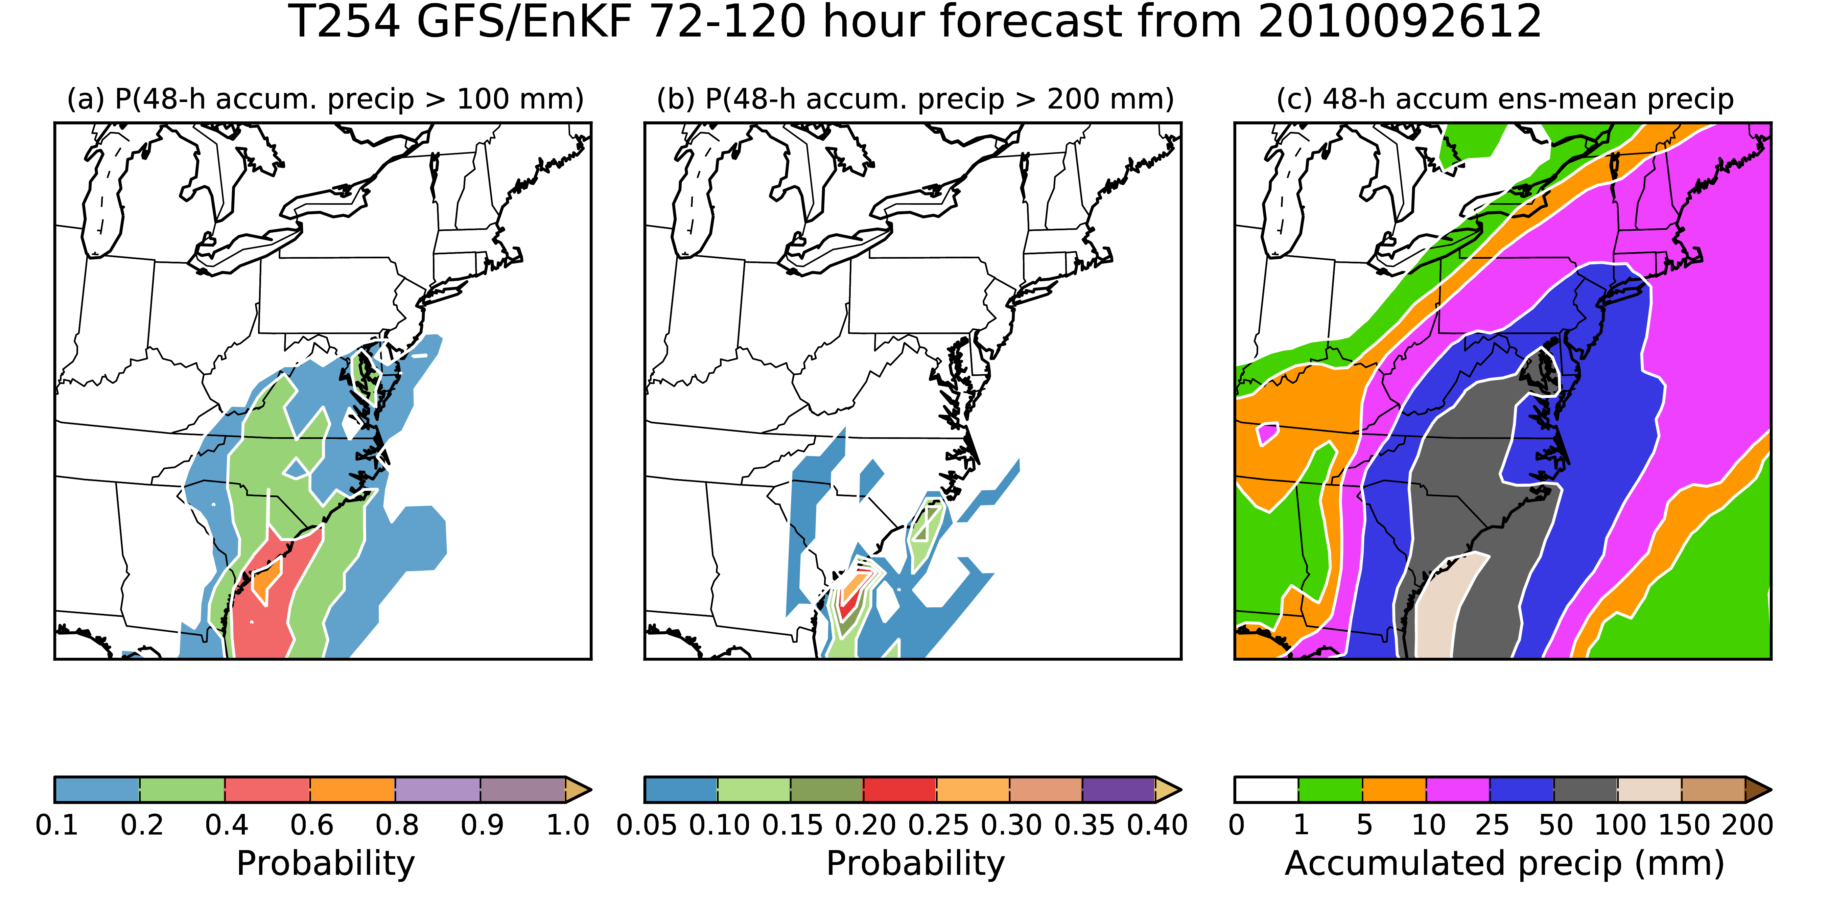
Probability and ensemble mean, GFS/EnKF
System appears to be a bit slow at this lead, with precip max too far south and west.
Ensemble mean is indicating widespread significant rain along I-95 corridor.

Slide 34
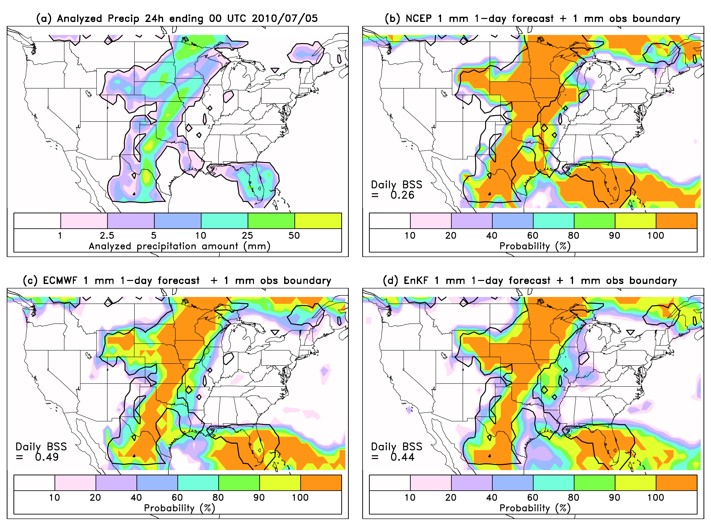
Representative day-1 forecast of 1-mm probabilities from NCEP, ECMWF, EnKF
NCEP penalized
for overforecast
in central MO,
IL

Slide 35
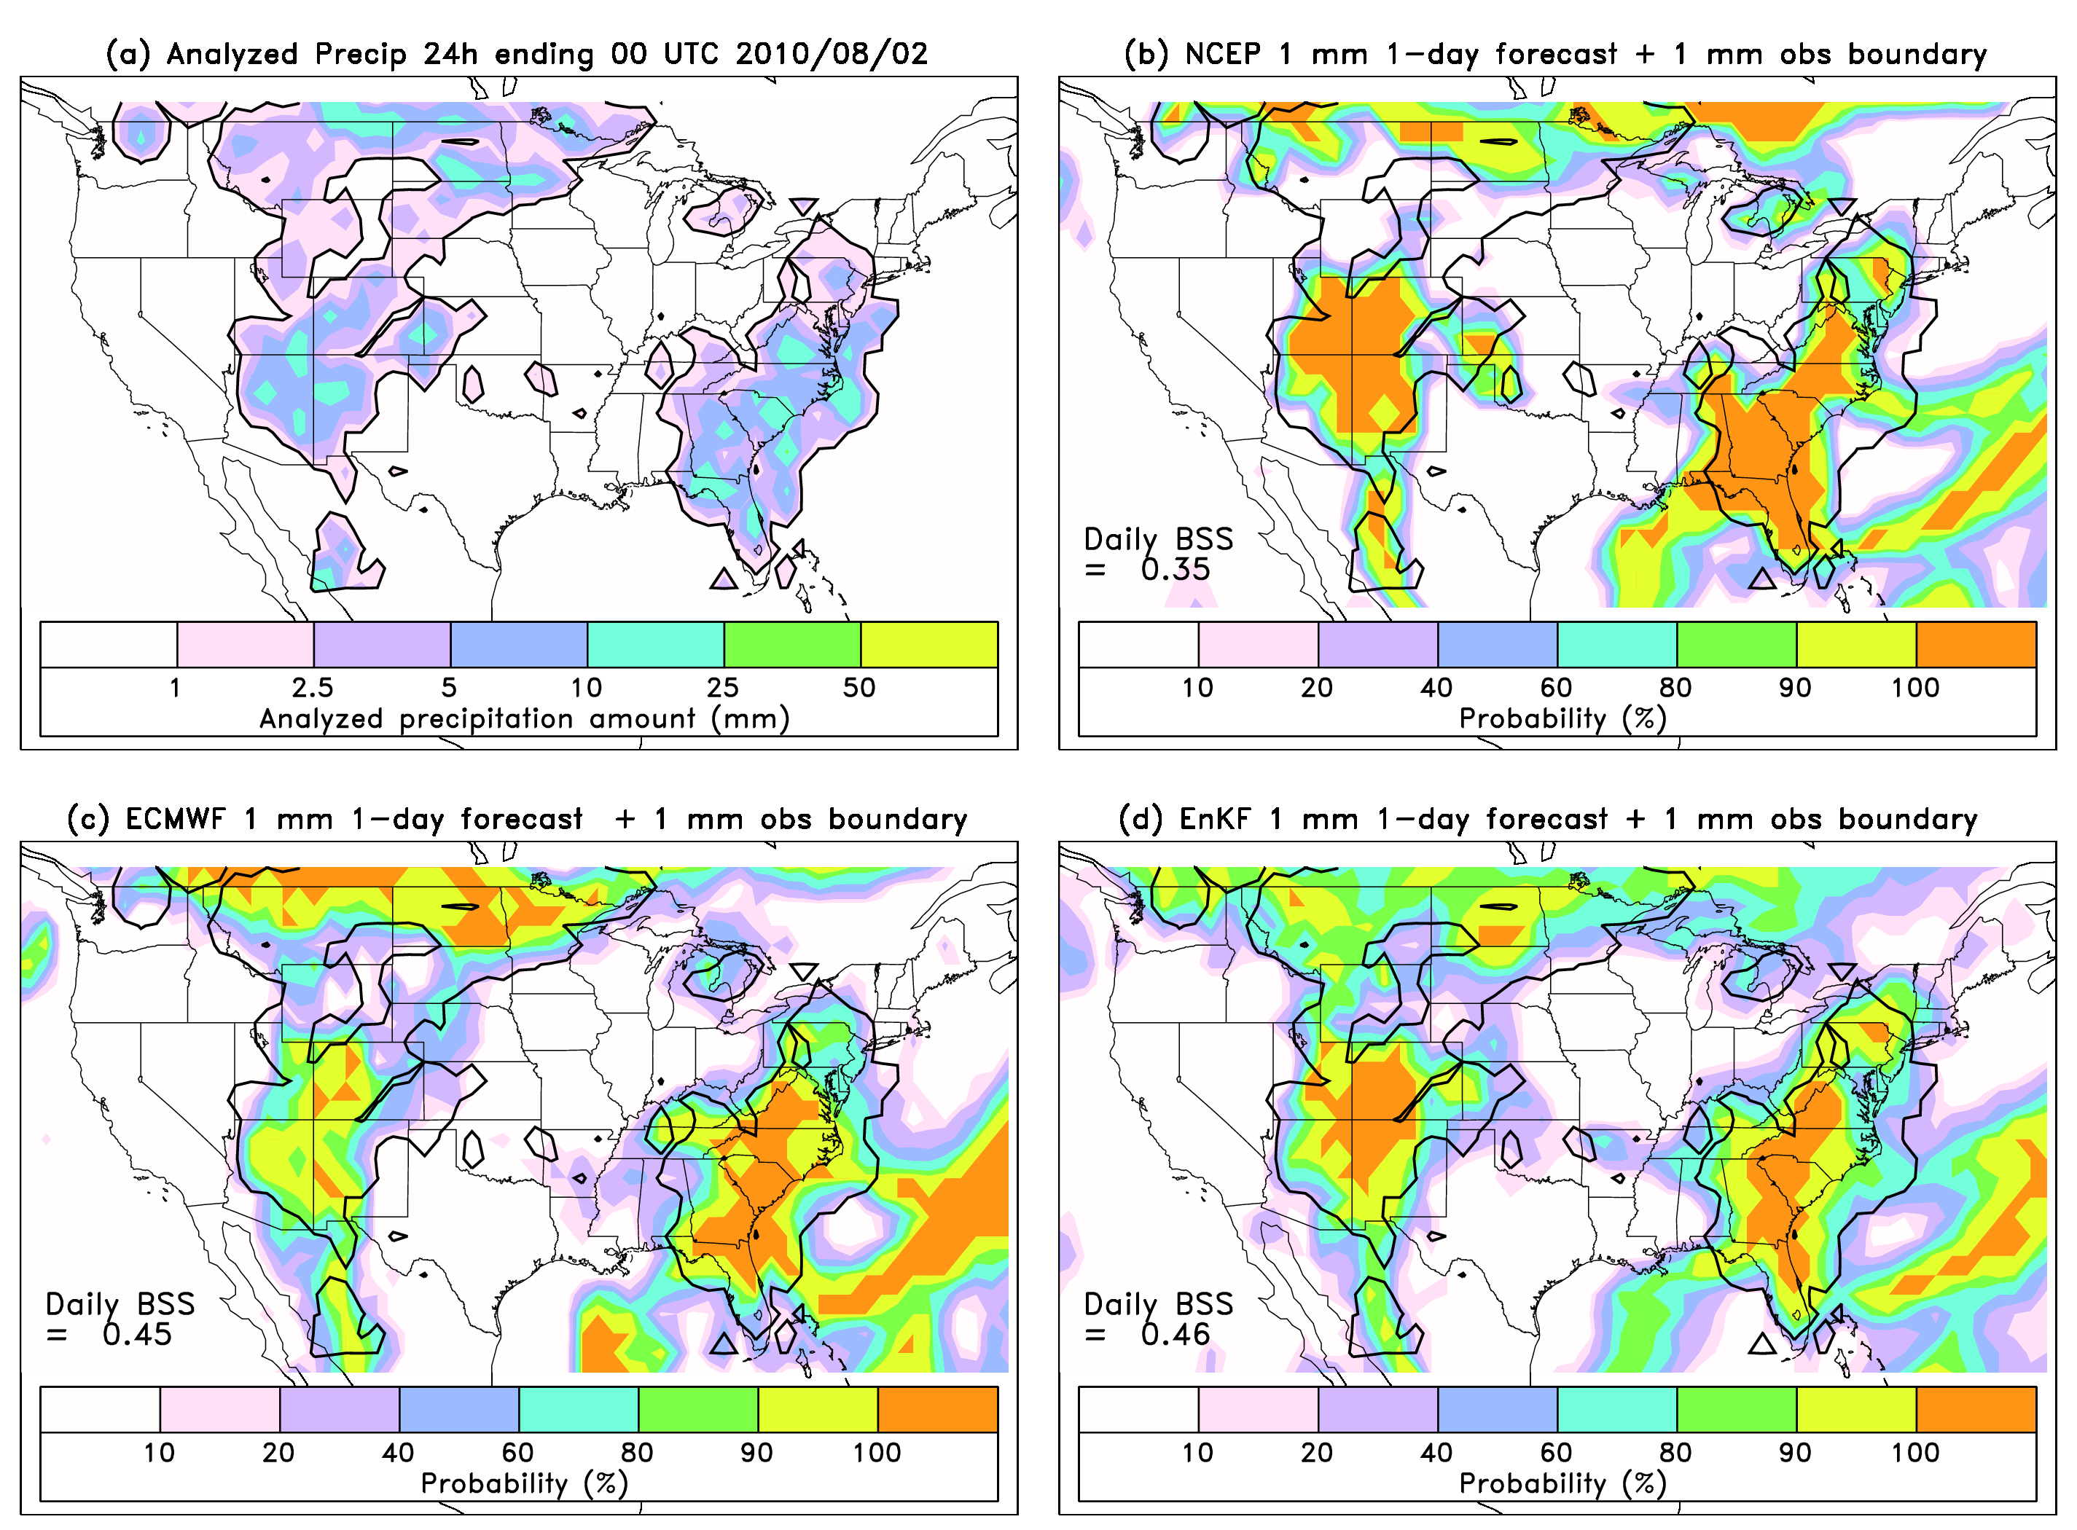
Representative day-1 forecast of 1-mm probabilities from NCEP, ECMWF, EnKF
NCEP penalized
for under-forecast
in upper Great
Plains, WY, MT

Slide 36
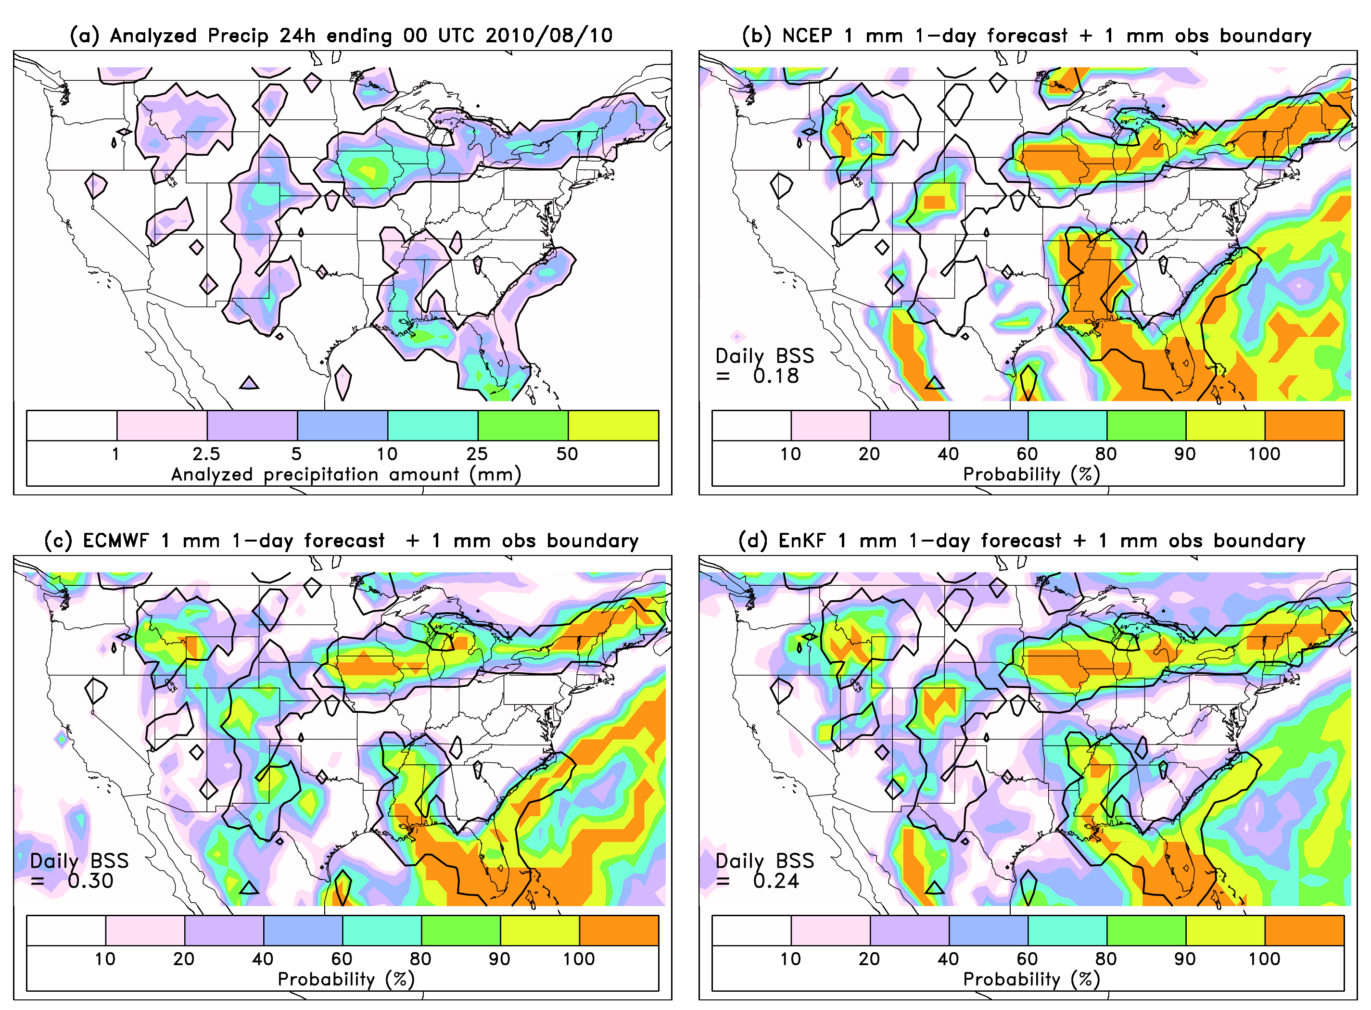
Representative day-1 forecast of 1-mm probabilities from NCEP, ECMWF, EnKF
NCEP less filled
in with higher
probabilities
in eastern
Rockies

Slide 37
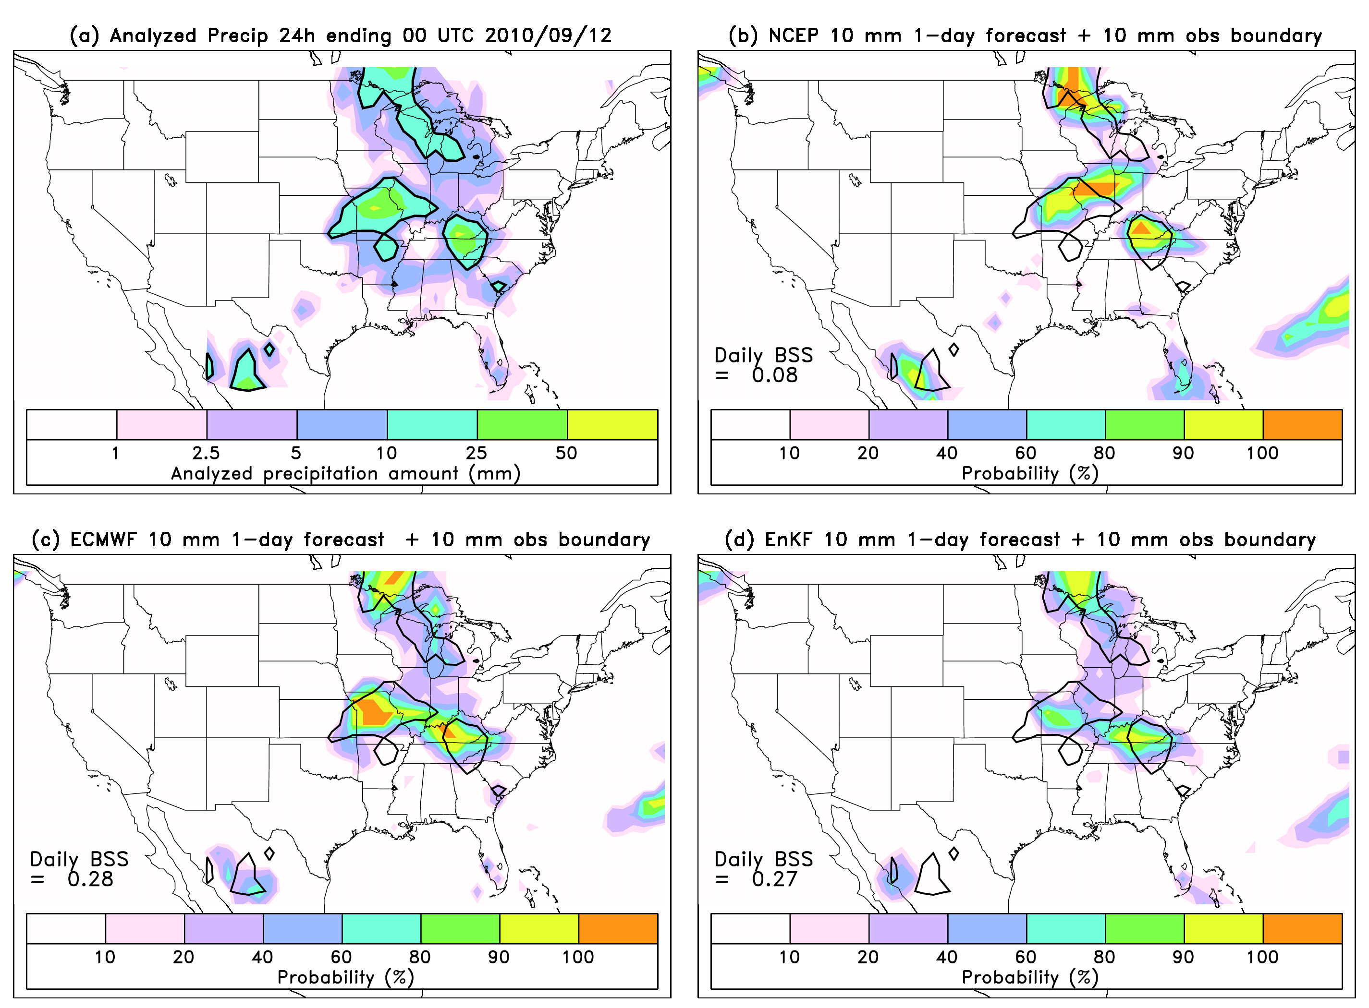
Representative day-1 forecast of 10-mm probabilities from NCEP, ECMWF, EnKF
NCEP more
penalized for
overforecast
in central IL.

Slide 38
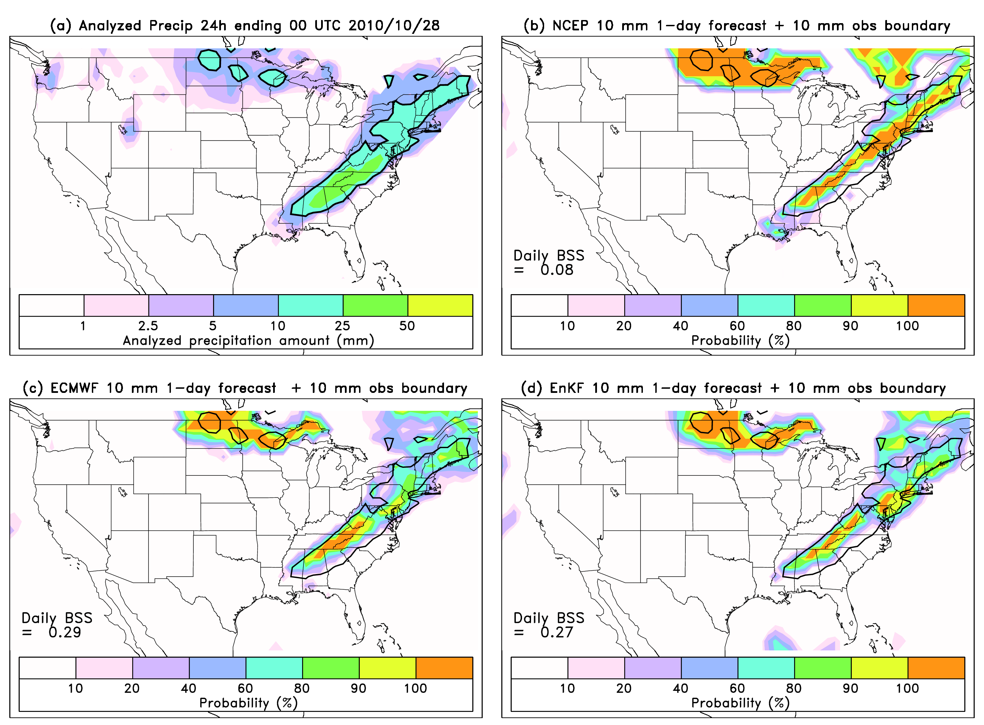
Representative day-1 forecast of 10-mm probabilities from NCEP, ECMWF, EnKF
NCEP
overforecasts
the most in
northern
Great Plains.

Slide 39
Conclusions
Improved performance of the EnKF + new GFS is consistent with the improved performance we’ve seen for, e.g., hurricane track, tropical winds, 500 hPa anomaly correlations.
More evidence that the new GFS and the EnKF should benefit the hybrid system, in development.
  suggestion that impact of improved precipitation forecasts here may be more due to new GFS than EnKF, however.
Thanks to Daryl Kleist, John Derber, Dave Parrish for their work in developing EnKF & hybrid, Yuejian Zhu for discussions, Yan Luo for precip. data set.

Slide 40
Verification details
CRPS
Brier skill scores
Reliability diagrams
ETS & Bias
Sharpness plots
[ go back ]

Slide 41
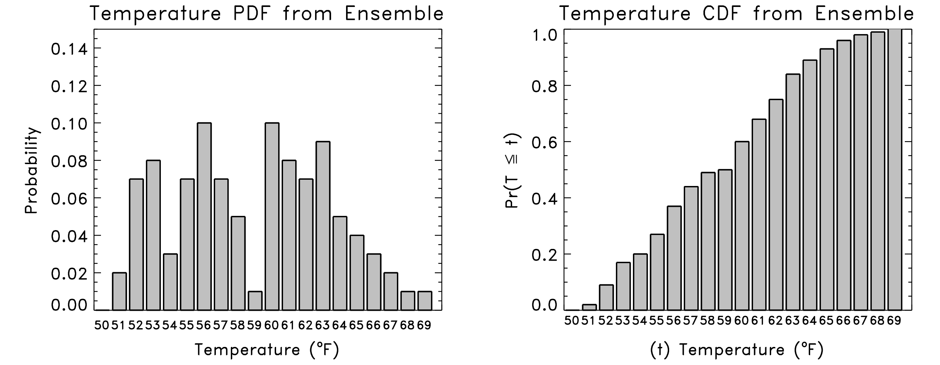
Cumulative distribution function (CDF); used in CRPS
F^{f}(x) = Pr {X ≤ x}
  where X is the random variable, x is some specified threshold.

Slide 42
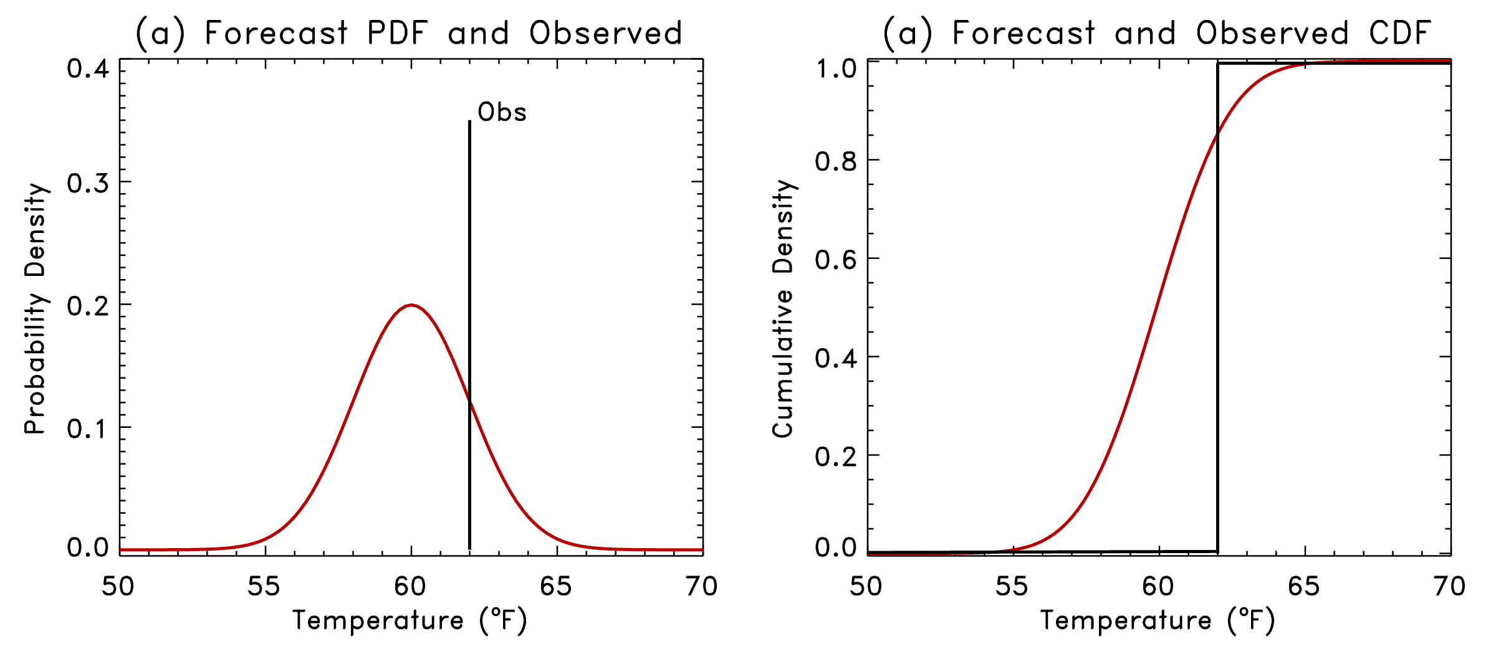
Continuous Ranked Probability Score
Let be the forecast probability CDF for the ith forecast case.
Let be the observed probability CDF (Heaviside function).
b

Slide 43
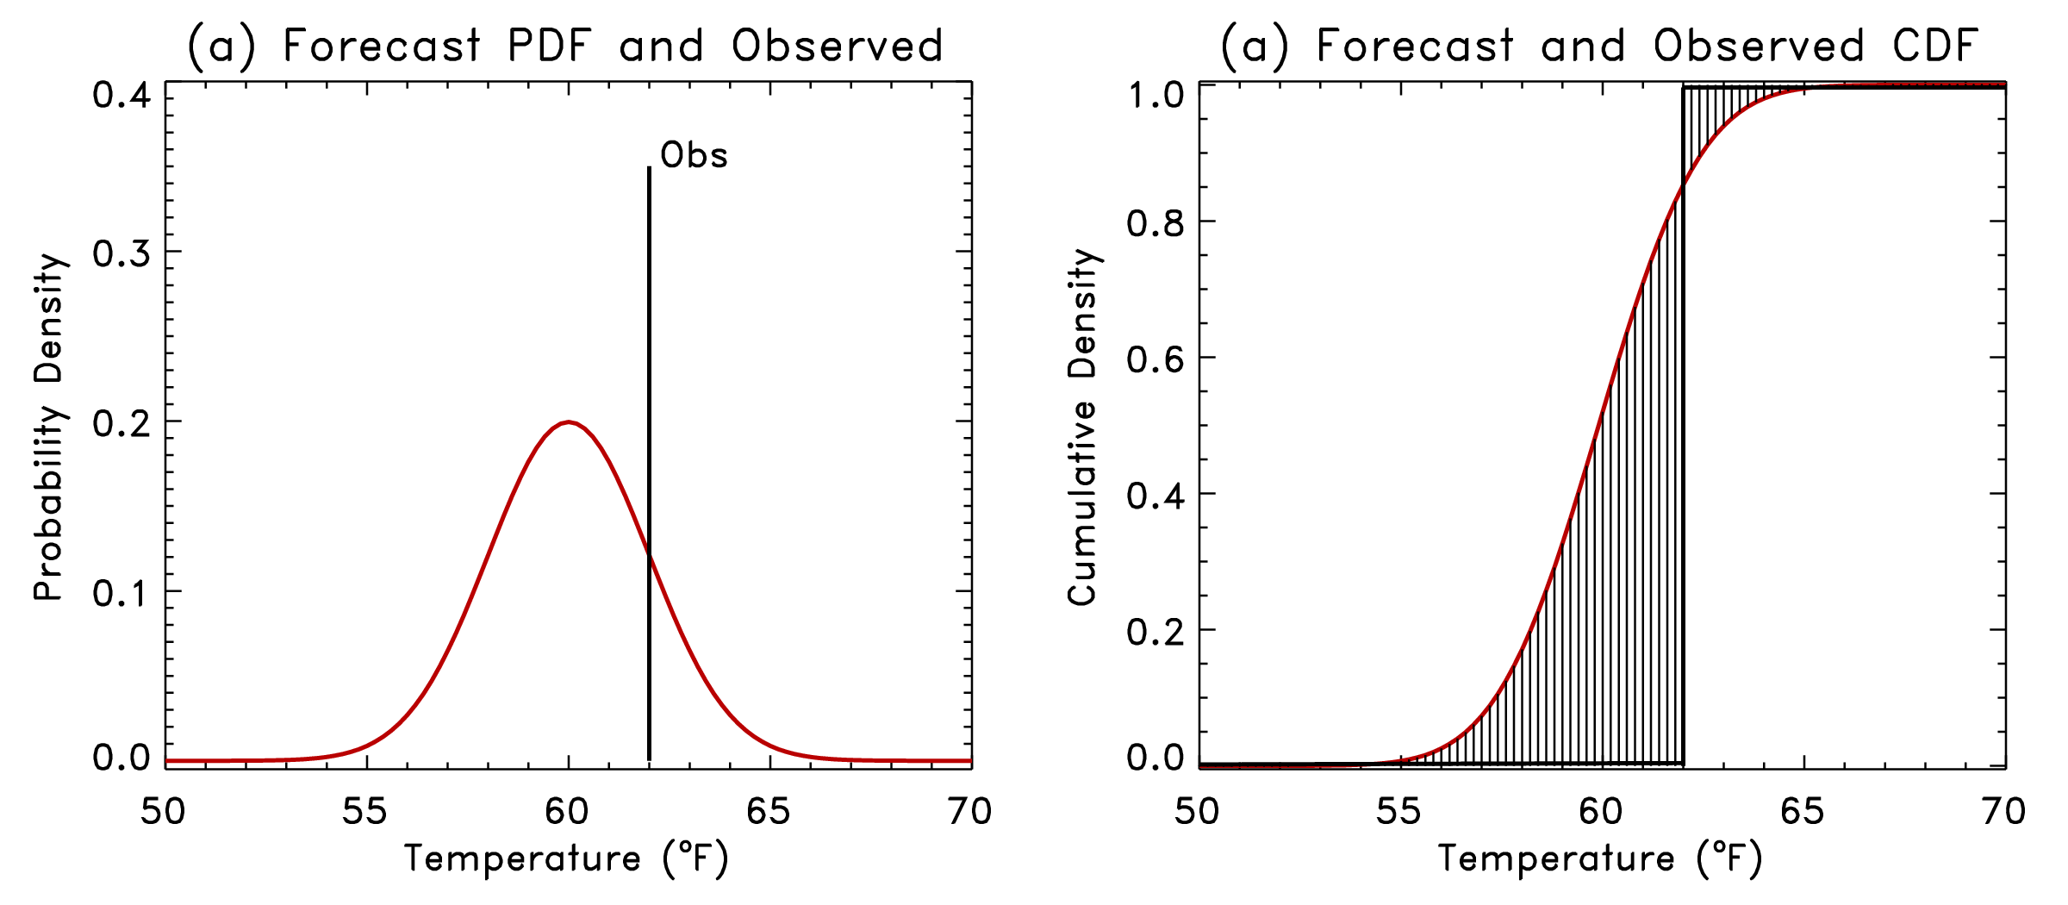
Continuous Ranked Probability Score
Let be the forecast probability CDF for the ith forecast case.
Let be the observed probability CDF (Heaviside function)*.
(difference
squared)
b
* or incorporate obs error; see Candille and Talagrand, QJRMS,2007

Slide 44
Brier score and skill score
My past research has discussed how this can over-estimate forecast skill (Hamill and
Juras, October 2006 QJRMS). For purposes today, we’ll ignore this effect, as we’re
more interested in relative scores of various models than in the absolute scores.

Slide 45
Calculation of climatological probabilities for BSS reference
Based on climatology of Stage-4 data, 2005-2009. Trouble generating off EMC CCPA product.
Climatological probabilities determined separately for each month.
In very dry regions, probabilities directly estimated from event relative frequency will be distorted by “small” sample size.
Remedy this by fitting Gamma distribution to nonzero precipitation amounts using maximum likelihood estimation technique to power transformed (^0.75) precipitation.
Resulting fields look reasonable.

Slide 46
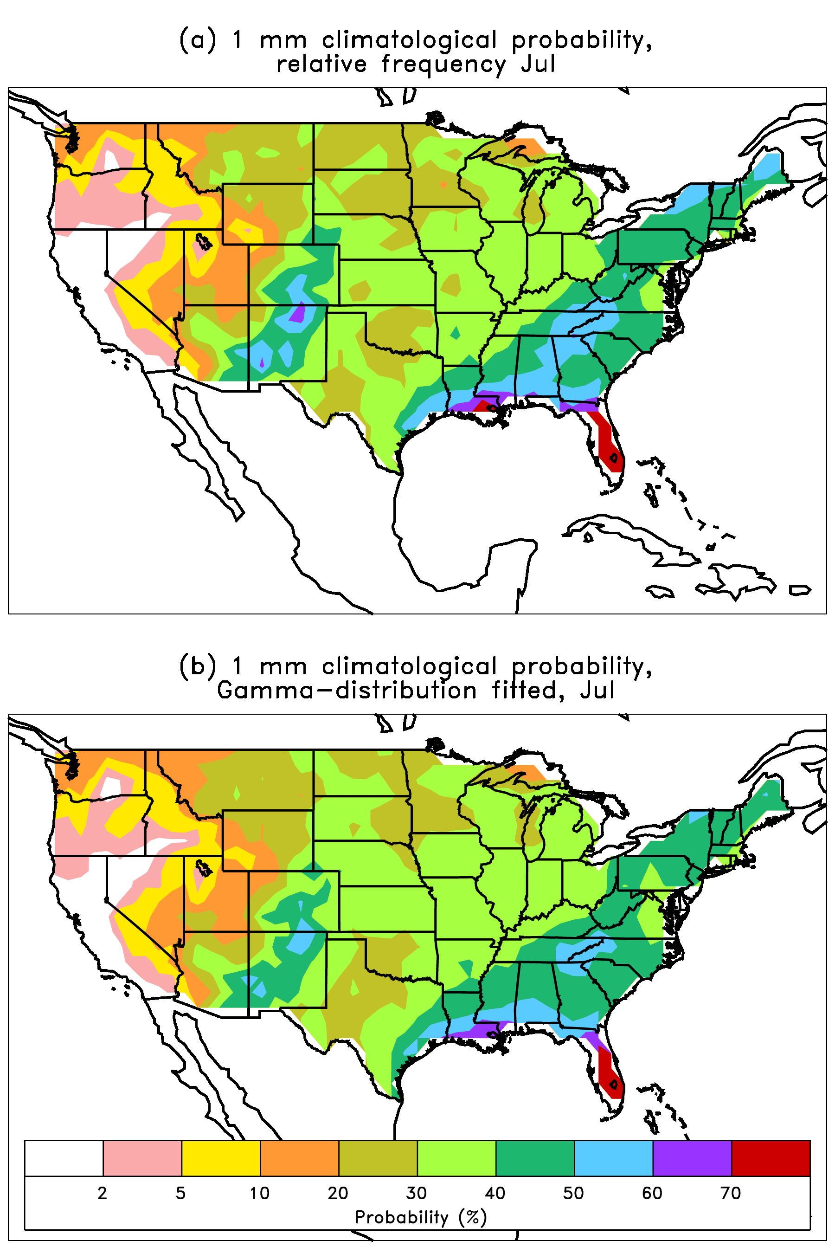
Climatological probability of
> 1 mm / 24h,
estimated from event
relative frequency (top)
and modeled (bottom)
you can find regions of slight
underestimate (e.g., northern
NM).

Slide 47
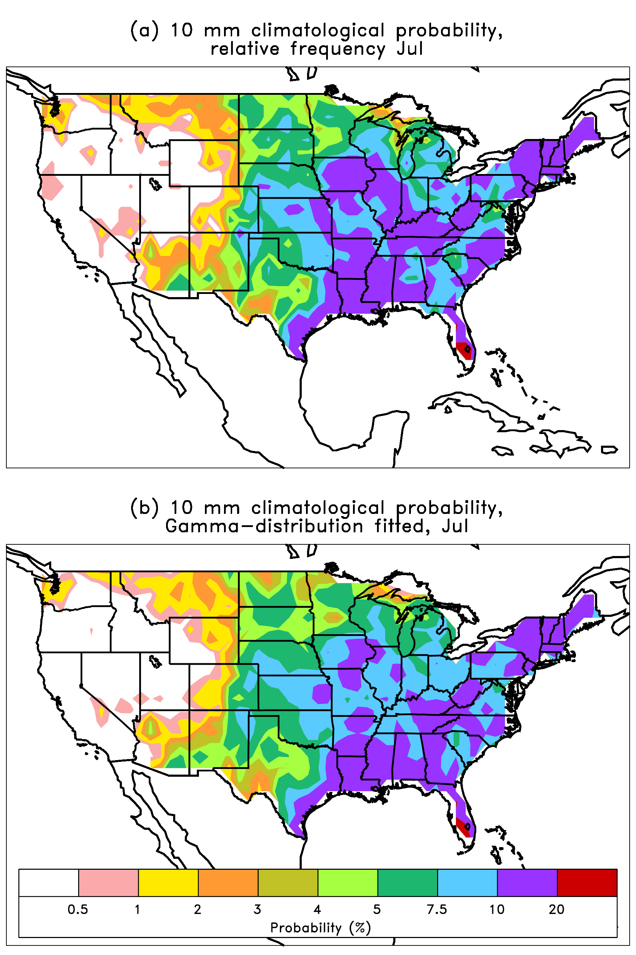
Climatological probability of
> 10 mm / 24h,
estimated from event
relative frequency (top)
and modeled (bottom)

Slide 48
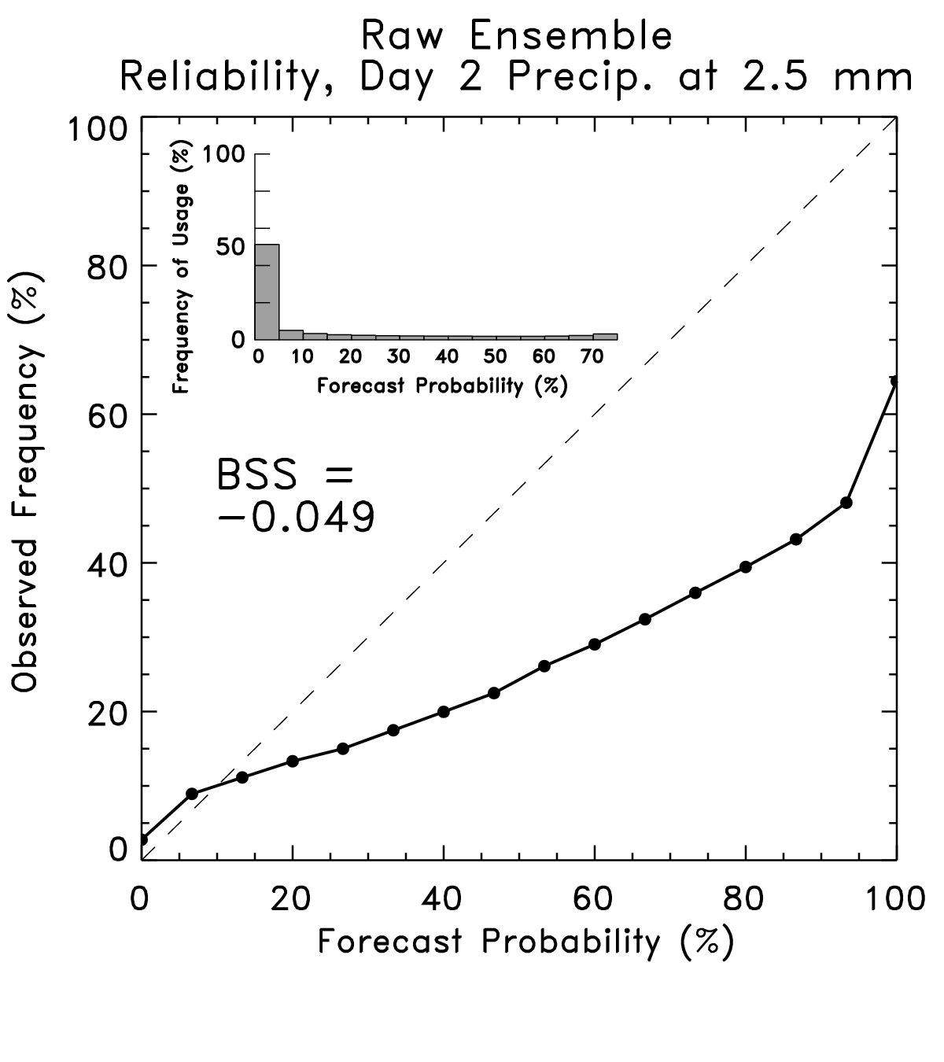
Reliability diagrams

Slide 49
Reliability diagrams
Curve tells you what
the observed frequency
was each time you
forecast a given probability.
This curve ought to lie
along y = x line. Here this
shows the ensemble-forecast
system over-forecasts the
probability of light rain.
Ref: Wilks text, Statistical Methods in the Atmospheric Sciences

Slide 50
Reliability diagrams
Inset histogram tells
you how frequently
each probability was
issued.
Perfectly sharp:
frequency of usage
populates only
0% and 100%.
Ref: Wilks text, Statistical Methods in the Atmospheric Sciences

Slide 51
Reliability diagrams
BSS = Brier Skill Score
BS(•) measures the
Brier Score, which you
can think of as the
squared error of a
probabilistic forecast.
Perfect: BSS = 1.0
Climatology: BSS = 0.0
Ref: Wilks text, Statistical Methods in the Atmospheric Sciences

Slide 52
Equitable Threat Score
Observed > Threshold?
YES NO
a | b
c | d
YES
NO
Forecast > Threshold ?

Slide 53
SUBROUTINE continuous_RPS_calc_ens (nmembers, fcstens, obs, CRPS)
INTEGER, INTENT(IN) :: nmembers
REAL, INTENT(IN) :: fcstens(nmembers), obs
REAL, INTENT(OUT) :: CRPS
REAL x(400), fcdf(400), vcdf(400)
! ---- set up array of precip to calc cdf at (every 0.5 mm to 200 mm)
DO itemp= 1, 400
x(itemp) = FLOAT(itemp-1)*0.5
END DO
! ---- cdf of observations, step function
vcdf = 0.
DO itemp = 1,400
IF (x(itemp) .gt. obs) vcdf(itemp) = 1.
END DO
! ---- forecast cdf
fcdf(:) = 0.
DO itemp = 1, 400
DO imem = 1, nmembers
IF (x(itemp) .gt. fcstens(imem)) fcdf(itemp) = fcdf(itemp) + &
1./FLOAT(nmembers)
END DO
END DO
! ---- calculate CRPS
CRPS = 0.0
DO itemp = 1,400
CRPS = CRPS + 0.5*(fcdf(itemp)-vcdf(itemp))**2
END DO
RETURN
END SUBROUTINE continuous_RPS_calc_ens

