Slide 1

A purely statistical 1-h background forecast of surface temperature.
Tom Hamill
ESRL Physical Sciences Division
Boulder, Colorado 80305
tom.hamill@noaa.gov
303-497-3060

Slide 2
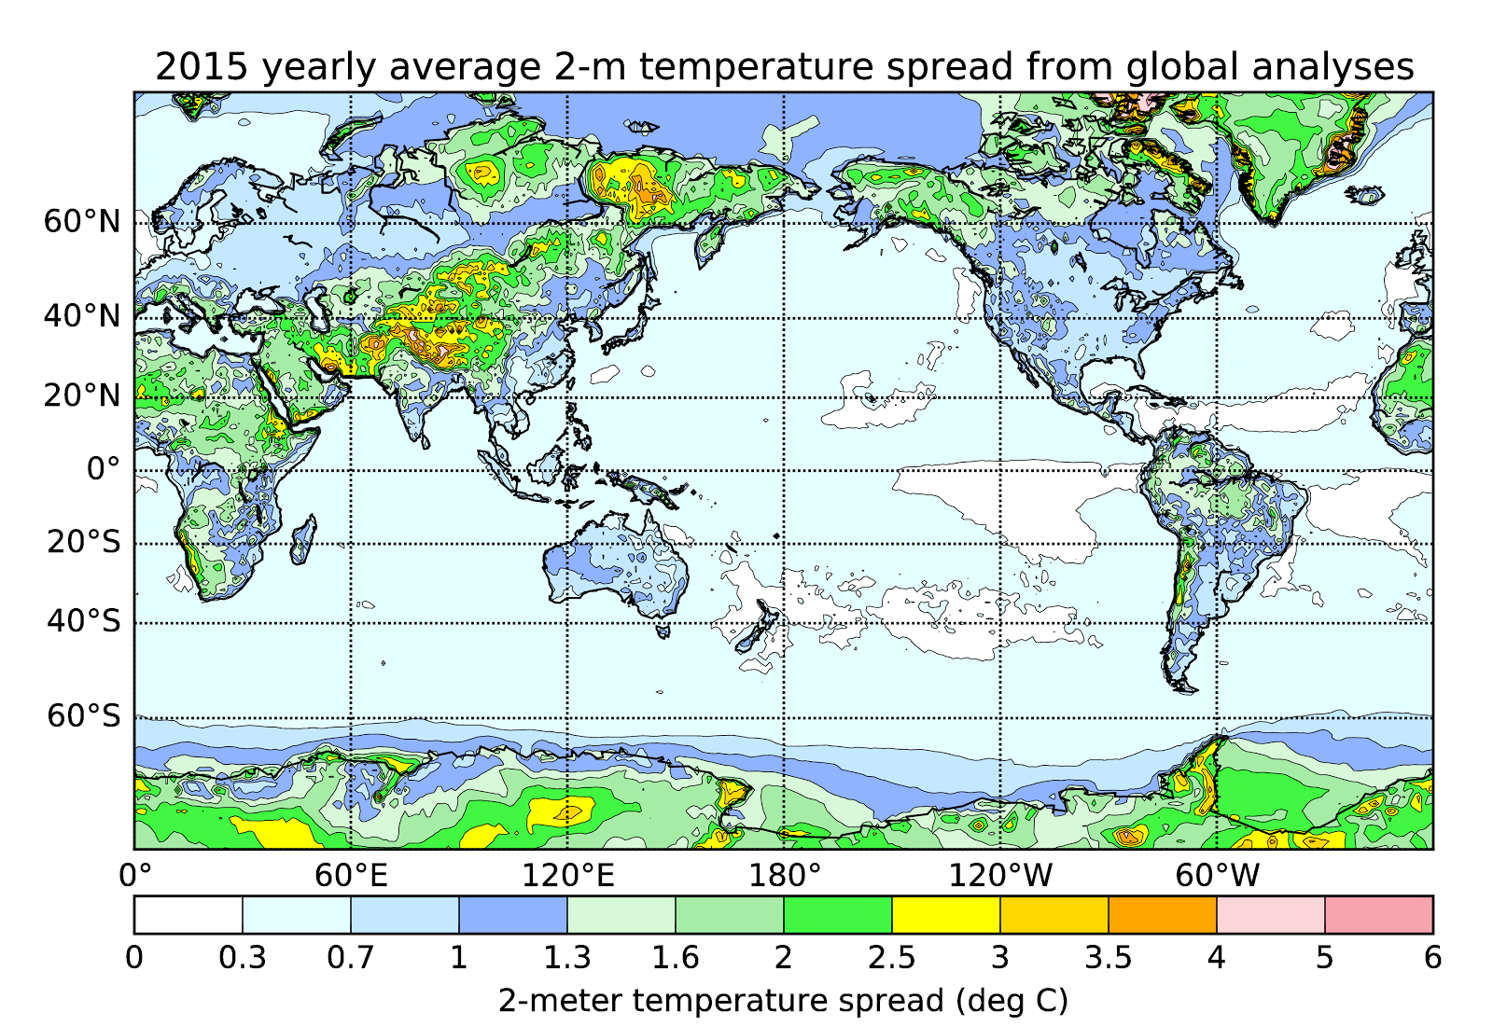
CMC, NCEP, ECMWF, UK Met Office
Surface temperature analyses vary a lot between global DA systems, a sign
that there are major underlying challenges.

Slide 3
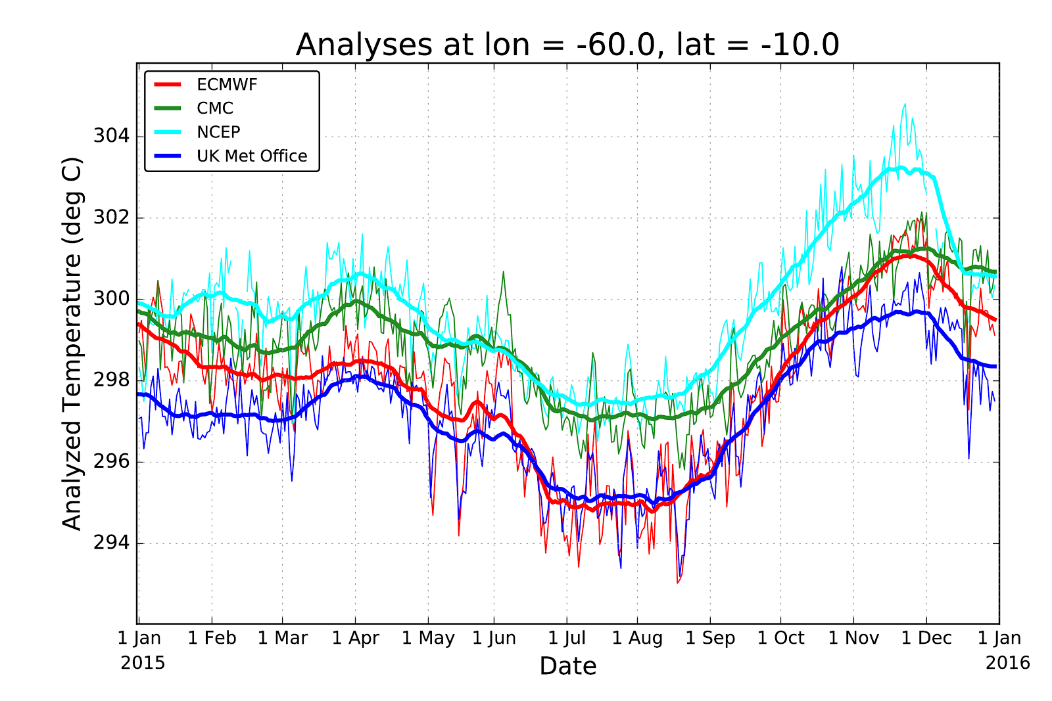
In data-sparse region of the Amazon Basin. Heavy lines with +/- 15 day smooth.
Data from TIGGE archive. Why such profound differences?

Slide 4
State estimation
(“data assimilation”)
Should be unbiased
in order for
the assimilation
to work properly
observations for time t
forecast for time t
“background”
data assimilation
state estimate for time t
“analysis”
weather
forecast
model
forecast for
time t+Δt
“background”
In rapidly updating systems, the updates are hourly, and headed for sub-hourly.

Slide 5
Given an unbiased background, the mean 1-h forecast minus analysis over many samples should be zero, within sampling error. Over one month, 2-meter temperatures did not appear to be for this time of day with NOAA’s Hi-Res Rapid Refresh system.

Slide 6
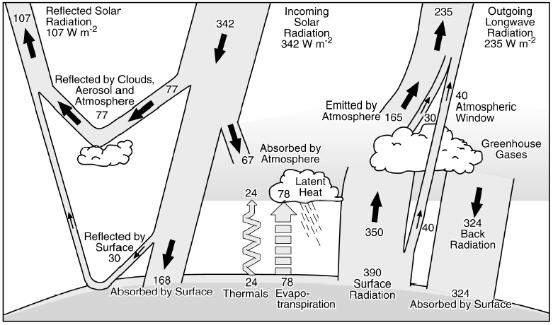
Why are NWP background forecasts of 2-m temperature often biased?

Slide 7
Why are NWP background forecasts of 2-m temperature often biased?
Clouds are very difficult to predict well in NWP models, often producing biased estimated of downward solar radiation.

Slide 8
Why are NWP background forecasts of 2-m temperature often biased?
Surface energy-balance problems: Partitioning into latent heat flux (evaporation), sensible heat flux (change in air temperature) and ground heat flux (soil temperature change) depends critically on hard-to estimate variables and parameters such as soil moisture, roughness lengths, exchange coefficients, soil hydraulic conductivity, stomatal resistance.

Slide 9
Why are NWP background forecasts of 2-m temperature often biased?
Soil as an accumulator of error: in many prediction systems, soil moisture is not directly assimilated, nor is it updated necessarily with information from other environmental state components. Instead, an offline land-surface model is run, forced with best guesses of temperature, precipitation, solar radiation, and so forth. By never being directly updated, the soil state (temperature, moisture) may start or drift from reality to very biased states.

Slide 10
Supposition:
(1) 2-m temperature forecast bias is hard to fix; it won’t be decreased substantially with a few months of NWP development.
(2) If an alternative method existed that provided improved first-guess forecasts, this may result in more sustained positive impact of surface observations on the analysis quality.

Slide 11
Time series of observed temperatures and deviations at Albany, NY
Temperature deviation
from climatology doesn’t exhibit the diurnal wiggles
evident in the raw data
time series. Hour-to-hour
changes appear modest.
For how time varying climatology determined, see supplementary slides here.

Slide 12
Time series of observed temperatures and deviations at Albany, NY
How were the blue curves obtained?
Temperature deviation
from climatology doesn’t exhibit the diurnal wiggles
evident in the raw data
time series. Hour-to-hour
changes appear modest.
For how time varying climatology determined, see supplementary slides here.

Slide 13
Climatology for Albany NY, 00 UTC
Red line denotes climatology from cubic-spline fit, 8 knots.

Slide 14
Fitted Albany, NY climatological diurnal cycle
No surprises, here in the eastern US, the climatological temperatures
generally were warmest at 18, 21 UTC.

Slide 15
How does last hour’s temperature deviation from climatology predict this hour’s temperature deviation?
Pretty well, with less predictive skill around sunrise and sunset. No apparent bias.
Note: a small amount of noise is added to the measurements to aid in interpretation
given the discrete values of observed temperature (rounded to nearest °F).

Slide 16
How does last hour’s temperature deviation from climatology predict this hour’s temperature deviation?
Pretty well in summertime also.

Slide 17
RMSE’s of 1-h persistence forecast of deviation from climatology across CONUS, July 00 UTC
gridded analysis generated with successive-corrections technique, akin to Kriging.

Slide 18
Comparison, persistence of climatological deviation vs. RTMA at stations.
RTMA (Real-Time Mesoscale Analysis) results taken from de Pondeca et al., W&F, Oct 2011.
With no other extra predictors, and no cycling of data assimilation, persistence of deviation from climatology at stations is clearly lower error than RTMA.
Recently, RTMA switched from RAP model to HRRR background, but this is unlikely to account for all the error difference.

Slide 19
Generating a gridded benchmark background 1-h, purely statistical forecast
Pieces of information available to us:
(1) This hour’s gridded climatology (background) via “PRISM”
(2) This hour’s observations
(3) Next hour’s climatology (background) via PRISM
Method: Use (1) and (2) to estimate a gridded deviation from climatology. Add that to the next hour’s climatology to produce a 1-h forecast that replaces the NWP forecast. Covariance model is Matern and penalizes horizontal distance and differences in a coastal proximity parameter.

Slide 20
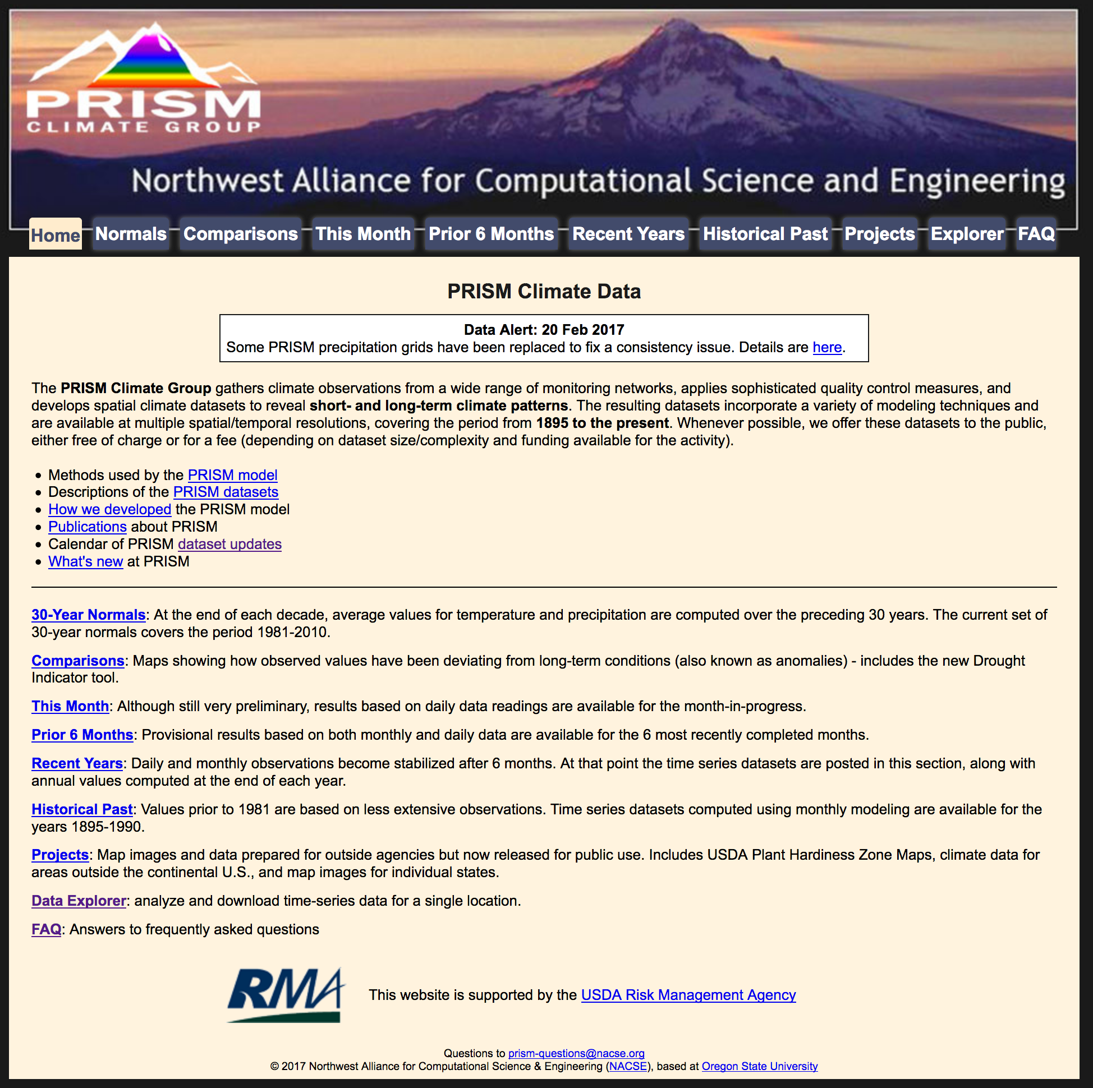
What is PRISM?
The PRISM group at
Oregon State University
developed a clever
weighted linear regression technique to develop temperature, dew point, and precipitation climatologies. Key reference is:
Daly, C., W. P. Gibson, G.H. Taylor, G. L. Johnson, P. Pasteris. 2002. A knowledge-based approach to the statistical mapping of climate. Climate Research, 22: 99-113.
http://prism.oregonstate.edu/

Slide 21
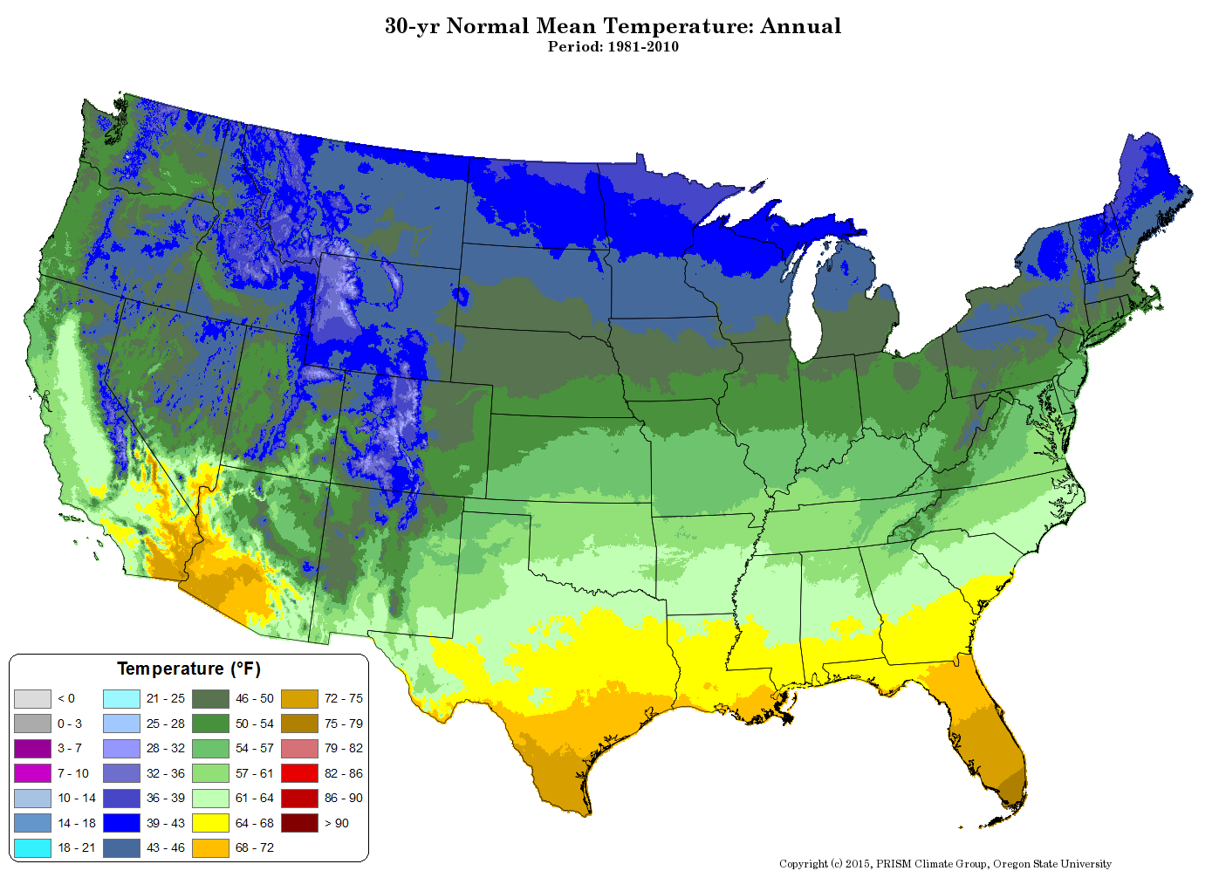
Example: PRISM 30-year climatology
Monthly climatologies of mean, daily min and max are also available. Dewpoint too.

Slide 22
Generating a gridded benchmark background 1-h, purely statistical forecast
Pieces of information available to us:
(1) This hour’s gridded climatology (background) via “PRISM”
(2) This hour’s observations
(3) Next hour’s climatology (background) via PRISM
Method: Use (1) and (2) and optimum interpolation to estimate a gridded deviation from climatology. Add that to the next hour’s climatology to produce a 1-h forecast that replaces the NWP forecast. Covariance model is Matern and penalizes horizontal distance and differences in a coastal proximity parameter.

Slide 23
Optimum interpolation methodology
xª = x^{b} + BH^{T}(HBH^{T} + R)⁻¹(y-Hx^{b}) , where
xª := vector of analyzed state, here the
deviation from climatology
x^{b} := vector of background (first guess) state,
here the deviation from climatology (set to 0)
B := background-error covariance matrix
H := interpolation operator, grid to station
R := observation-error covariance matrix (2°F² var)
y := vector of newly available observation
deviations from climatology
following Lev Gandin. See also Roger Daley Atmospheric Data Analysis text, eq. 4.2.9

Slide 24
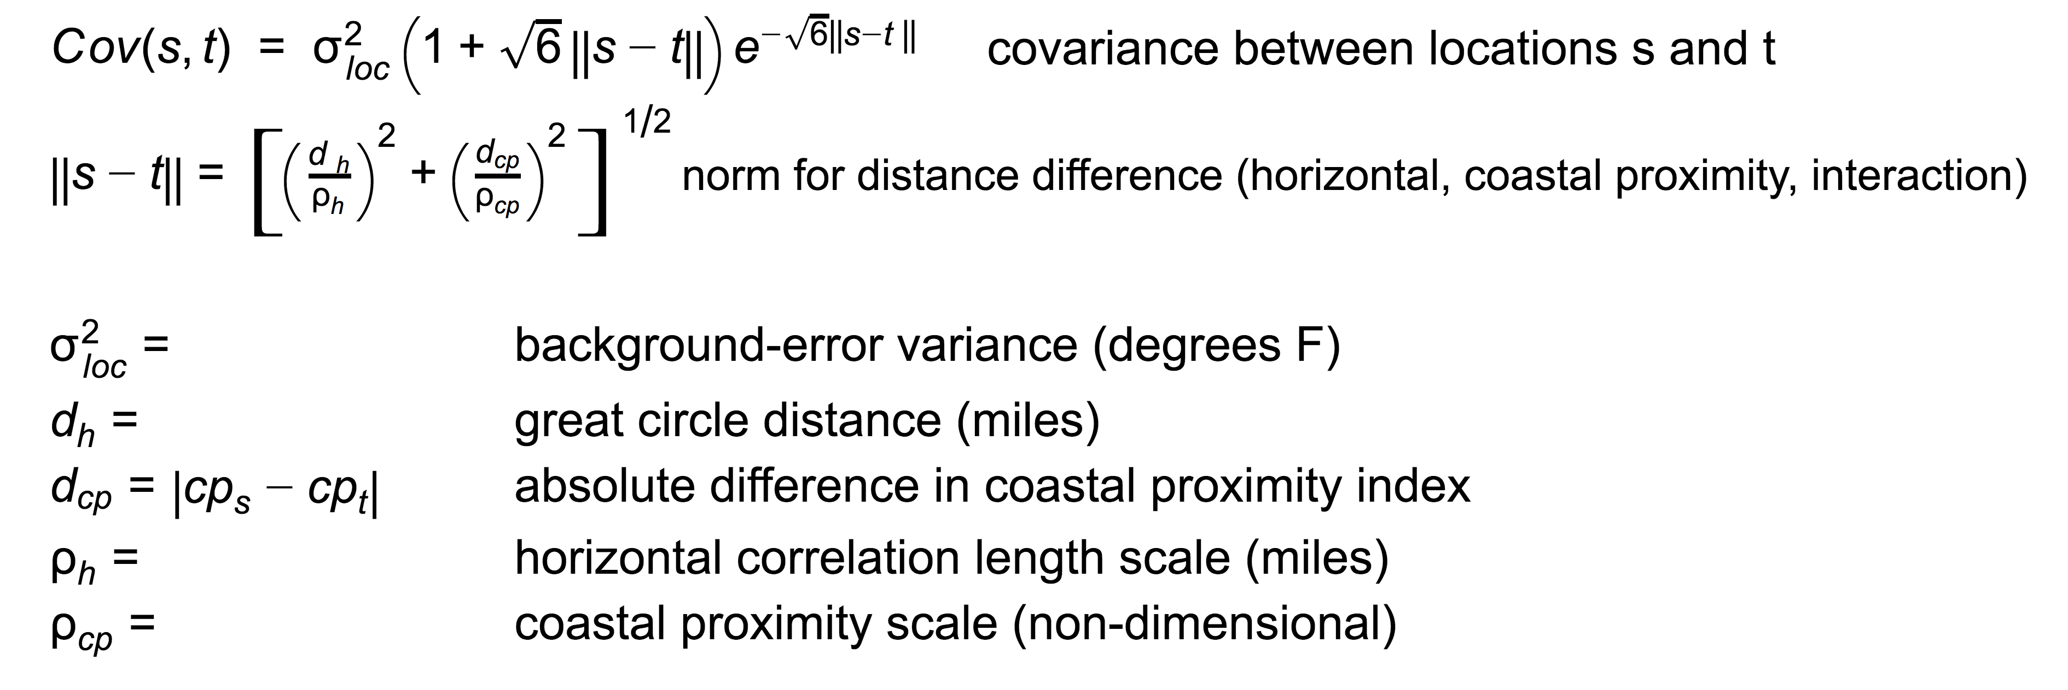
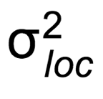
Simplified Matern model for background-error covariances
)
Parameters ⍴_{h}, ⍴_{cp}, and are determined objectively through a nonlinear least-
squares function-fitting python procedure (scipy.optimize.curve_fit)

Slide 25
Why use the Matern covariance model?
The faster taper to zero correlation for the Matern function is desirable for surface data, with its inhomogeneities and larger representativeness errors.

Slide 26
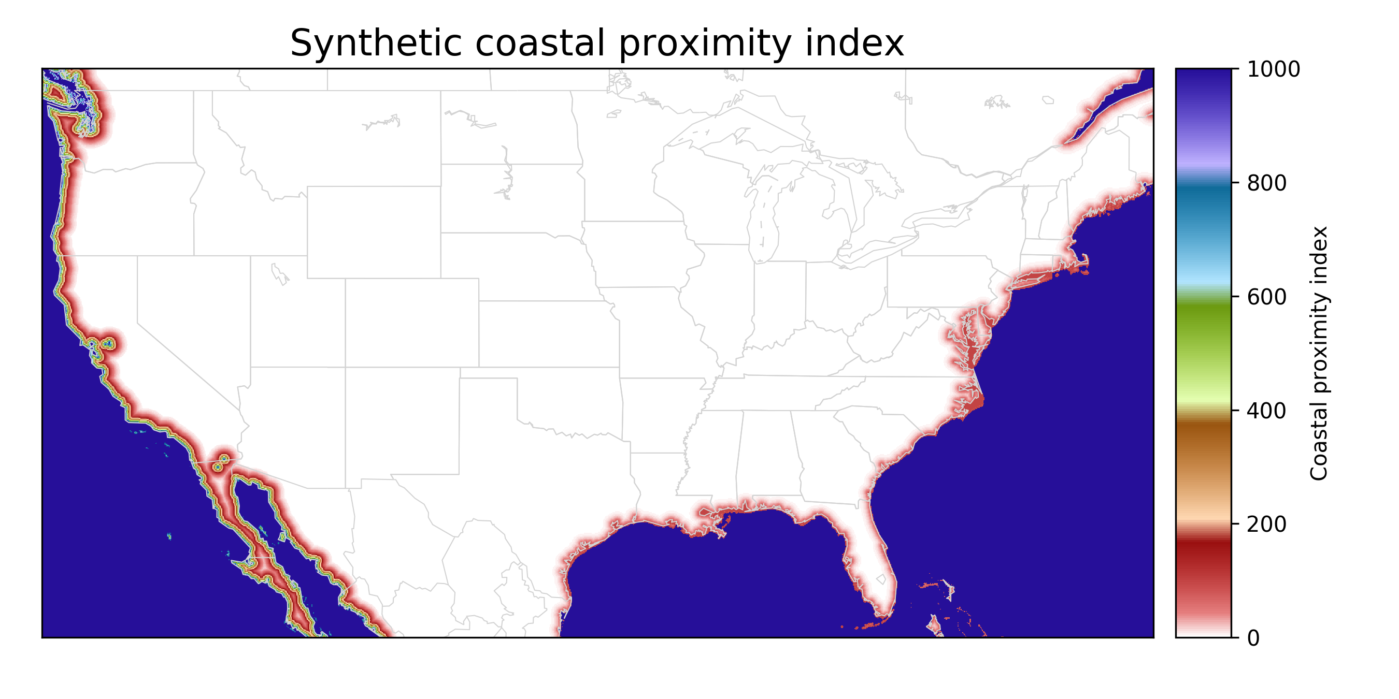
Along US west coast, there are very strong gradients in temperature as one moves
away from the coast. Accordingly, there is a penalty in the Matern covariance for
differences in coastal proximity index. To make differences more accentuated along
US west coast, the coastal proximity index varies more along the US west coast
than along the Gulf and east coast. This is ad hoc, but effective. Motivated by similar
approach used in PRISM.

Slide 27
Generating a gridded benchmark background 1-h, purely statistical forecast
Pieces of information available to us:
(1) This hour’s gridded climatology (background) via “PRISM”
(2) This hour’s observations
(3) Next hour’s climatology (background) via PRISM
Method: Use (1) and (2) and optimum interpolation to estimate a gridded deviation from climatology. Add that to the next hour’s climatology to produce a 1-h forecast that replaces the NWP forecast. Covariance model is Matern and penalizes horizontal distance and differences in a coastal proximity parameter.

Slide 28
Generating a gridded benchmark background 1-h, purely statistical forecast
Pieces of information available to us:
(1) This hour’s gridded climatology (background) via “PRISM”
(2) This hour’s observations
(3) Next hour’s climatology (background) via PRISM
Method: Use (1) and (2) and optimum interpolation to estimate a gridded deviation from climatology. Add that to the next hour’s climatology to produce a 1-h forecast that replaces the NWP forecast. Covariance model is Matern and penalizes horizontal distance and differences in a coastal proximity parameter.
We need a climatology that
varies with the day of the year and the hour of the day.

Slide 29
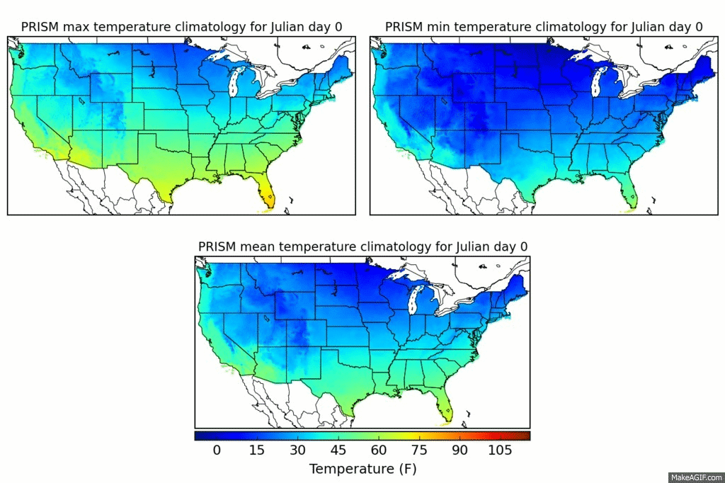
Producing a climatology as f(julian day, hour)
Daily T_{max}, T_{min} included and used in next step to estimate diurnal cycle.
The PRISM group
at Oregon State
produced monthly
gridded T_{max},
T_{min}. Using these,
I spline fit to get a
daily estimate of
T_{max}, T_{min}. PRISM
data c/o Chris Daly.
Daly et al. article on PRISM here, web page here.

Slide 30
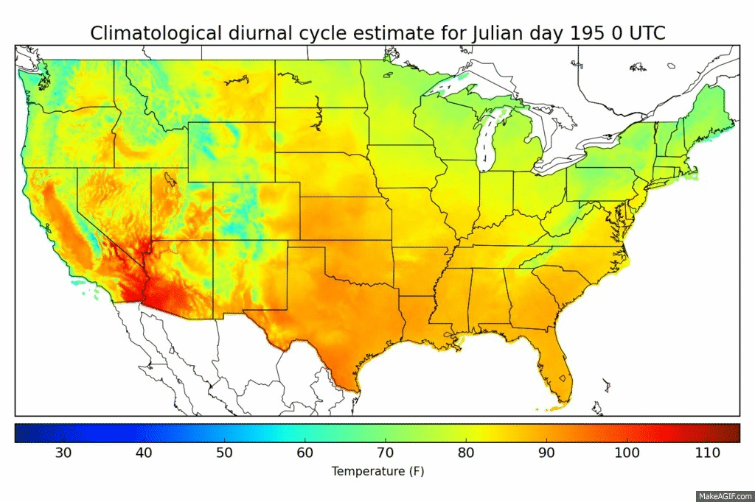
PRISM-based estimate of daily diurnal cycle for July 14
To create this animation of the diurnal cycle for a particular day of the year, PRISM max and mean spline fit to a particular day of the year set the overall magnitude of diurnal cycle, and Kriged station estimates of the diurnal cycle at stations set the hourly variations within the PRISM-defined max/min range.

Slide 31
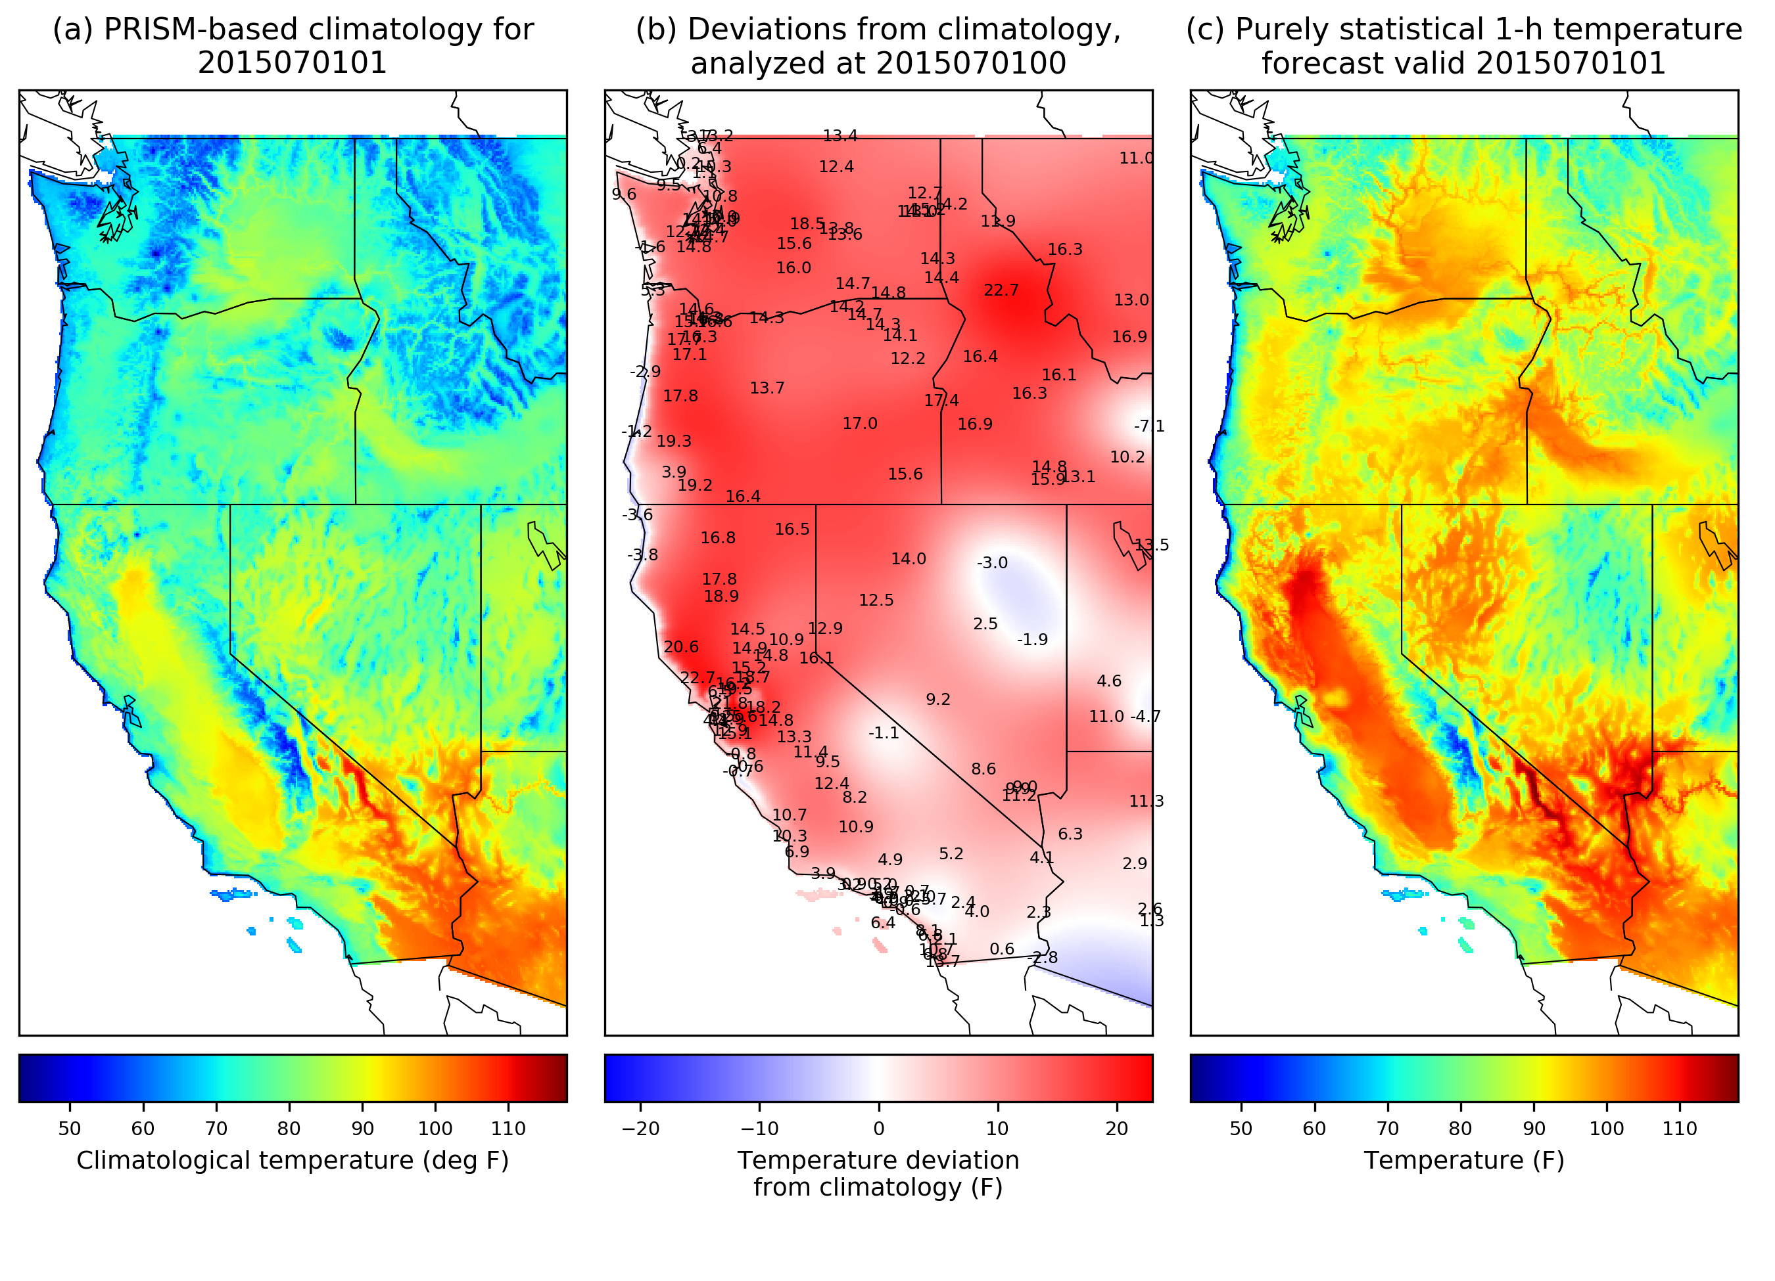
1-h predictions of temperature: moving from stations to grid.
PRISM-based climatology (01 UTC) + analyzed deviation (00 UTC) = 1-h forecast (01 UTC)
A purely statistical
1-hour temperature
forecast based on the
concept of persisting
the deviation from
climatology.
PRISM provides the climatology (panel a, which has been munged to vary with day of year, hour of day).
Gridded forecast deviations from climatology (b) are based
on the previous hour’s deviations from climatology at obs locations, then statistically interpolated to the grid.
Final first guess is produced by adding (a) and (b) to produce (c).

Slide 32
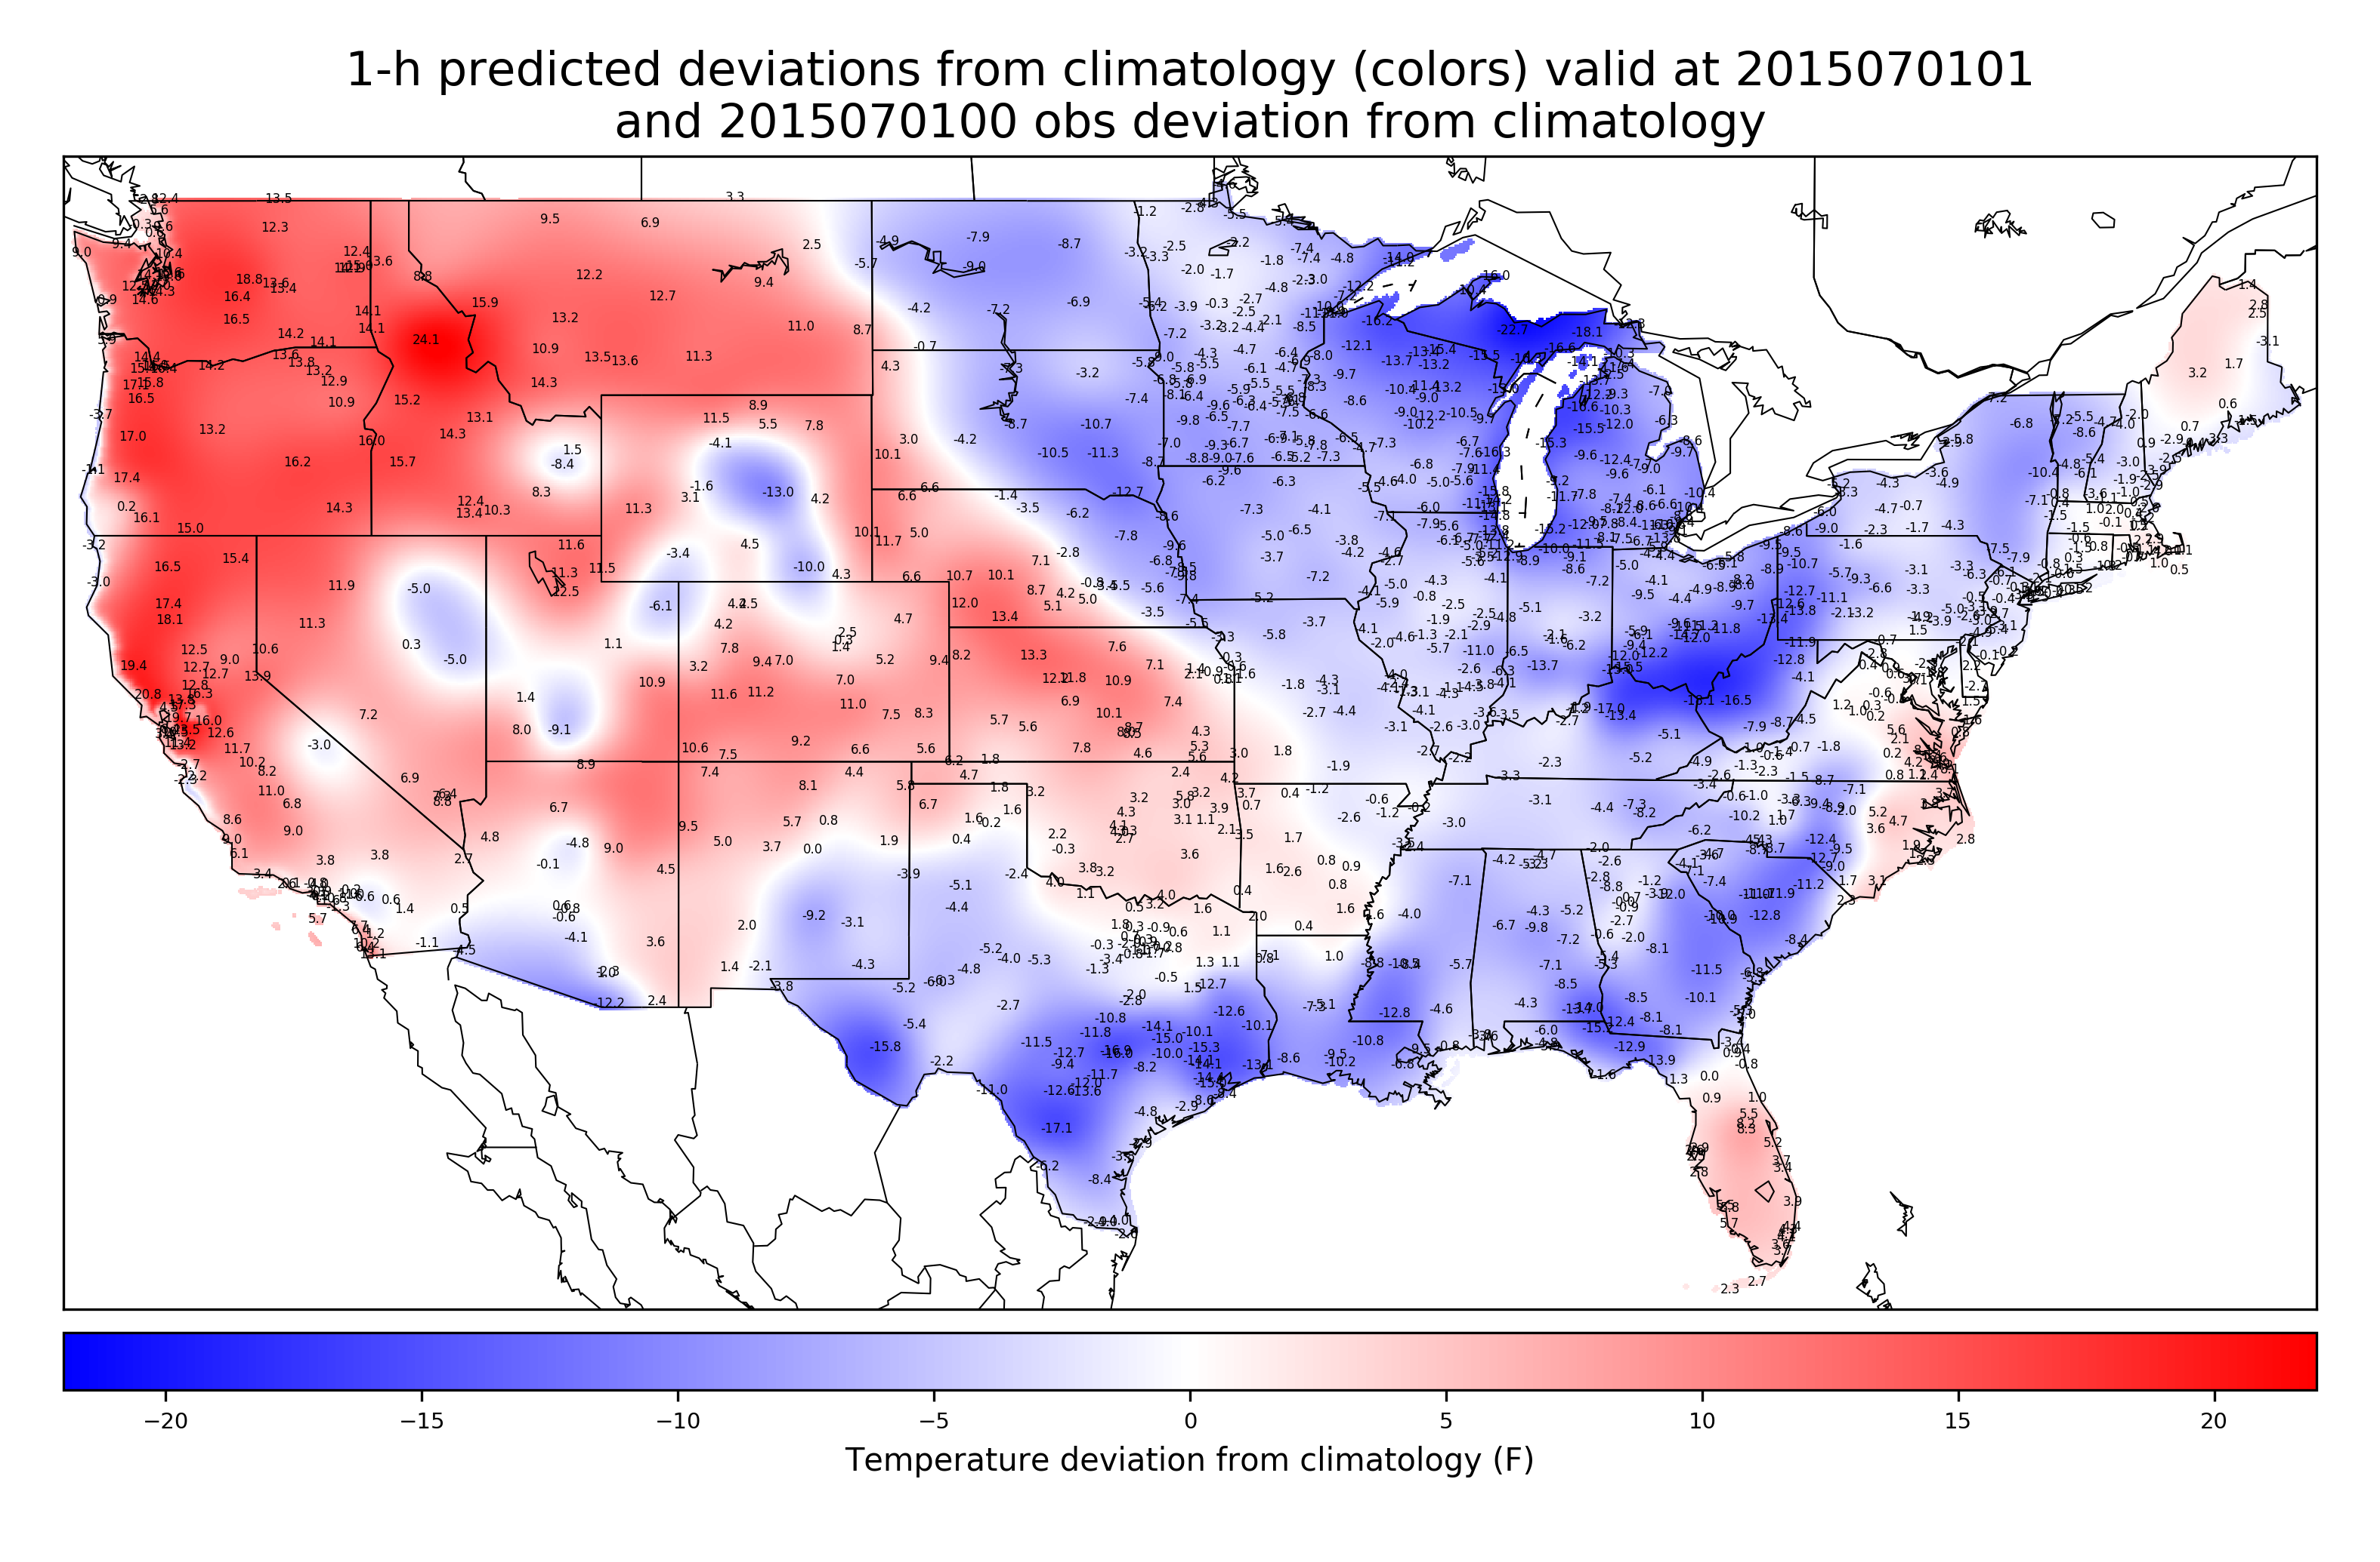
Observation deviations and OI analysis of deviations across CONUS
These analyzed deviations are what are persisted and added to the next hour’s
climatology to create the 1-h background forecast of 2-meter temperature.

Slide 33
Comparison of HRRR July 2015 1-h forecasts vs. this statistical model, verified against CONUS stations
52
Hour of day (UTC) | HRRR bias (°F) | Statistical bias (°F) | HRRR MAE (°F) | Statistical MAE (°F) | HRRR RMSE (°F) | Statistical RMSE (°F)
01 | -0.77 | -0.09 | 2.26 | 1.48 | 3.09 | 2.06
04 | -1.46 | -0.06 | 2.47 | 1.43 | 3.20 | 1.92
07 | -1.15 | -0.05 | 2.22 | 1.30 | 2.88 | 1.76
10 | -0.98 | -0.02 | 2.12 | 1.26 | 2.82 | 1.69
13 | 3.11 | 0.09 | 3.81 | 1.58 | 4.61 | 2.07
16 | 3.50 | 0.06 | 4.02 | 1.33 | 4.78 | 1.81
19 | 2.31 | 0.03 | 3.55 | 1.36 | 4.39 | 1.97
22 | 0.77 | 0.01 | 2.81 | 1.43 | 3.79 | 2.17
52% reduction in MAE
not cross validated here, so these estimates represent an upper bound of what
we could expect if we had infinitely dense observations (which we don’t here; about
1000 obs)

Slide 34
Comparison of HRRR July 2015 1-h forecasts vs. this statistical model, verified against CONUS stations
52
Hour of day (UTC) | HRRR bias (°F) | Statistical bias (°F) | HRRR MAE (°F) | Statistical MAE (°F) | HRRR RMSE (°F) | Statistical RMSE (°F)
01 | -0.77 | -0.09 | 2.26 | 1.48 | 3.09 | 2.06
04 | -1.46 | -0.06 | 2.47 | 1.43 | 3.20 | 1.92
07 | -1.15 | -0.05 | 2.22 | 1.30 | 2.88 | 1.76
10 | -0.98 | -0.02 | 2.12 | 1.26 | 2.82 | 1.69
13 | 3.11 | 0.09 | 3.81 | 1.58 | 4.61 | 2.07
16 | 3.50 | 0.06 | 4.02 | 1.33 | 4.78 | 1.81
19 | 2.31 | 0.03 | 3.55 | 1.36 | 4.39 | 1.97
22 | 0.77 | 0.01 | 2.81 | 1.43 | 3.79 | 2.17
nearly zero bias
Relative to the HRRR, which has greatly biased forecasts, you can see that the
statistical model of 1-h surface temperature forecasts is virtually unbiased.

Slide 35
Cross validated
Comparison of HRRR July 2015 1-h forecasts vs. this statistical model, verified against CONUS stations
Hour of day (UTC) | HRRR bias (°F) | Statistical bias (°F) | HRRR MAE (°F) | Statistical MAE (°F) | HRRR RMSE (°F) | Statistical RMSE (°F)
01 | -0.77 | -0.25 | 2.26 | 2.12 | 3.09 | 2.90
04 | -1.46 | 0.28 | 2.47 | 2.13 | 3.20 | 2.82
07 | -1.15 | 0.55 | 2.22 | 2.12 | 2.88 | 2.83
10 | -0.98 | 0.74 | 2.12 | 2.18 | 2.82 | 2.91
13 | 3.11 | 0.82 | 3.81 | 2.21 | 4.61 | 2.91
16 | 3.50 | 0.24 | 4.02 | 1.81 | 4.78 | 2.46
19 | 2.31 | -0.21 | 3.55 | 1.96 | 4.39 | 2.71
22 | 0.77 | -0.35 | 2.81 | 2.17 | 3.79 | 3.09
32 % reduction in MAE
over all cycles.
27 % reduction in RMSE
over all cycles.
With cross validation now, the reduction in error and bias is less impressive.

Slide 36
Conclusions
Statistical benchmark 1-h forecast outperformed 1-h HRRR first guess forecast at stations, indicating the substantial challenge of producing useful 1-h numerical background forecast for hourly surface temperature data assimilation.

Slide 37
Next steps
  Re-test the methodology with many more observations (recently acquired ~ 26,000 observations / hour, via MDL).
    Likely will have to make some changes to the code to make it more computationally efficient.
    Will need to perform observation QC, too.
  Verify more extensively that modified forecasts and analyses are unbiased, accurate (whole of 2015 being analyzed now).

Slide 38
Implications for surface data assimilation and forecast improvement
One might improve upon hourly surface data-assimilation procedures through one of several approaches:
  Blend background NWP and statistical forecasts where available to reduce bias.
  Use 1-h statistical forecasts for NWP system background bias correction, say, comparing last month of NWP forecasts vs. these statistical forecasts.
Alternative: discard the numerical forecast altogether in data-rich regions.
  Produce reanalysis and real-time temperature analysis.
    Produce 1-h statistical forecasts using only surface observations and PRISM.
    Develop a background-error covariance model for these gridded, persisted 1-h deviations.
    Use these to produce a long-term reanalysis and real-time analyses of surface temperature in CONUS using fuller surface observation data set.

Slide 39
Future directions for forecast improvement
  Following ECMWF, use statistical surface temperature analysis increments to make soil-temperature increments, thus constraining soil temperatures to more realistic values and addressing one of the root causes of NWP system bias.

Slide 40
Applicability to statistical postprocessing
Retrospective statistically based analyses of surface temperature can be used as the training and validation data.
Post-processed guidance should be markedly improved, as MOS-type methods are training against unbiased data.

Slide 41
Supplementary slides

Slide 42
Benchmarking test procedures
Observation data: surface observations over US (data from NCAR DS 472.0, 2004-2013, from NOAA MDL).
  For this study, use only stations with > 97% data availability (1349 stations, 1118 in CONUS).
Determine hourly, daily climatology at each station.
  Cubic spline; 8 knots across year, cross-validated by year.
T → T’ : express temperature time series as deviations from climatology.
Explore potential predictors for T’(next hour) at surface stations first
Later: consider how to make a gridded background from these.

Slide 43
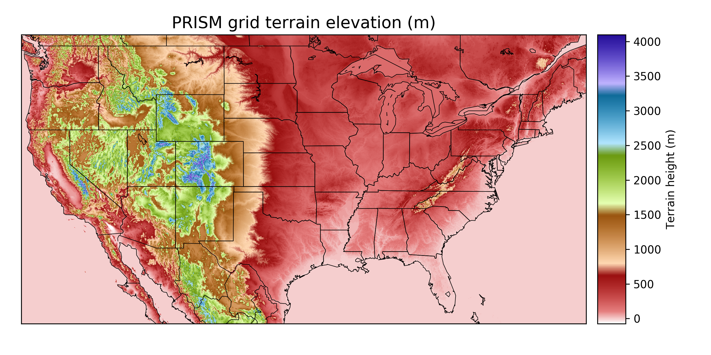
Terrain elevation

