Slide 1
Evaluation of Wintertime Precipitation Estimates and Forecasts in the Mountains of Colorado
Janice L. Bytheway, William R. Currier, Mimi Hughes,
Kelly Mahoney, and Rob Cifelli
NOAA Physical Sciences Laboratory, Boulder, CO
SPLASH/SAIL/SOS Workshop
November 1, 2023

Slide 2
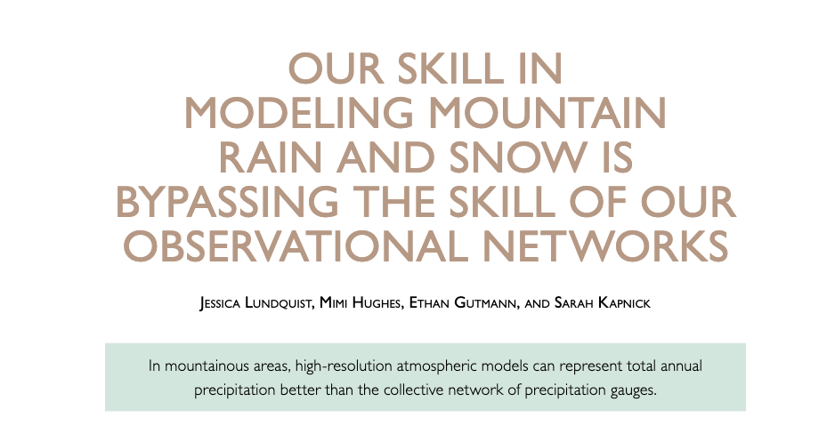
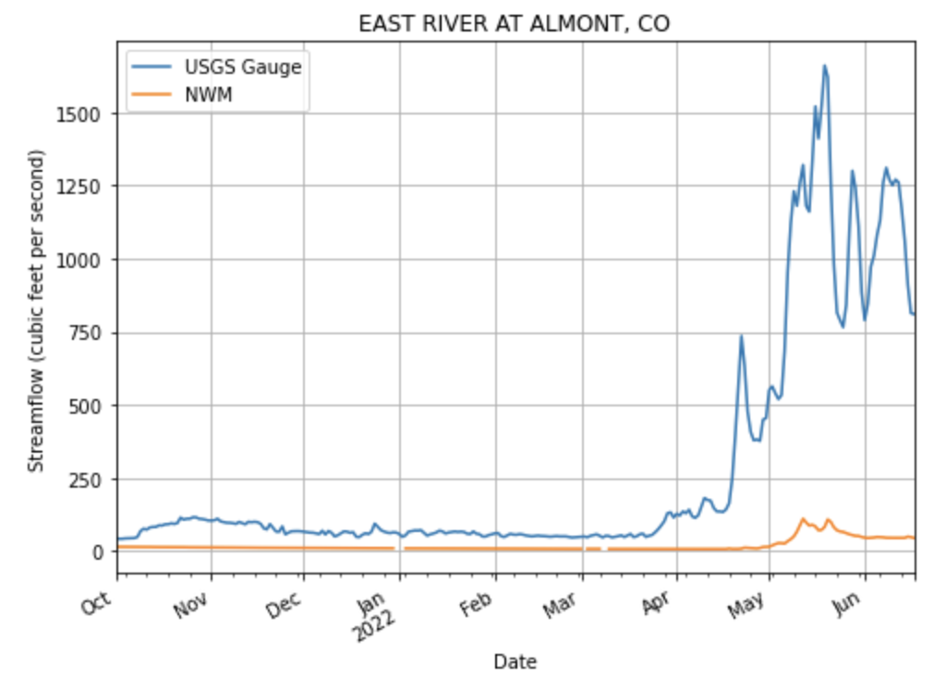
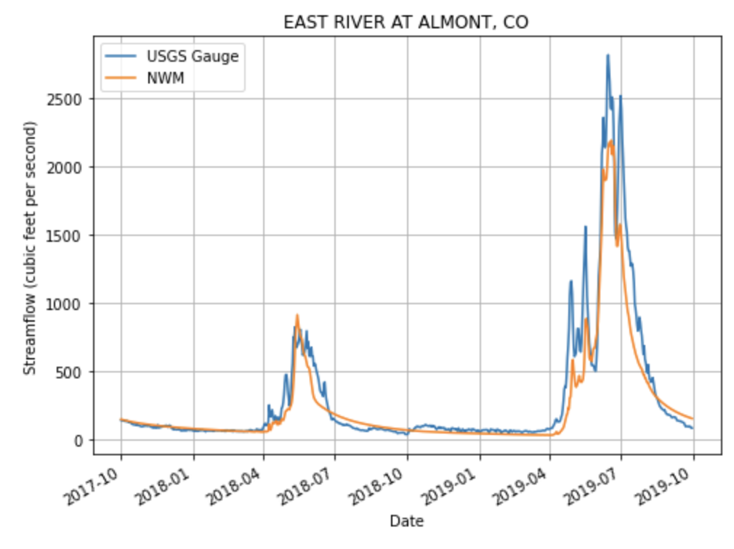
Motivation
Operational, WY2022 Retrospective, WY2017-WY2018
Courtesy R. Palladino

Slide 3
Science Questions
Is the operational HRRR model as good as, if not better than, observationally-based QPE at estimating wintertime precipitation in Colorado?
Are there ranges of forecast hours, lead times, or forecast lengths that provide precipitation forecasts that are better suited for forcing hydrologic models?
How do storm characteristics impact the results from (1) and (2) above?

Slide 4
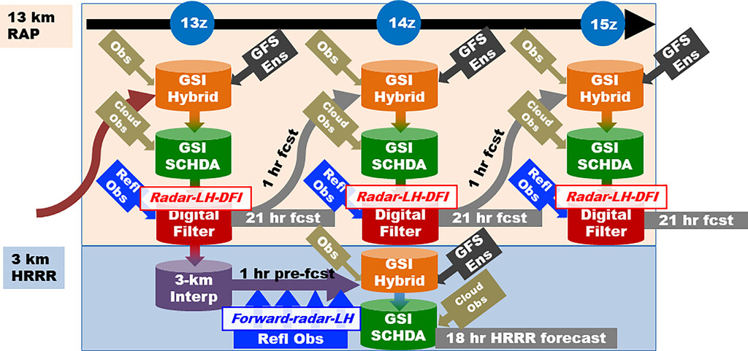
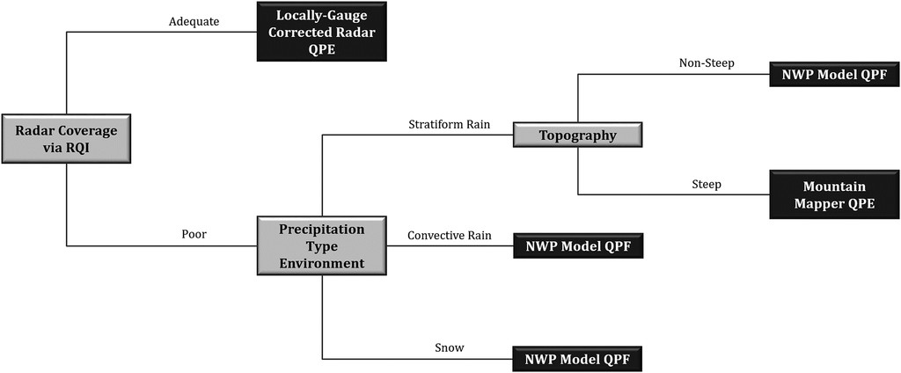
Data
Radar Quality Index
Gridded QPE/QPF
  Stage IV
    4km hourly, radar, gauge + manual QC
  MRMS
    Pass1 and Pass2
    1km hourly, radar + gauge, NWP
  HRRR
    3km, hourly updating
    5 Forecast Periods/Lead Times Concatenated over the cold season
      0-1h, 0-6h, 0-24h, 5-6h, 6-12h
Reference Datasets
  SNOTEL
    SWE and Snow Adjusted Precipitation
  SPLASH Instrumentation
    SPLASH and SAIL Gauges
    Additional gauges in the area
  Airborne Snow Observatory
    Instantaneous SWE measurements
RAP/HRRR Data Assimilation (from Weygandt et al 2022)
MRMS MSQPE input decision tree (from
Martinaitis et al 2020)

Slide 5
Results – East River Basin Instruments

Slide 6
Gridded SWE/ASO SWE
WY 2022
WY2023
Pre-flight melting
ASO Flight

Slide 7
Impacts of storm characteristics on Gridded QPE/QPF Bias
Bias compared to SNOTEL WY23 vs WY 22
Mean Daily Precipitation [mm]
WY23-WY22

Slide 8
Science Questions + Answers
Is the operational HRRR model as good as, if not better than, observationally-based QPE at estimating wintertime precipitation in Colorado?
  It depends…
Are there ranges of forecast hours, lead times, or forecast lengths that provide precipitation forecasts that are better suited for forcing hydrologic models?
  Yes. Longer forecast periods of 6 and 24h, and longer lead times of 6 and 12h produced seasonal precipitation totals with smaller biases
How do storm characteristics impact the results from (1) and (2) above?
  Although the two seasons were quite different, performance characteristics from the gridded QPE and QPF products were similar in both years. The ability of gridded products to capture wintertime precipitation in western CO appears to depend more on the products and methods of blending various data types into a multisensor product/modeling precipitation.

Slide 9
Thank you

Slide 10
Backup Slides

Slide 12
Motivation
Operational, WY2022 Retrospective, WY2017-WY2018
Courtesy R. Palladino

Slide 13
Results – seasonal precipitation WY22 (Oct 1-Apr 30)
 | RMSE | Bias | Correlation
MRMS Pass1 | 382.78 | -57.32 | 0.65
MRMS Pass2 | 430.24 | -65.11 | 0.55
Stage IV | 243.23 | -33.22 | 0.77
HRRR 0-1h | 402.41 | -60.37 | 0.61
HRRR 0-6h | 292.08 | -41.41 | 0.75
HRRR 0-24h | 204.53 | -25.5 | 0.80
HRRR 5-6 | 224.95 | -29.32 | 0.80
HRRR 6-12 | 226.97 | -30.91 | 0.82

Slide 14
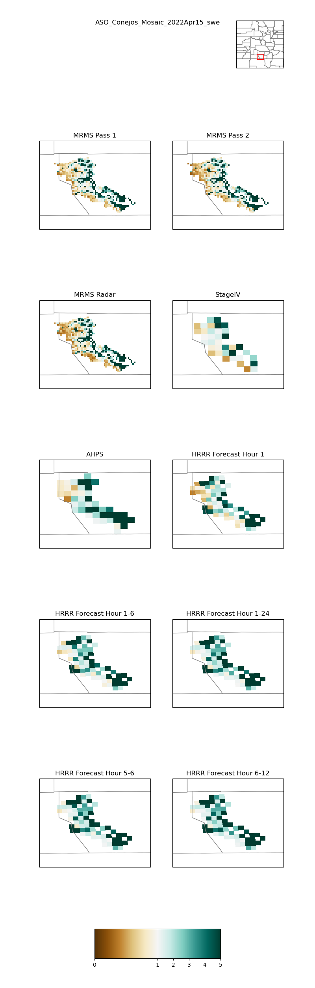
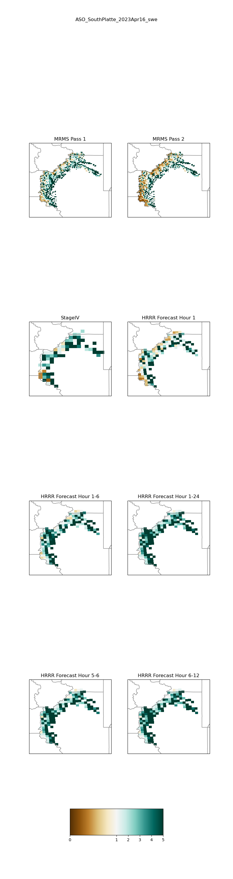
Future and Ongoing work
Conejos Basin April 15, 2022
NWM runs forced with different HRRR forecast periods
Influence of radar availability – Gridded products evaluation as a function of RQI
Evaluation of summertime precipitation
Processing of QPE from the X-band radars

Slide 15
