Slide 1



Statistical properties of conical graupel as detected by W-band radar and VISSS
Project overview:
SAIL workshop Nov 2, 2023
PIs: Heike Kalesse-Los & Maximilian Maahn
PhD: Anton Kötsche
PostDoc: Veronika Ettrichrätz
Notes:
Dec 31, 2023 case study: presenting synoptic situation first and then details would make sense

Slide 2
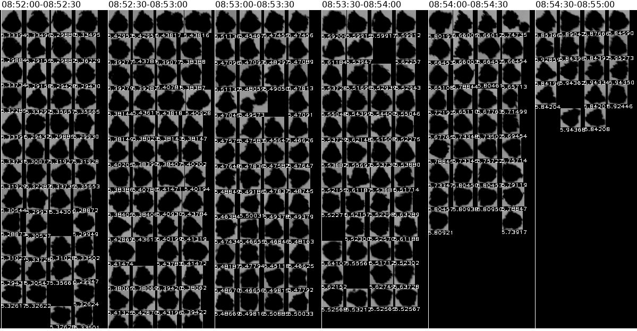
Basics | Statistical properties of conical graupel as detected by W-band radar and VISSS
Dec 5, 2022
Notes:
HKL: add case study date

Slide 3
Conical Graupel
Basics | Statistical properties of conical graupel as detected by W-band radar and VISSS
Graupel is devided into three main shapes: Hexagonal, Lump, Conical
The growth mechanism for conical graupel is the least understood
Certain conditions seem to promote the growth of conical graupel
If these conditions are met, conical graupel growths the fastest becomes important for precipitation formation (Knight and Knight, 1972)
Conical Graupel (Knight and Knight, 1972)

Slide 4
Formation Mechanism suggested by
Knight and Knight (1972)
Basics | Statistical properties of conical graupel as detected by W-band radar and VISSS
Dendrite starts riming on the outer edges
Rime builds up into the wind
Cones start to form
Cones break of from the dendrite and grow further or aggregate
→ Effective mechanism of ice multiplication
Knight and Knight (1972)
Knight and Knight (1972)

Slide 5
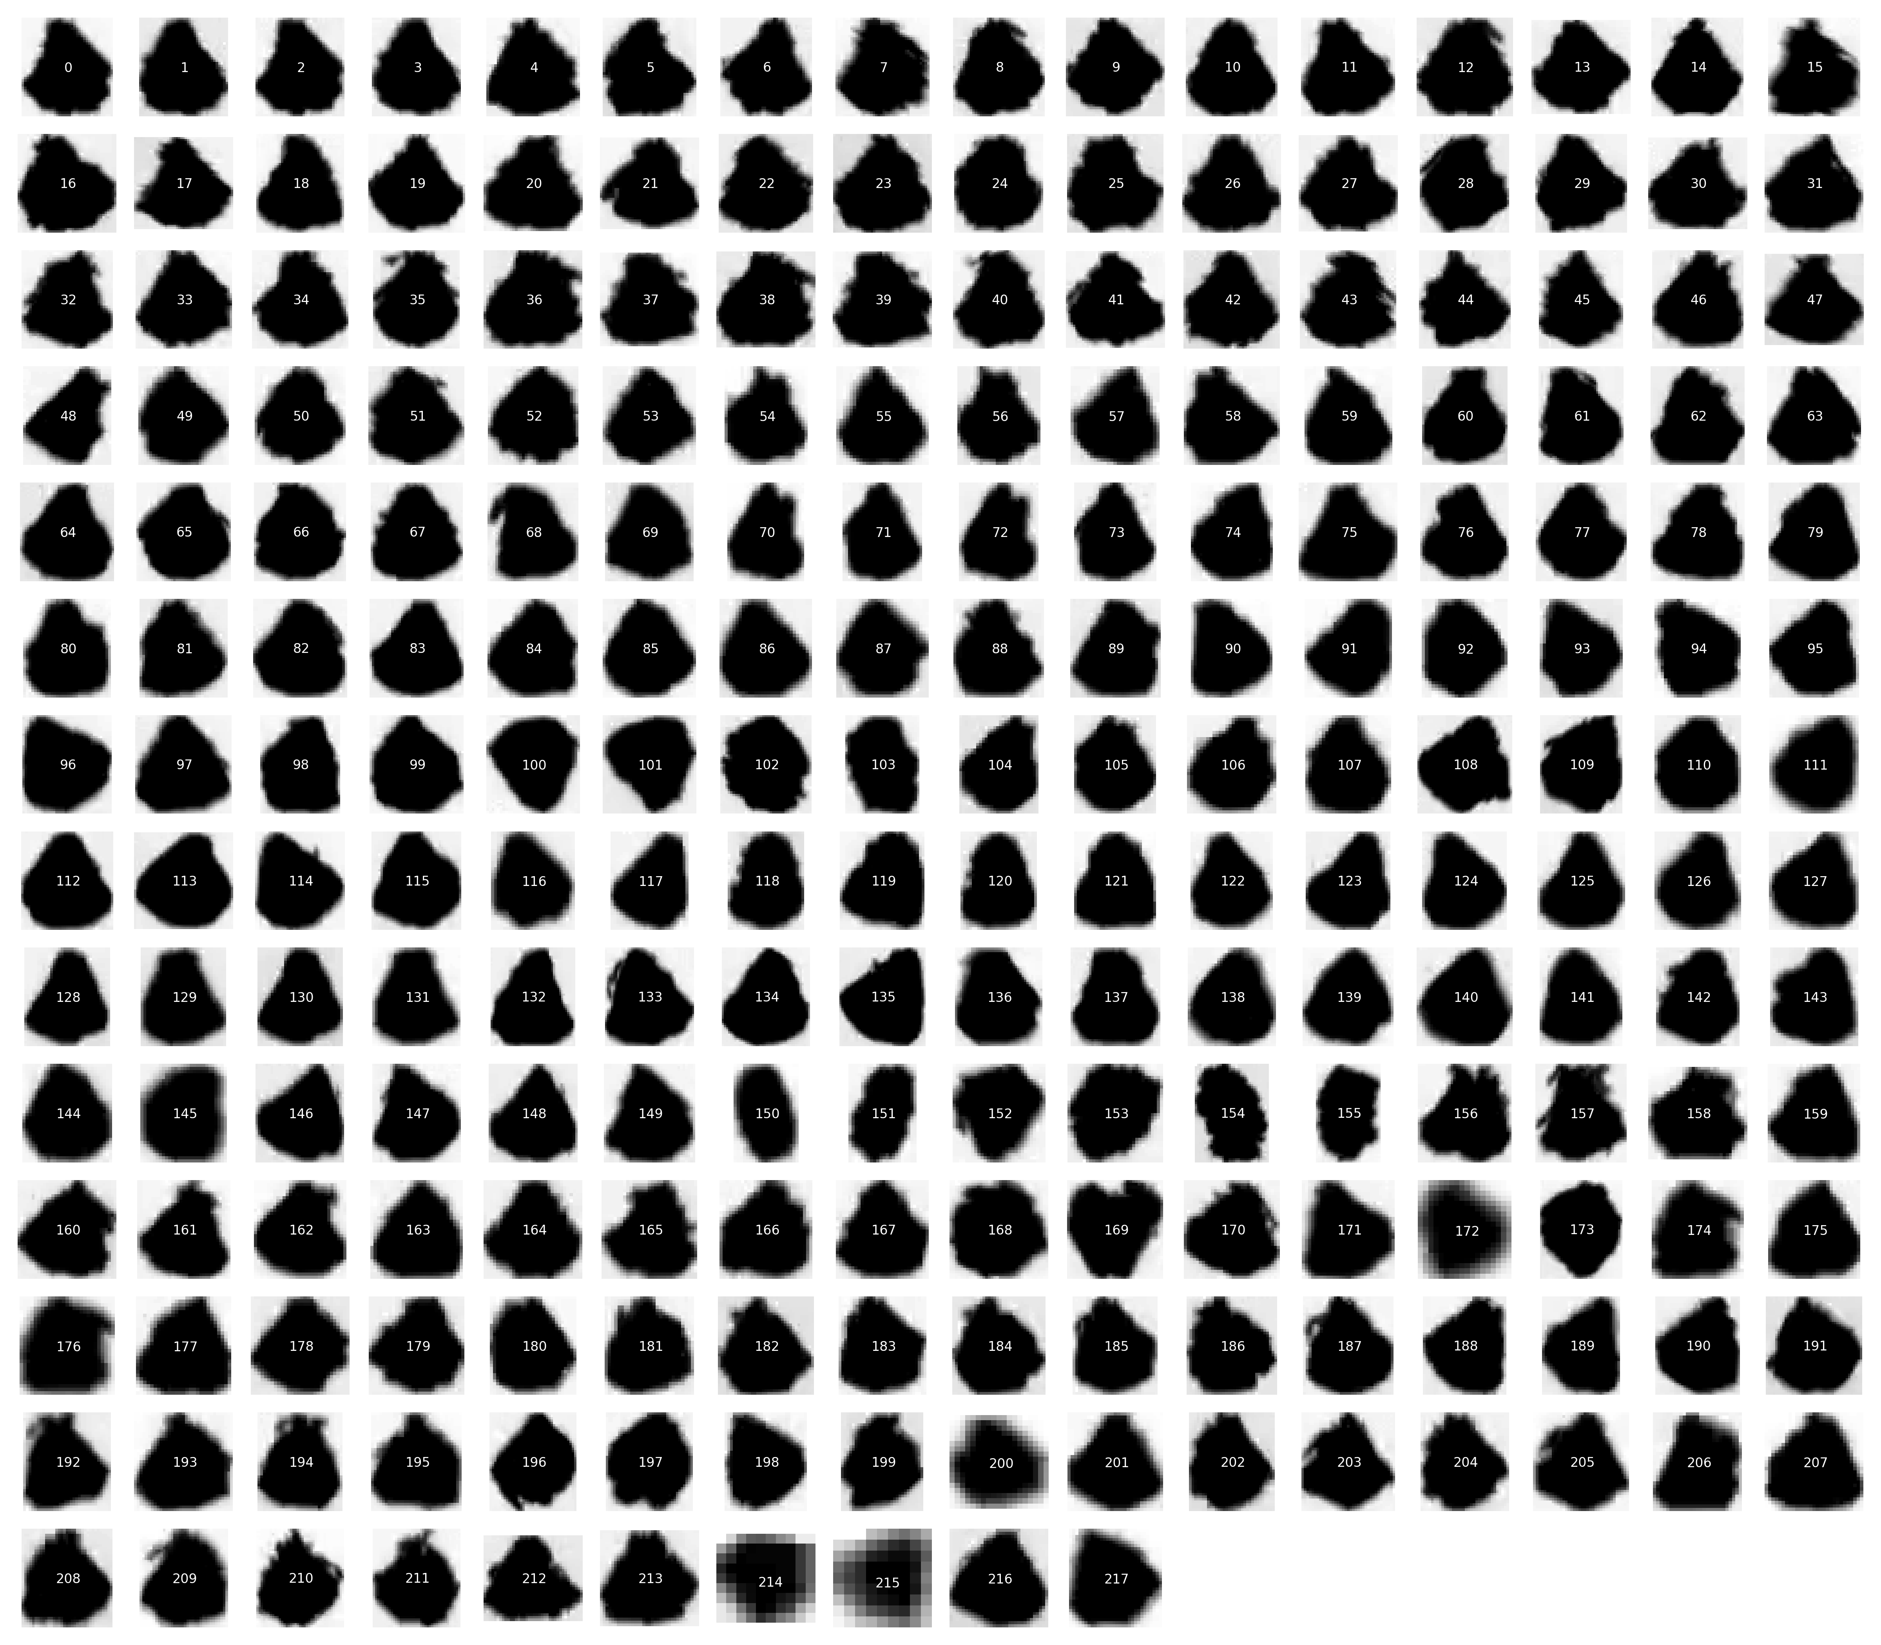
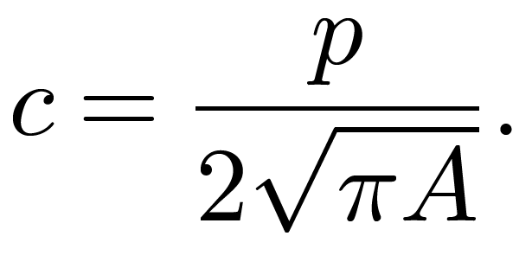
Detection
Detection | Statistical properties of conical graupel as detected by W-band radar and VISSS
217 snowfall camera images of hand-selected conical graupel particles
Calculate complexity and aspect ratio of every particle
c…complexity
p…perimeter
A…area
Notes:
HKL: so much space on the right: write which properties you calculate ;)

Slide 6
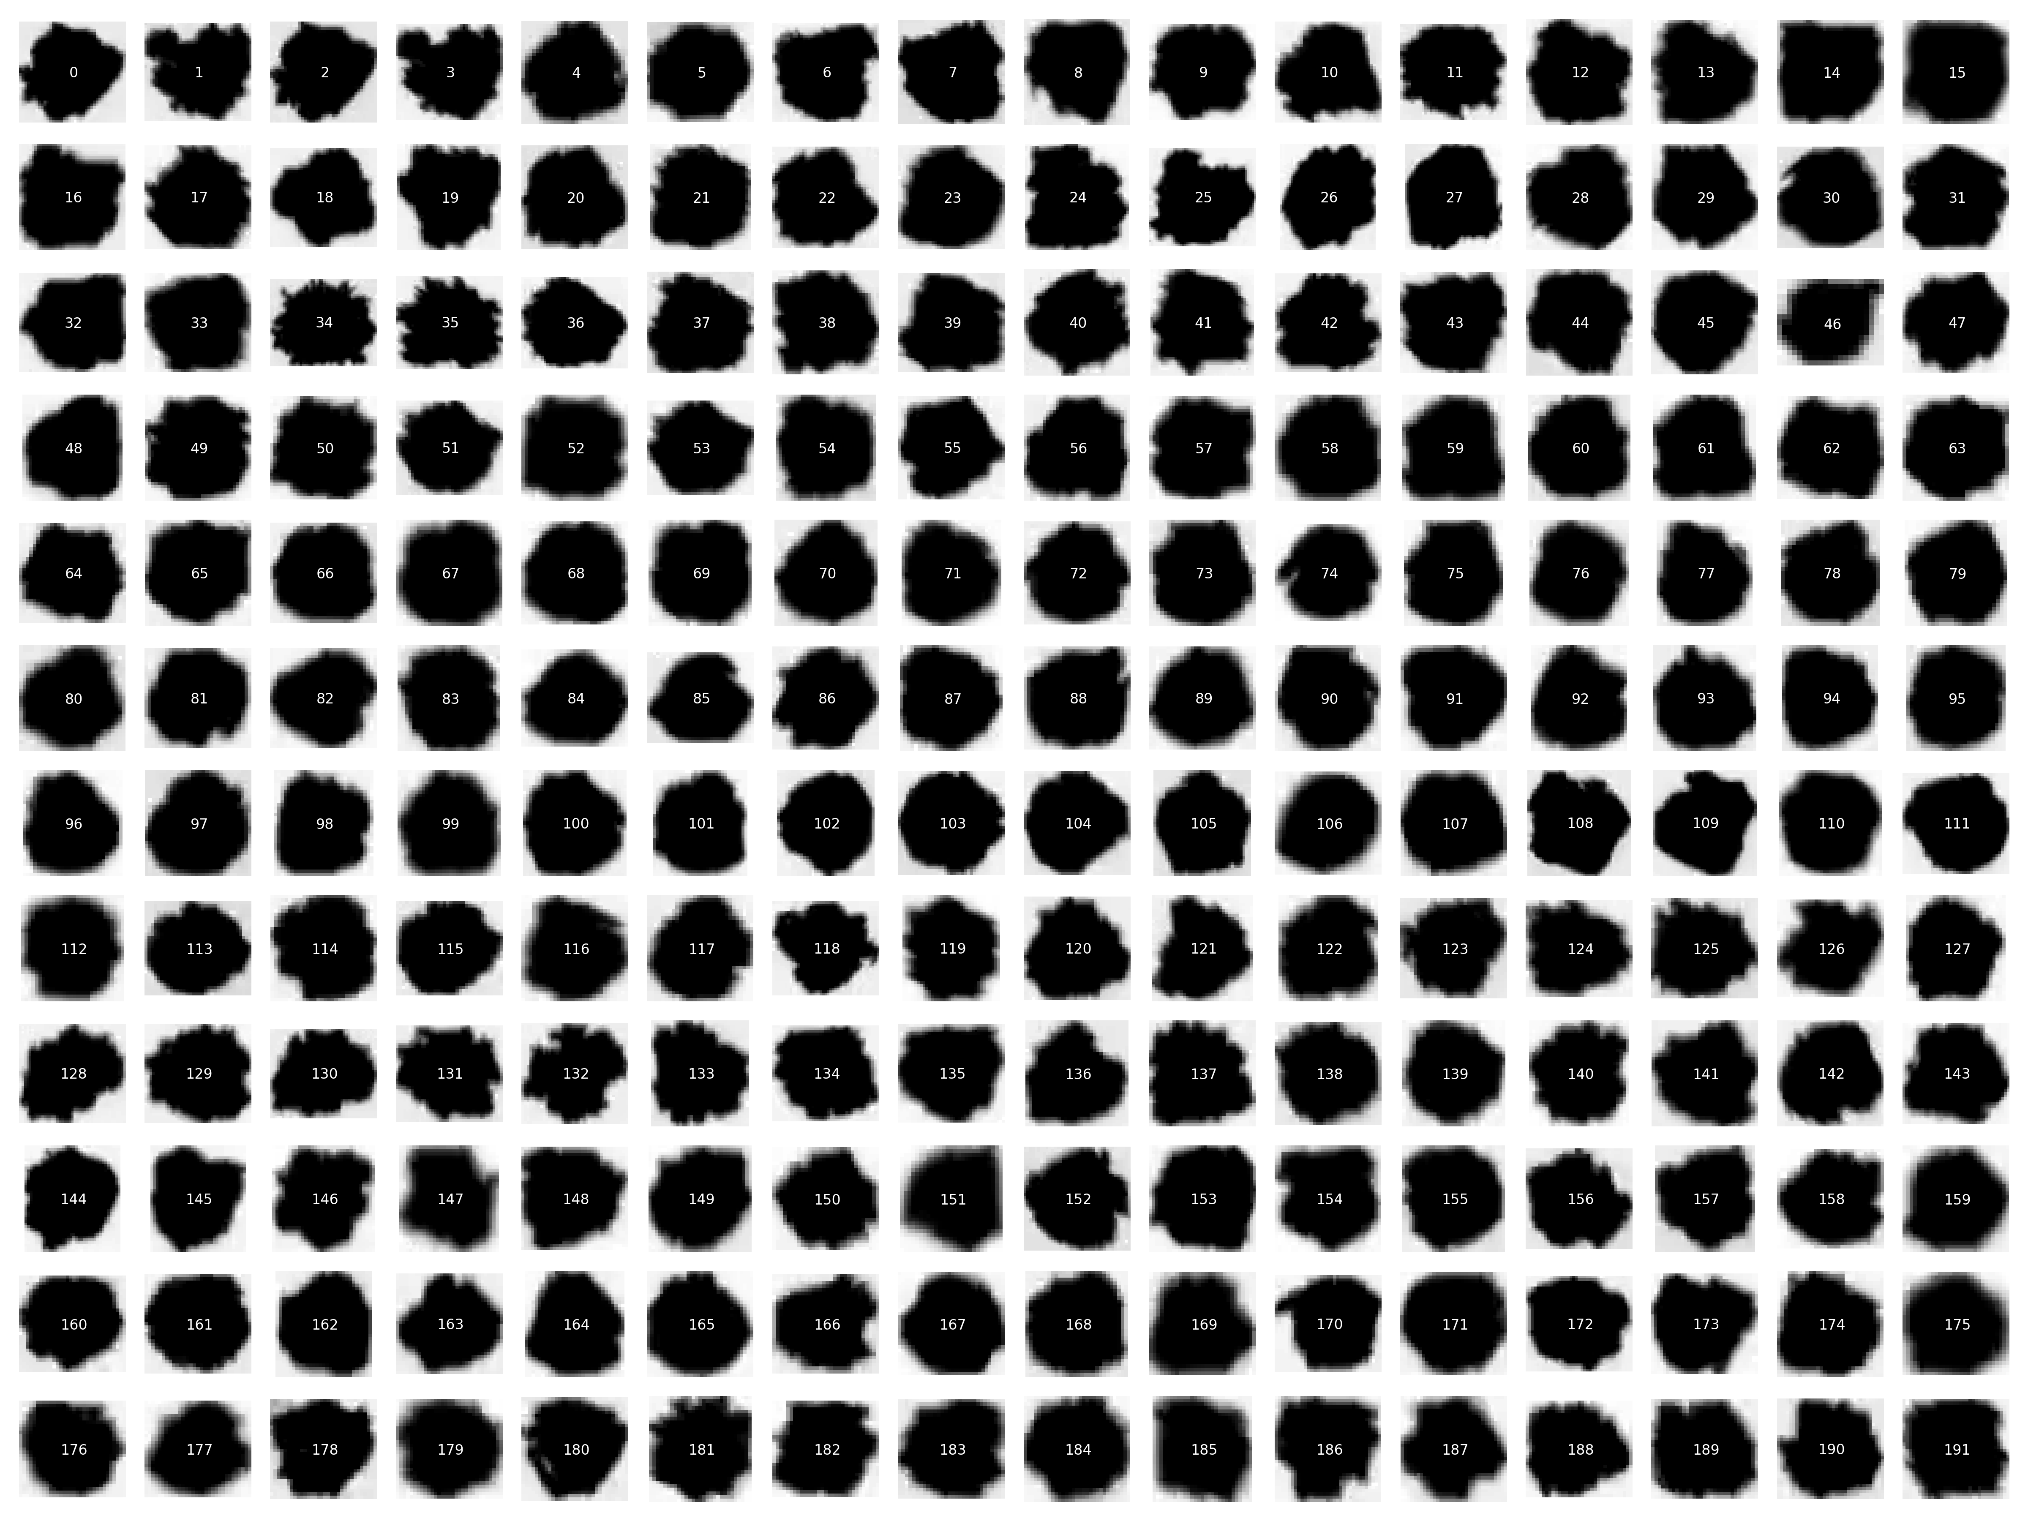
Detection
Detection | Statistical properties of conical graupel as detected by W-band radar and VISSS
191 snowfall camera images of hand-selected NON-conical graupel particles
Calculate complexity and aspect ratio of every particle
c…complexity
p…perimeter
A…area
Notes:
HKL: so much space on the right: write which properties you calculate ;)

Slide 7
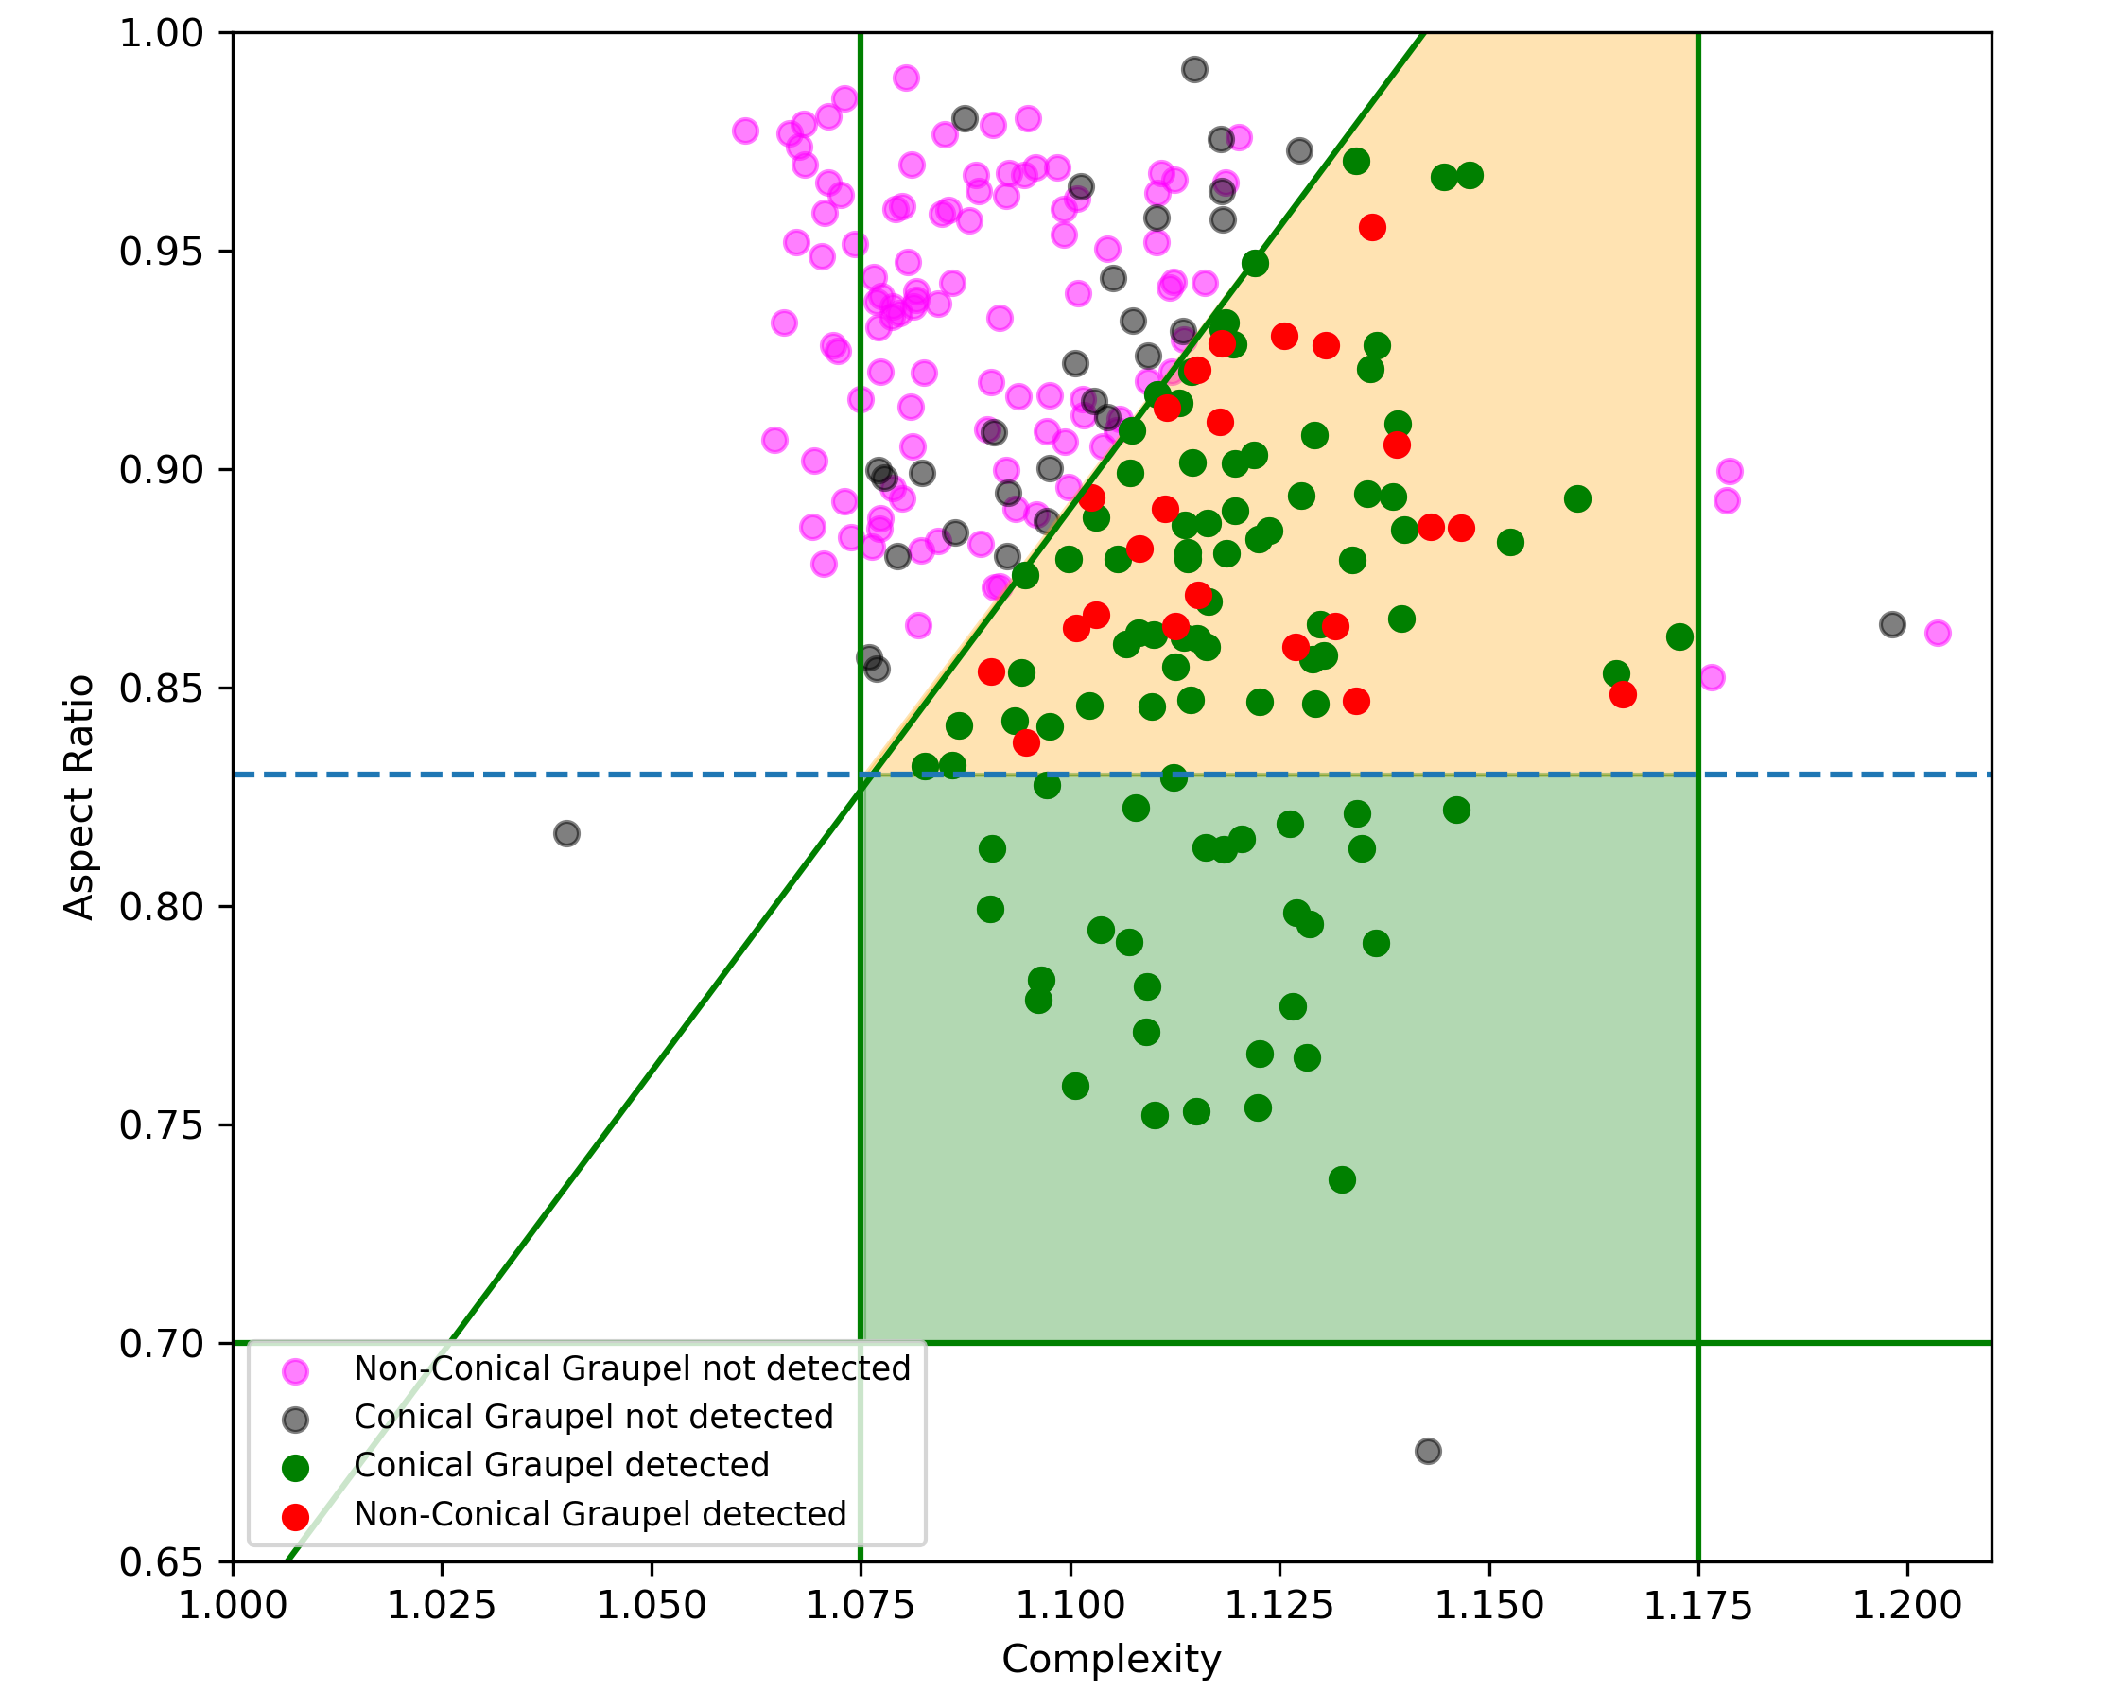
Detection Conical vs non-concial
Detection | Statistical properties of conical graupel as detected by W-band radar and VISSS
Plot non-conical particles and conical graupel particles
Filter conical graupel particles by aspect ratio and complexity → ORANGE and GREEN area
PINK: Non-conical graupel outside of filter area
RED: Non-conical graupel inside of filter area
GREEN: Conical graupel inside of filter area
BLACK: Conical graupel outside of filter area

Slide 8
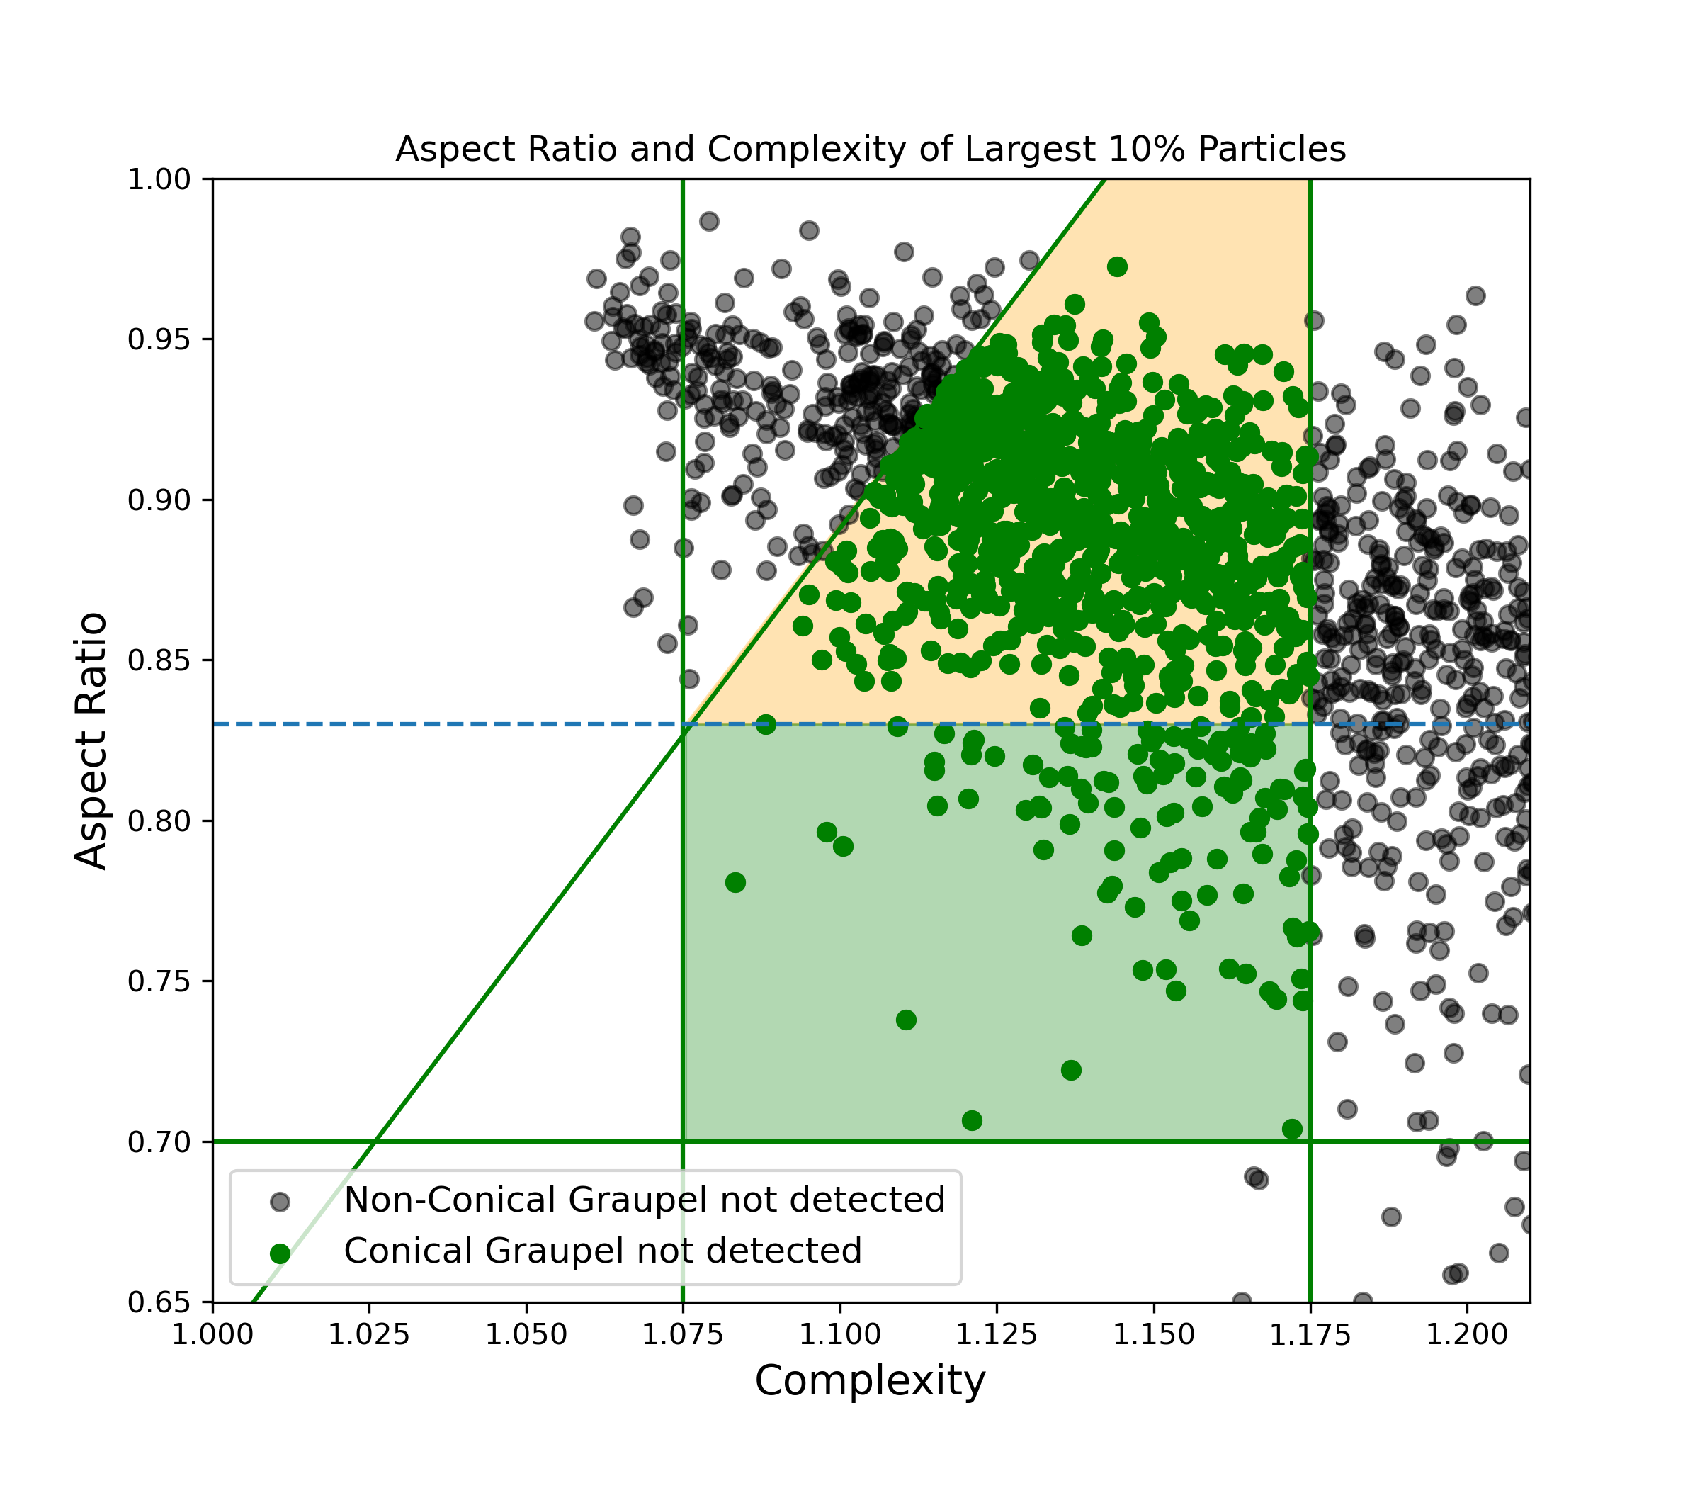
Detection Conical Graupel
Detection | Statistical properties of conical graupel as detected by W-band radar and VISSS
Mean properties of largest 10%
GREEN: Conical Graupel
BLACK: Others
969 Minutes in orange and green
111 Minutes in green

Slide 9
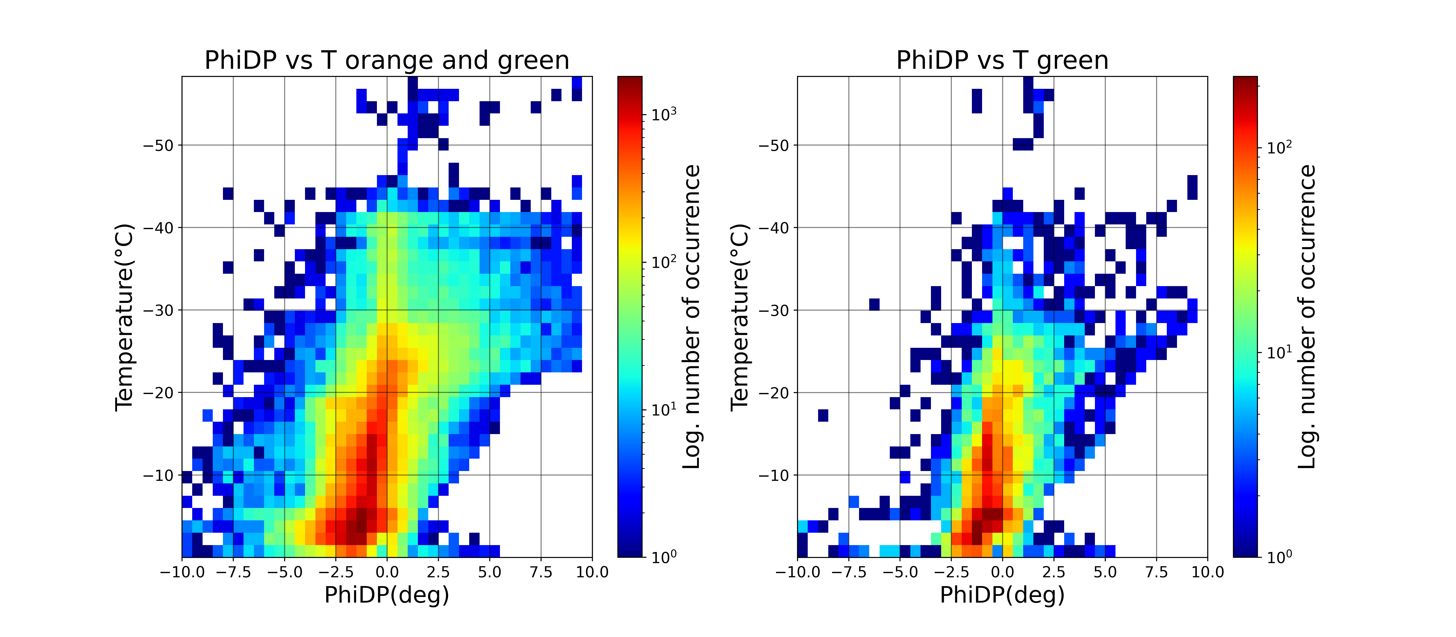
Phidp Conical Graupel
Statistics | Statistical properties of conical graupel as detected by W-band radar and VISSS
Notes:
HKL: it‘d be interesting to compare the polarimetric properties of conical- and non-conical graupel
HKL: If you have time, add one statement on each of the pol. Property plots

Slide 10
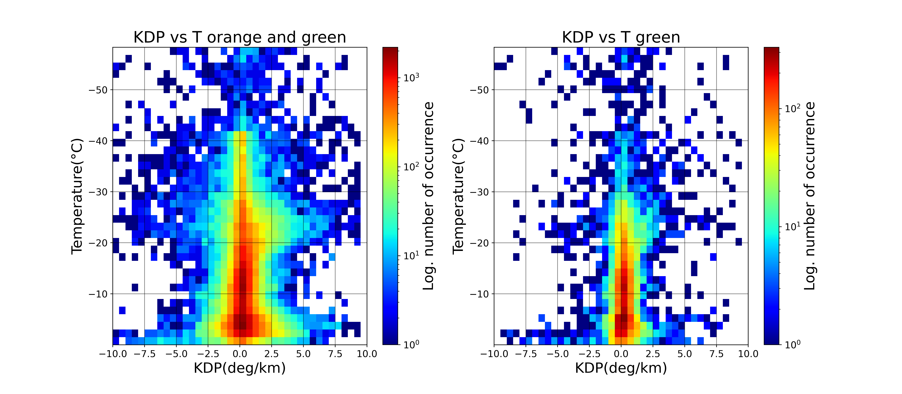
KDP Conical Graupel
Statistics | Statistical properties of conical graupel as detected by W-band radar and VISSS

Slide 11
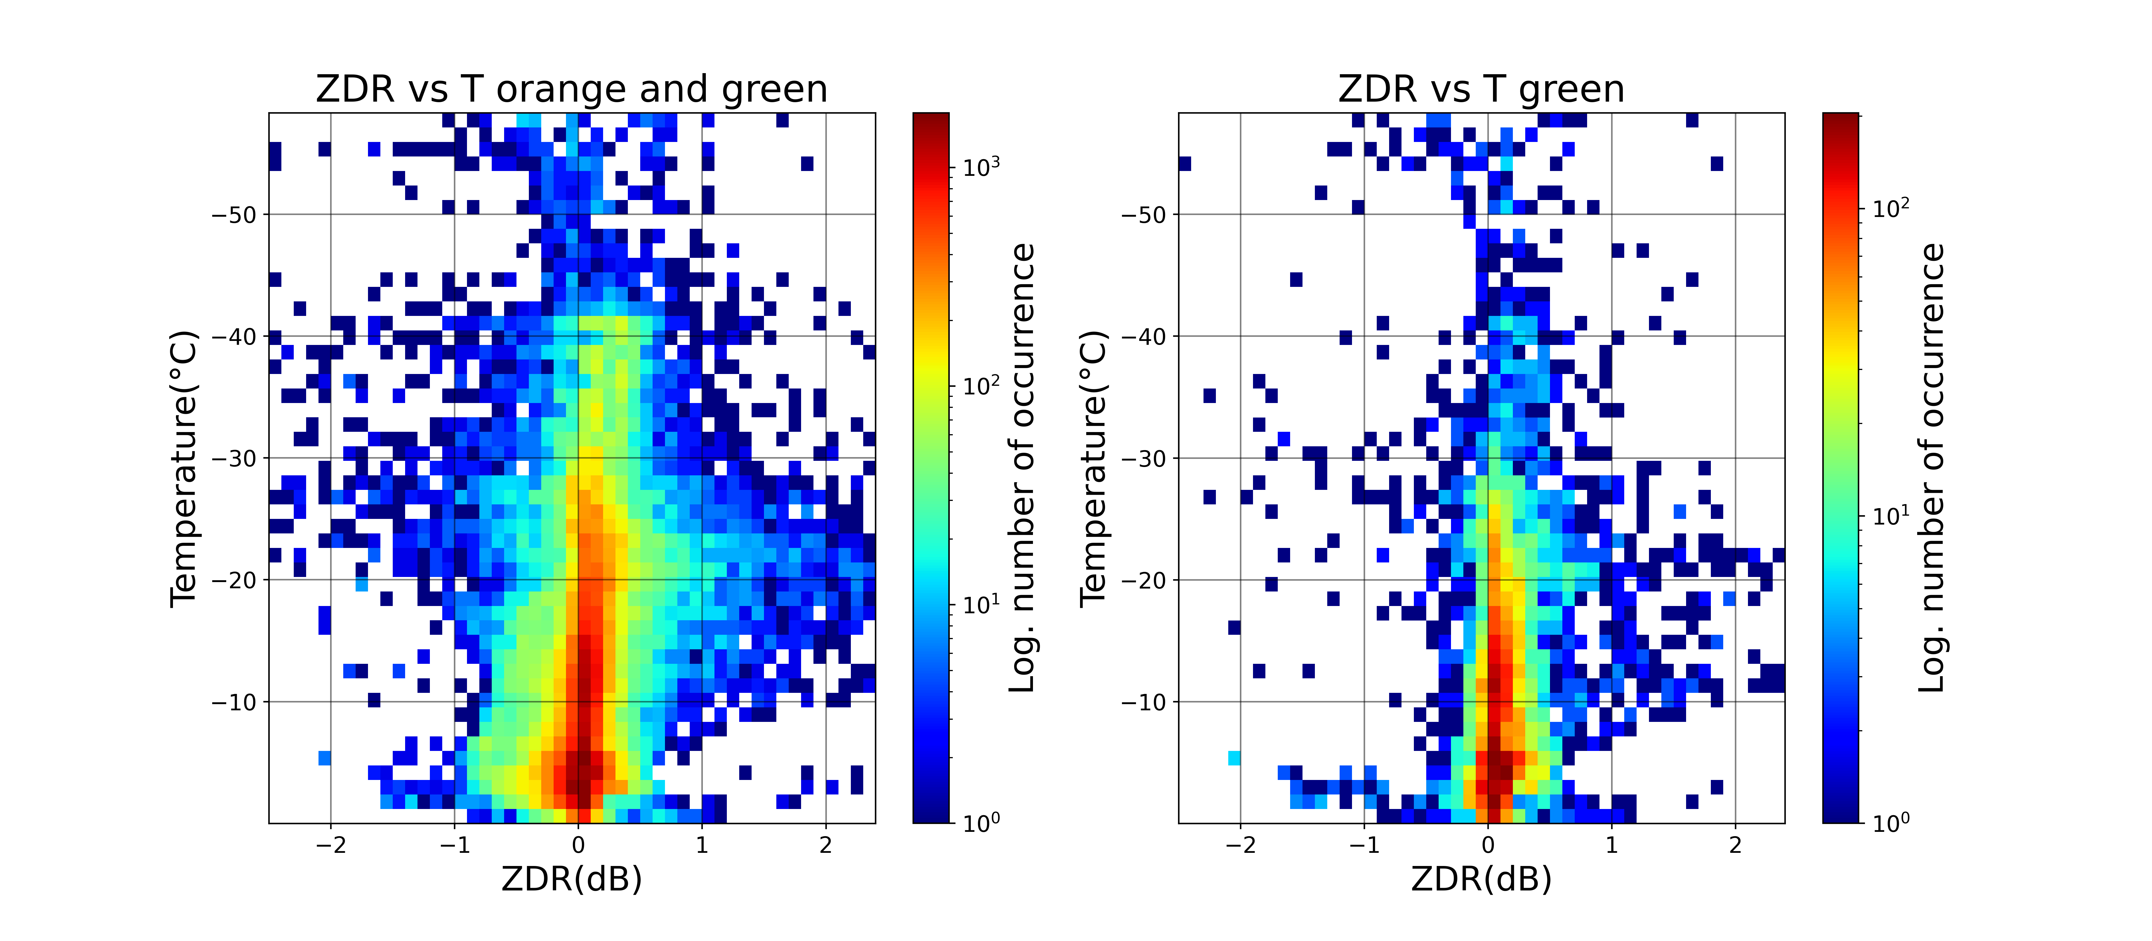
zdr Conical Graupel
Statistics | Statistical properties of conical graupel as detected by W-band radar and VISSS

Slide 12
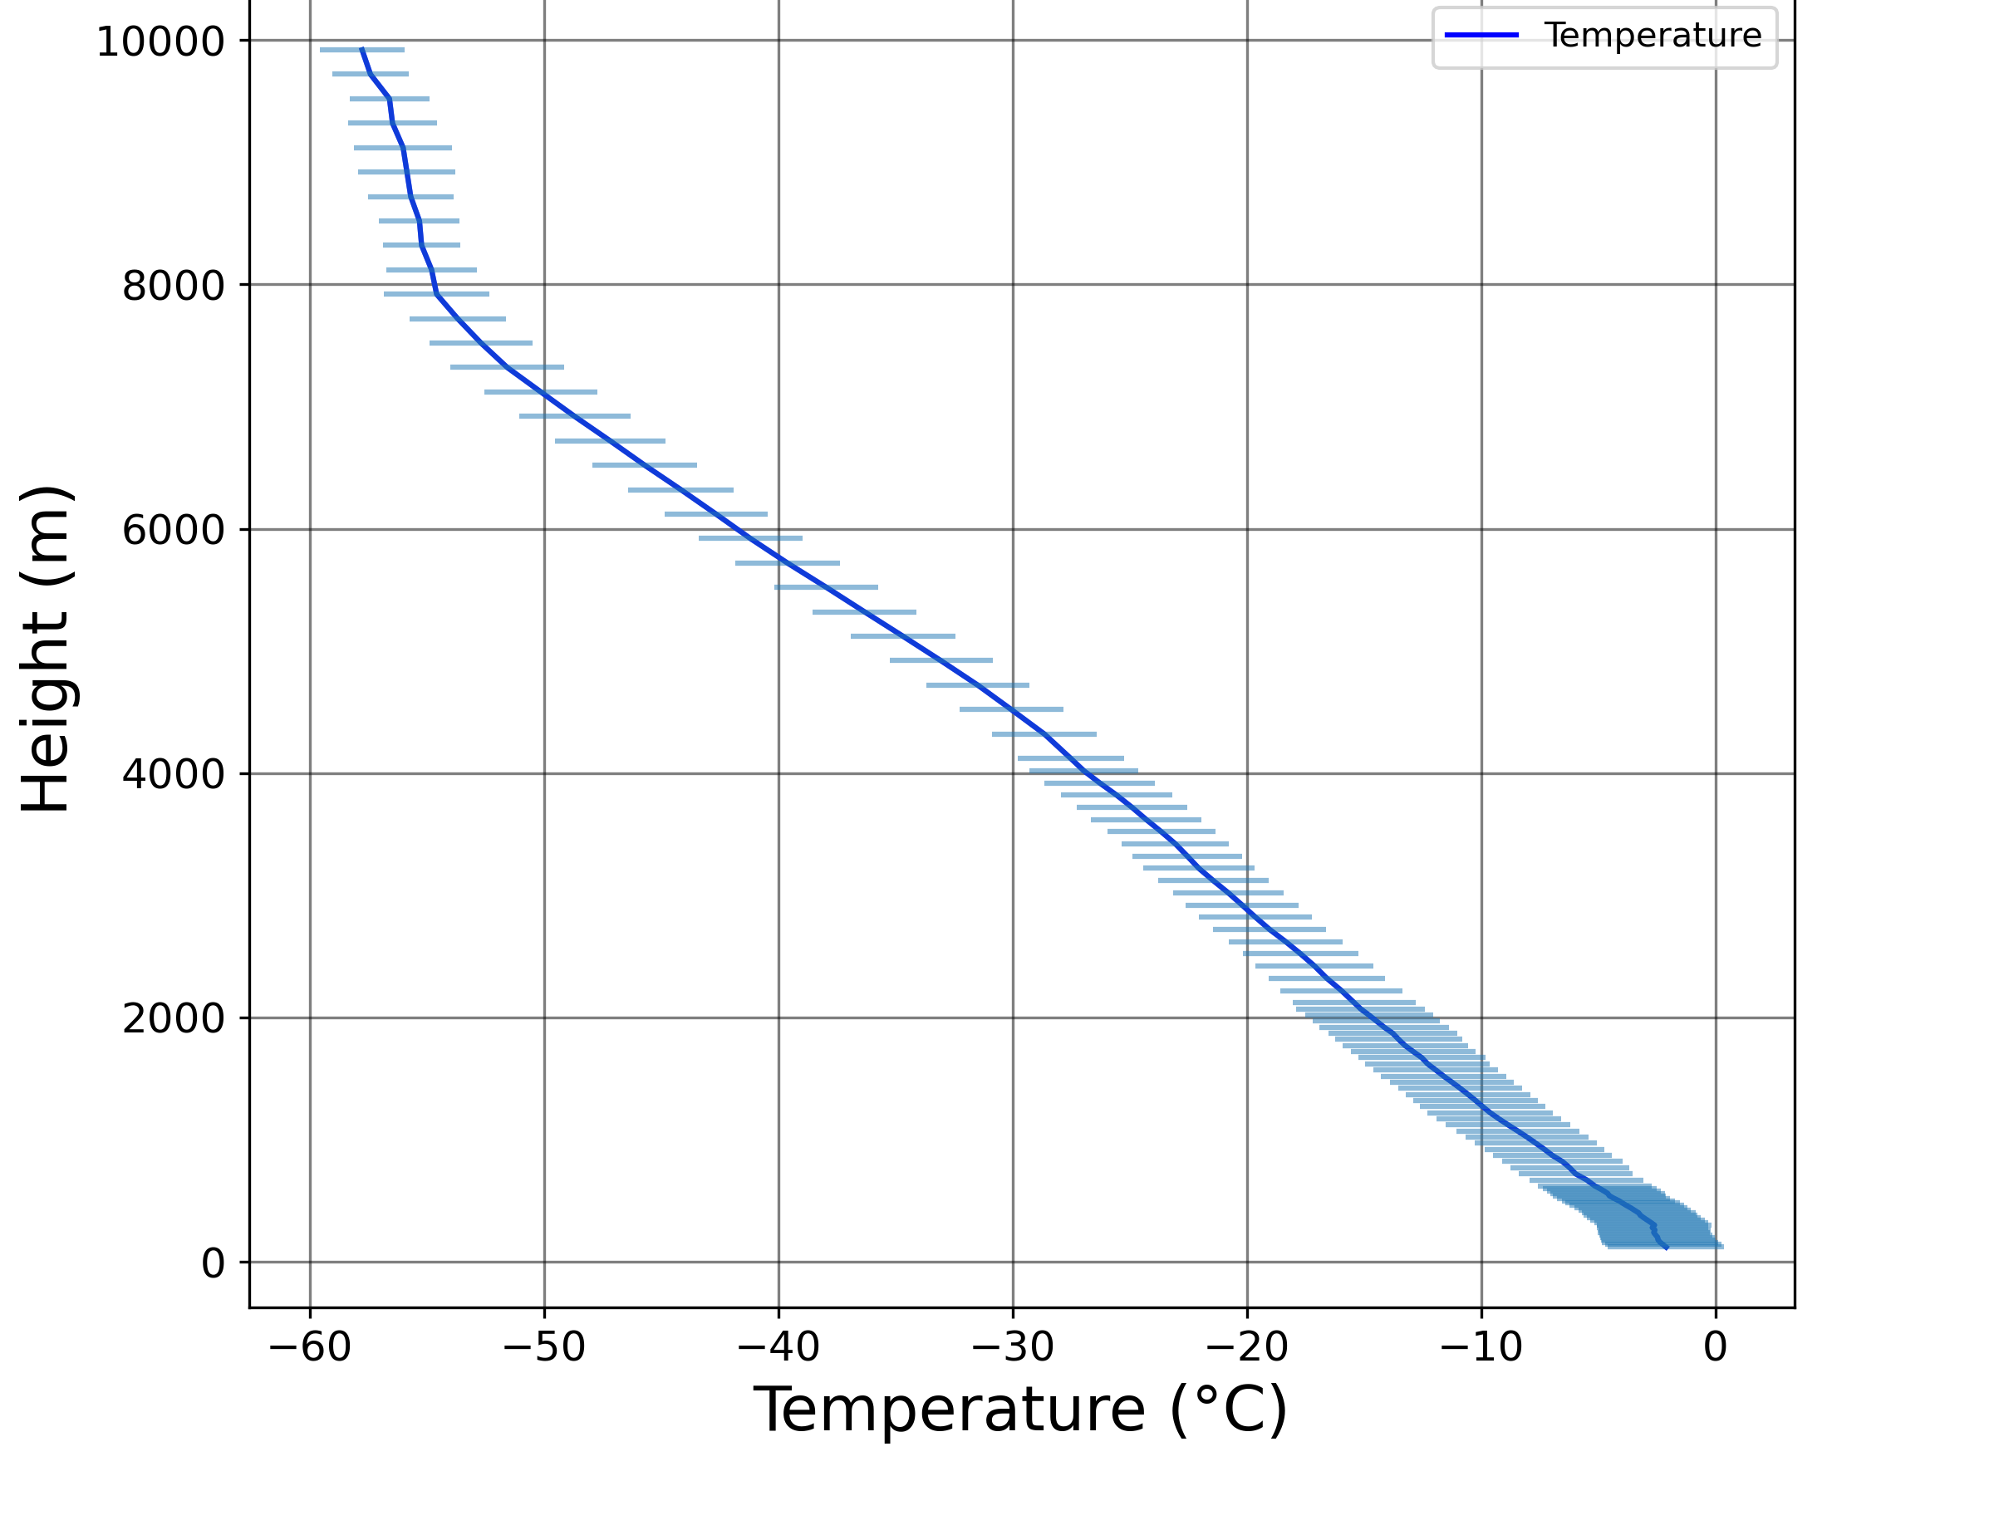
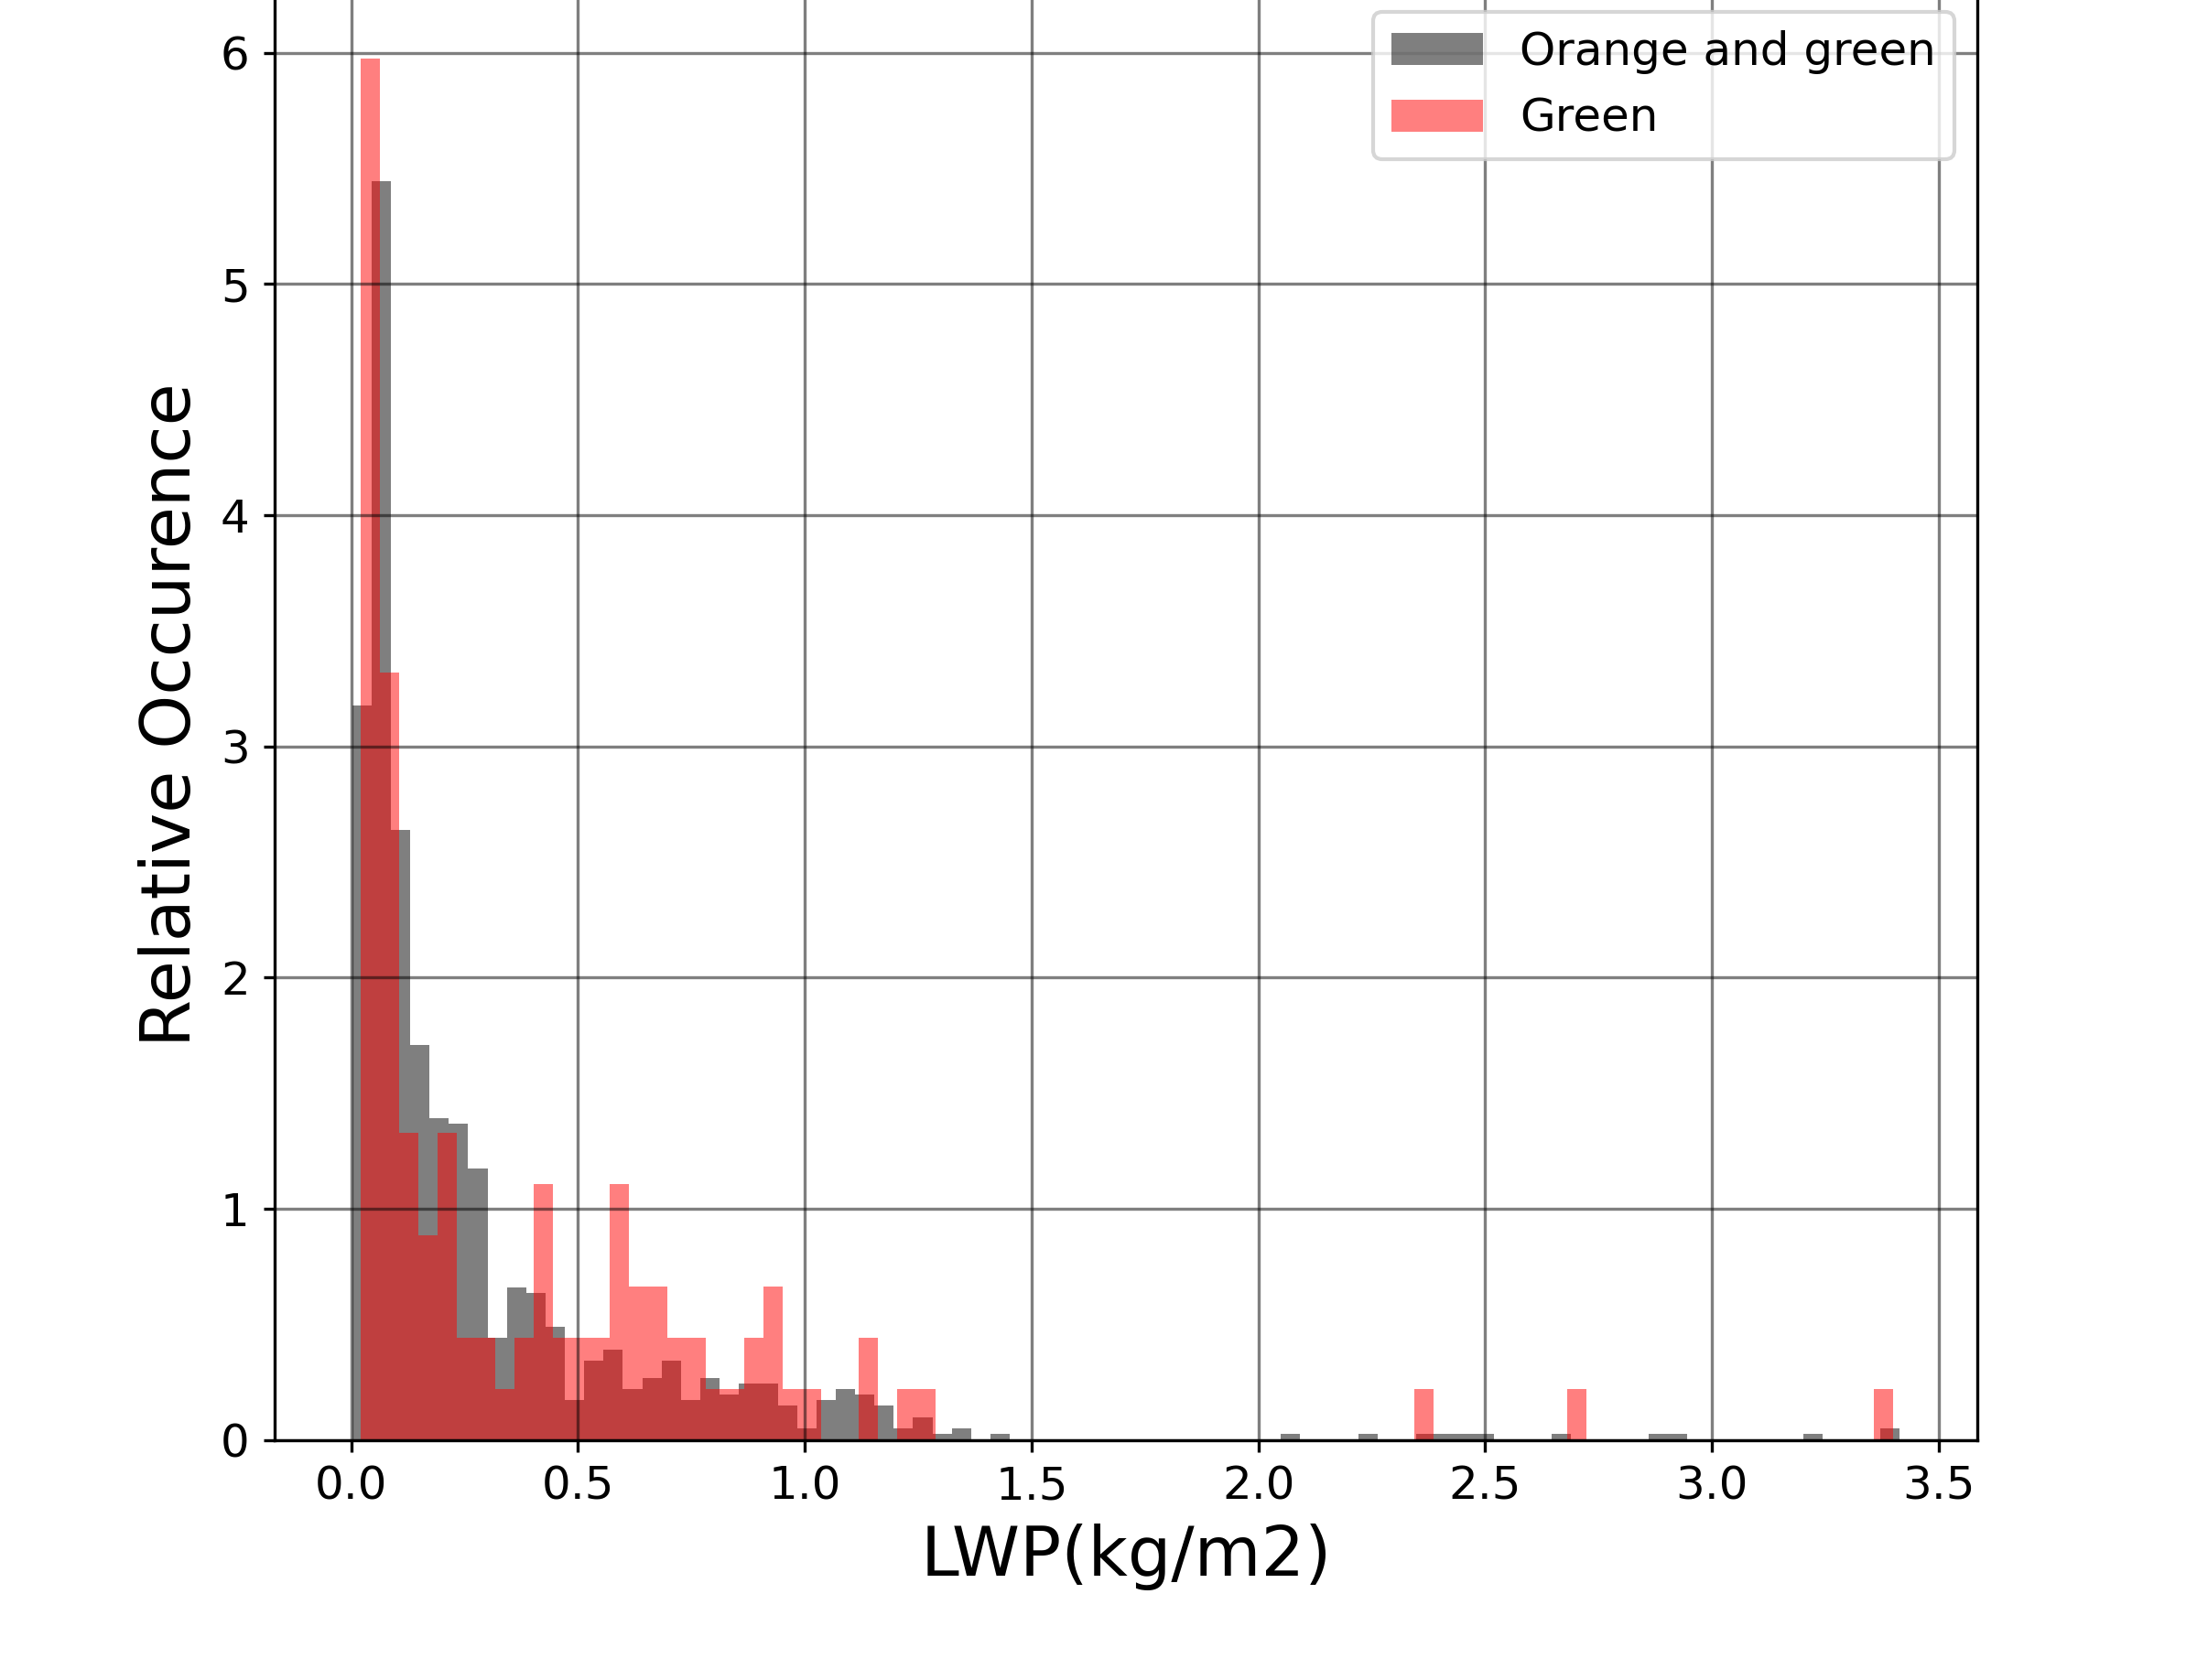
Temperature AND lwp Conical Graupel
Statistics | Statistical properties of conical graupel as detected by W-band radar and VISSS
Temperature during conical graupel
LWP during conical graupel
(%)
Notes:
HKL: left title: temperature profiles during , right title: LWP during …
HKL: relative occurence in %?

Slide 13
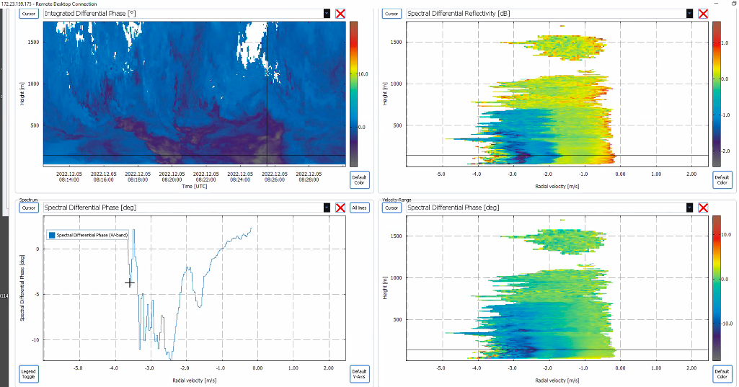
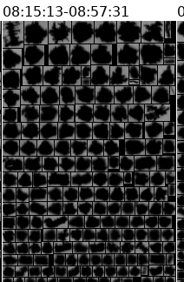
Spectral Oscillations in Conical Graupel?
2022-12-05
Spectral oscillations | Statistical properties of conical graupel as detected by W-band radar and VISSS
ZDR
phiDP
phiDP
By A. Myagkov
Notes:
State a few features! Polarimetric oscillations, …

Slide 14
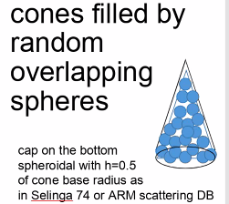
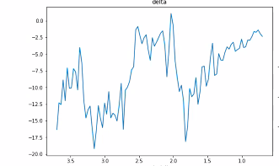
Scattering Simulations by davide ori
Spectral oscillations | Statistical properties of conical graupel as detected by W-band radar and VISSS
OBS
Spectral PhiDP (deg)
SIM
Radial velocity (m/s)
First simulations are able to repoduce the polarimetric oscillations
deg
By Dr. Davide Ori
University of Cologne
Eqiuv. Diameter (mm)
Notes:
HKL: Increase axis label fonts left plot

Slide 15
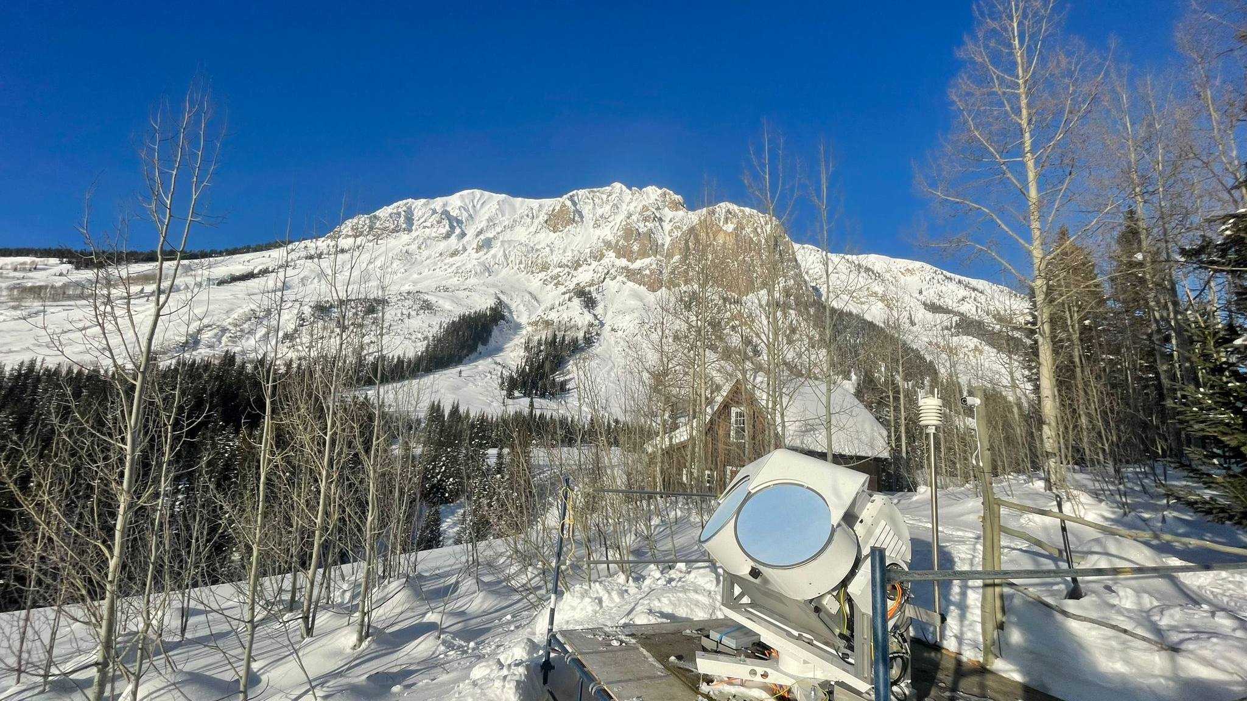
Thank You
Anton Kötsche
Leipzig Institute of Meteorology (LIM)
AG Remsens
Prager Straße 34
T +49 341 97-36654
anton.koetsche@uni-leipzig.de
www.uni-leipzig.de

