Slide 1
Signatures of Dust on Snow in Spectral Albedo
Laura Riihimaki, CIRES/NOAA GML
Spectral Albedo Measurements: Christian Herrera, Gary Hodges
Dust on Snow Folks: Leah Gibson, Allison Aiken, Adeyemi Adebiyi, Dan Feldman, Erica Woodburn

Slide 2
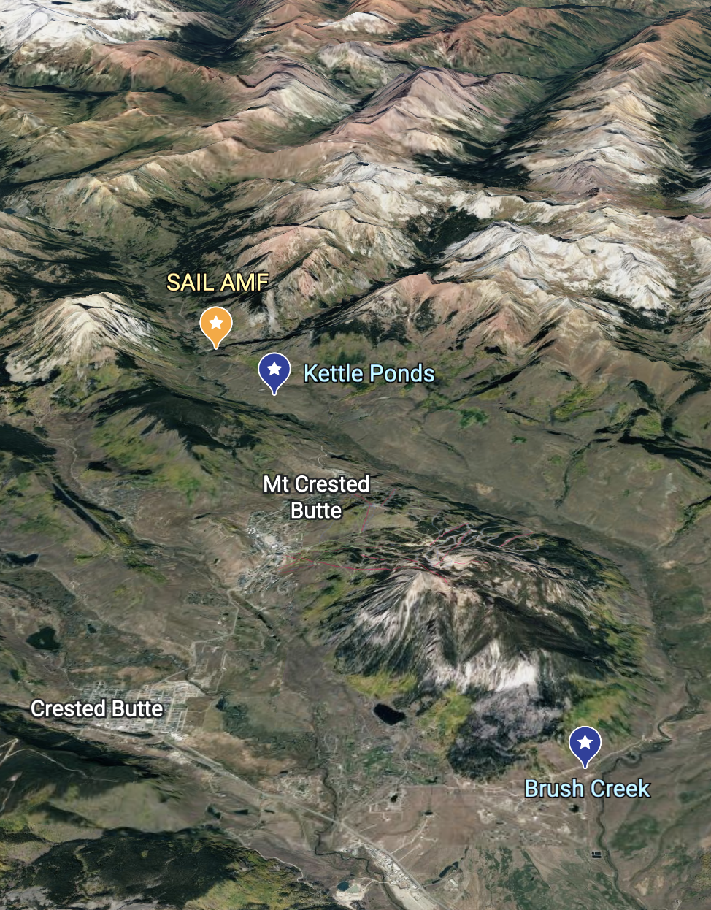
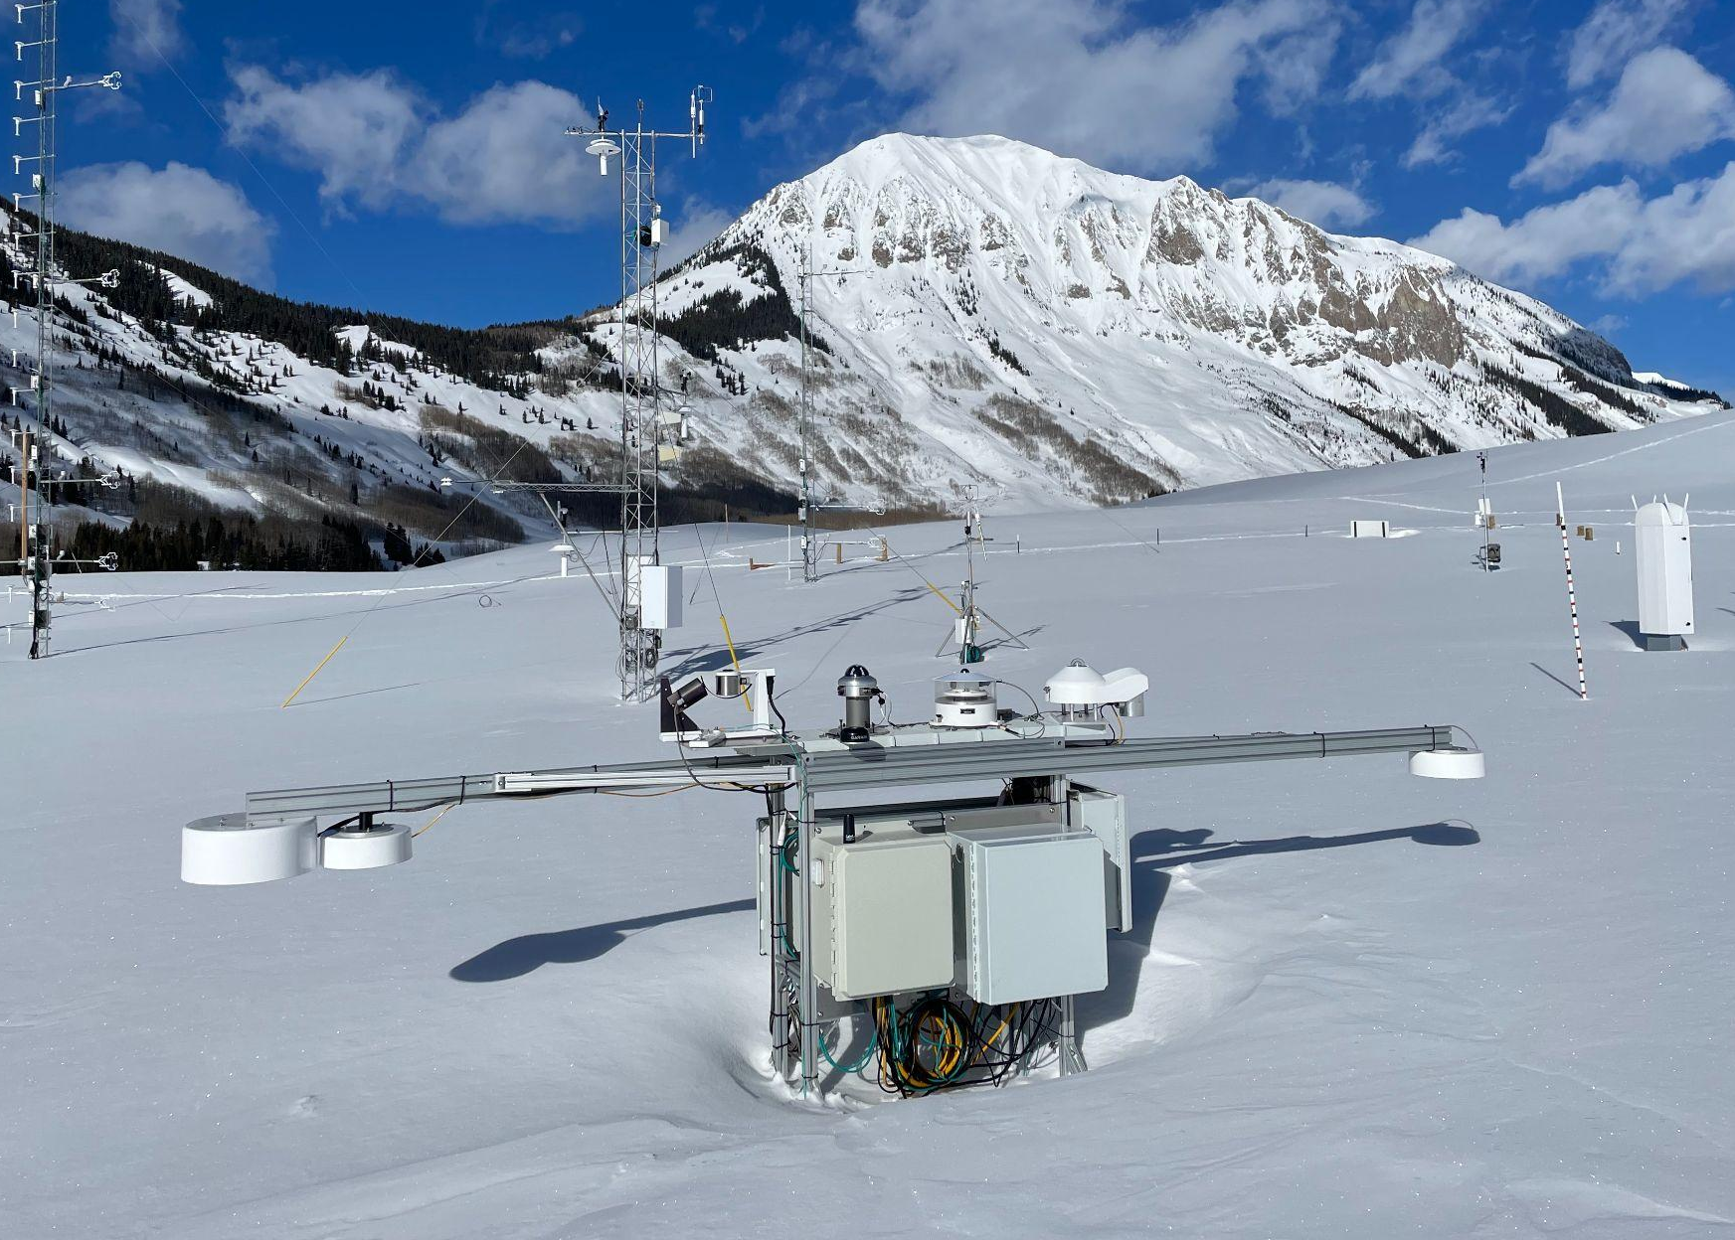
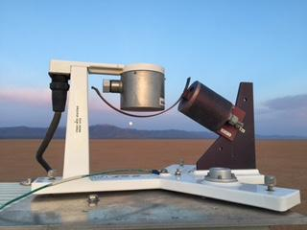
Spectral Albedo Measurements at 3 sites:
MFRSR up/down–415, 500, 610, 673, 870, 940, 1625 nm
Photo credit Gary Hodges
Photo credit Logan Soldo

Slide 3
A reduced albedo absorbs more solar energy and melts snow faster
https://gml.noaa.gov/grad/tools/splash/webcams/movs/CBC_N_20230407.mp4

Slide 4
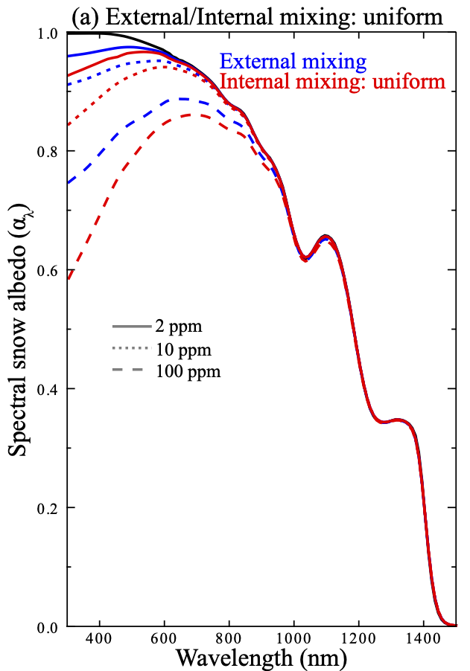
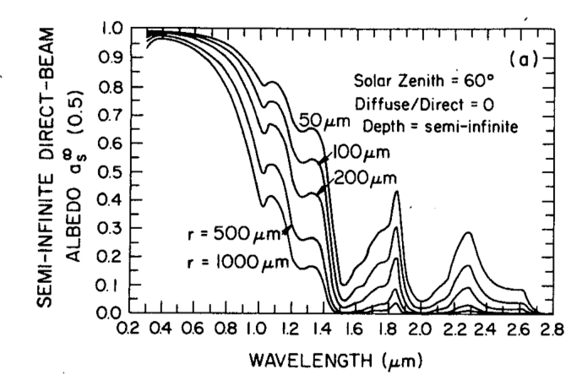
Absorbers have a stronger impact in the visible than the IR, changing snow properties (e.g. grain size) impact IR more
415 nm
870 nm
From Shi, T., et al: Enhanced light absorption and reduced snow albedo due to internally mixed mineral dust in grains of snow, Atmos. Chem. Phys., 21, 6035–6051, https://doi.org/10.5194/acp-21-6035-2021, 2021.
From Wiscombe, W. J., and S. G. Warren, 1980: A Model for the Spectral Albedo of Snow. I: Pure Snow. J. Atmos. Sci., 37, 2712–2733, https://doi.org/10.1175/1520-0469(1980)037<2712:AMFTSA>2.0.CO;2.

Slide 5
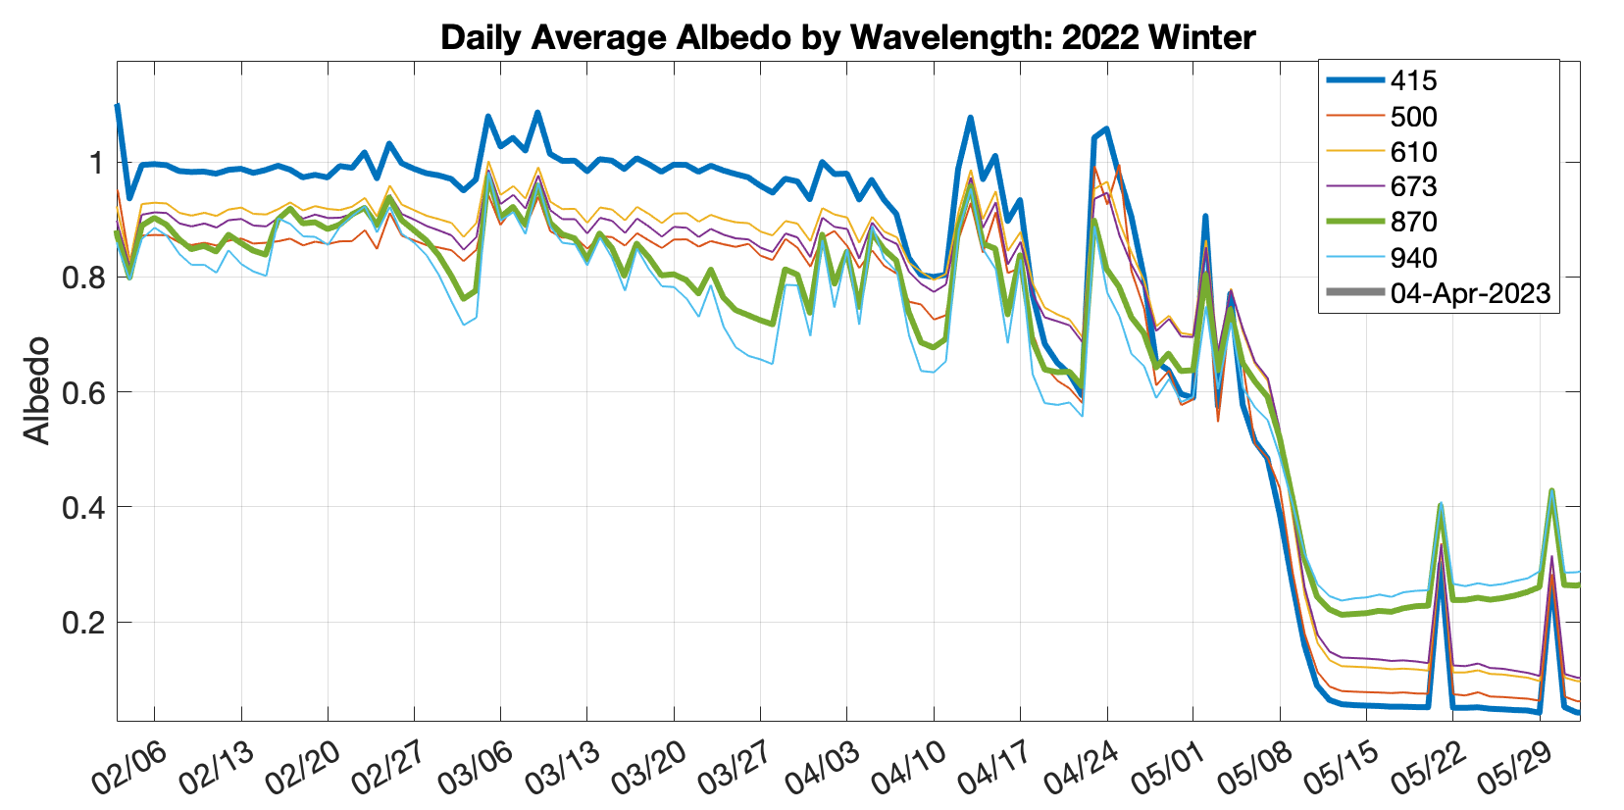
2022 Daily Average Spectral Albedo
Aging snow
Aerosol

Slide 6
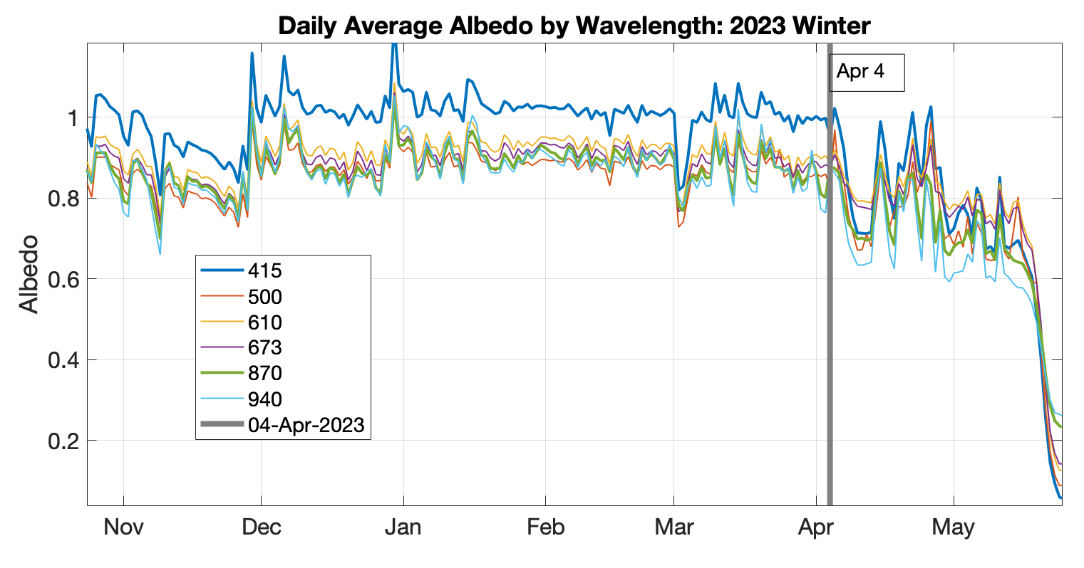
2023 Daily Average Spectral Albedo

Slide 7
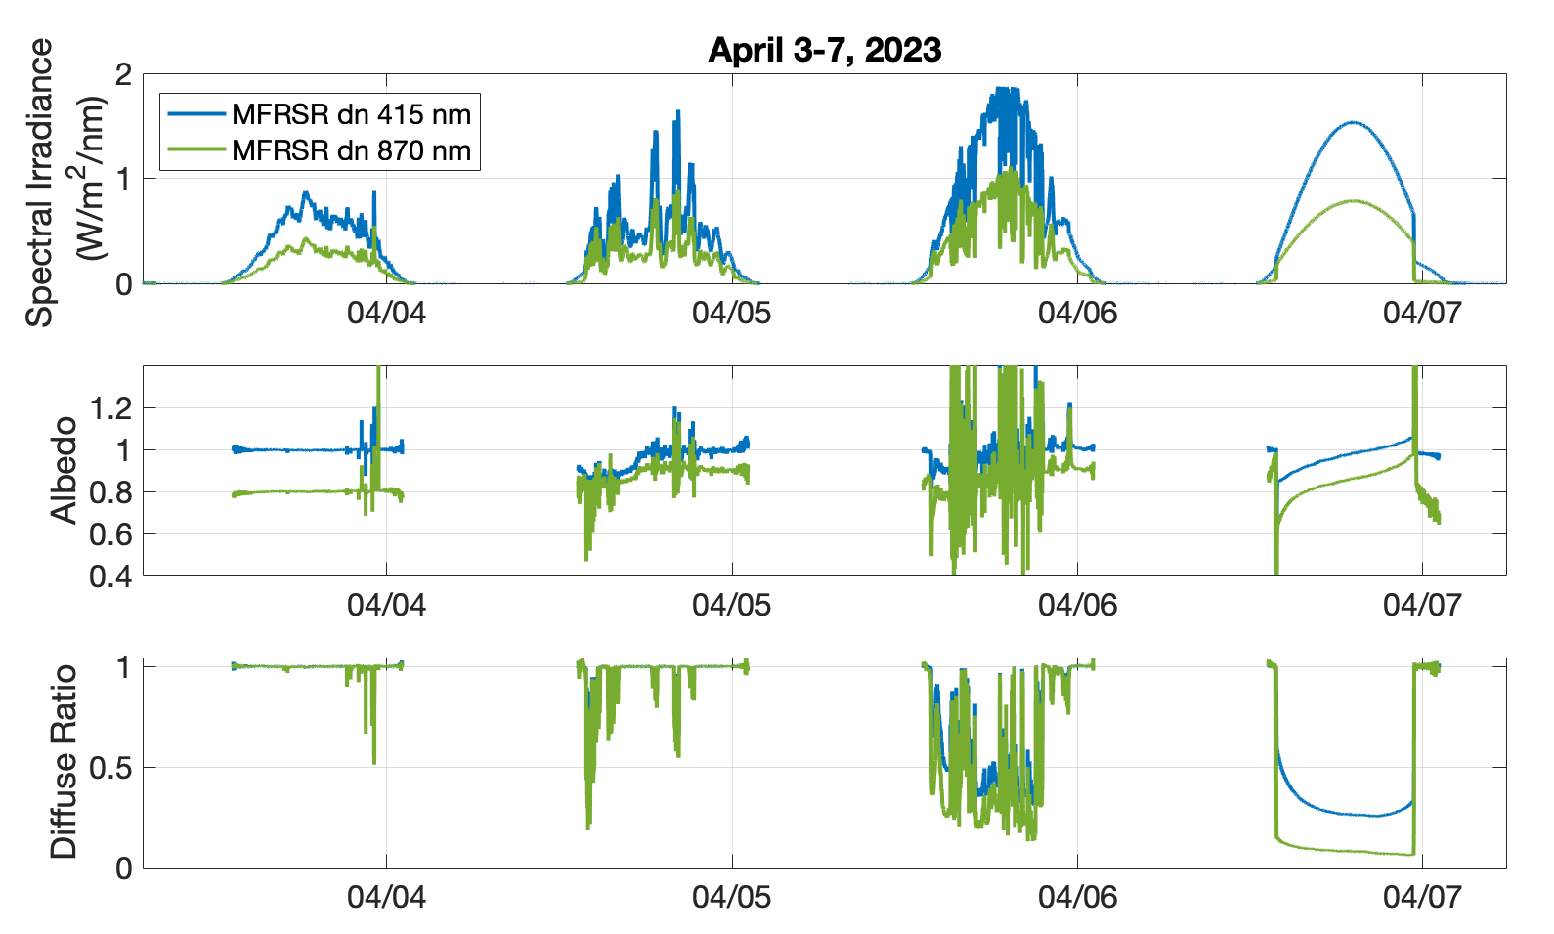

Slide 8
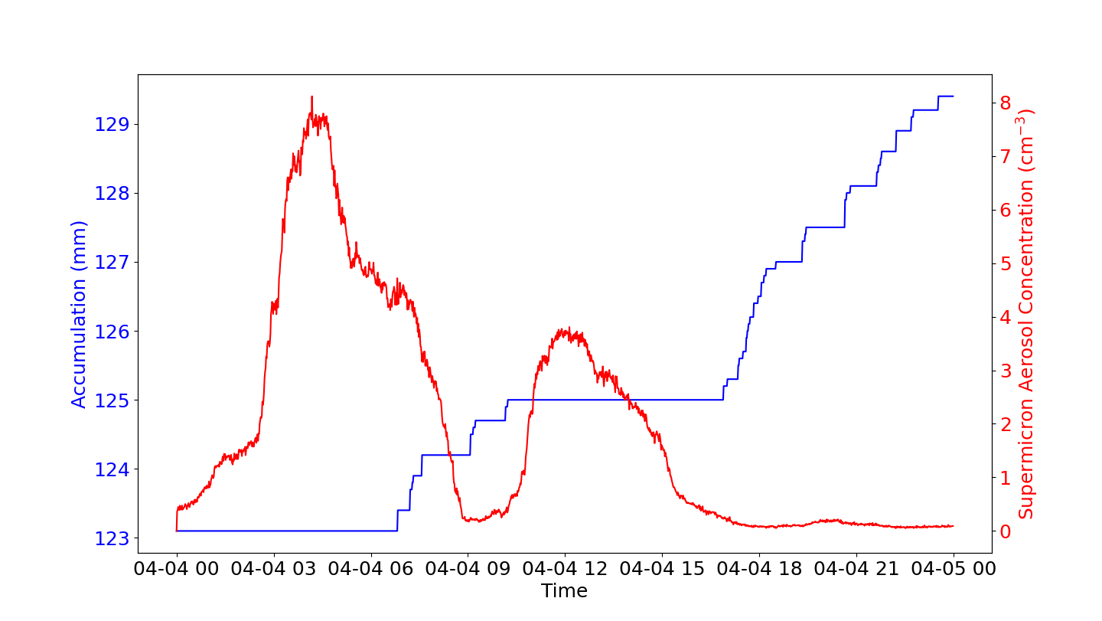
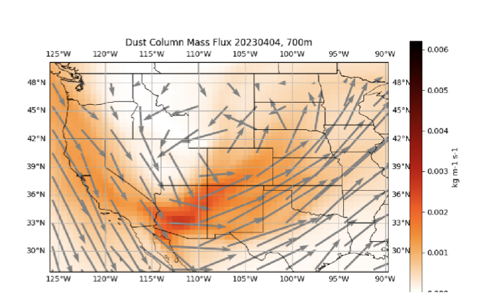
Figure courtesy of Leah Gibson
MERRA Dust Column 700 m mass flux
Dust transported from SW on April 3-4, 2023 comes right before snow. Both signals are seen in spectral albedo record

Slide 9
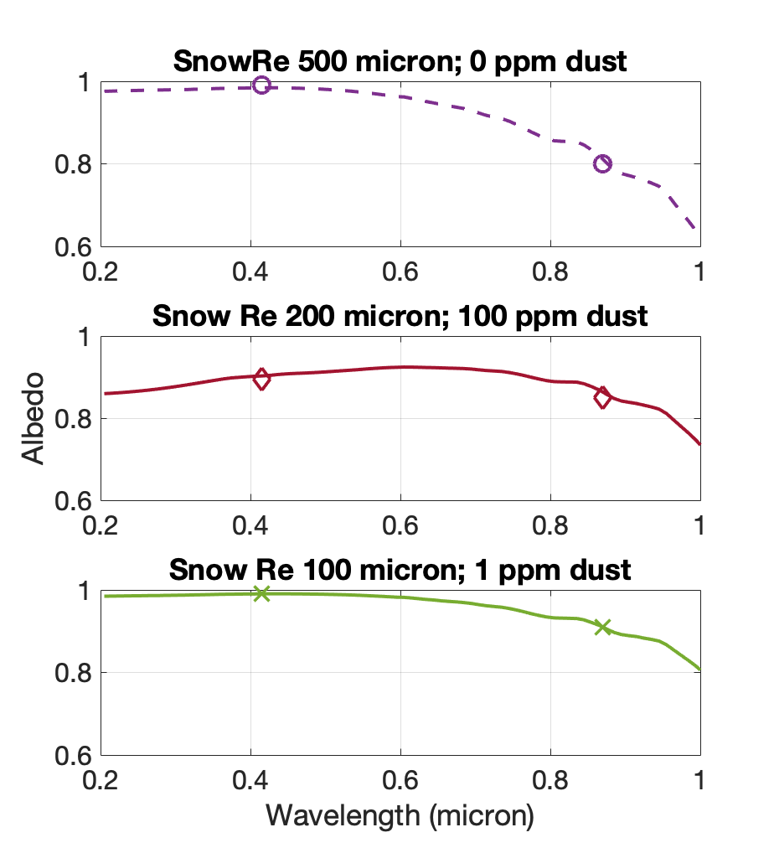
Figure courtesy of Leah Gibson
Calculations using SNICAR-AD v3.0

Slide 10
Summary: Spectral albedo measurements show signatures of snow aging and dust deposition in the temporal record
Next Steps:
Process data from all 3 sites, and examine calibration accuracy
Use radiative transfer calculations to separate impacts of slope, dust, and snow aging on measurements
Potential collaborations:
Work with others to better identify snow and aerosol properties for radiative transfer calculations
Integrate results into the bigger scientific picture of snow melt and surface processes

Slide 11
Extra slides

Slide 12
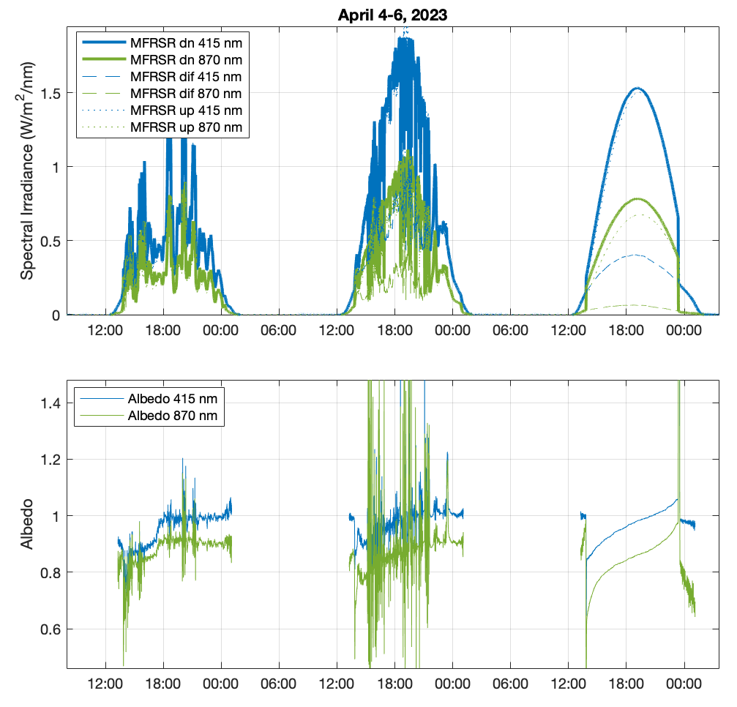
MFRSR Spectral Measurements

Slide 13
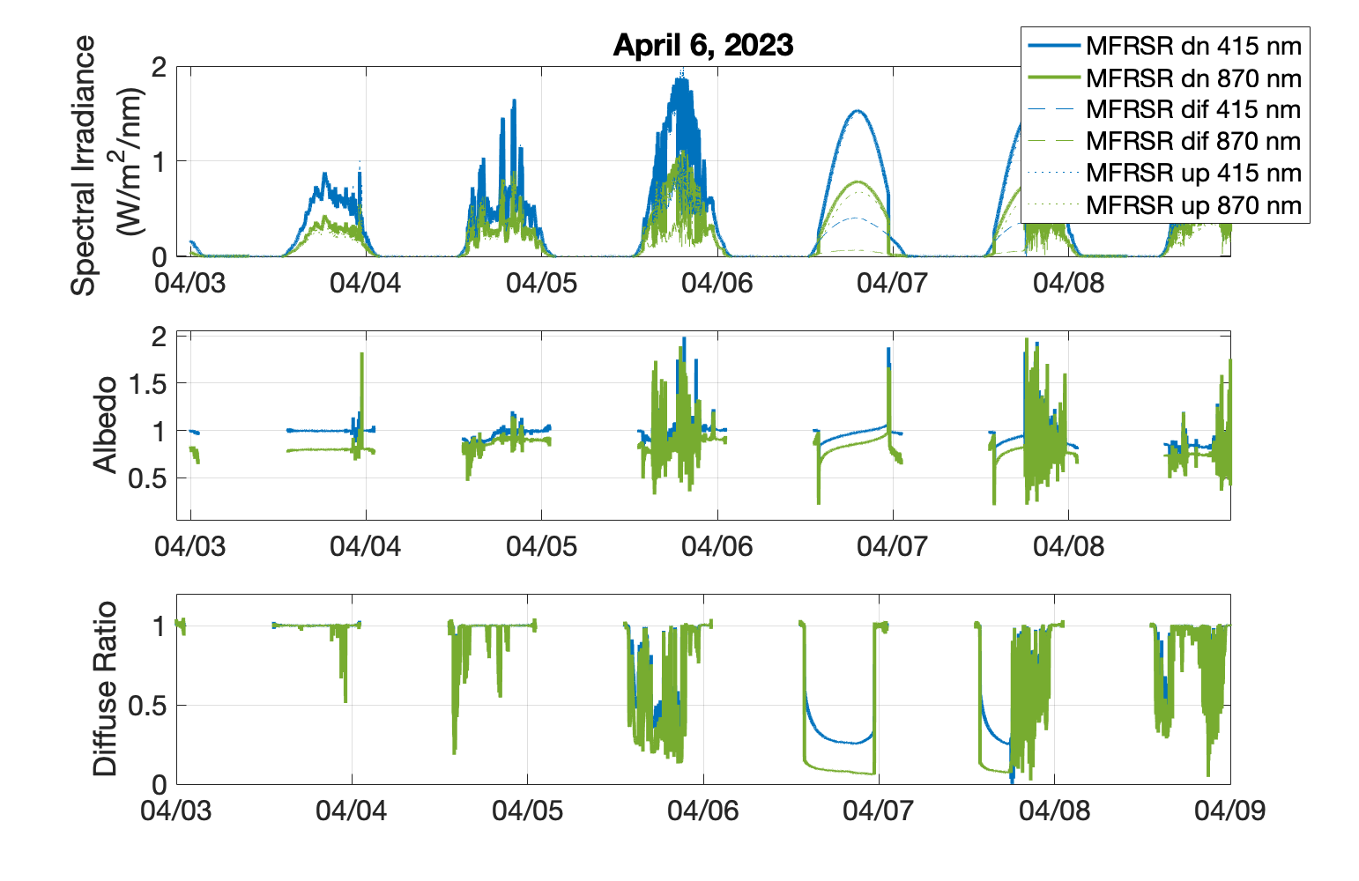

Slide 14
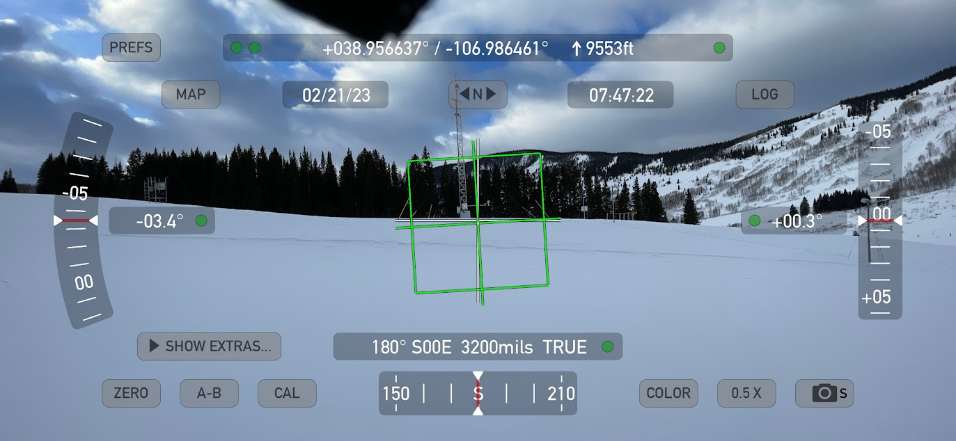
ARM SAIL site
~3° slope to the W, in the area below the tower.

Slide 15
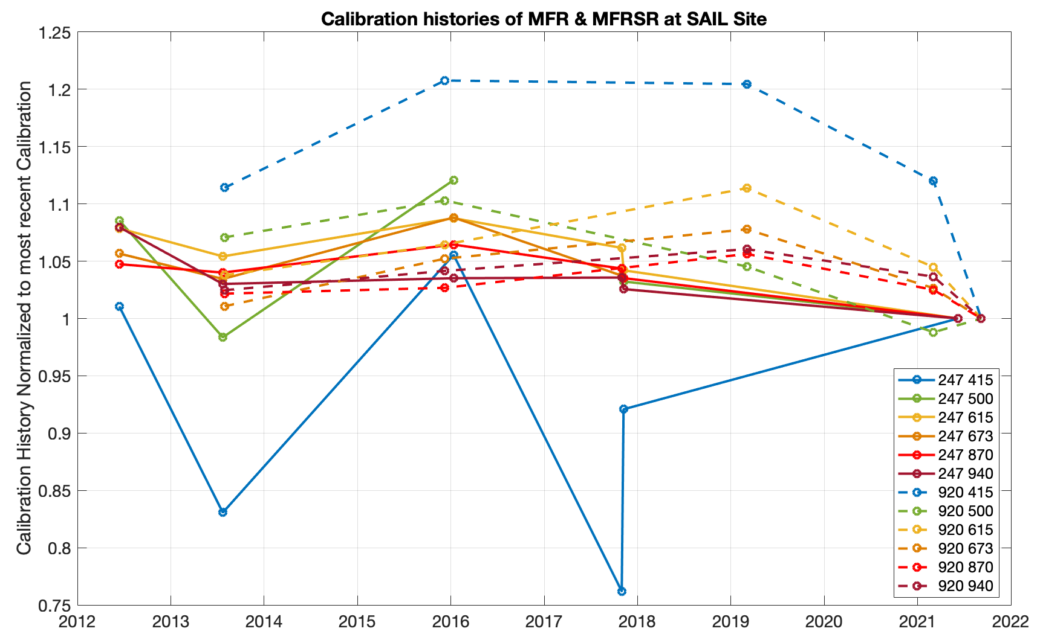
Solid lines: downwelling
Dashed lines: upwelling

Slide 16
Downwelling MFRSR Calibration History Statistics
Serial Number 247, ABBFF72, installed from 20210827-end
Wavelength (nm) | min | mean | max | St dev
415 | 0.7620 | 0.9299 | 1.0555 | 0.1143
500 | 0.9836 | 1.0444 | 1.1208 | 0.0578
615 | 1.0000 | 1.0540 | 1.0875 | 0.0311
673 | 1.0000 | 1.0404 | 1.0881 | 0.0298
870 | 1.0000 | 1.0385 | 1.0645 | 0.0213
940 | 1.0000 | 1.0344 | 1.0797 | 0.0258
Statistics of ~ 6 calibrations divided by the

Slide 17
Upwelling MFR10 Calibration History Statistics
Serial Number 920, ABC977D, installed for whole campaign
Wavelength (nm) | min | mean | max | St dev
415 | 1.0000 | 1.1293 | 1.2077 | 0.0849
500 | 0.9880 | 1.0414 | 1.1030 | 0.0481
615 | 1.0000 | 1.0522 | 1.1137 | 0.0416
673 | 1.0000 | 1.0334 | 1.0778 | 0.0316
870 | 1.0000 | 1.0260 | 1.0563 | 0.0201
940 | 1.0000 | 1.0326 | 1.0605 | 0.0224

Slide 18
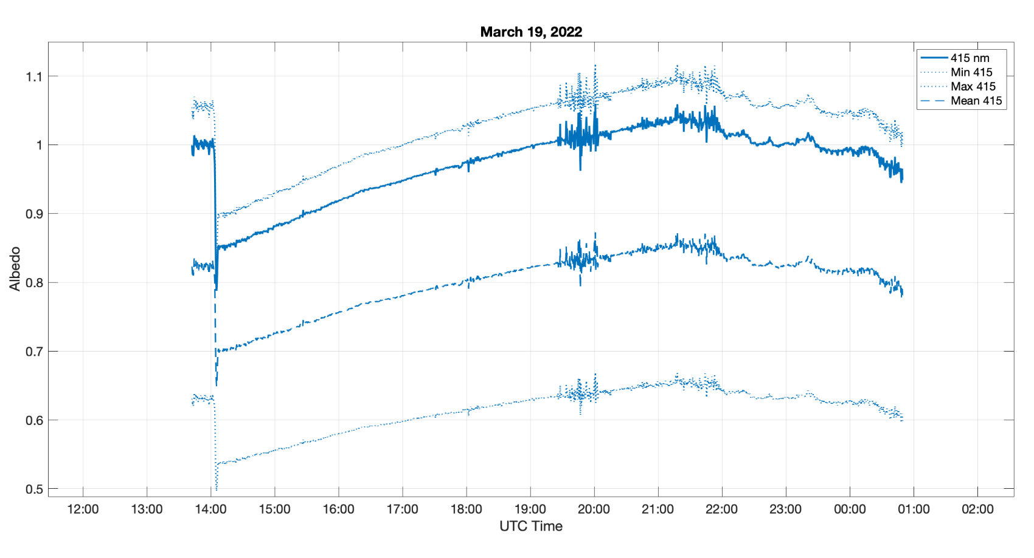
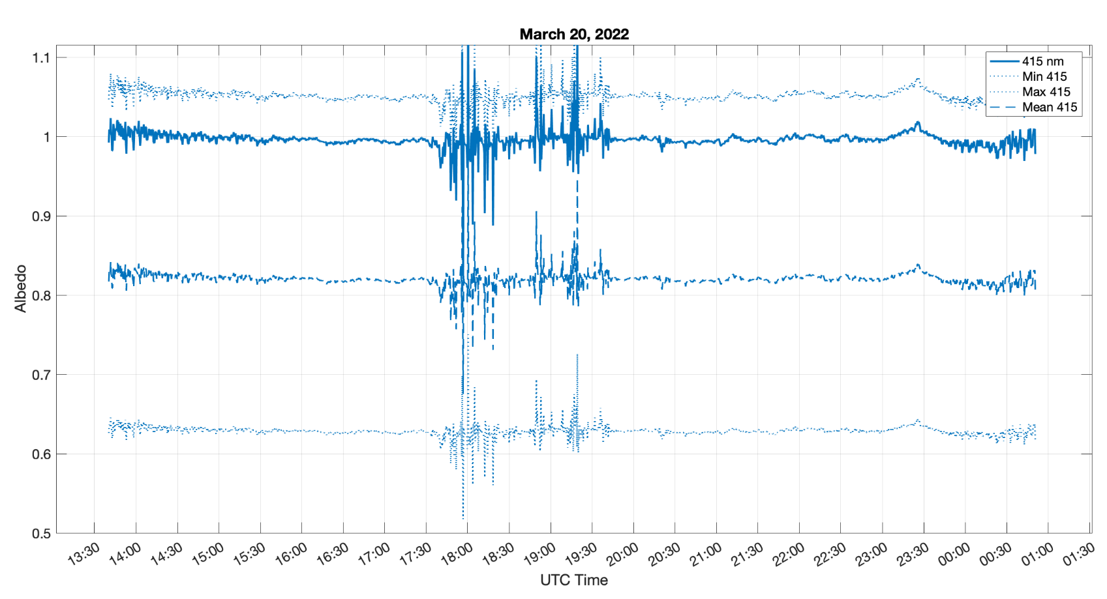
Sensitivity of 415 nm albedo to potential calibration error

Slide 19
Slope calculations

